Slide 1


GTFCC Laboratory capacity assessments
Facility checklists
V1.0 March 2026
© WHO / Lindsay Mackenzie

Slide 2


RDT or Laboratory checklist
The RDT and Laboratory checklists are essentially the same, but the RDT checklist has had questions hidden where not appropriate – such as questions on culture.
If a site only performs sample collection, RDT and shipment of samples use the RDT checklist.
If a lab performs any other testing, culture or molecular, use the laboratory checklist.
Tools → Laboratory Capacity Assessment – GTFCC

Slide 3
GTFCC recommendations
When using these checklists, the gold standard is the GTFCC recommendations. If the laboratory does not meet or exceed the
GTFCC guidelines then it must be marked “No” or “Partial”
regardless of the laboratory or country SOP’s.
!
All assessors must be fluent with the GTFCC guidelines and recommendations.

Slide 4
Download the latest checklist version
Tools → Laboratory Capacity Assessment – GTFCC
The GTFCC facility checklists are in a “Excel Macro-Enabled Template”, with lots of formula and validations to make completing it as simple as possible for the user.
            In the open document go to “file”,
            “Save as”,
            Name your new checklist, we suggest using the site name and date,
            Select the file type – “excel Macro-Enabled Workbook (*.xlsm),
            Click on “save”.
Before entering your site data, you need to save as a new file –“Excel Macro-Enabled Workbook”.
The original template will stay unchanged and can be used
again, whenever needed.
While you can reopen and continue working on facility file you’ve created, you must start fresh from the template for each new location.

Slide 5
Download a softcopy
Tools → Laboratory Capacity Assessment – GTFCC
When assessing the facility, it can be easier to use a paper checklist you can print annex 4 and 5 using the above link.
Send copies of the print versions to the facility before arrival.
Have 1 assessor + laboratory staff complete narrative pages while 2nd assessor asks scoring questions.
Transfer the data into the excel after the visit.
!
QUICK TIPS

Slide 6
Definitions
Macro | A small program inside excel which automates repetitive tasks.
Template | A file type that ensures the original is not modified by accident. In this case the original is a macro enabled excel file.
Worksheet/Tab | Each page inside the excel workbook.
Workbook | The whole collection of worksheets is called the workbook.
Validation | Data used to confirm the accuracy of a statement.
Protected | In excel protected cells can not be edited.
Formula | In excel, any data which starts with a “=“ it can be used mathematically i.e. to Sum totals, or on certain text functions.
Button | An object in a worksheet which when pressed runs a formula or a macro.

Slide 7
Familiarising yourself with the checklist
Black
Information tabs
Green
Narrative tabs, general information questions, background and essential information
Yellow
Scored checklist questions
Blue
Reporting information
and aggregated data

Slide 8



Background and instructions.
Read this section carefully before starting.
Buttons will take you to further information if needed.
And a different button will return you to the instructions.
Macro instructions
Abbreviations
INSTRUCTIONS TAB
Return to cover

Slide 9
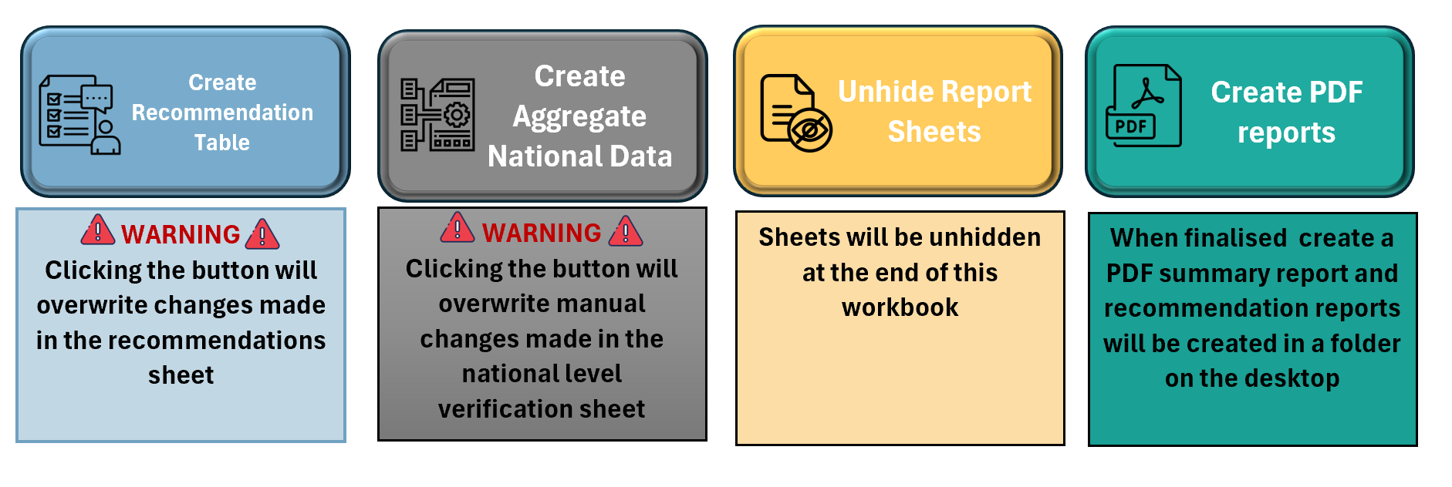
At the end of the instructions are more buttons.
When all the narrative and scored tabs are completed these buttons will create reports and combine data in the correct format.
If you manually modify the reports or tables then click these buttons again, the manual information will not be saved.
INSTRUCTIONS TAB

Slide 10
At the end of the workbook there are instructions on
how to enable macros so the sheet works correctly.
If you click on the Macros button it will take you to
this page.
To return click on the
user guide.
Macro instructions
Abbreviations
MACRO INSTRUCTIONS
Return to cover

Slide 11
At the end of the workbook there are references to help you understand the abbreviations used in the checklist.
If you click on the abbreviations button it will take you to this page.
To return click on the
user guide.
Macro instructions
Abbreviations
ABBREVIATION
Return to cover

Slide 12





Narrative tabs collects information to inform the assessment team about the facility collecting background data, such as number of staff, opening times, equipment lists, testing methods used and available SOPs.
The score tabs and report tabs
use information from this section to automate responses.
Failure to fill these sheets in can lead to extra work in the remaining checklist.
Attendance
General info
NARRATIVE TABS
Testing
Technical
Documentation

Slide 13
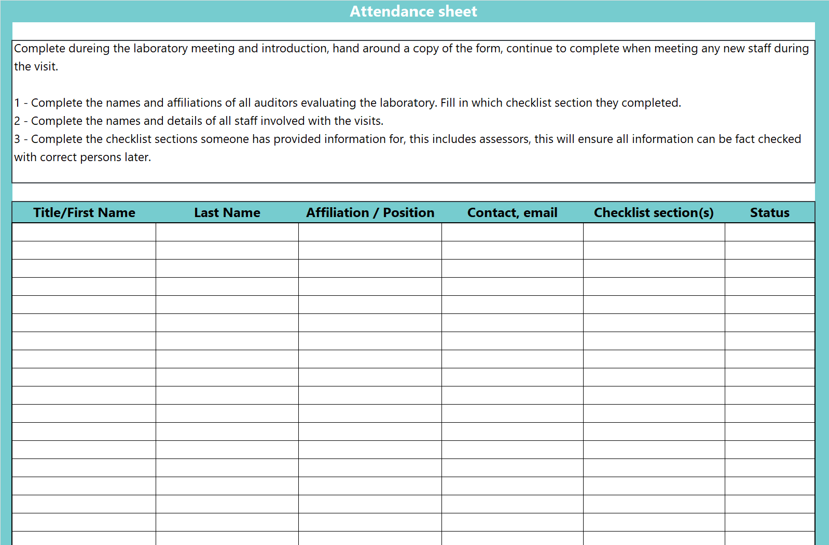
Simple list of who was
present at the site visit:
Assessors,
Laboratory staff,
Hospital such as management,
Program such as regional leads and people not at the site.
ATTENDANCE
!
It can help to indicate who completed the checklist section if there is more than one assessor or who you asked questions to at the facility. This was if you have any follow up, you know who to ask.
QUICK TIPS
Status - This completes a section in the laboratory report and must be completed.

Slide 14
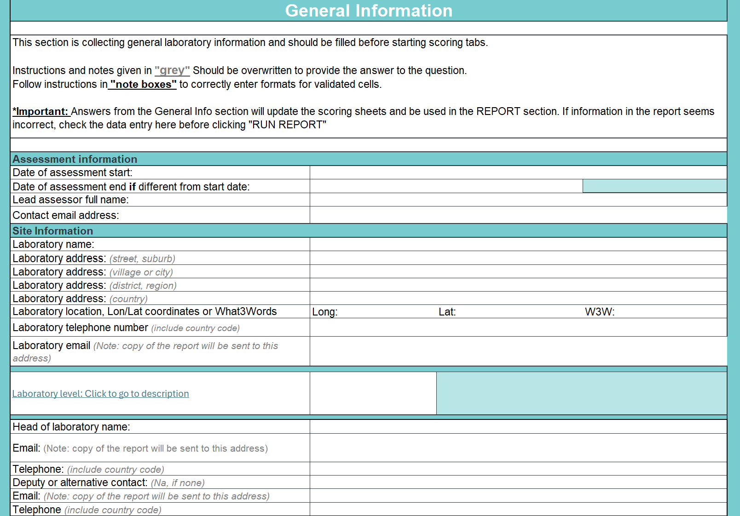
All data must be completed.
The scoring and reporting sections
rely on the information filled in this sheet.
Some cells have instructions in grey italic:
Read the instructions and write the answer in that cell.
Instructions may change based on your previous answers.
Some cells have validations this means you can only enter certain values, examples:
GENERAL INFORMATION
If a date is required, you can only enter
a date dd/mm/yyyy – 02/10/2020.
Drop down lists – select the best option
How many sites – number only.
Some cells have conditional formats:
Cells will change colour, red indicates something is missing or incorrect.
Grey indicates you do not have to complete those questions.

Slide 15
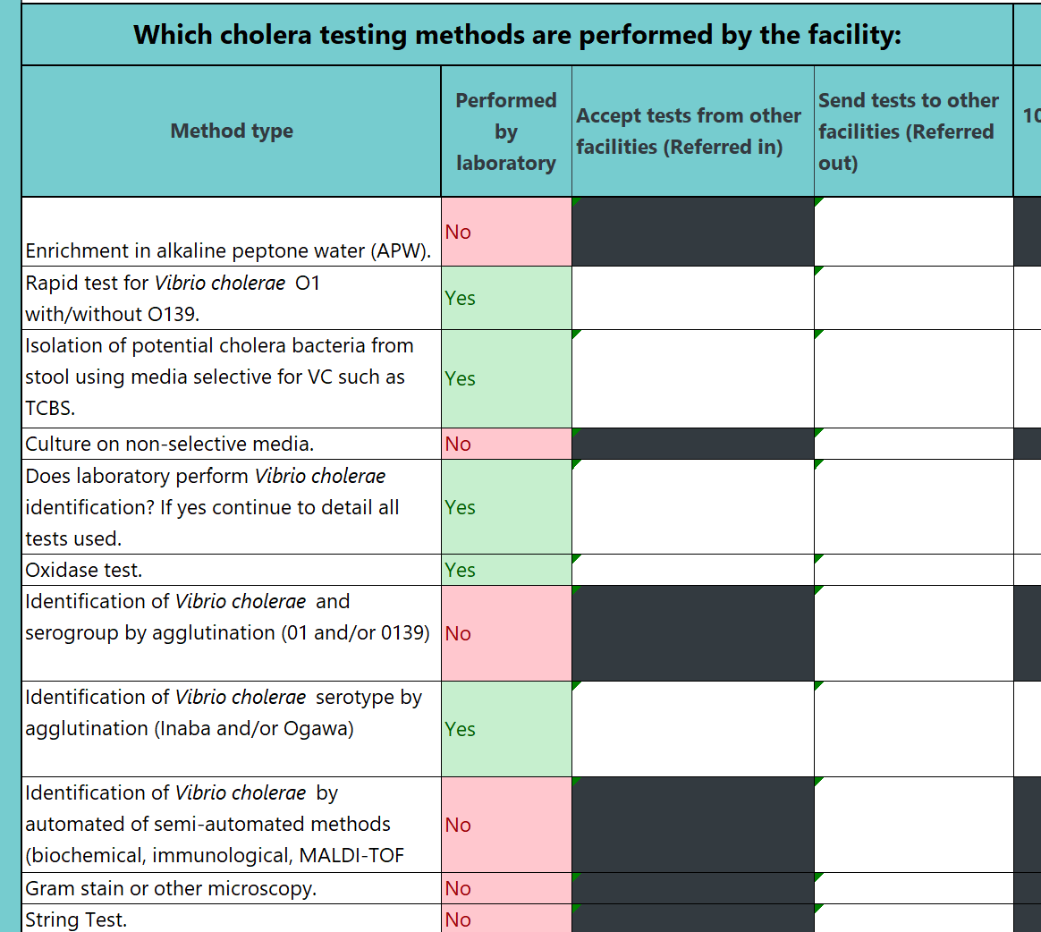
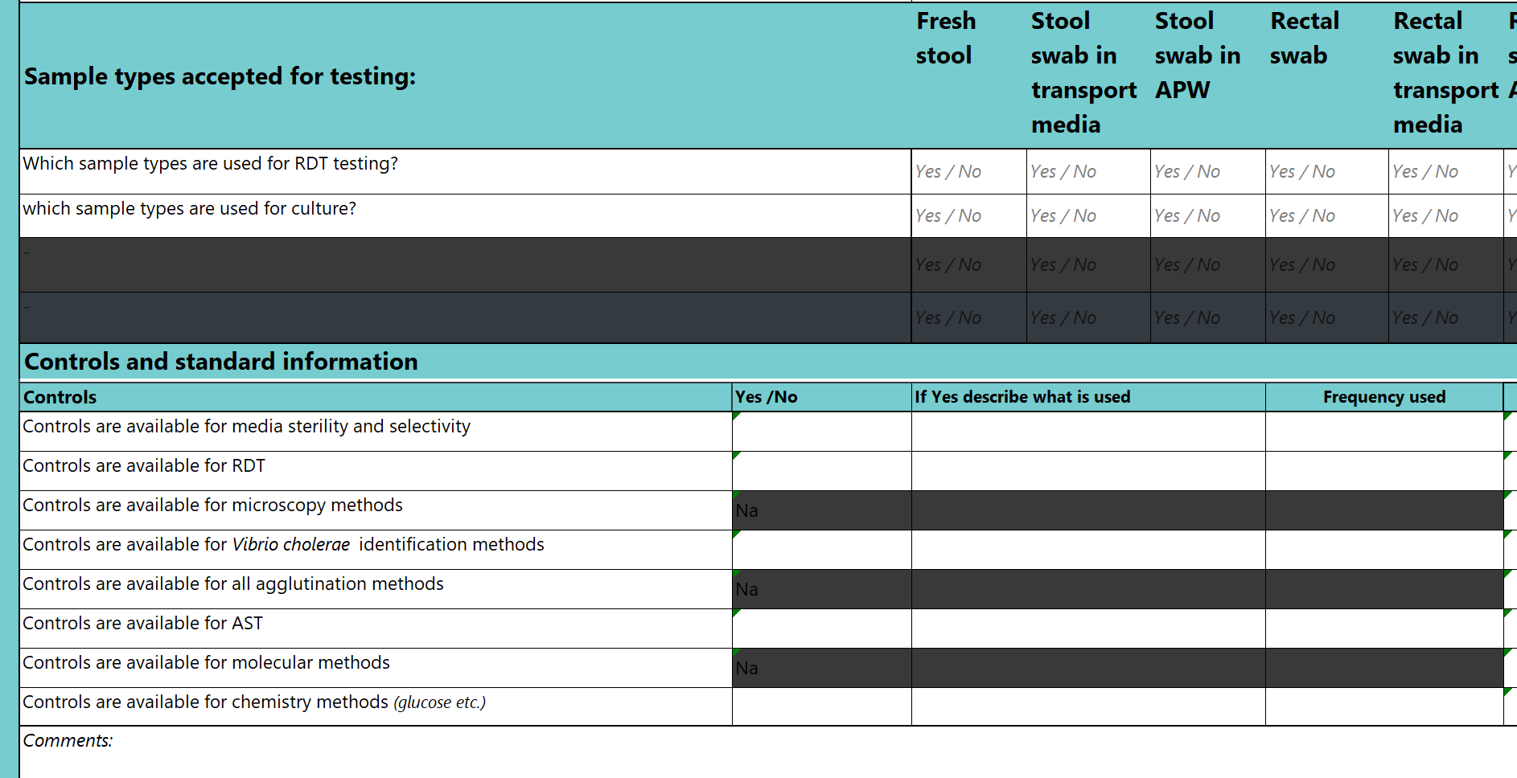
“Performed by laboratory” must be completed. The scoring section and reporting rely on the information filled in this sheet.
Additional questions are required based on the tests performed.
Sample types and control information must also be filled for each test performed.
Testing data – number of tests must be completed for each test type performed.
TESTING

Slide 16
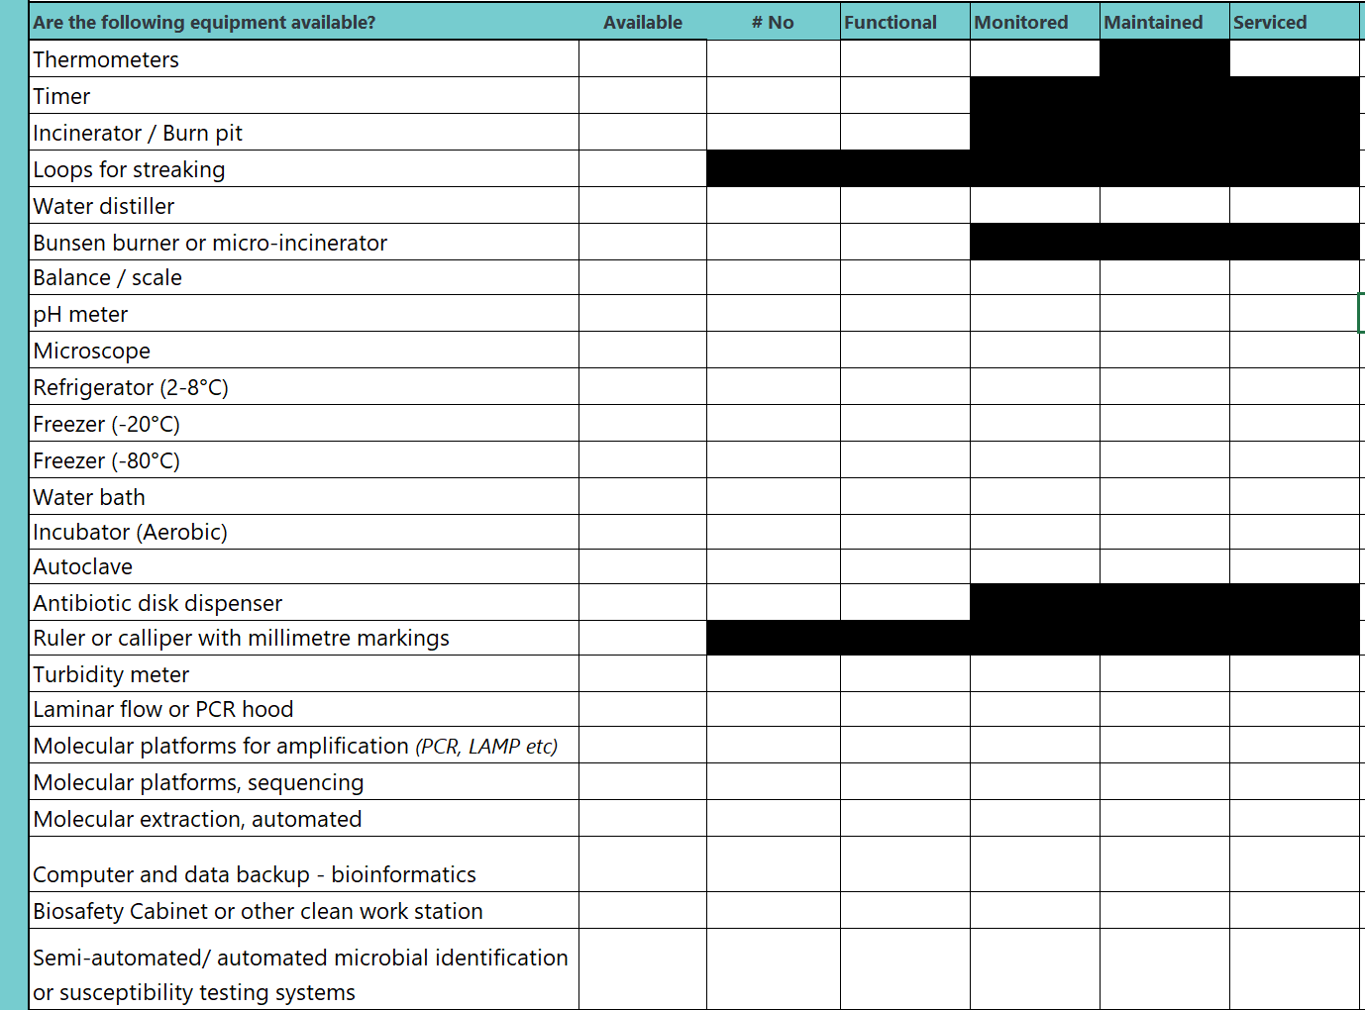
Available must be completed.
Follow the dropdown and complete yes or no.
Completing the number available and information about servicing and monitoring provides additional information for the final report.
This can help the program prioritise equipment purchasing or service contracts.
TECHNICAL

Slide 17
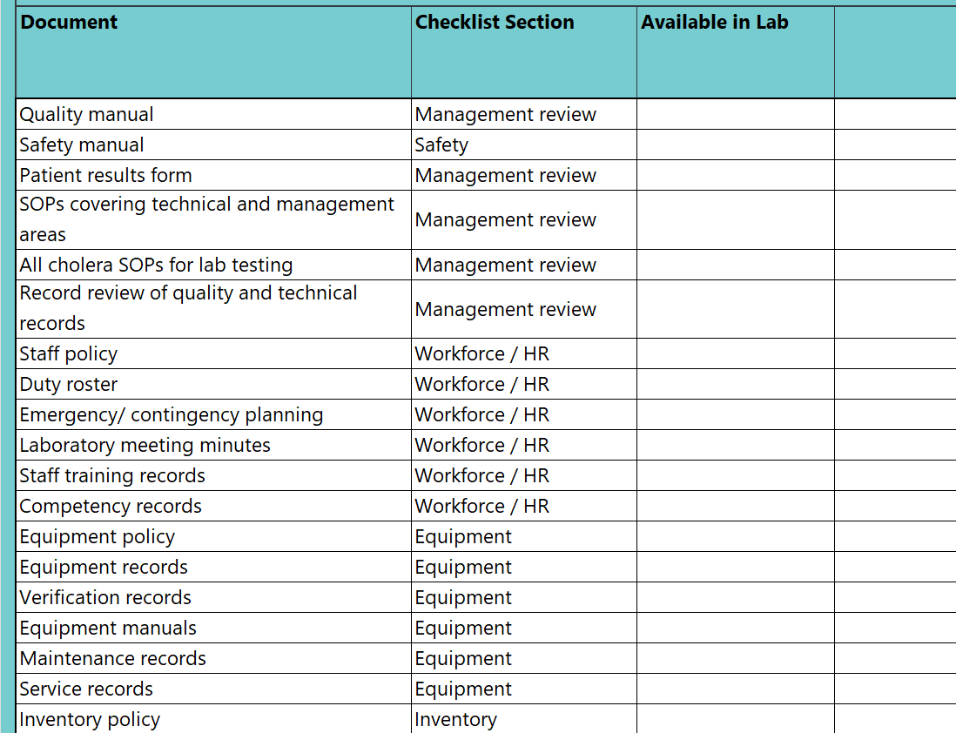
All data must be completed.
The reporting section relies on
the information filled in this sheet.
The print version of this
should be sent to the facility ahead of time.
This lists all the documents assessors will want to see during the visit.
The site having documents ready will reduce the assessment time needed.
DOCUMENTATION

Slide 18
TIPS AND TRICKS
!
Open the excel and set up a laboratory sheet, saving
with the name etc. before going to the facility.
QUICK TIPS
Complete any information you know – address,
contact information before going to the facility.

Slide 19


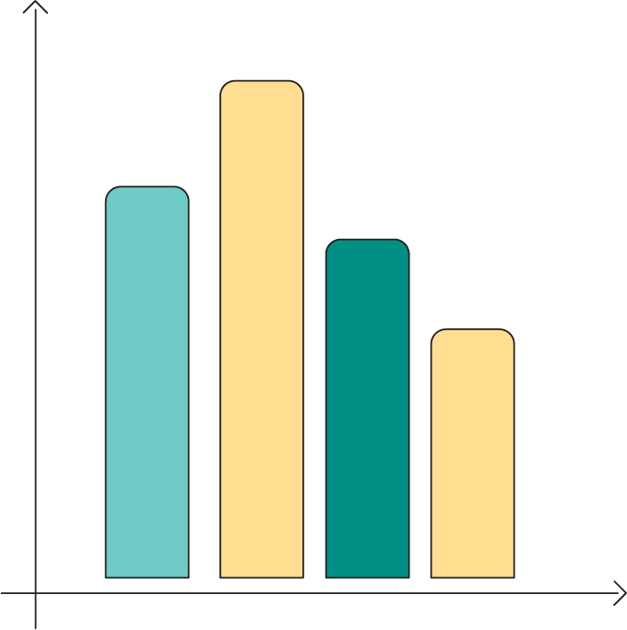
Scoring tabs contain questions with
a dropdown for answers.
All answers can be Yes/No but some questions can be Partial or NA
(not applicable).
Answers from “Narrative Section” prepopulates some of the scorecard.
Every question must be completed
for the final score.
The scores for each question and each section are automatically calculated.
“Notes for assessor” can provide additional background information.
Management
Human resources
Facilities and safety
SCORING TABS
Equipment and inventory
Pre-analytical
Analytical
Post-analytical

Slide 20
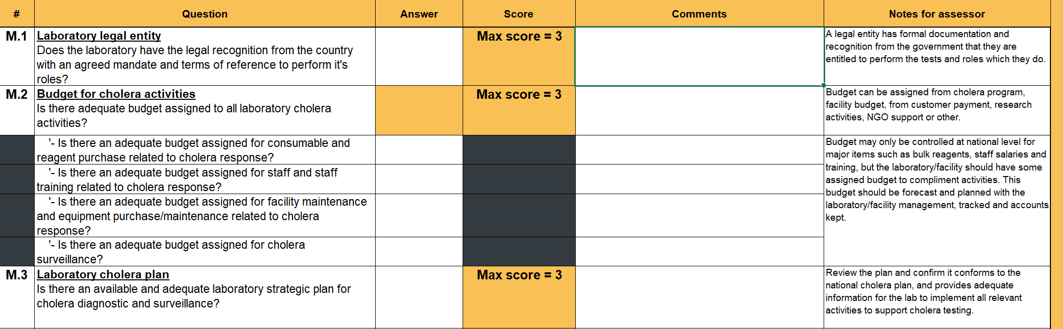
EXAMPLES
M.1 has a single question selecting from a dropdown to be awarded the score.
M.2 has multiple parts to be awarded a score, the assessor needs to answer the questions with a white box.

Slide 21
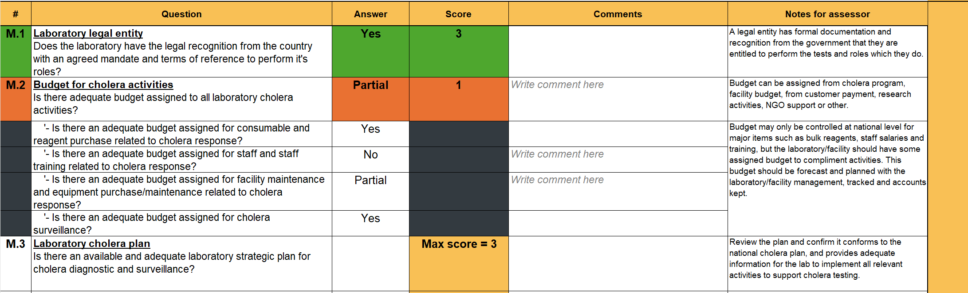
EXAMPLES
For single part questions (M.1) colours and score are automatically assigned.
For multiple part questions (M.2) the colours, overall outcome and score are automatically assigned.
Additional prompts to write a comment for No and Partial appear.

Slide 22
!
QUICK TIPS
For every question where you answer No or Partial, add a note which details what you saw to determine the score.
  “At the time of visit
  the laboratory was
  observed to have a total of
  5 faulty plug sockets in the reception/molecular rooms
  and waste room.”
  Take pictures to remind yourself later of what you saw – both the good and the bad.
TIPS AND TRICKS
Be specific,
give examples i.e.

Slide 23
The purpose of this section is to score the documentation within the facility management and quality department. It should be conducted through a paper-based review with the manager or quality officer.
?
Does the facility have the necessary structure and planning documentation to support its role in the National Cholera Program?
MANAGEMENT
The documents must be available and appropriate to score full marks.
Each question is worth 3 marks reflecting the importance of strong management commitment.

Slide 24
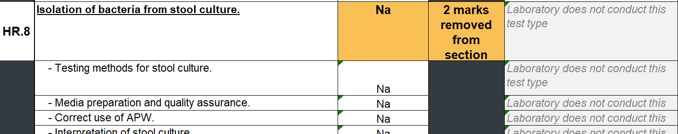
The purpose of this section is to score the availability and implementation of workforce policy and procedure within the facility. Site staffing
should be managed to facilitate optimum testing for cholera.
?
  Is the workforce sufficient for routine and outbreak workload?
  Are the workforce well trained and competent on use of appropriate cholera tests provided by the site?
HUMAN RESOURCES
Example
If site has said they do not perform certain tests then questions related to those tests are prefilled and the score is removed from the section total so the % remains consistent.

Slide 25
The purpose of this section is to review the laboratory facilities and safety procedures to determine adequacy for staff to conduct testing in conformance with best practice.
  Is the facility adequate for the tasks to be performed?
  Is the facility maintained for the performance of testing?
  Does the facility maintain safe working conditions for testing?
?
FACILITIES AND SAFETY

Slide 26
The purpose of this section is to review the equipment and inventory procedure
and implementation in the facility for cholera/microbiological testing.
Equipment includes all minimum equipment as well as all other equipment used during cholera testing at the facility.
  Is the equipment sufficient for testing needs based on the minimum package of testing for the level of facility?
  Does all equipment function
  as the manufacturer intended,
  is maintained and serviced based on manufacturer guidance to ensure optimal testing conditions?
EQUIPMENT AND INVENTORY
?
Equipment includes auxiliary equipment e.g. air-conditioning, computers, connected online system.

Slide 27
Inventory covers all minimum testing reagents and consumables including
locally made media, as well as materials derived from patient samples such as
stool samples, bacterial isolates, extracted DNA and amplicons.
  Are all reagents and consumables managed
  to ensure no interruption to testing services?
  Are all materials derived from patient samples inventoried
  and stored correctly?
EQUIPMENT AND INVENTORY
?

Slide 28
The purpose of this section is to review the testing process in the
pre-analytical phase. This includes instructions and oversight of sample collection and referral forms, packaging, reception and any sample
referral from this site to another.
A facility may receive samples/isolates from other locations and send samples/isolates to other facilities.
Both are covered in
this section.
  Referral in – receiving samples/isolates from a clinical collection site or a lower tier site or
  Referral out - sending samples/isolates from this site to another laboratory for further testing.
  If the narrative section was correctly filled, questions which are not relevant, such as for a laboratory who does not send any sample out, will already be removed.
PRE-ANALYTICAL

Slide 29
The purpose of this section is to review the testing process performed by the facility.
Are all protocols in place to ensure testing is conducted in a
standardised manner that conforms to national and international guidance for cholera testing?
Are all staff trained and competent to perform testing to
ensure optimal testing results?
?
ANALYTICAL
If the narrative section was correctly filled, questions which are not relevant, such as for a laboratory that does not perform sequencing,
will already be removed.

Slide 30
The purpose of this section is to review the post-analytical
processes and methods followed by the facility.
Are all protocols in place to ensure result reporting is conducted in a standardised manner that conforms to
national and international guidance for cholera reporting?
Are all staff trained and competent to perform review,
verify and release results?
?
POST-ANALYTICAL

Slide 31
!
QUICK TIPS
Check every question
has been completed
before leaving the site.
Review and tidy up
answers before doing
the reporting section.
TIPS AND TRICKS

Slide 32




Output tabs contain the final information that will be shared as a report to the facility and scoring totals to be transferred
into a “National Checklist”.
Before starting, all assessors should review and ensure all narrative and scoring sections are complete and accurate.
Gap analysis
Reporting
OUTPUTS
Recommendations
National aggregation

Slide 33
Each indicator has attributes that reflect various levels of capacity.
These are identified with scores ranging from “0” (indicating that implementation has not occurred) to “5” (indicating that implementation has occurred, is tested, reviewed, and exercised, and that the facility has a sustainable level of capability for the indicator).
GAP ANALYSIS
For each indicator, a facility receives a single score based on the current implementation.
The “Scored questions” help the evaluators determine the appropriate score – there is a % provided based on the relevant questions as a guide, but assessors should use their judgement and observations in tandem with this information to assign the stage.

Slide 34
Colour coding
No capacity: Attributes of a capacity are not in place.
0
Very rudimentary capacity: Attributes of a capacity are in development stage, may only only be on paper, or some evidence of implementation without documentation.
1
Limited capacity: Attributes of a capacity are in development stage (implementation has started with some attributes achieved and others commenced).
2
GAP ANALYSIS
Developed capacity: Attributes of a capacity are in place; however, sustainability has not been ensured (such as through inclusion in the operational plan of the national health sector plan with a secure funding source).
3
Demonstrated capacity: Attributes are in place and sustainable for a few years and can be measured by the inclusion of attributes or IHR core capacities in the national health sector plan and a secure funding source.
4
Sustainable capacity: All attributes are functional and sustainable, and the country is supporting one or more other countries in their implementation. This is the highest level of the achievement of implementation of IHR core capacities.
5

Slide 35
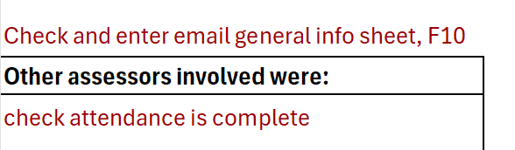


Most of the report will automatically fill in when the Narrative,
Scored and Gap analysis sections are completed.
  Review the report:
  There are warning messages where data
  has not been accurately completed, review and correct this data in the original tabs
  There are warning messages where assessors
  must make inputs to the report
REPORT SHEET
Once these are completed, scroll to the bottom of the report and click
on the report button to remove all the formula – this can not be undone
Assessors can now make edits and tidy up the language in the report file,
but changes in the previous sections will no longer be reflected.

Slide 36
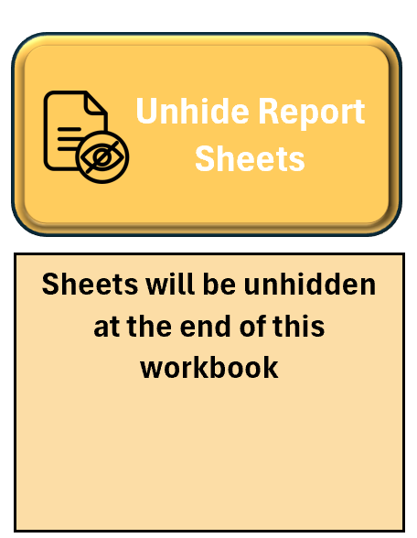

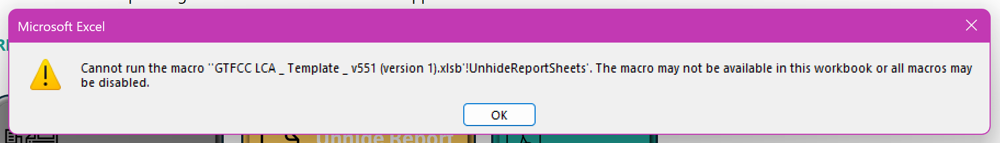

Remember we talked about the buttons in the “Cover Sheet”,
this is where we use them.
First we want to unhide the remaining sheets
now we are ready to use them;
Click on the “Unhide Report Sheets” button.
SETTING UP
If you get an error message review the section on enabling Macros.
Macro

Slide 37
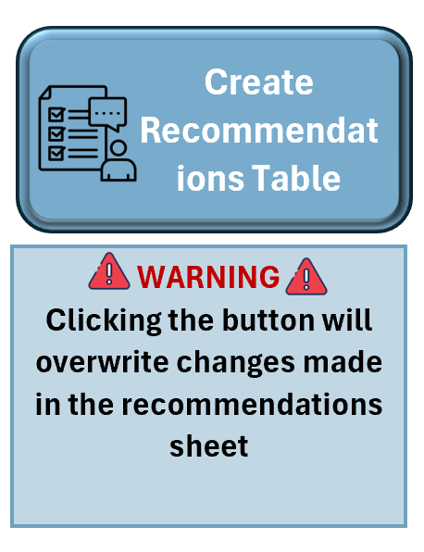
For every question which was not scored “YES” or “NA” the
assessor needs to write a non-conformity (NC) and short
recommendation on how to resolve the observed issue.
This is very time consuming; we have provided example NC and recommendations for you to review and modify as needed.
Click on the “Create Recommendations Table” button.
Go to the “Recommendations” tab, a table should
be populated.
Review all the NC and recommendations, there is
warning text showing you where data must be added.
Once manual edits have been done, DO NOT click on
the create table again, it will overwrite all manual edits
RECOMMENDATIONS

Slide 38
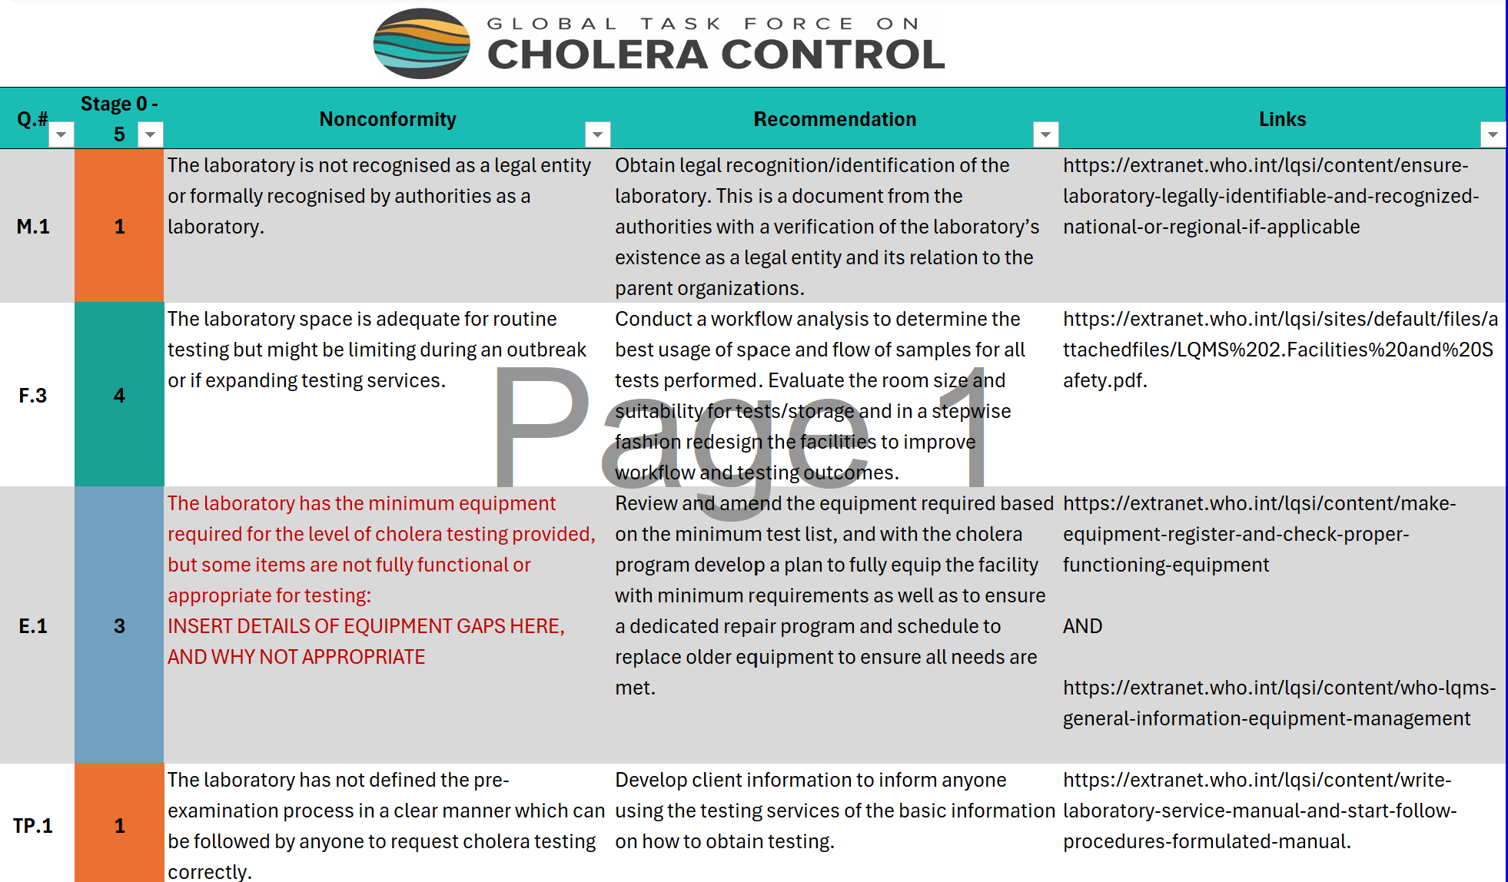
EXAMPLE RECOMENDATIONS
!
Colours and stage are linked to the gap analysis data.
Cells with mandatory modifications have red text.
You can edit any of the text to make it better reflect the facility you visited.

Slide 39
!
QUICK TIPS
Recommendations
Non-conformities
Refer to your comments in the scoring sheet
Give recommendations the laboratory can resolve and take action to improve
Be specific
Give examples
Use action words to define tasks
Be concise but include specifics where needed
for clear guidance
TIPS FOR WRITING

Slide 40
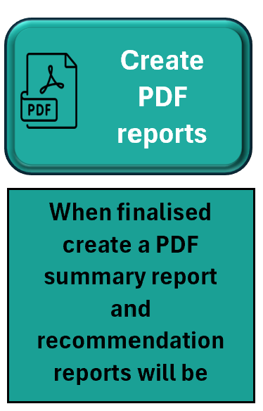
Every facility should be given an individual report within
1 week of the final visit.
Sending the entire excel file could be confusing to the facilities,
as well as being a very heavy file to send and download over email.
This button which will convert the report pages into PDF files
which can be easily shared.
Ensure the Report and Recommendation tabs are final,
all spelling, grammar, colour and formats are correct.
Click on the “Create PDF reports” button.
Reports can be found in a folder on your desktop called
“GTFCC LCA LABORATORY REPORTING”.
Open the reports, review the contents before sharing.
FINAL FACILITY REPORTS

Slide 41
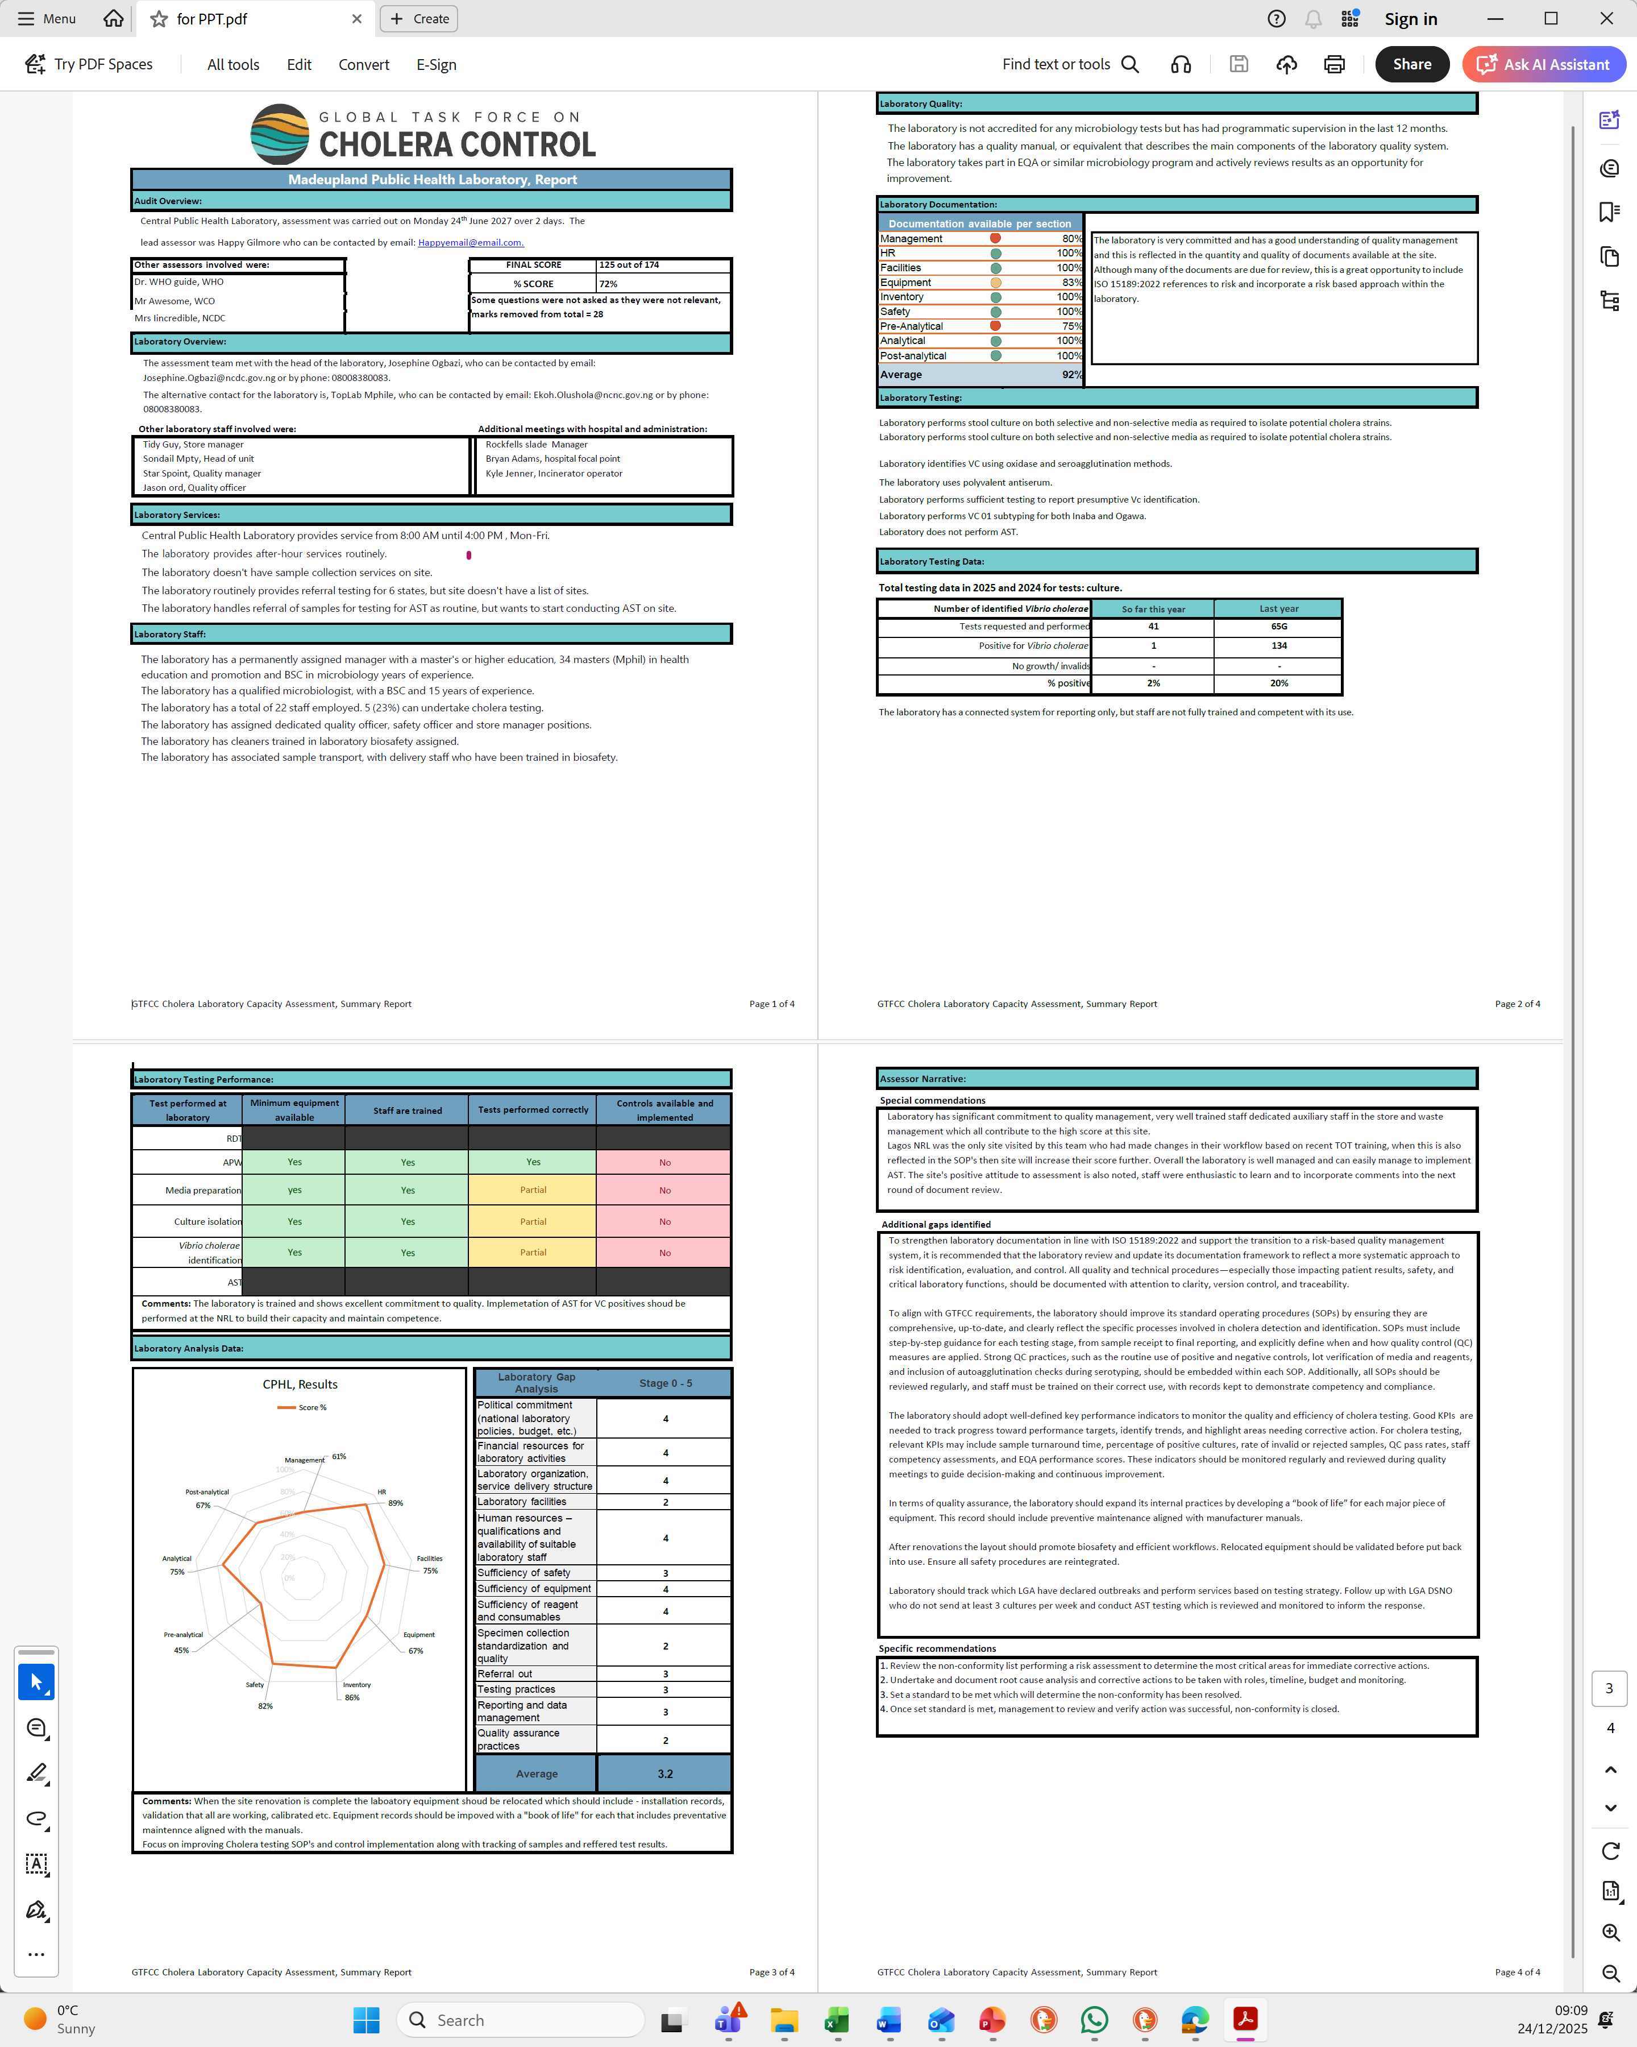
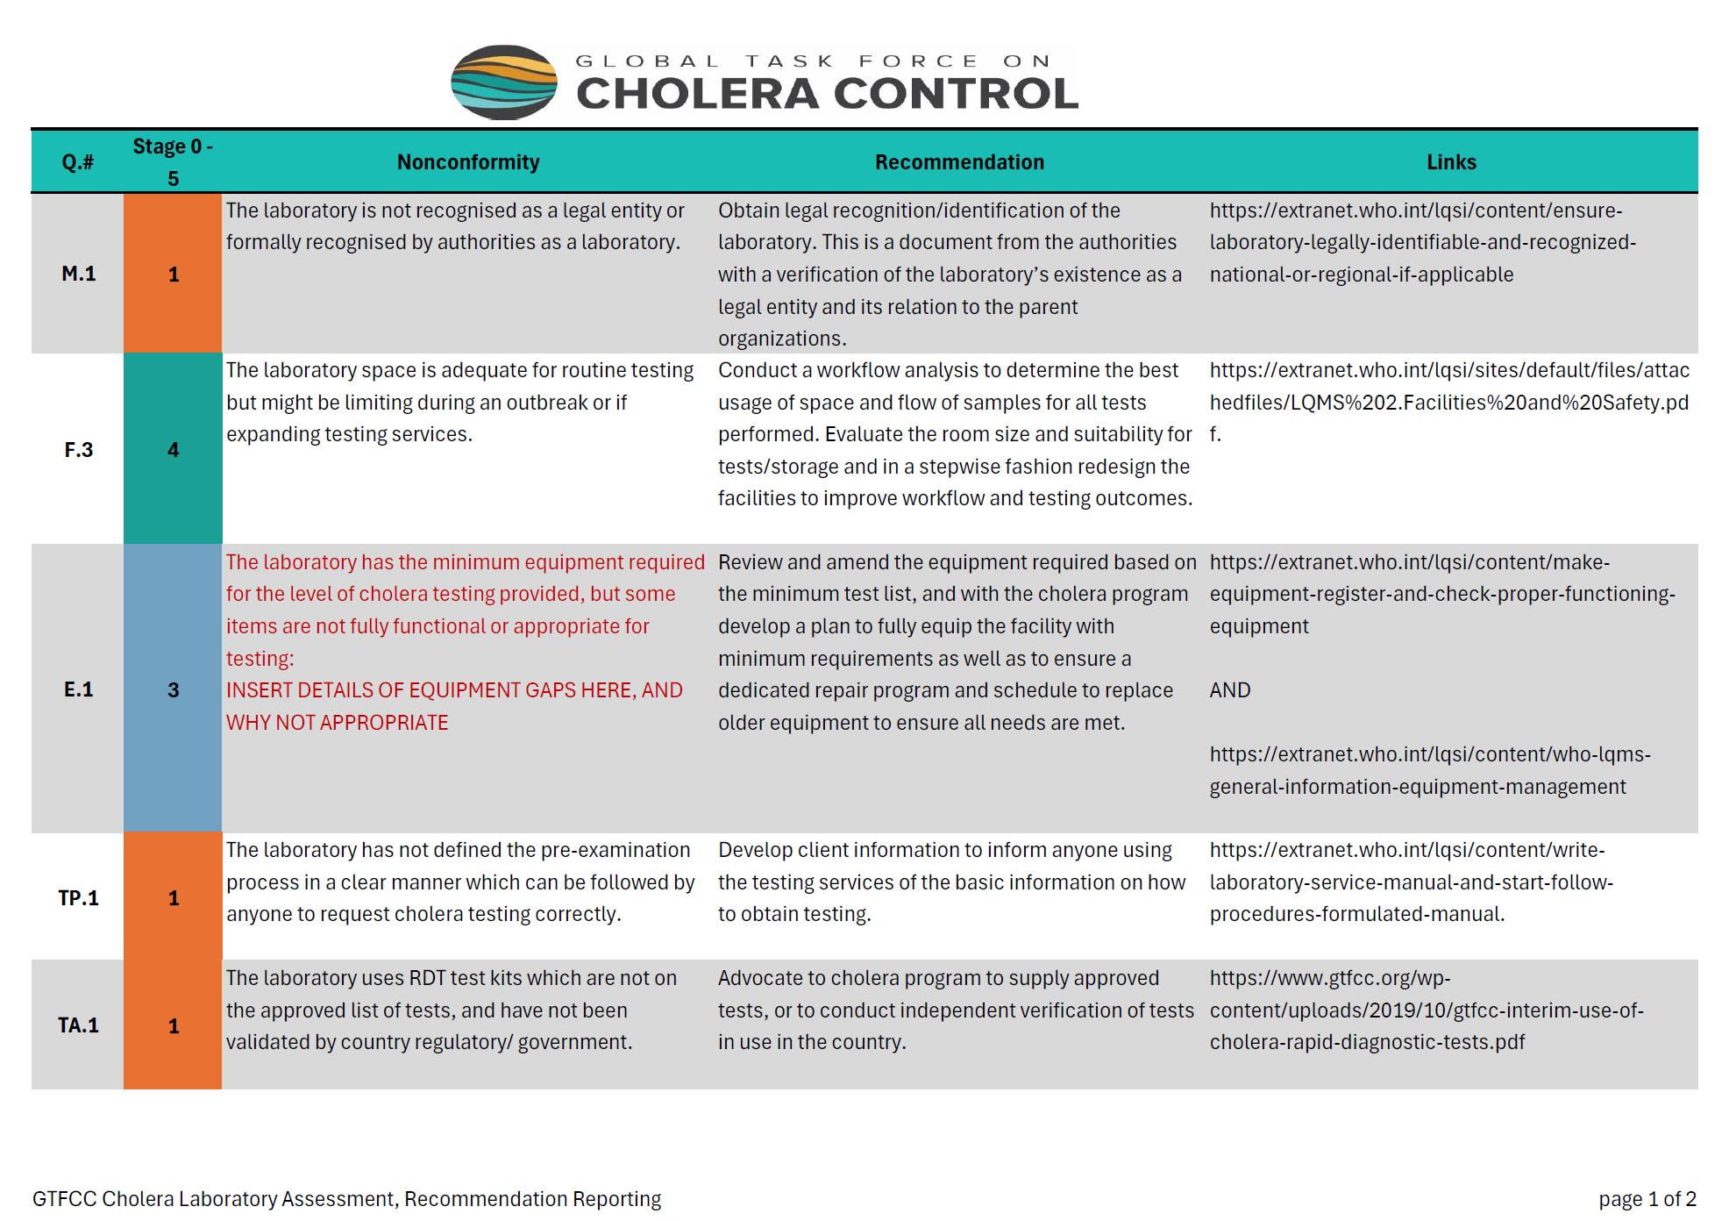
EXAMPLE REPORTS

Slide 42
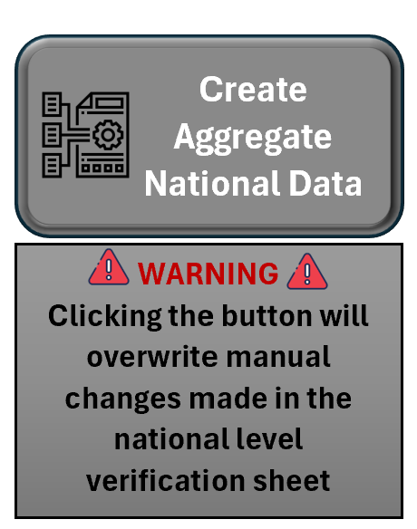
The data collected at all the different facilities needs to be compiled by the team and assessment leads.
This can be very time consuming; we have provided a method to automatically collect the data needed for National
reporting in one sheet.
Click on the “Create Aggregate National Data” button,
Go to the “National level verification” tab,
several table should be populated,
These are cut and pasted into the National sheets
in the correct tabs.
NATIONAL AGGREGATION

Slide 43
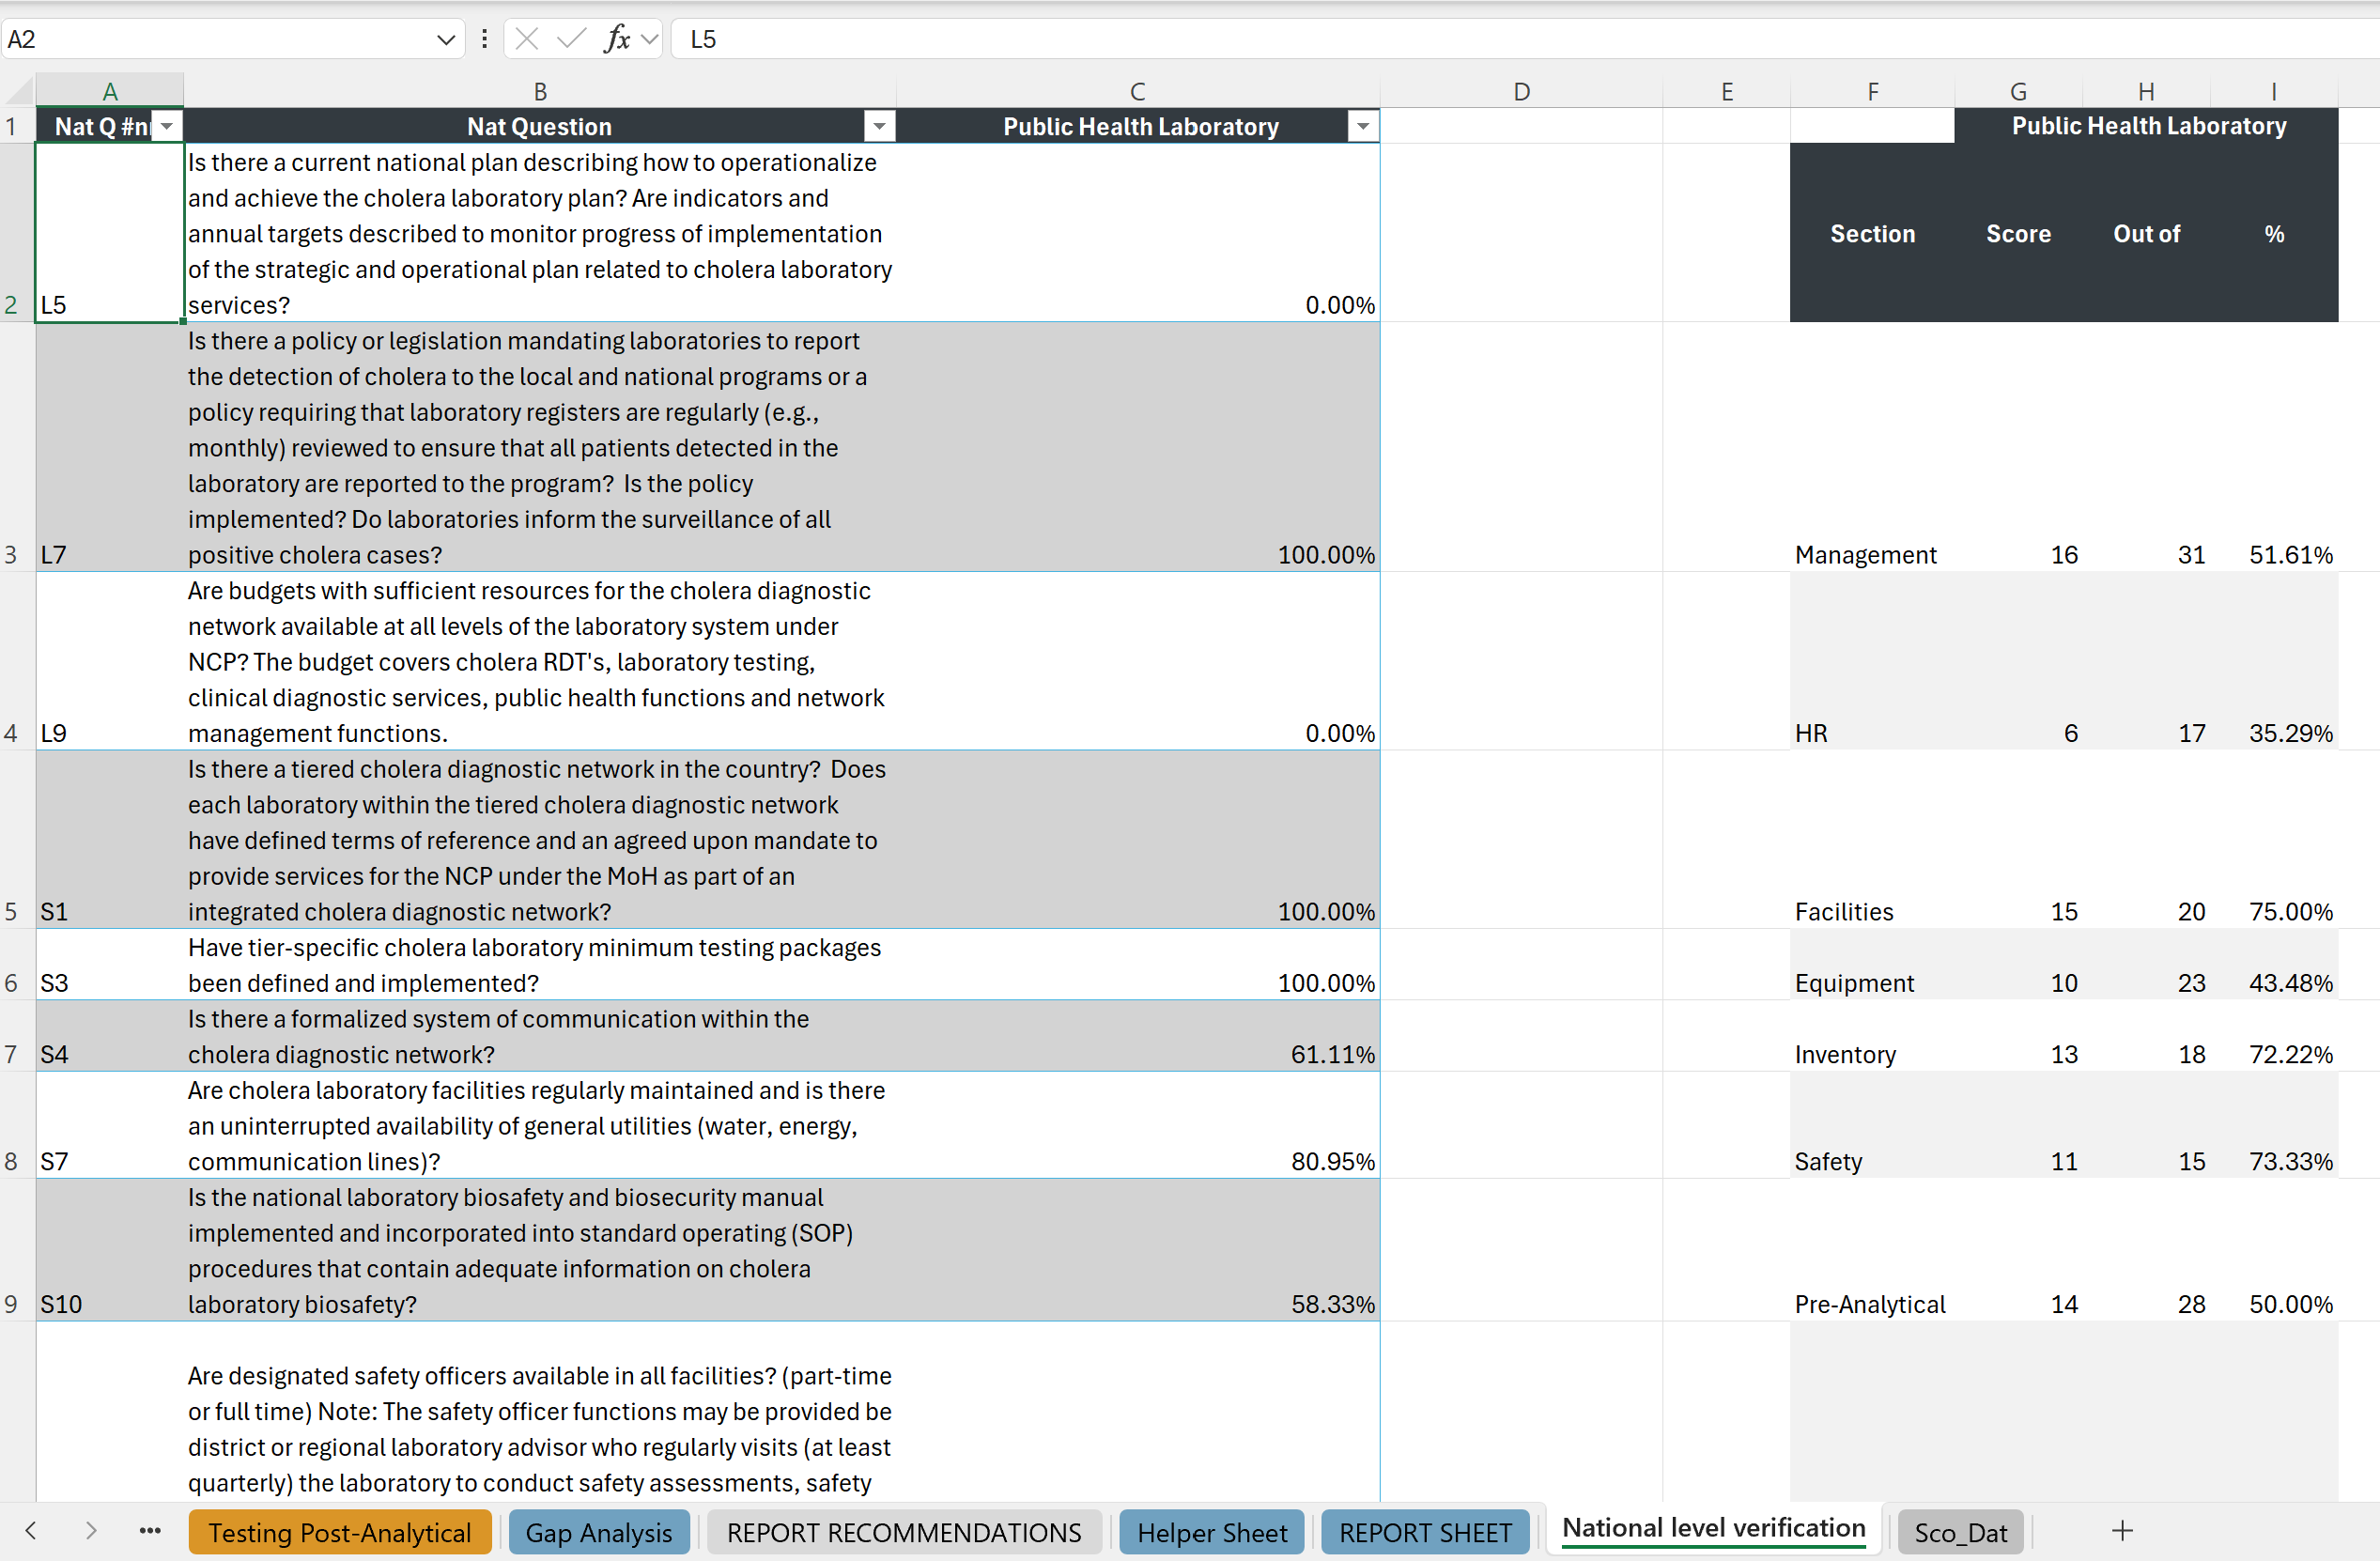
EXAMPLE NATIONAL DATA

Slide 44
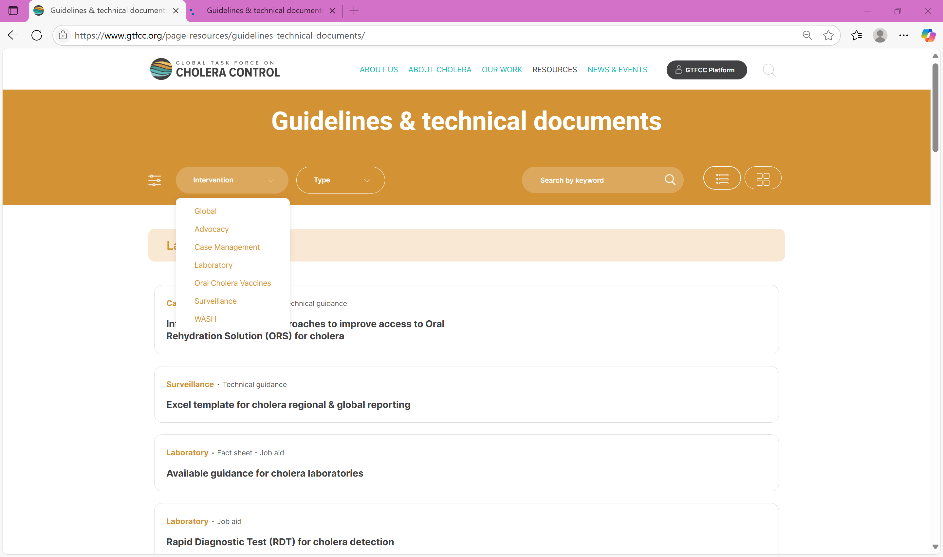

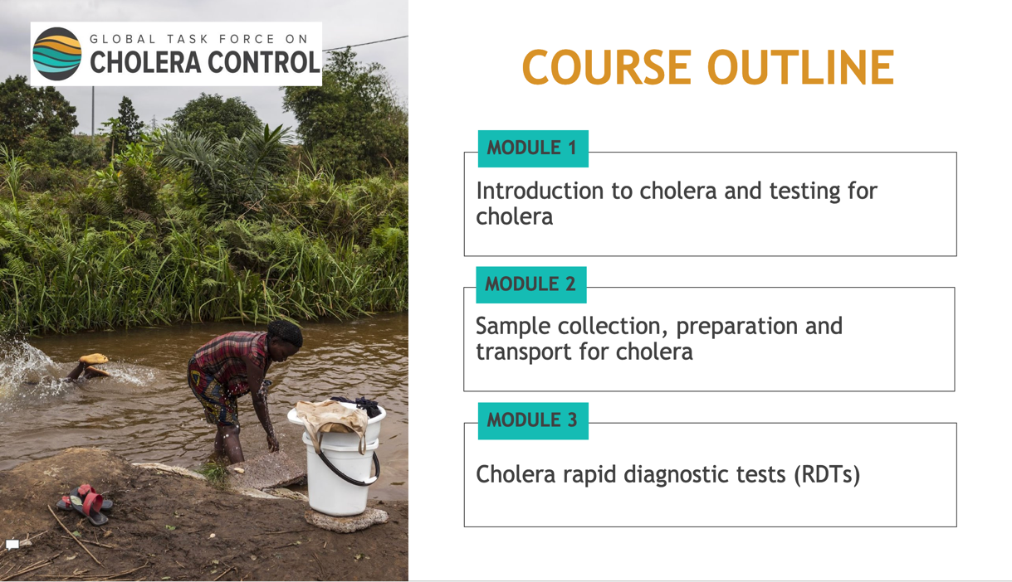


GTFCC support materials
https://www.gtfcc.org/page-resources/guidelines-technical-documents/
https://www.gtfcc.org/cholera-app/
https://www.gtfcc.org/training/sample-collection-and-testing-with-rapid-diagnostic-tests-for-cholera-for-health-care-workers/

Slide 45
THANK YOU!

