Slide 1
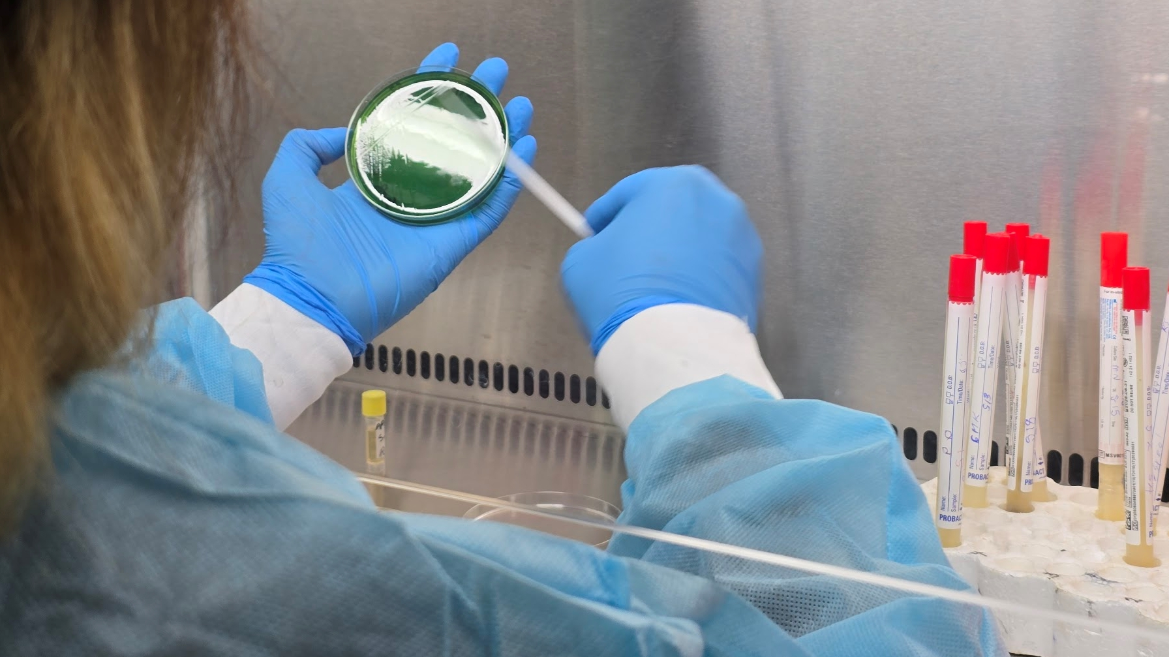

GTFCC Laboratory capacity assessments
Cholera Program Checklist – Excel Tool training
V1.0 March 2025
© Vix Harris

Slide 2
Assessment Workflow
Pre-arrival briefing, gather all documents
Inform laboratories and gather all documents
National checklist
(2 days)
Facility assessments
(1 day per lab/ 0.5 per RDT)
Aggregate facility scores (0.5 days)
Revise national checklist based on laboratory findings
(0.5 days)
Assign priorities and determine impact
(0.5 days)
Determine top 10 components (lowest score, highest priority, highest impact)
(1 day)
Write report
(3 weeks)

Slide 3


GETTING STARTED EXCEL

Slide 4
Download the latest checklist version
Laboratory Capacity Assessment – GTFCC– Tools, “National checklist Excel”
The GTFCC National checklists are in a “Excel Marco-Enabled Template”, with lots of formula and validations to make completing it as simple as possible for the user.
            In the open document go to “file”
            “Save as”
            Name your new checklist, we suggest using the laboratory name and date
            Select the file type – “excel Macro-Enabled Workbook (*.xlsm)
            Click on “save”
When you open it and start entering your data, you will
need to save it as a new file – “Excel Macro-Enabled Workbook”
The original template will stay unchanged and can be used
again whenever needed.
You can reopen and continue working on the created national file anytime.

Slide 5
Definitions
Macro | A small program inside excel which automates repetitive tasks
Template | A file type that ensures the original is not modified by accident. In this case the original is a macro enabled excel file
Tab/Worksheet | Each page inside the excel workbook
Workbook | The whole collection of worksheets is called the workbook
Validation | Data used to confirm the accuracy of a statement
Protected | In excel protected cells can not be edited
Formula | In excel, any data which starts with a “=“ it can be used mathematically i.e. to Sum totals, or on certain text functions
Button | An object in a worksheet which when pressed runs a formula or a macro

Slide 6
Familiarising yourself with the national checklist
Black:
Information pages
Green:
Scored checklist questions
Implementation
Blue:
Scored checklist questions Programmatic
Yellow:
Reporting information and aggregated data

Slide 7




Background and instructions.
Read this section carefully before starting.
Buttons will take you to further information.
And a different button will return you to the user guide instructions cover page.
Macro instructions
Abbreviations
Additional Infomation
INSTRUCTIONS TAB
Return to cover

Slide 8
At the end of the workbook there are instructions on how to enable macros so the sheet works correctly.
If you click on the Macros button it will take you to the instruction page.
To return click on the user guide.
Macro instructions
Abbreviations
Additional Infomation
MACRO INSTRUCTIONS
Return to cover

Slide 9
At the end of the workbook there are references to help you understand the abbreviations used in the checklist
If you click on the Abbreviations button it will take you to this page
To return click on the user guide
Macro instructions
Abbreviations
Additional Information
ABBREVIATIONS
Return to cover

Slide 10
At the end of the workbook there is additional information to help you understand the abbreviations used in the checklist
If you click on the additional information button it will take you to this page
To return click on the user guide
Macro instructions
Abbreviations
Additional Information
ADDITIONAL INFORMATION
Return to cover

Slide 11
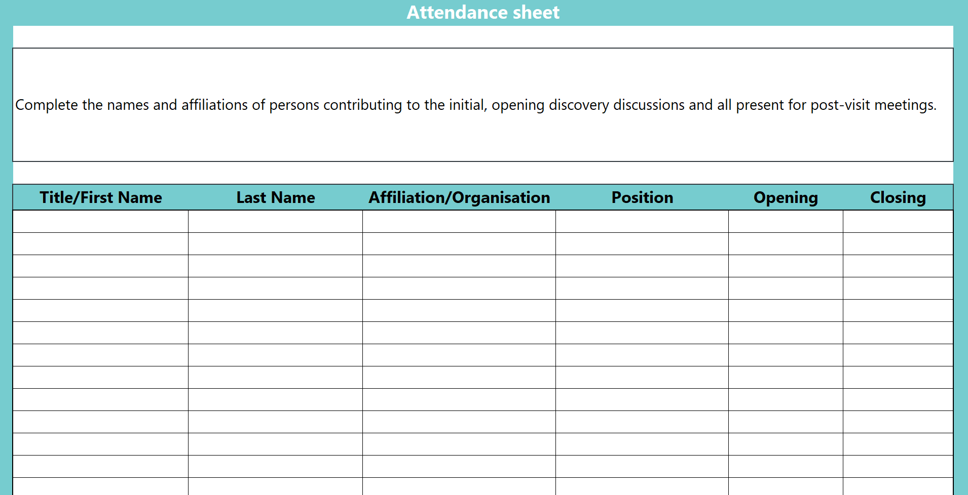
ATTENDANCE SHEET
At the start of the workbook, before the scoring tabs there is an attendance sheet to document who is present for the activity.
This is also available in PDF as a handout.
  Laboratory Capacity Assessment – GTFCC under tools, Annex 3
The same worksheet can be used for the closing meeting attendance.

Slide 12
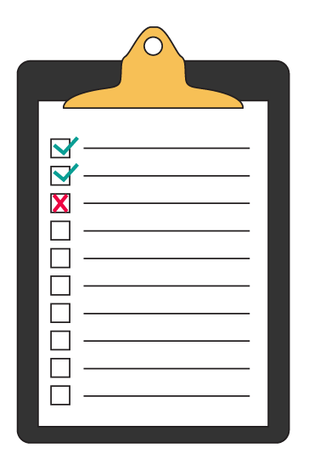
SCORING EXCEL

Slide 13

The Power point tool has every question from the Excel so it is easy to discuss as a group
During the bench review of documents, make notes in the comments section to bring up with the group, or ask for additional information
Present each slide, move the slider over the final agreed score for each question
In excel, fill in the score and add any comments, such as anything to be validated in the laboratory
This microscope icon on a slide, indicates that the final score can be modified based on the facility findings
Don’t get hung up on the small details!
TIPS AND TRICKS
!
QUICK TIPS
INSERT LINK TO THE PPT TOOL

Slide 14
1
2
3
Policy
Structure
Coverage
Legislation, policy, regulatory and financial framework.
9 Questions
Structure and organization of the diagnostic network
8 questions
Coverage and universal access to cholera diagnostics
10 Questions
SCORED CHECKLIST QUESTIONS PROGRAMMATIC
All questions must be scored and the score should be
supported by the evidence provided and verified.
!
You can click on the header to go directly
to additional information, then click to return.
QUICK TIPS
Sections

Slide 15

4
5
6
7
Resources
Biosafety
Data management
Quality
Supplies, equipment, human resources and training
11 Questions
Safety systems
and waste management
7 questions
Data policy, forms and analytics including electronic systems
9 Questions
Documentation, quality systems and management
9 Questions
SCORED CHECKLIST QUESTIONS PROGRAMMATIC
All questions should be scored; however it is also acceptable to wait
for the laboratory verification if there is difference in opinions.
!
Let the laboratory assessment team know which questions
may need additional information from the facility visits
QUICK TIPS

Slide 16
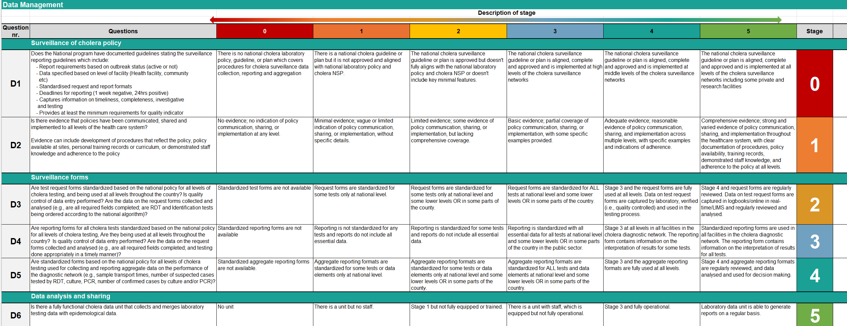
Example
Core component
Staging comparison
Stage / Score
Sections
Questions

Slide 17
Assessment Workflow
Pre-arrival briefing, gather all documents
Inform laboratories and gather all documents
National checklist
(2 days)
Facility assessments
(1 day per lab/ 0.5 for RDT)
Aggregate laboratory scores (0.5 days)
Revise national checklist based on laboratory findings
(0.5 days)
Assign priorities and determine impact
(0.5 days)
Determine top 10 components (lowest score, highest priority, highest impact)
(1 day)
Write report
(3 weeks)

Slide 18
Conduct facility visits
Facility assessments
(1 day per lab/ 0.5 day per RDT)
Facility assessments are covered in Module 3
When the laboratory visits are completed and the reports finalised, come back and finalise the National checklists.
Tools, Lab site checklist Excel and RDT site checklist Excel
Laboratory Capacity Assessment – GTFCC

Slide 19

FINALISING EXCEL

Slide 20
Assessment Workflow
Pre-arrival briefing, gather all documents
Inform laboratories and gather all documents
National checklist
(2 days)
Facility assessments
(1 day per lab/ 0.5 day per RDT)
Aggregate laboratory scores (0.5 days)
Revise national checklist based on laboratory findings
(0.5 days)
Assign priorities and determine impact
(0.5 days)
Determine top 10 components (lowest score, highest priority, highest impact)
(1 day)
Write report
(3 weeks)

Slide 21
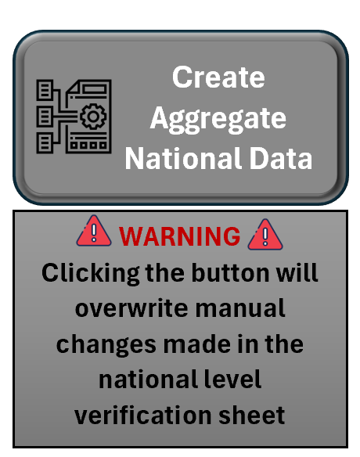
The data collected at all the different facilities needs to be compiled by the team and assessment leads.
This can be very time consuming; we have provided a method to automatically collect the data needed for National reporting in one sheet.
Click on the “Create Aggregate National Data” button
Go to the “National level verification” tab,
several table should be populated
These can then be cut and pasted into the
National sheets in the correct tabs
NATIONAL AGGREGATION

Slide 22
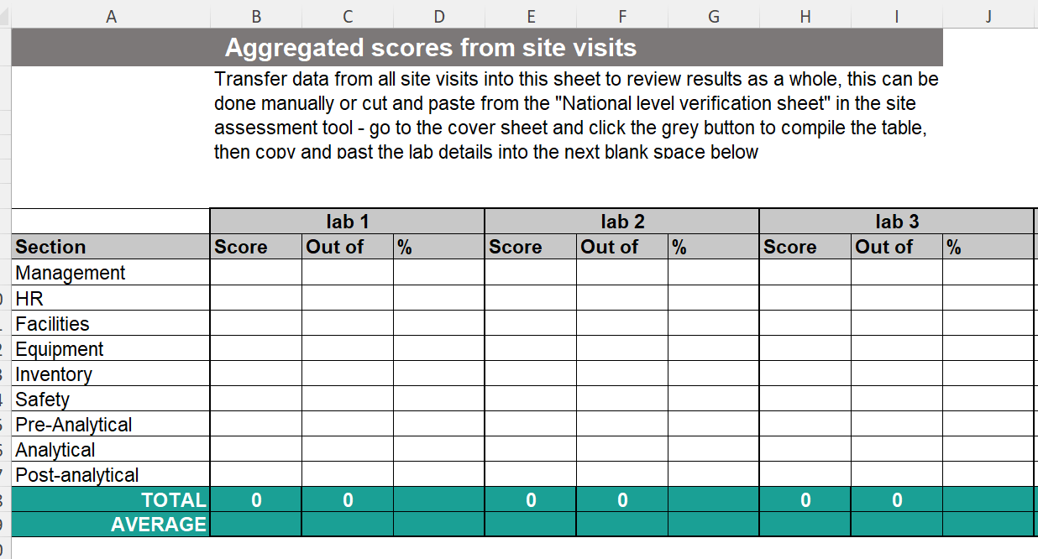
Aggregate laboratory scores
(0.5 days)
Unhide all the aggregate worksheets in the National level checklist.
Carefully cut and paste from each facility the data required in each worksheet.
POST-LABORATORY ASSESSMENT

Slide 23
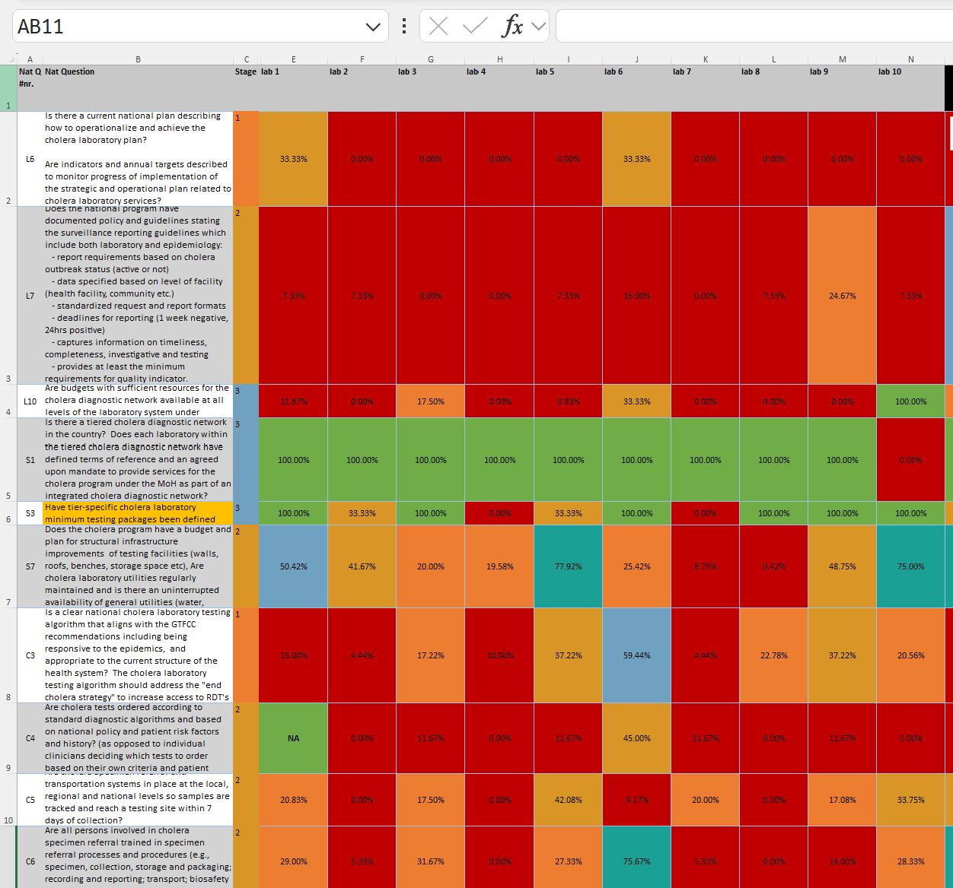
Revise national checklist based on laboratory findings
(0.5 days)
Compare the national scoring to the on-ground reality and revise the scores as required.
POST-LABORATORY ASSESSMENT

Slide 24
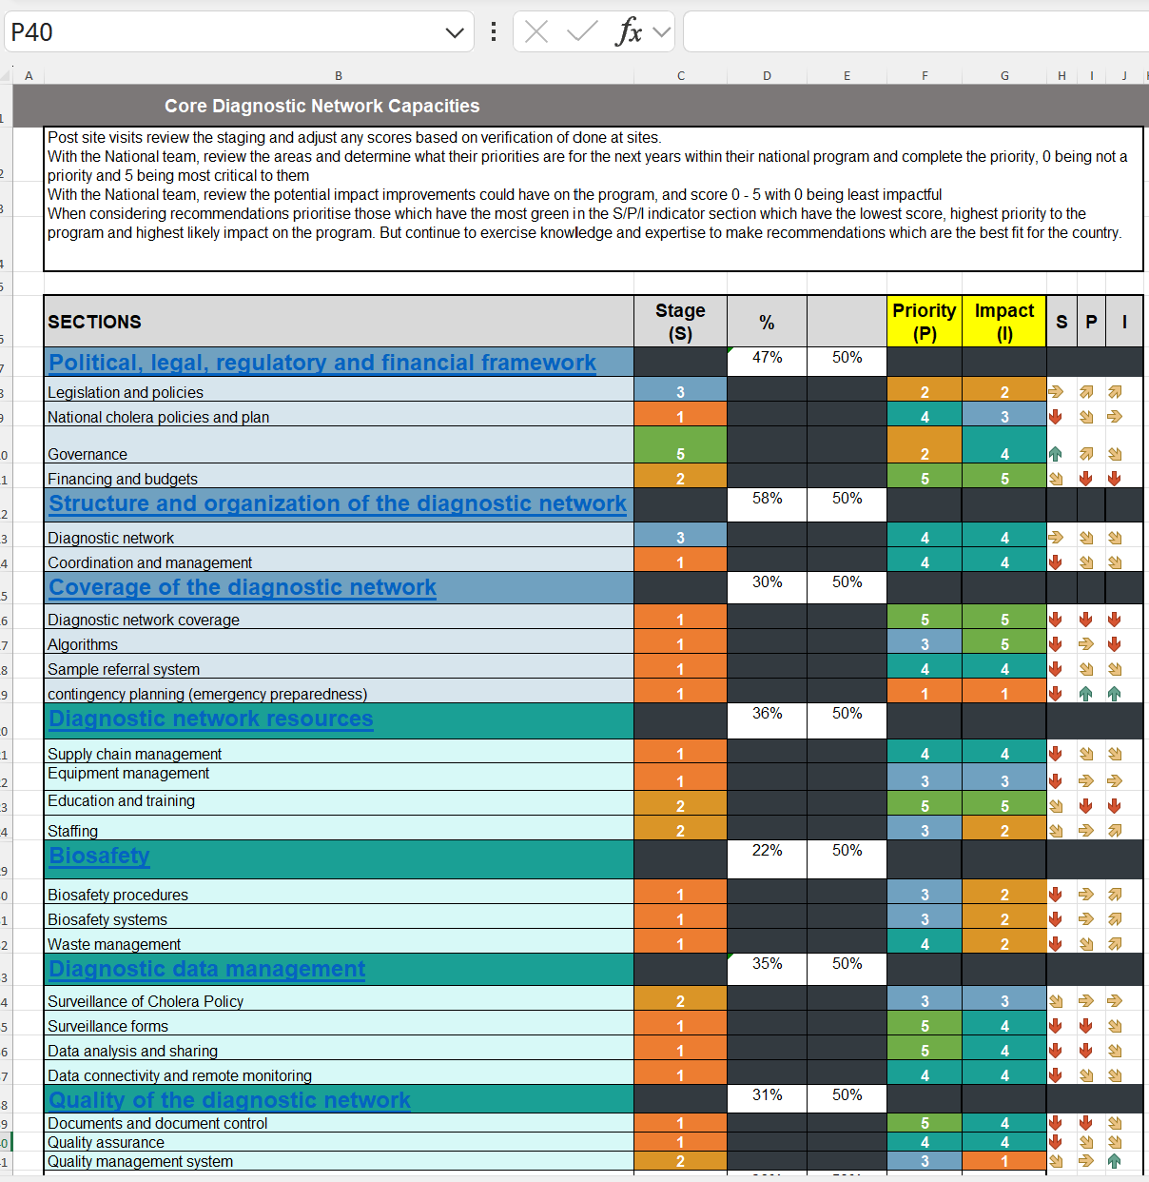
Assign priorities and determine impact
(0.5 days)
POST-LABORATORY ASSESSMENT

Slide 25
With the National team, review the areas and determine what their priorities are for the next years within their national program and complete the priority, 0 being not a priority and 5 being most critical to them.
With the National team, review the potential impact improvements could have on the program, and score 0 - 5 with 0 being least impactful.
POST-LABORATORY ASSESSMENT
When considering recommendations priorities those which have the most green in the S/P/I indicator section which have the lowest score, highest priority to the program and highest likely impact on the program. But continue to exercise knowledge and expertise to make recommendations which are the best fit for the country.

Slide 26
Assessment Workflow
Pre-arrival briefing, gather all documents
Inform laboratories and gather all documents
National checklist
(2 days)
Laboratory assessments
(1 day per lab)
Aggregate laboratory scores (0.5 days)
Revise national checklist based on laboratory findings
(0.5 days)
Assign priorities and determine impact
(0.5 days)
Determine top 10 components (lowest score, highest priority, highest impact)
(1 day)
Write report
(3 weeks)

Slide 27

REPORTING
Write report
(3 weeks)
Now you are ready to pull everything together and write the report.
Tools, Annex 6 - Laboratory Capacity Assessment – GTFCC (coming soon)

Slide 28

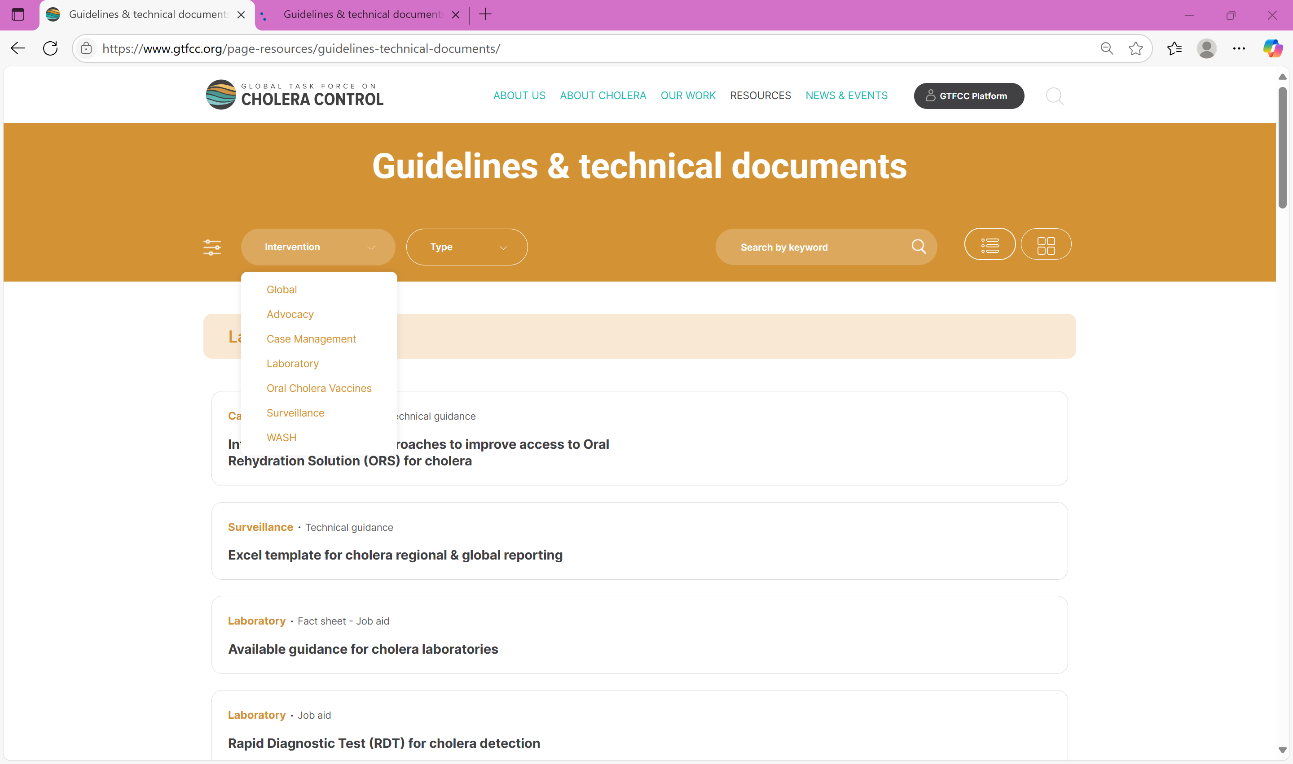

GTFCC support materials
Guidance document - https://www.gtfcc.org/resources/public-health-surveillance-for-cholera/
https://www.gtfcc.org/page-resources/guidelines-technical-documents/
https://www.gtfcc.org/cholera-app/

Slide 29
THANK YOU!

