Slide 1


GTFCC recommendations
Laboratory Capacity Assessments
Overview of Activities
July 2025
© WHO / Natalie Naccache

Slide 2
Laboratory Capacity Assessments For Cholera
Improved laboratory diagnostics and surveillance is essential to reach the first two strategic objectives of the “Ending Cholera A Global Roadmap To 2030”
1
2
Early detection and quick response to contain outbreaks
A targeted multi-sectoral approach to prevent cholera recurrence

Slide 3
?
How do we help countries if we don’t know where to start?
Perform laboratory capacity assessments of laboratory surveillance systems in countries.

Slide 4
Laboratory Capacity Assessment Objective
Observe the current laboratory surveillance system’s diagnostic and confirmation capacities to identify gaps or weaknesses within the network and laboratories involved in cholera control.

Slide 5
Cholera Laboratory Assessment Activity Outputs
1
2
3
Evaluate the Cholera diagnostic network including policies and guidance, laboratory infrastructure, utilization of diagnostic technologies, diagnostic practices and algorithms
Identify challenges that prevent the overall diagnostic network from performing efficiently and effectively
Propose evidence-based interventions to improve access, capacity and quality of the cholera diagnostic network to increase early detection of cholera cases

Slide 6




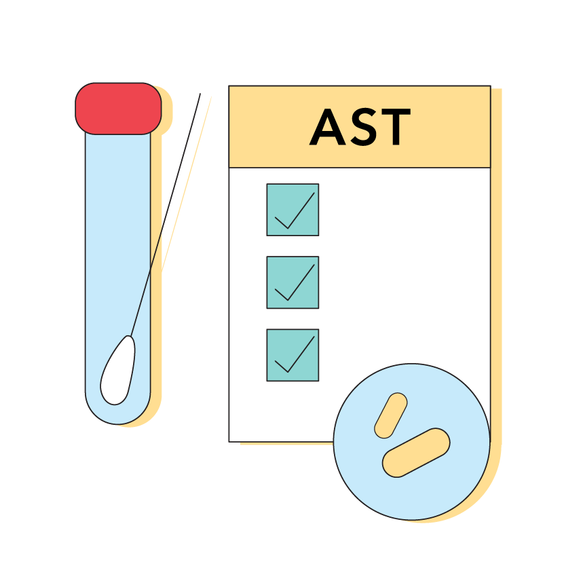
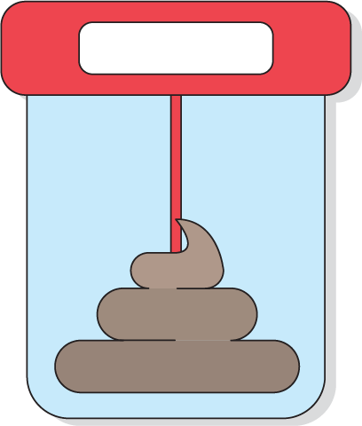


Laboratory Capacity Assessment Activity
Comprehensively assess the functionality and performance of the national cholera diagnostic network and its ability to meet the needs of the country.
Look at the entire network, not just laboratory testing.
!
Lab tests
Diagnostic Network

Slide 7
Methodology
The LCA approach combines document reviews, interviews with key individuals, observation, and visits to various cholera facilities in the country.
The evaluations will be conducted using cholera specific questionnaires based on ISO 15189, SLMPTA, WHO and JEE evaluations measured against compliance to the GTFCC guidelines and recommendations.

Slide 8
Methodology - Activities
The assessment will be conducted through the following process:
1
3
Desk review: Collect and analyze existing data on program capacities, country publications, previous assessments, online manuals.
Site visits: Conduct on-site evaluations using standardized assessment tools to gather data on infrastructure, equipment, human resources, and diagnostic workflows.
2
4
Stakeholder engagement: Engage with key stakeholders, including the Federal Ministry of Health, Nigeria Centre for Disease Control (NCDC), WHO, and laboratory staff, to gather insights and context.
Data analysis: Analyze findings to identify strengths, weaknesses, opportunities, and threats in the laboratory system.

Slide 9
Methodology – Areas Addressed
National program readiness: Policy and planning
National Cholera laboratory network systems across health care cascade
Implementation of National policy and plans at field levels
Laboratory infrastructure
Human resources
Equipment management
Sample referral mechanisms
Testing process and accuracy
Supply and inventory management system for cholera laboratory surveillance
Examine quality management systems:
Compliance with biosafety standards.
Supply chain and inventory management systems
Reporting and data management

Slide 10
Cholera Laboratory Assessment Tools
Complimentary assessment tools
1
2
National level
Facility level
1
National level data is used to evaluate facility implementation meets national goals
Standardised checklist to support review of NCP policy and procedures to identify areas of need
Standardised checklist to support in-depth review of facilities conducting cholera testing
2
Facility level is used to verify national level progress towards the Cholera Roadmap

Slide 11
Cholera Laboratory Assessment Workflow
Pre-arrival briefing, gather all documents
Inform laboratories and gather all documents
National checklist
(2 days)
Facility assessments
(1 day per lab/ 0.5 per RDT)
Aggregate facility scores (0.5 days)
Revise national checklist based on laboratory findings
(0.5 days)
Assign priorities and determine impact (0.5 days)
Determine top 10 components (lowest score, highest priority, highest impact)
(1 day)
Write report (3 weeks)

Slide 12
Cholera Laboratory Assessment Facilities
The assessment will target laboratories involved in cholera diagnostics at national, state, and community, including;
National reference Laboratories (NCDC-NRL and CPHL)
State Public Health Laboratories – without current response
State Public Health Laboratories – without current response, (preparedness)
Selected private and academic laboratories with capacity for cholera diagnostics
Sample collection and shipment centers, if any
RDT provider – health facility without current response
RDT provider - health facility with current response, (preparedness)

Slide 13
Cholera Laboratory Assessment Timeline
2 days - Opening meetings
2 – 3 weeks - Laboratory assessment and verification
2-3 days reporting and half day closing review meeting
The national level cholera assessment tool guides users through determining strengths and gaps in the country through a staging exercise.
Each core component of the cholera diagnostic network is broken into key sections and evaluated by a panel of experts.
Many of the national components are verified during laboratory assessments.
The panel of experts reviews the laboratory information and adjusts the staging if needed.
Evidence-based interventions recommendations and reporting.

Slide 14
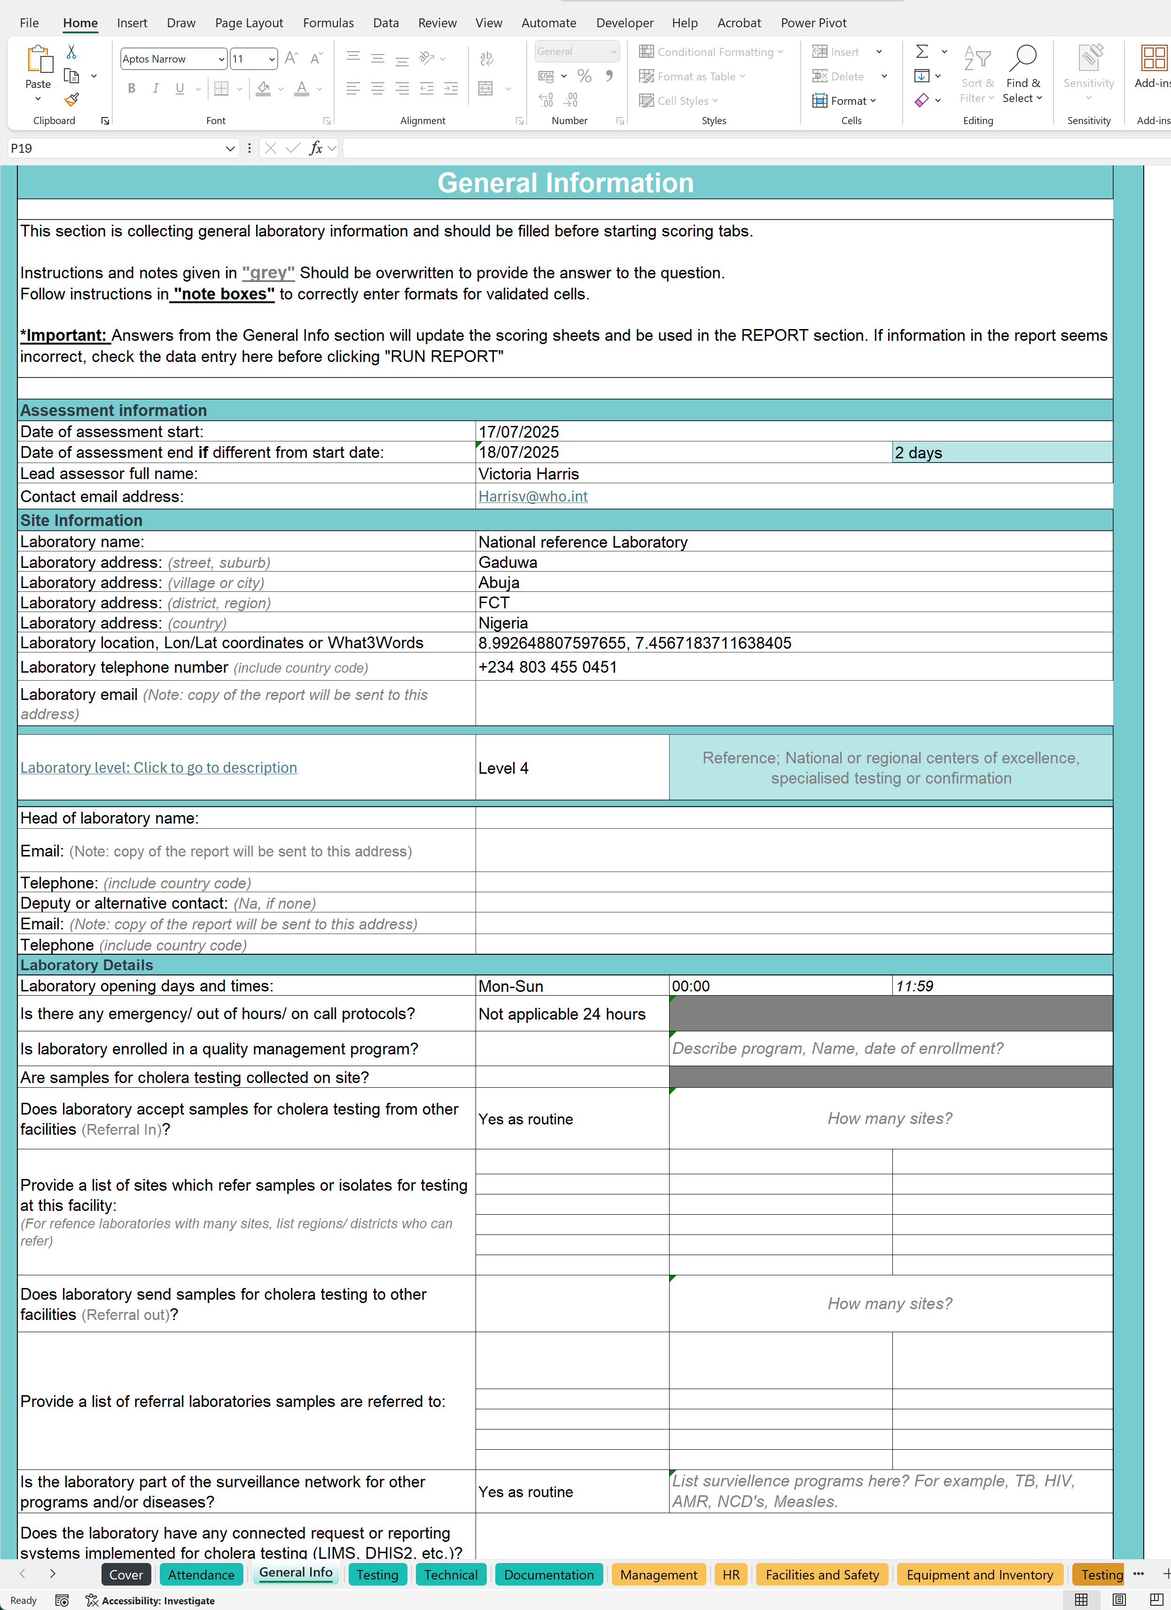
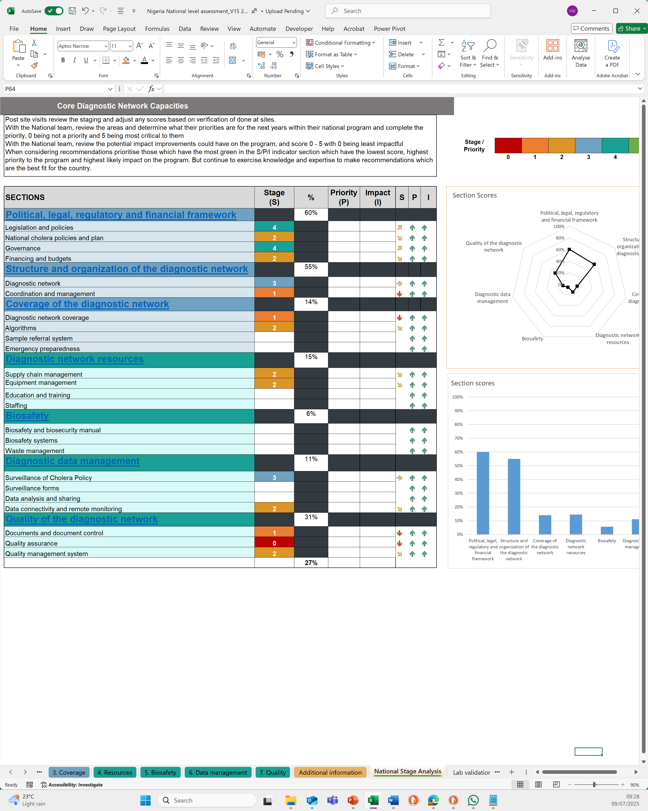
TOOLS USED: CHECKLISTS

Slide 15
National Level Checklist

Slide 16
National Checklist Core Components And Sections
Each component is in a separate excel tab and is broken into key sections each with 1 or more questions
1. Policy
2. Structure
3. Coverage
4. Resources
5. Data management
6. Quality
Legislation and policies
National cholera policy and plans
Governance
Financing and budget
Diagnostic network
Coordination and management
Biosafety and biosecurity manual
Biosafety systems
Waste management
Diagnostic network coverage
Sample referral system
Emergency preparedness
Algorithms
Supply chain management
Equipment management
Education and training
Staffing
Surveillance of Cholera Policy
Surveillance forms
Data analysis and sharing
Data connectivity and remote monitoring
Documents and document control
Quality assurance
Quality management system

Slide 17
National Checklist Staging
Each question is reviewed and compared to the stage description and “scored” from 0 to 5
0
1
2
3
4
5
Stage 0: Absence of attributes that are considered key to the development of inputs and processes needed for the implementation of a functional diagnostic network.
Stage 1: Foundational level. Includes attributes that are considered key to the development of inputs and processes needed for the implementation of a functional diagnostic network.
Stage 2: Moderate level. Listed attributes including inputs and processes needed to build or maintain the diagnostic network.
Stage 3: Strong technical or managerial or organizational capacity and a high level of performance of the diagnostic network with defined public health output and outcomes.
Stage 4: Advanced level. Performance of the network is continuously measured and achieves national standards of capability.
Stage 5: Attainment of international standards. Systems of revision are in place for continuously improving the diagnostic network.

Slide 18
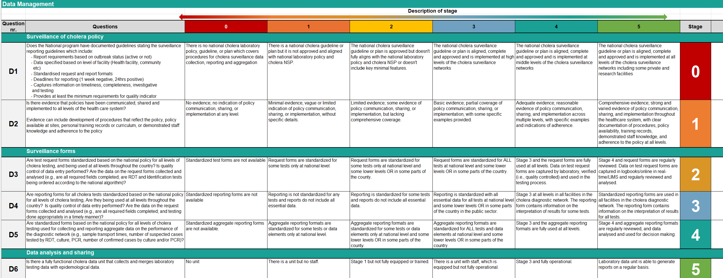
Example
Core component
Staging comparison
Stage / Score
Sections
Questions

Slide 19
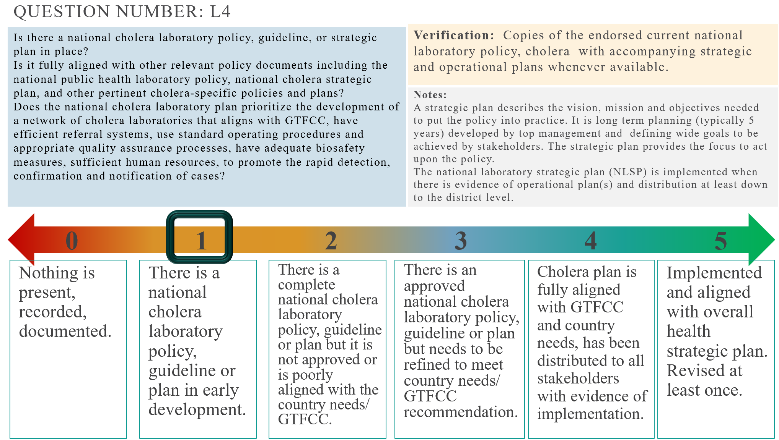
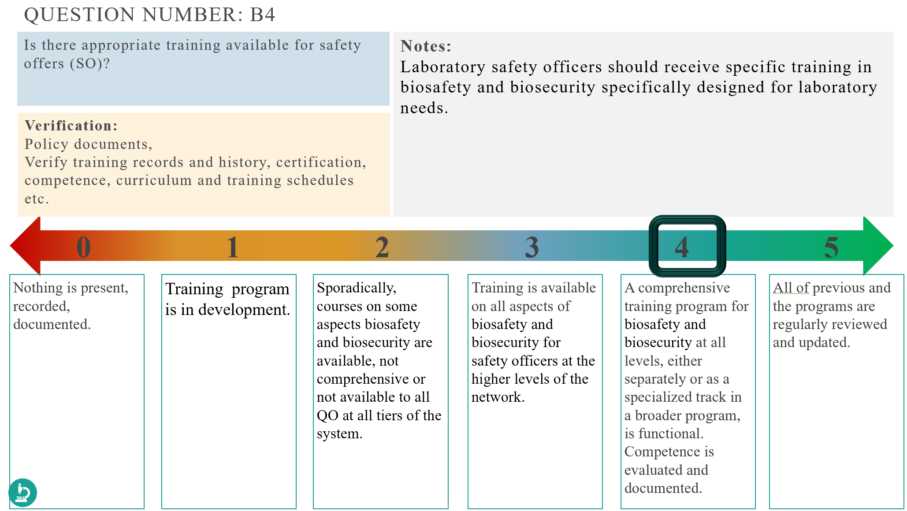
PowerPoint - Training GTFCC LCA 02 Cholera Program Checklist
To make it easer to fill with a large group there is a PowerPoint included in the package with each question, verification needs and comments included.
A score bar is moveable to record the score which can later be used to fill in the excel file.
Questions with a microscope icon indicate further verification needed in laboratories.
Microscope icon

Slide 20
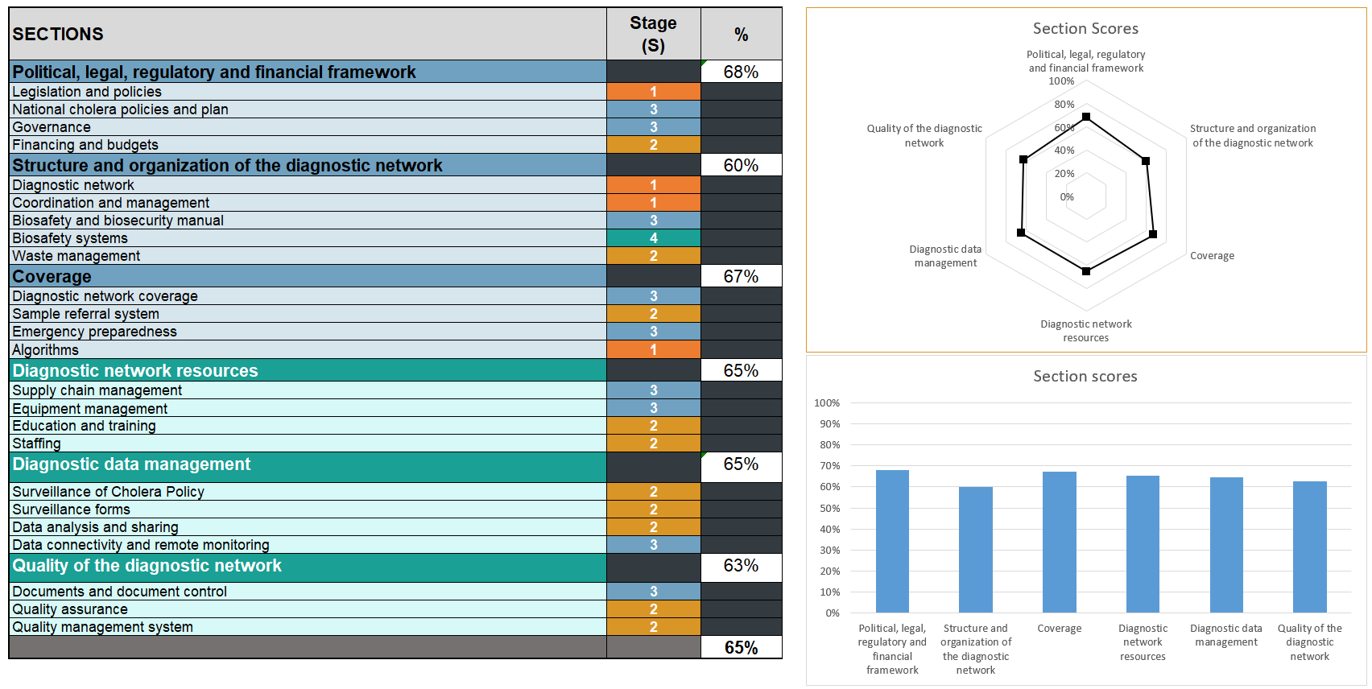
National Checklist Scoring
The overall stage for each section reflects the ‘weakest’ stage recorded for that section
Core component
Sections

Slide 21
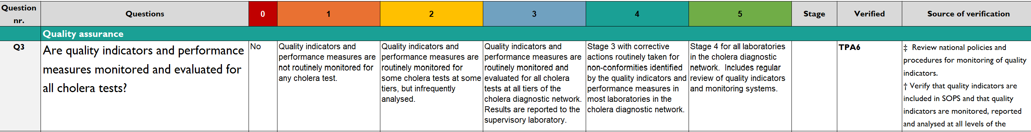
Laboratory Verification
Some questions will be verified in laboratories to confirm implementation as per GTFCC recommendations
!
You will find notes on how to verify as well as the laboratory checklist question it corresponds to. This is semi-automated to support reviewers.
Trust the process!

Slide 22
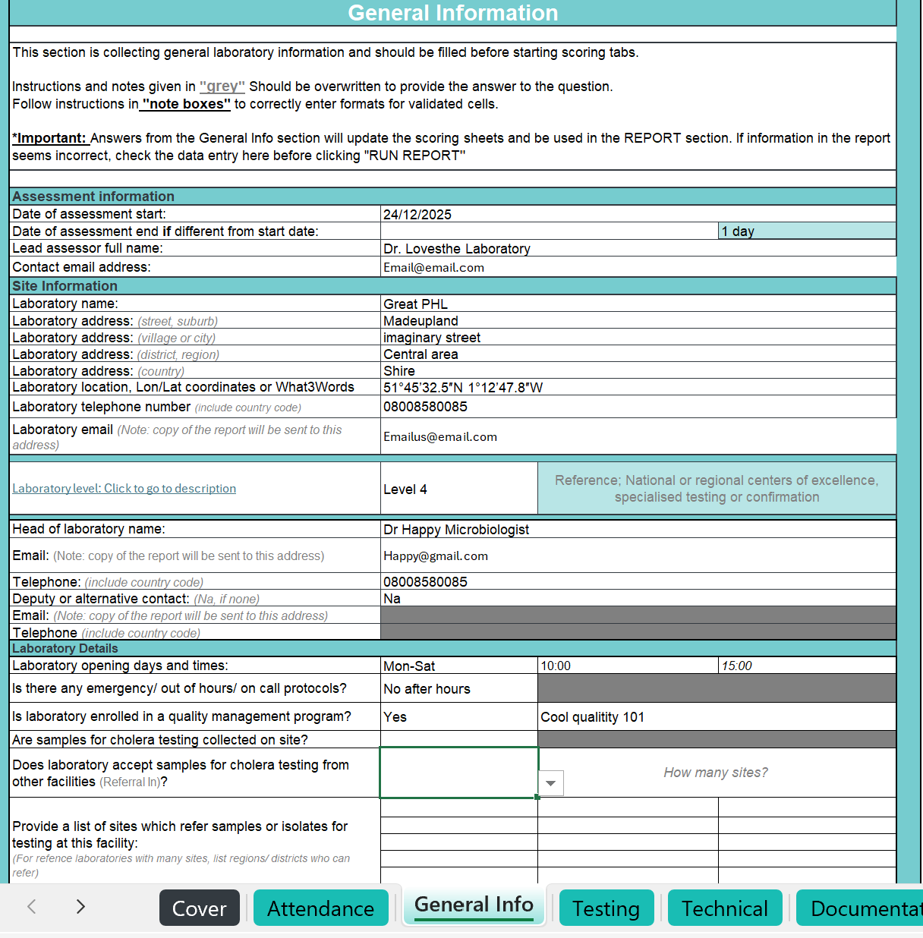
Facility Checklists

Slide 23





Narrative tabs collect information to inform the assessment team about the facility collecting background data, such as number of staff, opening times, equipment lists, testing methods used and available SOPs.
The score tabs and report tabs use information from these tabs to automate responses.
Attendance
General info
NARRATIVE TABS
Testing
Technical
Documentation

Slide 24


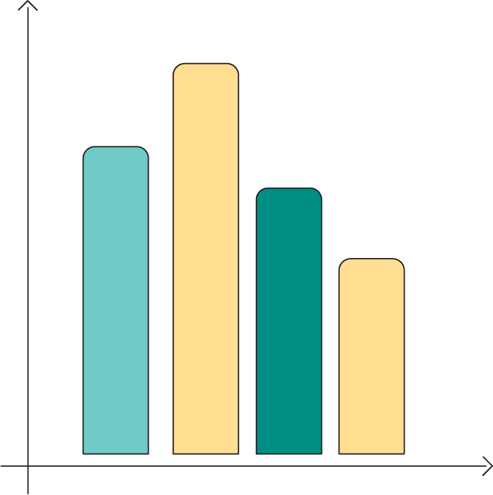
Scoring tabs contain questions with a dropdown for answers.
All answers can be Yes/No but some questions can be Partial or NA (not applicable).
Answers from “Narrative Tabs” prepopulates some of the scorecard.
Every question must be completed for the final score.
The scores for each question and each section are automatically calculated.
Mangement
Human resources
Facilitites and safety
SCORING TABS
Equipment and inventory
Pre-analytical
Analytical
Post-analytical

Slide 25




Output tabs contain the final information that will be shared as a report to the facility and scoring totals to be transferred into a “National Checklist”.
Before starting, all assessors should review and ensure all narrative and scoring sections are complete and accurate.
Gap analysis
Reporting
OUTPUT TABS
Recommendations
National aggregation

Slide 26
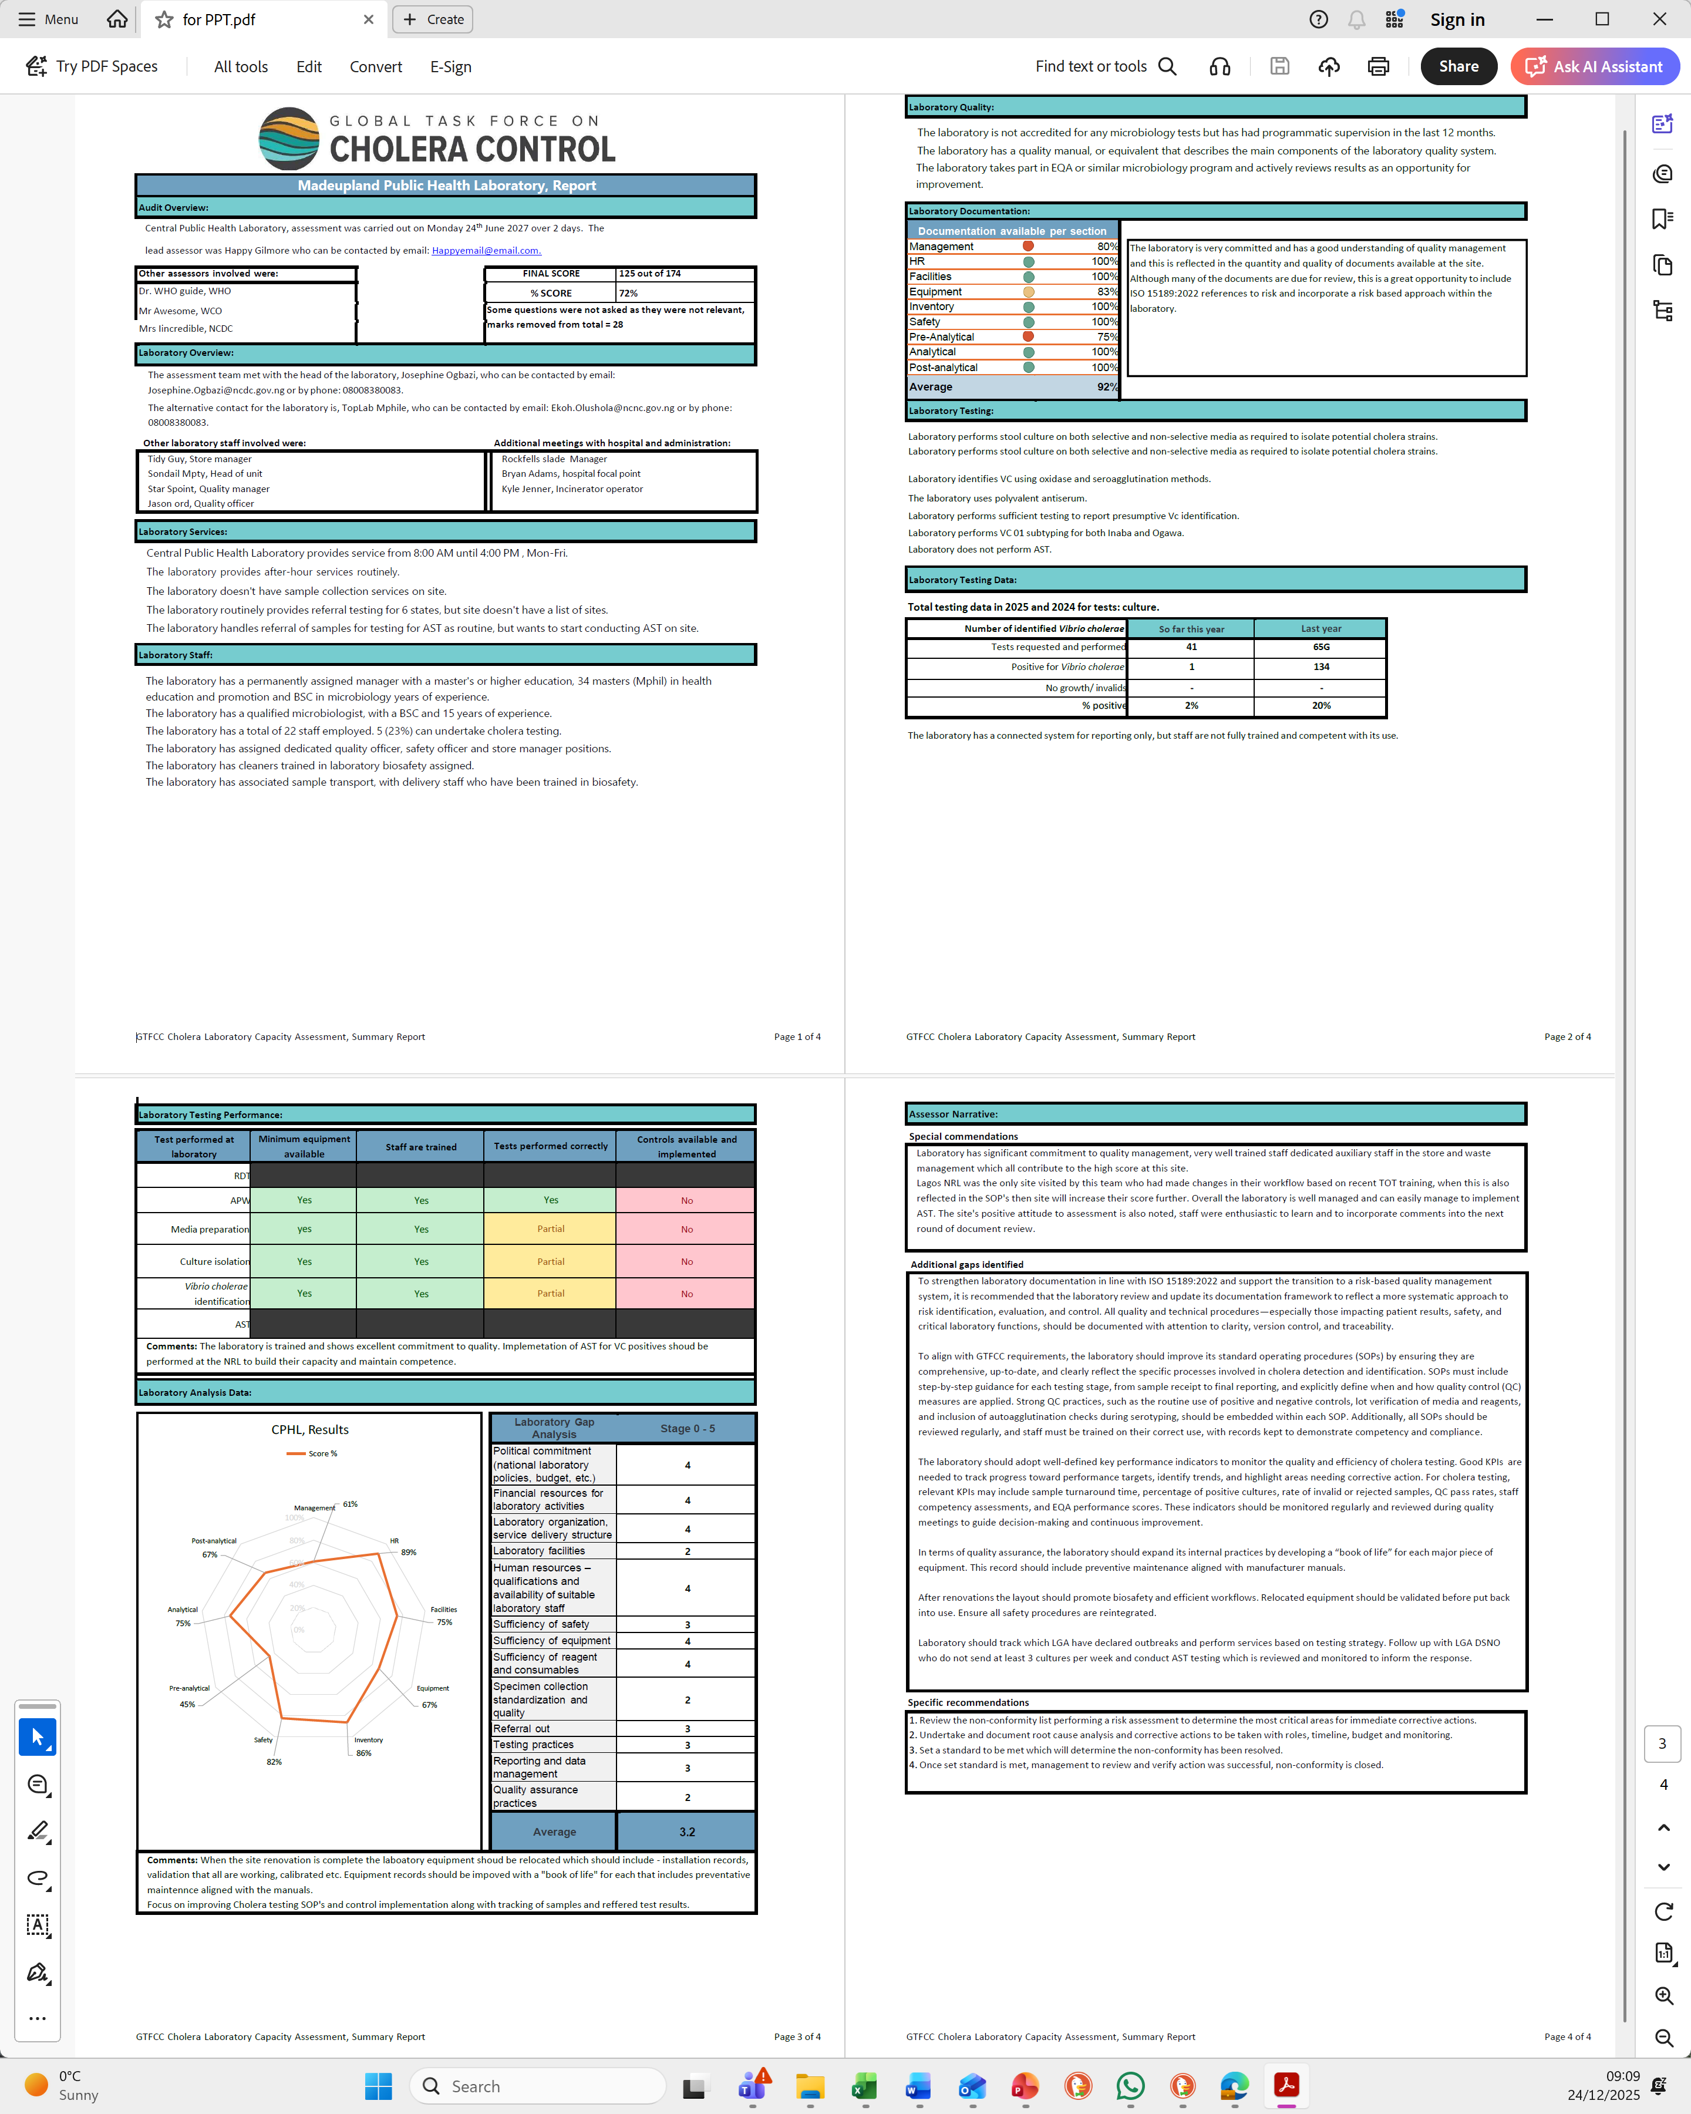
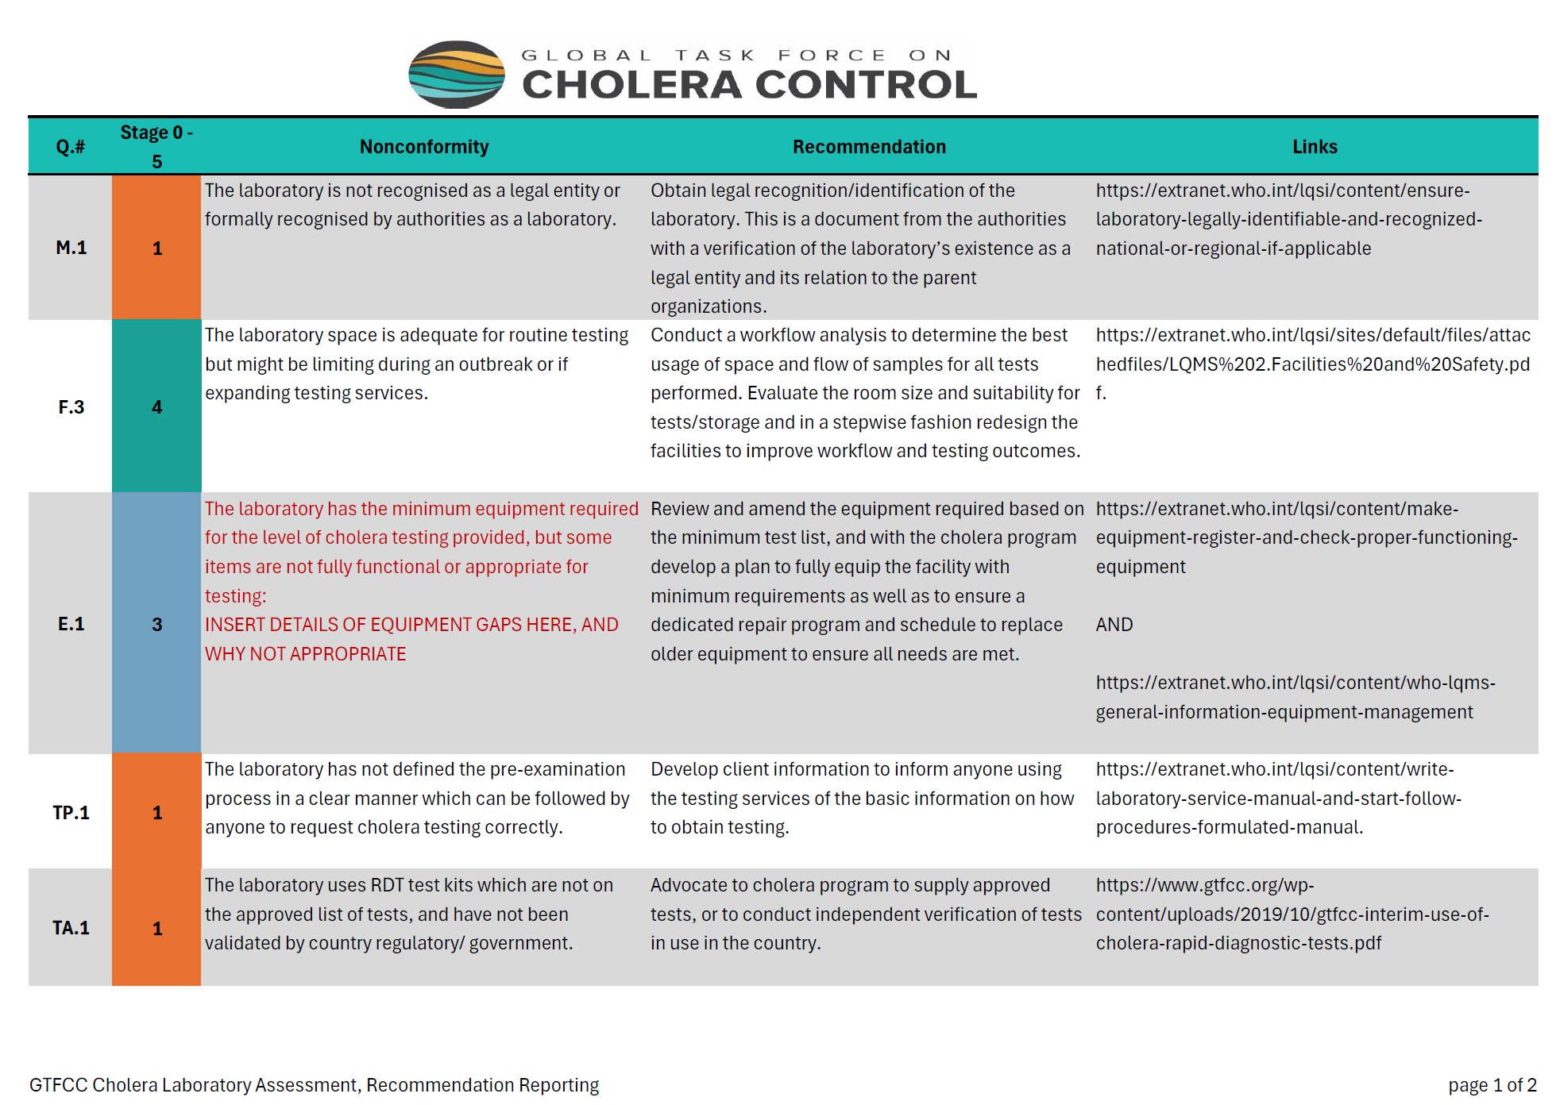
Summary report
Non-conformity report
FACILITY REPORTS

Slide 27
Going Forward
The Laboratory or RDT site reports are a tool for you to use to:
Improve each laboratory or RDT site performance and outbreak response through correction of nonconformities
Align testing to minimum GTFCC guidelines
Leverage local government funding to improve services
Extrapolate an overall picture of needs in the country to strengthen services

Slide 28

FINAL REPORTING

Slide 29
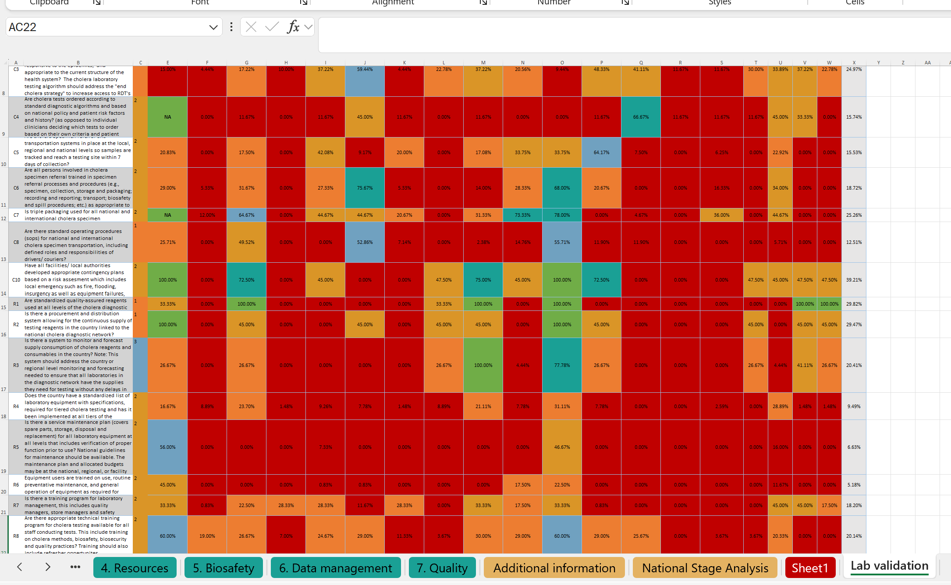
Overall Reporting
In Excel
It is now time to unhide excel worksheets and transfer all the laboratory data from each file into the “GTFCC LCA Cholera Program” excel file for analysis.

Slide 30
Overall Reporting
In Word
Report template “Annex 7 GTFCC LCA Report template” is provided with all relevant sections.
Complete all sections using the data analysis from the excel files, the laboratory reports and observations.
Introduction
Methodology
National Level Checklist Results
Results
PHL Checklist Results
Combined National and Laboratory Scores and Prioritisation
Programmatic Recommendations
Recommendations
National Public Health Recommendations:
Conclusions
Provincial Laboratory Recommendations
References
Supplementary materials
30

Slide 31
Going Forward
The extensive report is a tool for you to use to:
Improve individual facility performance and outbreak response through correction of nonconformities
Improve system as a whole
Use to leverage donors with evidence of needs to align to GTFCC recommendations
Use to leverage government funding based on GTFCC recommendations

Slide 32
Benefits
1
Structured, repeatable, nothing is missed
2
Verified, laboratory implementation is reviewed and related back
3
Comparable results between labs, between countries, over time
4
Evidence based recommendations made based on need, priority and impact
5
Data driven
6
Compatible with other vertical program reviews

Slide 33

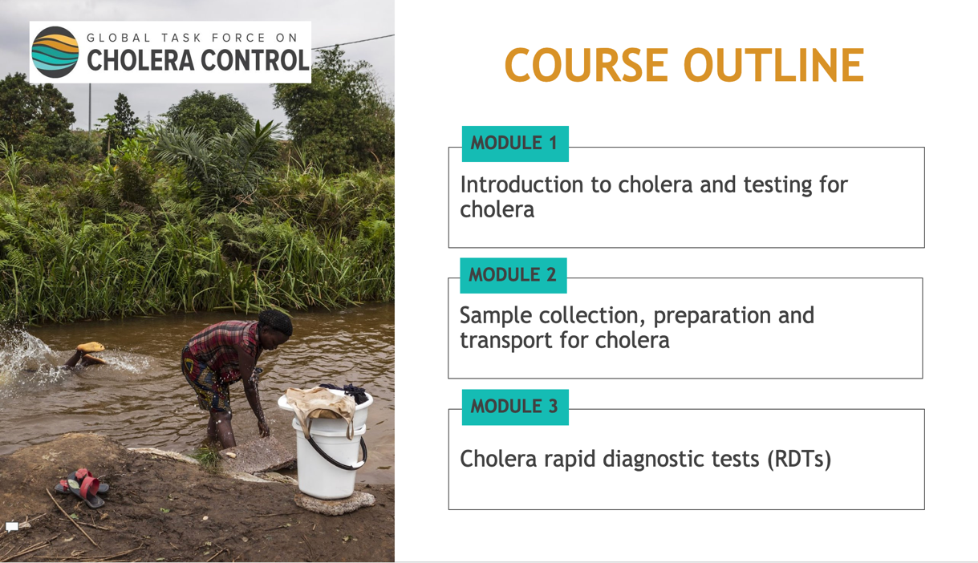
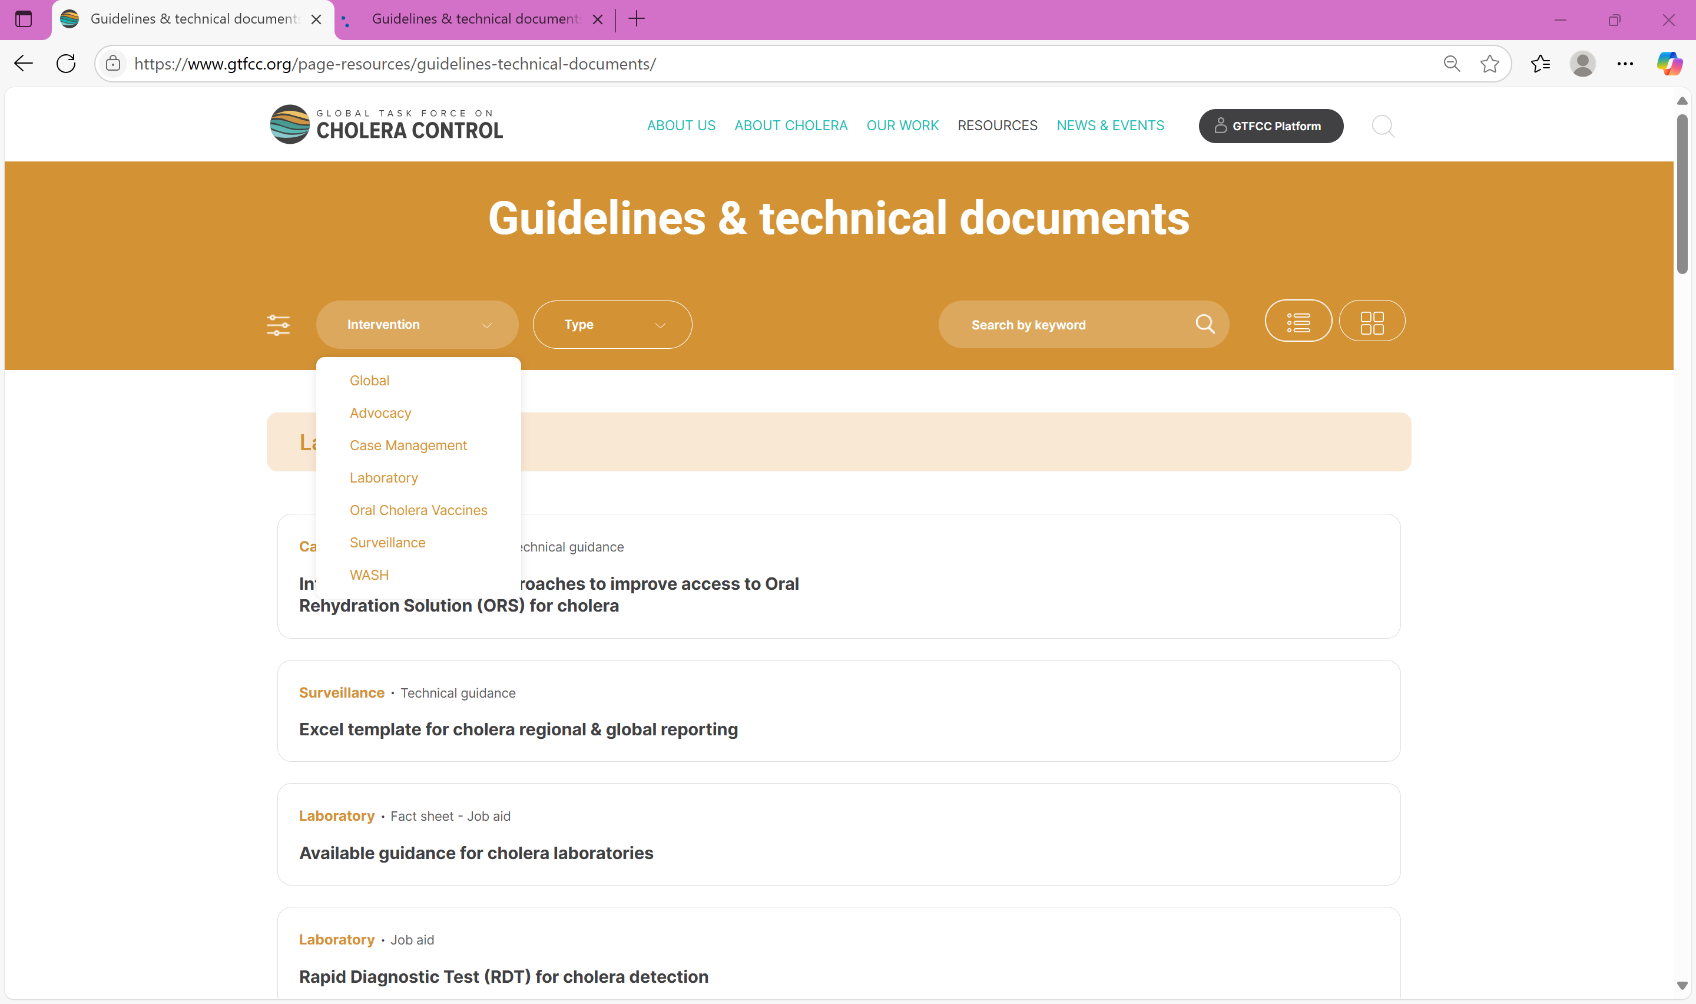

GTFCC support materials
Guidance document https://www.gtfcc.org/resources/public-health-surveillance-for-cholera/
Training materials https://www.gtfcc.org/training/sample-collection-and-testing-with-rapid-diagnostic-tests-for-cholera-for-health-care-workers/
Guidance https://www.gtfcc.org/page-resources/guidelines-technical-documents/
Mobile App https://www.gtfcc.org/cholera-app/

Slide 34
THANK YOU!

