Slide 1


GTFCC Laboratory capacity assessments
Cholera Program Capacity Checklist
V1.0 Sept 2024
© WHO / Lindsay Mackenzie

Slide 2
Before you start
Ensure you have read and understood the training materials found on the Laboratory Capacity Assessment – GTFCC website under “Training and planning”

Slide 3
National Checklist Staging
Each question is reviewed and compared to the stage description and “scored” from 0 to 5
0
1
2
3
4
5
Stage 0: Absence of attributes that are considered key to the development of inputs and processes needed for the implementation of a functional diagnostic network.
Stage 1: Foundational level. Includes attributes that are considered key to the development of inputs and processes needed for the implementation of a functional diagnostic network.
Stage 2: Moderate level. Listed attributes including inputs and processes needed to build or maintain the diagnostic network.
Stage 3: Strong technical or managerial or organizational capacity and a high level of performance of the diagnostic network with defined public health output and outcomes.
Stage 4: Advanced level. Performance of the network is continuously measured and achieves national standards of capability.
Stage 5: Attainment of international standards. Systems of revision are in place for continuously improving the diagnostic network.

Slide 4
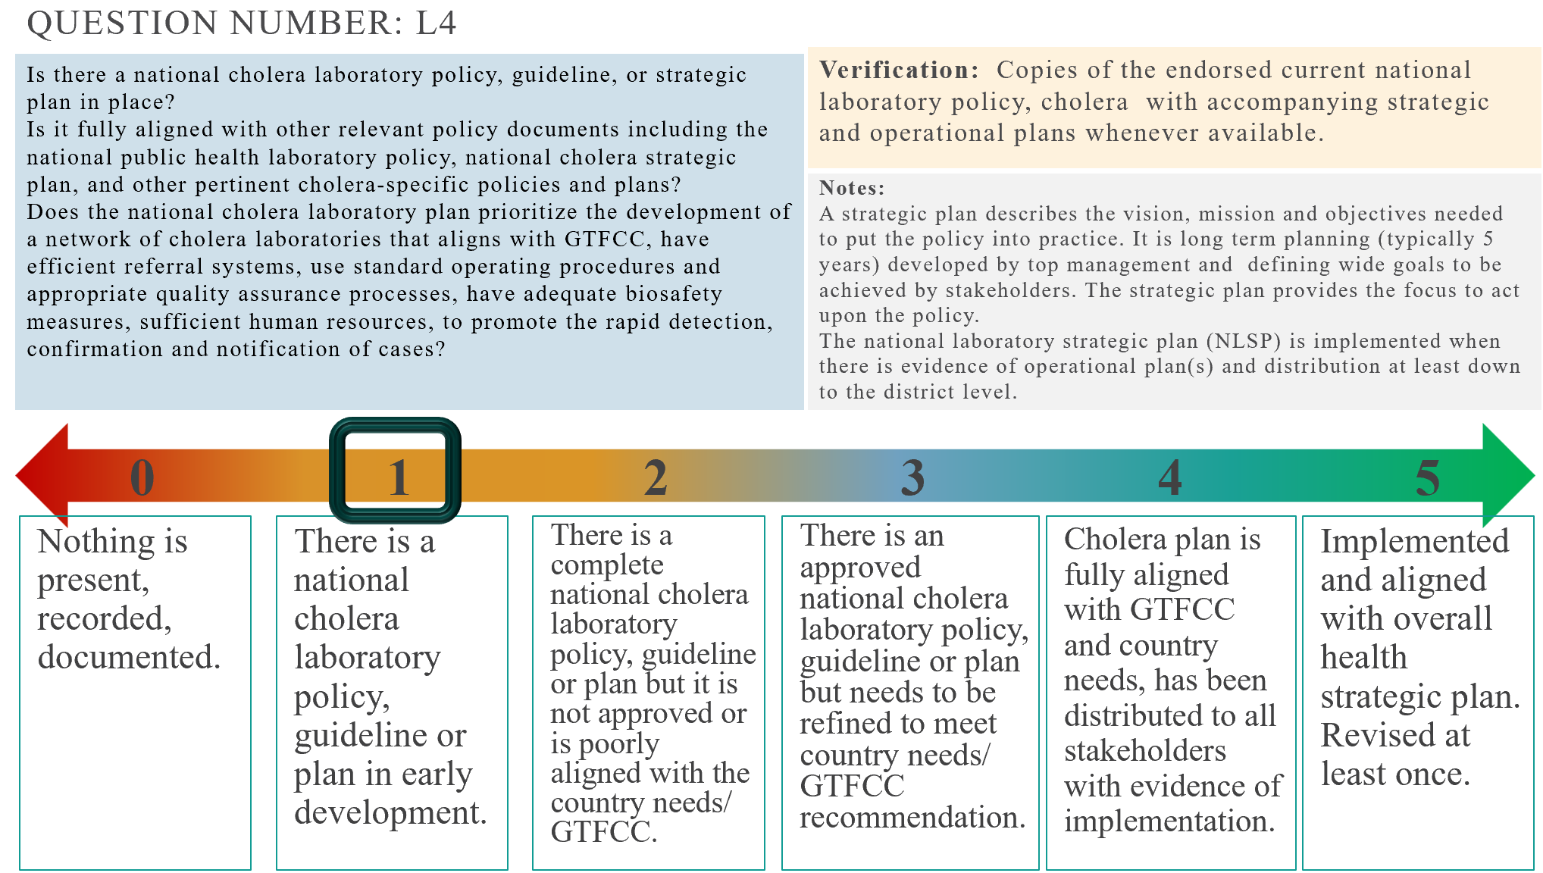
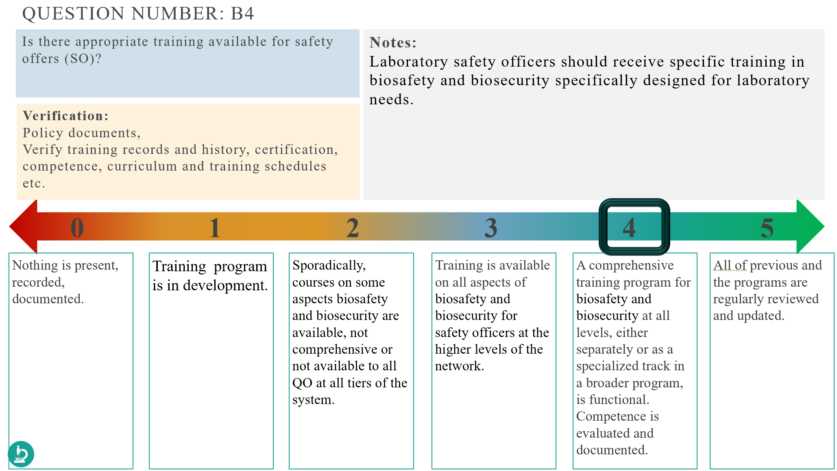
Using the PowerPoint
The score bar is moveable to record the score which can later be used to fill in the excel file.
Questions with a microscope icon indicate further verification needed in laboratories.
Microscope icon

Slide 5

policy
Policy

Slide 6
Aims
Policies are established to guarantee the ongoing, nationwide provision of free or reimbursed, quality-assured diagnostic services in accordance with national guidelines.
The country has a comprehensive and officially approved political, legal, and regulatory system that facilitates the implementation of the National Cholera Plan (NCP). This system governs and regulates all diagnostic services to align with the NCP, backed by adequate dedicated funding.

Slide 7
Question number: L1
Are the following key legal frameworks and policies related to cholera control and diagnostic networks available and enforceable?
- Regulatory framework
- Accreditation and certification
- Standard operating procedures (sops)
- Quality assurance and quality control
- Data privacy and confidentiality
- Reporting requirements
- Biosecurity and biosafety
- Personnel training and certification
- Public health emergency preparedness
Verification:
Copies of legislation either as separate bills or part of overarching bills which are cholera specific or regulations and policies related to biosafety; waste management; public health functions of the networks; and laboratory reporting of notifiable diseases which encompass frameworks under which cholera is included.
0
1
2
3
4
5
Nothing is present, recorded, documented.
1 or 2 areas only.
3- 6 key areas.
6 or more key areas.
All are in place and enforced.
Everything is finalised to international standards of planning and implementation at all levels of the health cascade, includes public and private.

Slide 8
Question number: L2
Are there regulatory procedures in place for the control of in vitro diagnostics (IVD)?
NOTES: Control of IVD’s is to monitor the quality of reagents after they have been purchased. This would ensure that no counterfeit or defective reagents are being used. Regulatory procedures include policy, plans or regulations. Authorized reagents are those allowed to enter the country. They include all but are not limited to standardized reagents. Post market surveillance are the activities conducted to ensure that reagents and products retain the characteristics that had when they were placed on the market. According to WHO, post market surveillance can be pro active (lot verification testing and evaluation of EQA/QC data) or reactive (field verification and corrective action upon users' complaint)
Verification:
Copies of documents relating to regulatory processes, how a new product is brought to market in country, copy of current list of authorized reagents for cholera testing - this could include RDT's, semi- automated or automated culture equipment and reagents, PCR equipment and cholera tests, sequencing equipment and reagents. Reports of post market surveillance.
0
1
2
3
4
5
Nothing is present, recorded, documented.
There is a regulatory agency or department, but no regulatory for IVD’s.
Regulatory procedures are being developed for IVD’s.
Regulatory procedures are in place and a list of authorized IVDs is available.
The list of authorized IVDs is routinely updated. Post market surveillance is organized for some IVDs including those for cholera.
The list of authorized IVDs and the regulatory procedures are routinely updated. In country post market surveillance include IVDs for cholera.

Slide 9
Question number: L3
Is the licensing of laboratory workers based on education, continuous education and competency?
Verification:
Copy of laboratory licensing procedure, training materials, authorized certification bodies.
0
1
2
3
4
5
Nothing is present, recorded, documented.
One-time licensing is automatically issued with registration or graduation for some categories of laboratory workers.
One-time licensing is automatically issued with registration or graduation for ALL categories of laboratory workers.
Including a regular re-licensing system in place with records.
There is a re-licensing mechanism in place based on qualification, continuous education and documentation of national standard of competency.
Licensing, relicensing, competence requirements are all regularly reviewed and updated.

Slide 10
Question number: L4
Is there a national cholera laboratory policy, guideline, or strategic plan in place? Is it fully aligned with other relevant policy documents including the national public health laboratory policy, national cholera strategic plan, and other pertinent cholera-specific policies and plans? Does the national cholera laboratory plan prioritize the development of a network of cholera laboratories that aligns with GTFCC, have efficient referral systems, use standard operating procedures and appropriate quality assurance processes, have adequate biosafety measures, sufficient human resources, to promote the rapid detection, confirmation and notification of cases?
Verification: Copies of the endorsed current national laboratory policy, cholera with accompanying strategic and operational plans whenever available.
Notes:
A strategic plan describes the vision, mission and objectives needed to put the policy into practice. It is long term planning (typically 5 years) developed by top management and defining wide goals to be achieved by stakeholders. The strategic plan provides the focus to act upon the policy.
The national laboratory strategic plan (NLSP) is implemented when there is evidence of operational plan(s) and distribution at least down to the district level.
0
1
2
3
4
5
Nothing is present, recorded, documented.
There is a national cholera laboratory policy, guideline or plan in early development.
There is a complete national cholera laboratory policy, guideline or plan but it is not approved or is poorly aligned with the country needs/ GTFCC.
There is an approved national cholera laboratory policy, guideline or plan but needs to be refined to meet country needs/ GTFCC recommendation.
Cholera plan is fully aligned with GTFCC and country needs, has been distributed to all stakeholders with evidence of implementation.
Implemented and aligned with overall health strategic plan. Revised at least once.

Slide 11
Question number: L5
Is there a current national plan describing how to operationalize and achieve the cholera laboratory plan? Are indicators and annual targets described to monitor progress of implementation of the strategic and operational plan related to cholera laboratory services?
NOTES: An operational plan guides day to day activities down to the district level. The plan should operationalize and budget for the achievement of the core capabilities of the laboratory network so that it aligns with the cholera NSP. The plan should describe milestones, indicators and annual targets to measure progress.
An operational plan describes milestones, indicators, annual targets, conditions for success and explains how (who, what, where, when), or what portion of the national laboratory strategic plan will be put into operation during a given operational period. The operational plan is developed by the middle level management of the laboratory system. It describes the day-to-day activities to implement the strategic plan. It provides the toolkit to implement the strategic plan and put the policy into practice. The operational plan is implemented when there is evidence that it is distributed and used at least at district level.
Verification:
Review of operational plan or relevant sections of the National laboratory strategic plan or National cholera Plan which contains the indicators and targets of the cholera program
0
1
2
3
4
5
Nothing is present, recorded, documented.
The operational plan is in early development.
There is a complete operational plan, but it is not approved or is poorly aligned with the national cholera plan.
There is an approved implementation plan but needs to be refined to fully align with the cholera plan.
Operational plan is fully aligned with cholera national plan and country needs, has been distributed to all stakeholders with evidence of implementation.
Implemented and aligned with overall health strategic plan. Revised at least once.

Slide 12

Question number: L6
Is there a licensing mechanism for cholera laboratories in place?
NOTES:
This may be part of a wider MOH licensing plan or program.
This question is to ensure that all laboratories in the private and public sector are authorized to practice under the same stringent criteria. Re-licensing is to ensure that laboratories adapt to evolving regulatory framework for the laboratory sector or perform according to the standards.
Verification:
Copy of current national licensing procedure
List of laboratories licensed to carry out cholera testing
0
1
2
3
4
5
Nothing is present, recorded, documented.
Being part of government facility is assumed to equate to licensing, but no documentation or procedure is available. No licensing for non-government laboratories such as NGO, private, military.
One-time licensing is provided with registration and is legally required for all laboratories in the health sector. Licensing requirements are different for public versus private laboratories.
One-time licensing in place and enforced for public or private cholera laboratories for health.
Licensing and re-licensing of all public and private cholera laboratories for health are legally required.
Re-licensing is based on national certification standards and is legally required for all cholera laboratories.

Slide 13

Question number: L7
Does the national program have documented guidelines stating the surveillance reporting guidelines which include: - report requirements based on outbreak status (active or not) - data specified based on level of facility (health facility, community etc.) - Standardized request and report formats - deadlines for reporting (1 week negative, 24hrs positive) - captures information on timeliness, completeness, investigative and testing - provides at least the minimum requirements for quality indicator.
Verification:
Copies of the policies, plans, regulation or legislation copies of request/reporting forms copies of standardized reporting forms and standardized procedure(s) for data collectiondescription of electronic system supporting the reporting of diagnostic data to local and national program
Notes:
Surveillance guidelines and policy may be within the NCP or as a separate document, but should spell out the laboratory data collection needs, frequency and methods of reporting
0
1
2
3
4
5
Nothing is present, recorded, documented.
There is a national cholera surveillance reporting guideline or plan in early development.
There is a national cholera surveillance reporting guideline or plan, but it is not approved and/or aligned with national laboratory policy and/or doesn't meet minimum requirements for data collection/reporting.
The national cholera surveillance guideline or plan is approved but doesn't fully align with the national laboratory policy or doesn't include all key minimal features or doesn't cover all levels of MoH network.
The national cholera surveillance guideline or plan is aligned, complete and approved and is implemented in all MoH levels of the cholera surveillance networks.
The national cholera surveillance guideline or plan is aligned, complete and approved and is implemented at all levels of the cholera surveillance networks including private and research facilities.

Slide 14
Question number: L8
Does the national cholera laboratory strategic plan or national cholera strategic plan address key issues of the laboratory workforce including staffing, salaries, retention, career development, etc. and is it implemented?
NOTES:
Relates to the availability and implementation of a strategic plan that addresses laboratory workforce development.
Key issues of the laboratory workforce include: 1)shortage, 2) distribution, 3) norms, 4) private sector, 5) salaries, 6) retention, 7) career plans, 8) deployment practices, 9) task-shifting, 10) pre-service training, 11) continuing professional development, 12) management strategies, 13) professional associations, and 14) financing.
Among these, priority areas are staffing, salaries and retention and career development for laboratory workers.
Verification:
Budget and national planning documents with specific lines for laboratory workforce and career development.
0
1
2
3
4
5
Nothing is present, recorded, documented.
The strategy addresses <3 key issues.
The strategy addresses 3-6 key issues including staffing, salaries, and career development.
Stage 3 and the strategy addresses 7-10 key issues with clear targets. Some HR strategies are implemented at some facilities.
The strategy addresses all issues. All HR strategies exist are implemented at some facilities.
The national strategy addresses all key issues with clear targets that are revised based on monitoring and evaluation. All HR strategies are implemented at all facilities.

Slide 15
Question number: L9
Does the Ministry of Health (MoH) or other responsible ministry have a dedicated organizational unit in charge of cholera coordination which covers all cholera testing facilities?
NOTES: The question relates to the involvement of laboratory services at the top management level within the MoH for decision-making processes, direct access to budget earmarked for laboratory-specific operations, involved in inter-ministerial coordination for relevant topics. There should be regular (e.g., quarterly) meetings of the coordination unit.
The laboratory coordination unit can be a directorate or a department of laboratory services, It is an entity responding directly to the ministry with top management level decision capacity. Hence, the directorate could be a sub-division of, for example, a clinical services unit or prevention and control of infectious diseases unit. Most often this unit is in the Ministry or Health but may be located in another Ministry with responsibility for laboratory or medical services.
Public health related committees e.g. cholera preparedness committees, emergency committees, or immunization committees.
Verification:
Copies of terms of reference and organogram for national laboratory coordination unit
TOR for committees
Meeting minutes or other reports
0
1
2
3
4
5
Nothing is present, recorded, documented.
There are several entities involved in cholera coordination without clear mandates or divided so as not to provide comprehensive cohesive services.
Dedicated entity but not at senior management level within the MoH. There is an official mandate, defined terms of reference and setting of targets.
Stage 2 plus coordination mechanisms with disease specific vertical programs and public health-related committees.
Stage 3 plus the entity is a directorate or a department, representing cholera services at top management level of the MoH with the private/NGO/ research sites performing testing included in oversight.
All of before, with interministerial coordination.

Slide 16
Question number: L10
Are budgets with sufficient resources for the cholera diagnostic network available at all levels of the laboratory system under cholera program? The budget covers cholera RDT's, laboratory testing, clinical diagnostic services, public health functions and network management functions.
NOTES:
Relates to the access to budget for laboratory activities at national and sub-national levels and for private sector laboratory services under cholera or laboratory program budget.
Public health functions include conducting testing and analysis for routine and surge capacity; supporting public health investigations, reporting; and conducting surveillance.
Clinical functions include patient diagnostic services.
Network management functions include coordination and monitoring of the laboratory network; technical maintenance and update of the network; quality management and accreditation; and quality assurance.
Verification:
Earmarked budget for laboratory services and yearly balance of the government, indicating spending of laboratory services.
0
1
2
3
4
5
Nothing is present, recorded, documented.
Program is significantly underfunded, only through donor funds, with limited amount available for cholera program direct use at referral laboratory only.
Program is underfunded, not all functions can be supported to regional level.
Program is mostly funded, with few gaps, to the community level.
Stage 3 and sufficient resources are available for cholera laboratory activities and clinical diagnostic services at all levels of the cholera laboratory system (NRLs, regional and peripheral laboratories). The budget completely covers the costs of laboratory testing, public health, patient diagnostic, and network management functions.
Sufficient resources are available for cholera laboratories at all levels of the network facilities providing services under cholera program with capacity to respond to changing circumstances.

Slide 17
Question number: L11
Is the budget for cholera laboratory and clinical diagnostic services covered by sustainable government funding and other local funding sources?
NOTES: Relates to the sustainability of cholera laboratory services. There should be a progressive shift toward more government funding and away from external sources.
Domestic sources include: government (national, state, or local), national private funding, user fees, health insurance fees.
Verification:
Earmarked budget for laboratory services and yearly balance of the government, indicating spending of laboratory services.
0
1
2
3
4
5
Nothing is present, recorded, documented.
Government and local funding contribution to cholera laboratory and clinical services includes only basic infrastructure and staff costs.
Stage 1 plus funding of basic supplies and reagents for some cholera diagnostics (e.g., culture).
Stage 2 plus funding for supplies for advanced cholera diagnostics and other costs (e.g., training, QA, equipment, maintenance etc.).
Government and local funding represent 100% of the total cholera laboratory and clinical budget.
Stage 4 and 100% of the budget spent in the last 3 years from government sources.

Slide 18

Structure

Slide 19
Aims
A sustainable, logical, and effective cholera diagnostic network delivers comprehensive and high-quality diagnostic services crucial for patient care and public health initiatives. This network, overseen by a national reference or public health laboratory, encompasses diagnostic services at various levels, including community-based facilities. Each facility operates under clearly delineated responsibilities and receives appropriate supervision.
Sufficient materials, means and skills are available throughout the system to ensure safe and secure procurement, handling, storage, transportation and disposal of samples and materials, both in routine as well as in emergency circumstances.

Slide 20
Question number: S1
Is there a tiered cholera diagnostic network in the country? Does each laboratory within the tiered cholera diagnostic network have defined terms of reference and an agreed upon mandate to provide services for the cholera program under the MoH as part of an integrated cholera diagnostic network?
NOTES: To determine whether a network is in place and whether it adequately supports clinical, public health, and network management functions.
Clinical functions include patient diagnostic services.
Public health functions include conducting testing and analysis for routine and surge capacity; supporting public health investigations, reporting; and conducting surveillance. Network management functions include coordination and monitoring of the laboratory network; technical maintenance and update of the network; quality management and accreditation; and quality assurance.
Verification: Copies of organogram of the Cholera diagnostic/ surveillance network;
Copies of terms of reference for each laboratory within the tiered diagnostic network
List of tier-specific cholera laboratory minimal testing packages
0
1
2
3
4
5
Nothing is present, recorded, documented.
Testing is performed but without defined roles and mandates for each level of the system.
Only division into reference and other laboratory, without clearly defined roles and responsibilities for the different tiers.
There is a cholera diagnostic network with at least 3 tiers in the country with roles and responsibilities defined for the different tiers.
Stage 3 plus all roles and responsibilities and written terms of reference (TORs) are available and meet the country needs and GTFCC guidelines.
Stage 4 plus the network includes private and other facilities with roles clearly defined for routine and outbreak.

Slide 21
Question number:S2
Does the organizational structure of the cholera diagnostic network include decentralization of diagnostic services with appropriate testing at different tiers and screening, RDT’s or sample collection to the community level?
This question relates to the incorporation of community level services into the cholera diagnostic network and approaches to support the accessibility of good laboratory screening and diagnostic services to all populations. Basic cholera testing services includes symptom screening and RDT's and referral of positives for confirmatory testing at a minimum. Community level providers may include community outreach from public facilitates, pharmacies etc.
Verification: List of tier-specific cholera laboratory minimal testing packages and facilities implementing these packages.
0
1
2
3
4
5
Nothing is present, recorded, documented.
Cholera tests are only available at central or referral sites.
Identification tests are decentralized to a regional level with HF able to refer samples from district level or above.
Identification tests are decentralized to a district level with HF able to routinely refer samples from community level.
RDT screening is implemented at all PAMI with on demand sample referral for identification.
RDT’s are pre-positioned and accessible to all community providers in country, including private and NGO, sample referral is accessible on demand to public and private.

Slide 22
Question number: s3
Have tier-specific cholera laboratory minimum testing packages been defined and implemented?
NOTES:
This question is to determine whether all tiers of the laboratory network have a defined minimum testing package, and whether these packages allow for the provision of all cholera diagnostic services according to the national algorithms (either through local testing or referral).
The minimal testing package for each tier should be defined by the national program in alignment with GTFCC recommendations
Verification: List of tier-specific cholera laboratory minimal testing packages
Evidence of communication and implementation within the network(s): e.g., telephone directories, newsletters, meeting reports, evidence of data exchange, training, etc.
0
1
2
3
4
5
Nothing is present, recorded, documented.
Cholera tests are available in country but have not been defined based on tier specific network.
Minimum cholera testing packages are defined for some tiers of laboratories or fully defined but are not implemented.
Minimum cholera testing packages are defined for all tiers of laboratories and implemented in some laboratories at some tiers.
Minimum cholera testing packages are defined for all tiers of laboratories and implemented correctly in all laboratories in all tiers.
Testing packages for cholera in all public laboratories in cholera network are implemented as defined. Testing is defined and implemented in relevant private and non-government labs. The packages have been reviewed and updated at least once.

Slide 23
Question number: S4
Is there a formalized system of communication within the cholera diagnostic network?
NOTES: This relates to the linkages, communication, and management of the diagnostic network between and within tiers of the diagnostic network.
Formalized system of communication takes place through well-known channels according to established procedures. Information circulates from top management to lower level or lower level to top management: vertical communication. Information can also flow across the levels of the laboratory network: horizontal communication.
Verification:
Evidence of communication within the network(s): e.g., workshops, annual schedules, telephone directories, newsletters, meeting reports, evidence of data exchange, training, etc.
0
1
2
3
4
5
Nothing is present, recorded, documented.
Communication goes from the top down and doesn’t have any formalised lines of communication; communications are poorly recorded or documented.
Communication is unidirectional but is performed through a documented channels on an ad-hoc schedule.
Communication is bi-directional through documented channels; cross communication may occur but is ad-hoc and/or poorly documented.
Communication also occurs across tiers through formalised channels on regular schedules.
Formal communication vertically and horizontally between and within tiers using a system and occurs on a regular basis.

Slide 24
Question number: S5
Is there a designated national reference laboratory (NRL) for cholera in the country?
If more than 1 NRL:
- Is there a focal point at the national level that is responsible for managing the network of NRLs?
- Do coordination meetings of the NRLs occur at least once a year if there is more than 1 NRL?
Notes:
This question relates to the designation of a national cholera reference laboratory (ies) that are responsible for management and coordination of the cholera diagnostic network.
In large countries, there may be more than one designated laboratory that functions as an NRL, each with an assigned jurisdiction.
Documentation can be in the form of meetings, collaborations for exchange of information, training, technology transfers, formation of technical working groups, etc.
Verification:
Copies of terms of reference for the reference laboratory/ (ies)
Participation in coordination meetings, produced technical documents, training/technology exchanges, policy development, meeting minutes etc.
0
1
2
3
4
5
Nothing is present, recorded, documented.
There is a laboratory/ies which perform the referral facility roles, but it is not formalised, doesn’t have documented roles and responsibilities within the cholera network.
An NRL has been designated. OR More than one NRL has been designated and each NRL has a clearly defined jurisdiction.
An NRL coordinates public health functions of the national cholera laboratory network and has informal links with the cholera program (or other national agencies focusing on public health). Responsible for coordinating the activities of the network of NRLs.
Stage 3 and the links with the cholera program (or other national agencies) are formalized through MoUs or similar. AND if more than one NRL, coordination meetings of the NRLs occur at least once-a year. NRLS actively participates in policy and technical developments.
Stage 4 and formalized links with a supranational (international) lab.

Slide 25
Question number: S6
Does the NRL provide essential cholera public health functions?
1) support for disease prevention, control and surveillance, 2) integrated data management, 3) reference and specialized testing, 4) laboratory improvement, 5) policy development, 6) public health preparedness and response,7) public health related research, 8) training and education; partnership and 9) communication.
Verification:
Copies of terms of reference for the national reference laboratory(ies).
Notes:
This question relates to whether the NRL provides essential public health functions.
The NRL does not have to perform them all but must ensure that they are in place throughout the network.
0
1
2
3
4
5
Nothing is present, recorded, documented.
<3 essential cholera public health functions, including at least support for cholera disease prevention, control and surveillance.
Between 3-5 essential cholera public health functions, including at least support for cholera disease prevention control and surveillance.
Between 6-8 essential cholera public health functions, including at least support for cholera disease prevention control and surveillance.
NRL performs all essential cholera public health functions.
NRL performs all essential cholera public health functions and supports all public sector laboratories and private sector laboratories.

Slide 26
Question number: s7
Does the cholera program have a budget and plan for structural infrastructure improvements of testing facilities (walls, roofs, benches, storage space etc.), are cholera laboratory utilities regularly maintained and is there an uninterrupted availability of general utilities (water, energy, communication lines)?
Verification:
Program plan for facilities repairs and improvements with budget including utilities.
Notes:
Relates to ensuring the safe functioning of laboratory facilities in the network and covers all infrastructure and utilities required for safe laboratory operation. This maybe covered by a more general department in the MoH, but the program should be aware of and be part of decision making.
0
1
2
3
4
5
Nothing is present, recorded, documented.
No specific budget or plan, only sporadic infrastructure repairs, and labs experience outages of services (water, electricity, internet) routinely.
There is a plan for repairs and maintenance of facilities and services, but budget is not available to implement so only urgent repairs are addressed. Structures are in need of upgrade/repair, and utility outages occur frequently.
There is a plan for repairs and maintenance with limited budget allowing for repairs and limited maintenance. Most facilities are in good condition Utilities are funded and rarely experience outages.
Planning and budget allows for ongoing preventive maintenance at some tiers and backup systems for some utilities are available at some levels. All structures are in good repair and outages are rare at al tiers.
Ongoing planning and preventive maintenance at all tiers with backup systems for all utilities are available, regularly tested and replaced when necessary.

Slide 27
Question number: S8
Does the cholera diagnostic network collaborate with other diagnostic networks (e.g. HIV) regarding laboratory and diagnostic services (e.g., Infrastructure, connectivity specimen transport, shared diagnostic platforms, etc.)?
Verification:
Copies of organogram of the larger surveillance network
Copies of communication between networks, meetings, trainings, telephone logs etc.
Notes:
Coordination of the overall network of laboratories is essential.
Collaboration and coordination between national programs and laboratories is important for efficient use of resources such as specimen referral systems or shared diagnostic platforms (e.g., AMR culture and AST, PCR testing).
0
1
2
3
4
5
Nothing is present, recorded, documented.
There is limited ad hoc collaboration between cholera and non-cholera diagnostic networks either at the NRL level or program level.
There is a formal collaboration between program, but only at high levels.
Formal collaboration and coordination mechanisms between cholera and non-cholera diagnostic to share some services.
Coordination mechanisms of cholera and non-cholera diagnostic networks occur at least once a year. All tiers of the laboratory network share joint services, such as sample transport, internet, LIMS, warehouses, equipment, quality management, joint training events etc.
Coordination mechanisms of cholera and non-cholera diagnostic networks occur at least once a year. A national level unit coordinates collaboration between cholera and non-cholera diagnostic networks with Review and analysis of collaboration on regular basis.

Slide 28

Coverage

Slide 29
Aims
The national network for diagnosing cholera ensures broad coverage of diagnostic services to promptly identify cases and outbreaks. It includes referral systems to quickly and securely send specimens to the right level for testing, providing results promptly for timely treatment initiation.
A smooth interface between diagnostics and clinical practice facilitates ordering and conducting appropriate tests, ensuring quick linkage of cases to surveillance efforts.

Slide 30
Question number: C1
At the national level, is there a current list or map of laboratories that fall under the national cholera diagnostic network?
Does this list or map include a current inventory of cholera diagnostic tests (RDT, culture, AST, Molecular etc.) and instruments within the existing diagnostic network?
Verification:
Map of laboratories with cholera services
Lists of tests available at facilities.
Notes:
This question relates to understanding the locations and testing capabilities of cholera laboratories throughout the country.
This mapping information is essential to evaluate access to services and to develop plans and budgets to ensure access to cholera diagnostics.
0
1
2
3
4
5
Nothing is present, recorded, documented.
A list or map exists of some laboratories in the public sector that offer cholera services but is not complete or detailed.
A list or map exists of ALL laboratories in the public sector that offer cholera services.
A list or map exists of all laboratories in the public sector that offer cholera services AND the map or list includes current inventory of diagnostic tests and instruments.
Stage 3 plus complete GIS mapping of laboratories, services, and inventories.
Stage 4 plus GIS mapping and includes private, academia or NGO laboratories.

Slide 31
Question number: C2
Are there sufficient cholera diagnostic facilities to meet the estimated needs for the basic cholera testing package available in all districts?
Cholera diagnostic facilities may include community-based health facilities that screen patients, collect samples, and refer samples to cholera laboratories for testing.
Notes:
Are laboratory facilities to meet the estimated needs for the basic cholera testing package available in all districts or in such a way that >80% of the risk population is at a maximum of 5 km (or 1 hour travel time) from the lowest laboratory tier, in each district?
Basic testing package is the minimal testing package for the lowest tiers of the laboratory network.
Cholera laboratory facilities may include community-based health facilities that screen patients, collect samples, and refer samples to cholera laboratories for testing.
Verification:
Review national, regional, and local estimates of the need for basic cholera diagnostic services, population, tests performed, PAMI etc.
0
1
2
3
4
5
Nothing is present, recorded, documented.
Coverage to less than 20% of at risk populations.
Coverage to less than 50% of at risk populations.
Coverage of 50-80% of all at risk population.
Over 80% coverage of at risk populations.
Full coverage and with continuous services accessible in all districts.

Slide 32
Question number: C3
Is a clear national cholera laboratory testing algorithm that aligns with the GTFCC recommendations including being responsive to the epidemics, and appropriate to the current structure of the health system?
Notes:
The algorithm should strive to reach the laboratory goals of the end cholera roadmap. The algorithm should focus on the whole diagnostic process from screening through to treatment and surveillance completion, and not just the laboratory testing workflow component.
A well-designed algorithm should address the epidemiology of cholera in the country (e.g. Geographic and at-risk populations), referring samples facilities, and use technologies in approved ways.
Verification:
National cholera diagnostic algorithm as a flow chart or other documents which covers all tests, tiers and scenario.
0
1
2
3
4
5
Nothing is present, recorded, documented.
There is a test request, but it doesn’t form a structured algorithm of which test to order when at which level, or doesn’t include escalation from presumptive to confirmed.
There is an algorithm which includes screening and testing that has a tiered structure but doesn’t cover all tests at all levels, or is not aligned to GTFCC or country needs.
There is a testing algorithm, screen which includes all tests at all levels correctly aligned for surveillance and outbreak scenario.
There is algorithm which covers all aspects from screening to surveillance, which includes all tests at all levels correctly aligned for surveillance and outbreak scenario with reference to at-risk populations and country geography.
There is a fully optimized, adaptive algorithm integrating public and private facilities, advanced technologies, providing real-time surveillance, and ensuring rapid, precise outbreak response.

Slide 33
Question number: C4
Are cholera tests ordered according to standard diagnostic algorithms and based on national policy and patient risk factors and history? (As opposed to individual clinicians deciding which tests to order based on their own criteria and patient preference).
Notes:
The national diagnostic algorithm should be adhered to by all clinicians to ensure that the right test is ordered for the right patient.
*If C4 scores less than 3 then this cannot score more than 1 as no matter how well the current algorithm is adhered to testing can’t be done in a way to support cholera testing in country.
Verification:
Facility level confirmation through clinical interviews, request forms and data analysis.
0
1
2
3
4
5
Nothing is present, recorded, documented.
National cholera diagnostic algorithm is followed by some clinicians but is not aligned in surveillance and outbreak scenario.
National cholera diagnostic algorithm is followed by some clinicians in all scenario.
National cholera diagnostic algorithm is followed by all clinicians in some districts in all scenario.
National cholera diagnostic algorithm is followed by all clinicians in all districts for all scenario.
Stage 4 plus all public and private sector clinicians.

Slide 34
Question number: C5
Are cholera specimen referral and transportation systems in place at the local, regional and national levels so samples are tracked and reach a testing site within 7 days of collection?
Notes:
Sample referral system reach all levels of the cholera cascade so that all facilities can refer samples according to national testing algorithms and sample referral guides and includes both public and private referrals. Laboratories should have the ability to track shipments as well as individual specimens through the referral process. The system may be electronic or paper-based. At a minimum, receiving laboratories should be informed when a shipment has been sent and sending laboratories should be informed when a shipment has been received. Ideally, there is a real-time tracking system that can provide reports in a timely manner and can be used to assess the performance of the system (e.g., assess turn-around-times).
Verification:
Copies of procedures to ensure efficient linkage of persons or samples to testing and results. Route maps, with schedules of collection policy and procedures for result reporting back to submitting facility. Verify the availability of a specimen tracking system and evidence of recent records with review.
0
1
2
3
4
5
Nothing is present, recorded, documented.
A non-structured specimen referral system exists between some tiers in some parts of the country; transport time is over 7 days/ unknown/not-calculated.
A specimen referral system is in place to transport cholera specimens to laboratories in less than 50% of the districts and sample transport time is over 7 days/ unknown/not-calculated.
A specimen referral system is in place to transport cholera specimens to laboratories in 50-80% of the districts. Labs are informed of shipments through ad hoc systems, and some transport time is recorded and presumed to be less than 7 days in most cases.
A specimen referral system with national (>80% of the districts) coverage, receiving lab is informed, and most samples tracked showing majority of samples arrive within 7 days.
An integrated specimen referral system with national coverage including public and private facilities is in place with real-time tracking providing reports which are routinely monitored and systems reviewed.

Slide 35
Question number: C6
Are all persons involved in cholera specimen referral trained in specimen referral processes and procedures (e.g., Specimen, collection, storage and packaging; recording and reporting; transport; biosafety and spill procedures; etc.)
As appropriate to their duties and responsibilities?
Verification:
Copies of training materials for cholera specimen collection, referral, transportation and reception.
Notes:
All persons involved in specimen transport must be trained specimen referral processes and procedures, this includes sample collectors, packaging staff and drivers/couriers.
0
1
2
3
4
5
Nothing is present, recorded, documented.
Some components of training is available but does not include all processes and procedures relevant to the duties of each category of worker.
Training in specimen referral processes and procedures is available for some categories of workers at some levels of the diagnostic network.
Training in specimen referral processes and procedures is available and complete for all categories of workers and is sanctioned by competency testing and a certificate. There is a list of all staff and dates completed.
Stage 3 with regular refresher training with repeated competency at defined time points, for all workers and at all levels.
Stage 4 and regular competency testing and supervision at all levels in the public sector and in all other sites such as NGO, research etc.

Slide 36
Question number: C7
Is triple packaging used for all national and international cholera specimen transportation with temperature monitoring and sample storage conditions adhered to?
Notes:
Triple packaging must be in accord with international recommendations the requirement applies to public and private sector laboratories within their own networks and also transportation between public and private sector.
Verification:
Copies of standardized procedure(s) for sample transportation.
0
1
2
3
4
5
Nothing is present, recorded, documented.
Triple packaging is recommended for all sample shipments between public facilities but is not available and/or not used.
Triple packaging material is used but referring sites have frequent stock outages. Sample shipment conditions such as temperature are not monitored.
Triple packaging material is used with few stock outages. Some sample shipment conditions are monitored between some facilities.
Triple packaging is used at all tiers and shipments are temperature monitored throughout storage and shipments between all facilities.
Stage 4, plus internationally recognized shipment conditions met and adhered to with tracking and monitoring of specimens.

Slide 37
Question number: C8
Are there standard operating procedures (SOPs) for national and international cholera specimen transportation, including defined roles and responsibilities of drivers/ couriers?
Notes:
National guidelines for sample transport should be aligned with GTFCC guidelines for sample shipments, and all operators trained, qualified and authorized by the national program to carry out defined roles and responsibilities includes public and private sector laboratories within their own networks and transportation between public and private sector.
Verification:
Review national policies and SOPs for specimen transport. copies of courier’s roles and responsibilities, Courier certification, evidence of sharing SOP’s to all sites.
0
1
2
3
4
5
Nothing is present, recorded, documented.
Ad hoc methods are in place but have not been standardised by the program.
Partially standardized procedures for cholera specimen transportation are available at some levels, but roles and responsibilities are not defined.
Standardised SOPs are developed for all levels and roles. Published by the program and implemented to at least district levels.
Standardised SOPs are developed for all levels and roles. Published by the program and implemented to community levels.
Standardized procedures for national and international cholera specimen transportation in place with tier-specific roles and responsibilities defined and regular review and update.

Slide 38
Question number: C9
Are there Material Transfer Agreements (MTAs), Memoranda of Understanding (MoUs) and an international specimen referral system in place for cholera specimens that require testing outside of the country and for importation of quality assessment and control materials?
Notes:
This is to ensure that adequate agreements are in place beforehand for the timely referral of cholera specimens for testing outside the country (e.g., at SNRL) or importation of quality control materials MTA: material transfer agreement between two countries, or two ministries or two institution. This is to ensure that senders and recipient of the samples are properly identified and have clear terms of reference about what should be done with the samples. An MTA relates to research as opposed to clinical sample. MOU: memorandum of understanding is a general agreement defining the scope of collaboration regarding the confirmation, sharing of samples between countries, ministries or institution. Other important documents include import permits. Some countries have 'blanket permits' that cover any type of sample that would need to be send outside the country.
Verification:
Review copies of MTAs and MoUs.
0
1
2
3
4
5
Nothing is present, recorded, documented.
Informal agreements are in place for cholera specimens.
MTAs and/or MoUs are in place for cholera specimens or QC or other similar materials.
MTAs and/or MoUs are in place for all cholera specimens, QC and other similar materials.
MTAs and/or MoUs and international specimen referral systems are in place for routine and emergency situations for cholera specimens, QC or other similar materials.
Stage 4 plus a tracking system is in place for all international cholera specimen referrals and receival of materials entering the country. Agreements have been reviewed and renewed at least once.

Slide 39
Question number: C10
Have all facilities developed appropriate contingency plans based on a risk assessment which includes local emergency such as fire, flooding, insurgency as well as equipment failures, referral car breakdowns, lack of fuel etc.?
Notes:
Facilities have access to country contingency plan and have assessed and identified risks to testing at their facility, with local plans in place.
Verification:
Examples of facility contingency plans, and verification at facilities
0
1
2
3
4
5
Nothing is present, recorded, documented.
Ad hoc plan is understood that samples will be sent to a nearby facility, but no plans, structure or documents are in place.
A formal agreement is made between local facilities to accept samples if a laboratory is out of service.
Stage 2 plus additional agreements with distant labs in case all local labs are impacted by the emergency.
Stage 3 plus, detailed planning for different types of contingency, i.e.. Autoclave breakdown, vs local insurgency could have different action plans.
Stage 4 plus, plans have been drilled and improved at least once.

Slide 40
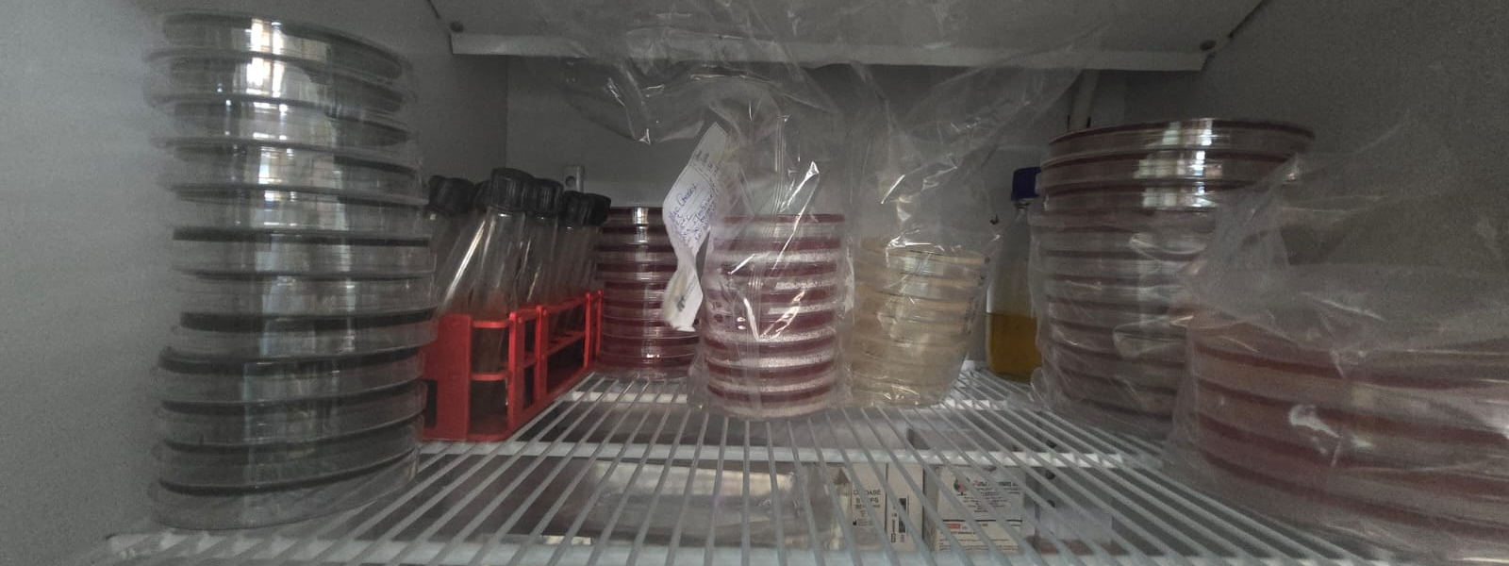
Resources

Slide 41
Aims
Testing is performed with functional, well-maintained equipment and an uninterrupted supply of quality reagents and consumables using standardized testing methods throughout the country.
Adequate numbers of competent, well-trained and motivated technical and managerial staff are available at all levels of the diagnostic network.

Slide 42
Question number: R1
Are standardized quality-assured reagents used at all levels of the cholera diagnostic network?
Notes:
The question relates to the use of standardized quality-assured reagents at all levels of the cholera diagnostic network.
Standardization is the process of setting test menus, reagents, techniques, and laboratory equipment for every level in the laboratory network. Standardization is a policy intervention with supply chain implications.
Quality-assured: Reagents have passed stringent quality control processes to guarantee their effectiveness and reliability in laboratory tests. This means they have been validated for accuracy, sensitivity, and specificity, among other factors.
Verification:
List of standardized reagents and evidence in facilities of compliance.
0
1
2
3
4
5
Nothing is present, recorded, documented.
Standardized reagents are listed for all tests in the tier-specific cholera testing package.
Stage 1 plus Standardized reagents are available for some tests in the tier-specific cholera testing package but are not available to all levels.
Standardized testing reagents are used at all levels in the cholera diagnostic network, with regular monitoring and updating.
Stage 3 and SOPs are available for reporting complaints on quality of laboratory supplies and for corrective actions. Reagents are quality assured by lot verification testing before use.
All laboratories in the cholera diagnostic network operate use approved, standardized quality-assured reagents that can be procured locally or regionally. Contract management capacity for reagents and supply is demonstrated in central laboratories.

Slide 43
Question number: R2
Is there a procurement and distribution system allowing for the continuous supply of testing reagents in the country linked to the national cholera diagnostic network?
Notes:
Relates to the robustness of the system in place for reagent procurement and distribution. Supply of reagents and consumables should be continuous also for remote locations. The system should guarantee that supplies are adequately procured in case of emergency (time and volume). Supplies include materials, consumables, reagents, testing kits, etc. used by both clinical and public health laboratories.
Verification:
Procedure(s) for procurement and forecasting.
0
1
2
3
4
5
Nothing is present, recorded, documented.
Procurement is ad hoc through donations, with ad hoc distribution and storage through MoH. Stock outs and expirations are frequent.
Procurement is through government and donation with a distribution and storage system is in place to the national and regional levels, but stock outs and expirations remain common.
Procurement is through government and donation with a distribution and storage system is in place to the national and district levels, stock outs and expirations are infrequent.
Procurement is through government and donation with a distribution and storage system is in place to the national and district levels, stock outs and expirations are infrequent.
The national procurement system ensures the continuous distribution of all needed supplies with a universal coverage during routine and emergency situations. Expiration and stock outs do not occur. A dedicated supply management system is implemented the system is regularly reviewed and quality controlled.

Slide 44
Question number: R3
Is there a system to monitor and forecast supply consumption of cholera reagents and consumables in the country?
Notes:
This system should address the country or regional level monitoring and forecasting needed to ensure that all laboratories in the diagnostic network have the supplies they need for testing without any delays in testing due to stockouts.
It is crucial that the system captures information on consumption from all levels.
Forecasting is a step higher than monitoring consumption. The system can be centralized or decentralized, national, tier specific or facility based.
Verification:
Procedure(s) for procurement, forecasting and monitoring.
0
1
2
3
4
5
Nothing is present, recorded, documented.
Ad hoc reporting of supplies by facilities when prompted by central level, limited records of inventory are present at the facility.
Individual facilities monitor consumption of some supplies, and the data are compiled and used at the district or higher levels to forecast supply needs.
Individual facilities have inventory monitoring, and the data are compiled and used at the higher levels to forecast supply needs.
Real time supply consumption monitoring and forecasting systems are in place for procurement, storage and distribution of some supplies.
Real time supply consumption monitoring and forecasting systems are in place for procurement, storage and distribution of all supplies and system is regularly monitored.

Slide 45
Question number: R4
Does the country have a standardized list of laboratory equipment required for tiered cholera testing?
Notes:
Equipment is the ensemble of tools needed to perform a task. They can include cutting tools, purification tools, cleaning tools, and instruments. Instruments are scientific devices that measure a physical entity. Standardization is the process of setting test menus, reagents, techniques, and laboratory equipment for every level in the laboratory network. Standardization is not a supply chain intervention; rather, it is a policy intervention with supply chain implications. Enforced means that no equipment that is not on the list is permitted and that controls are taking place.
Verification:
Copy of plan for standardization of equipment, list of standardized equipment, regulation for control of medical devices.
0
1
2
3
4
5
Nothing is present, recorded, documented.
There is a standard list of equipment, but it is not aligned to tier specific requirements.
There is a list of equipment for routine testing, aligned with tier- specific testing requirements, and the national reference laboratory is compliant with the list.
There is standardized list of equipment for routine testing, aligned with testing requirements for all tiers of the laboratory network.
Stage 3 plus the list is enforced in all laboratories in the cholera diagnostic network and is regularly reviewed and updated.
There is standardized list of equipment for routine testing for all tiers of the laboratory network which is enforced and regularly. Contract management capacity for equipment is demonstrated in central laboratories.

Slide 46
Question number: R5
Is there an implemented procedure for pre-service validation of equipment to ensure functionality during cholera testing?
Notes:
All equipment should be verified as fit for purpose prior to being used for testing of patient samples and after equipment repair. This can include equipment regulation and validation by a regulatory body, national approvals and verification of performance in on installation.
Verification:
Protocol for pre-service evaluation and validation reports (both pre-service and in-service)
Laboratory verification records.
0
1
2
3
4
5
Nothing is present, recorded, documented.
There is pre-service validation of some pieces of equipment at the national level.
There is pre-service validation of all pieces of equipment at the national level.
There is pre-service validation of some pieces of equipment at all levels.
There is pre-service validation of all pieces of equipment at all levels of the cholera diagnostic network. Operational validation (in service) is done for some instruments at some levels.
There is pre-service and ongoing validation of all pieces of equipment at all levels of the cholera diagnostic network.

Slide 47
Question number: R6
Is there a maintenance plan (covers spare parts, storage and disposal) for all laboratory equipment at all levels? National guidelines for maintenance should be available. The maintenance plan and allocated budgets may be at the national, regional, or facility level.
Notes:
A maintenance plan should be available for all equipment. Maintenance plan includes planned/preventive maintenance, forecasting for spare parts, tools, replacement equipment as well as schedules designed based on equipment instructions.
Verification:
National maintenance plan, service records, budget allotments and planned equipment purchases.
0
1
2
3
4
5
Nothing is present, recorded, documented.
Ad hoc maintenance and servicing with no defined schedule.
A maintenance or service plan is in place only for essential or sophisticated equipment.
A maintenance plan is in place for all equipment at the national level and some sub-national levels.
A maintenance plan is in place for all equipment at the all levels in the public sector. Contracts and engineers are available at national and regional levels for some equipment.
Stage 4 plus Companies are evaluated, and contracts are reviewed, renewed or replaced. Coverage of all laboratories of the cholera diagnostic network. Engineers are available for all equipment in all laboratories.

Slide 48
Question number: R7
Is there a training program for laboratory management in place?
Notes:
Laboratory managers should receive specific training in laboratory and quality management and should be qualified at master's level or higher.
Verification:
Copies of relevant training curricula and schedules for managers, certification, degrees, evidence of review.
0
1
2
3
4
5
Nothing is present, recorded, documented.
Sporadically, courses on aspects of laboratory management (i.e., leadership course) are available.
Regular courses on aspects of laboratory management are available for upper-level laboratory managers.
A training program for laboratory management at all levels, either separately or as a specialized track in a broader program, is functional.
All of previous and the program(s) is(are) available up to Master (MSc or MBA) programs.
All of previous and the programs are regularly reviewed and updated.

Slide 49
Question number: R8
Are there appropriate technical training program for cholera testing available for all staff conducting tests. This include training on cholera methods, biosafety, biosecurity and quality practices?
Notes:
Relates to the availability and availability of training for all staff at all tiers of cholera network
Verification:
Copies of trainer certification
Copies of relevant training curricula for testing, biosafety, quality, management activities etc. Evidence of review and update.
0
1
2
3
4
5
Nothing is present, recorded, documented.
Pre-service education only on bacteriology methods and general safety and quality methods.
Online or classroom-based training is available for classical methods.
Practical training on cholera testing is available and consists mainly of hands-on practical, in person training on classic and new techniques. includes practical training in cholera-specific aspects quality, biosafety and biosecurity management.
Stage 3 plus Training is customized to meet the needs of the diagnostic tiers, delivered by certified trainers prior to staff performing cholera testing.
Stage 4 plus Trainings in all cholera methods used in the laboratories are regularly reviewed and updated to meet international standards and recommendations with input from the end users.

Slide 50
Question number: R9
Is there a structured procedure in place to ensure competency of all staff conducting cholera testing including competency assessments routinely conducted and documented?
Notes:
Structured standardized procedure for ensuring all staff conducting testing are competent, this includes
competency assessments with clear criteria, pass/fail, performed at a frequency defined by risk and document in personnel files. Program should be able to determine the number of competent staff currently performing testing. Auxiliary functions: includes but not limited to equipment use and maintenance, quality, training and other tasks staff performs contributing to cholera services
Verification:
Competency criteria relevant to staff performing cholera testing and documentation of competence performance, list of staff currently passed competency etc.
0
1
2
3
4
5
Nothing is present, recorded, documented.
Non-standardized competency carried out once on employment for some staff.
Non-standardized competency carried out on an ad hoc basis for staff at some levels, documentation is limited.
Standardized competency procedures are available with clearly defined pass/fail for testing. Not all levels or tests or auxiliary functions are documented.
Assessments of all staff competency on all cholera methods, and auxiliary functions are conducted on a defined period as defined by risk, with clear pass/fail criteria and results documented in personnel files.
All of the before and regular review and updating.

Slide 51
Question number: R10
Is there a national staffing plan for the cholera diagnostic network that is based on workload forecasting that takes into account any anticipated changes in outbreak circumstance?
Notes:
Staffing is the process of hiring, positioning and overseeing employees in an organization. Staffing norms are best based on current and forecasted workload.
Surge capacity: capacity of the laboratory system to expand quickly to respond to increased demand for laboratory services (diagnostic, confirmation, referral, etc.) in the event of a large-scale public health threat.
Verification:
National staffing plan, routine and surge latest inventory of laboratory staff.
0
1
2
3
4
5
Nothing is present, recorded, documented.
There is a national staffing plan, but it is not based on workload forecasting.
A workload forecasting -based staffing plan is being developed.
A workload forecasting based staffing plan is being implemented at some tiers.
There is an implemented staffing plan for all tiers based on workload forecasting.
There is an implemented staffing plan for all tiers based on workload forecasting with procedures for surge capacity.

Slide 52
Question number: R11
Are numbers of different categories of cholera laboratory workers sufficient to cover the workload needs at all levels?
Notes:
The workload need is expressed as ‘full-time equivalents. In laboratories, this need may be filled by several workers who each spend part-time rotations doing cholera testing.
Categories of laboratory professionals include laboratory technicians, technologists, biologists, medical microbiologists, pathologists. Support staff position include laboratory managers, quality officers, biosafety officers, cleaners, drivers, procurement and supply officers. These can be full or part-time functions. Sufficient numbers relate to staffing norms defined by the country. Workload indicator: is a method for calculating number of health workers per cadre based on health facility workload. WHO has developed such a method: the workload indicator of staffing needs.
Verification:
Latest inventory of laboratory staff.
0
1
2
3
4
5
Nothing is present, recorded, documented.
Shortages based on positions available exist for all categories of cholera laboratory workers. Needs based on workloads are not defined.
All positions available are not filled for some categories of cholera laboratory workers or in some districts or at some tiers. Needs based on workload are defined at some facilities or at some tiers.
All available positions are filled but shortages exist based on the workload-based staffing norms.
Positions available are based on workload-based norms and are all filled within a reasonable time.
There is enough of all categories of laboratory workers based on current and anticipated workload and assist during surge capacity needs.

Slide 53
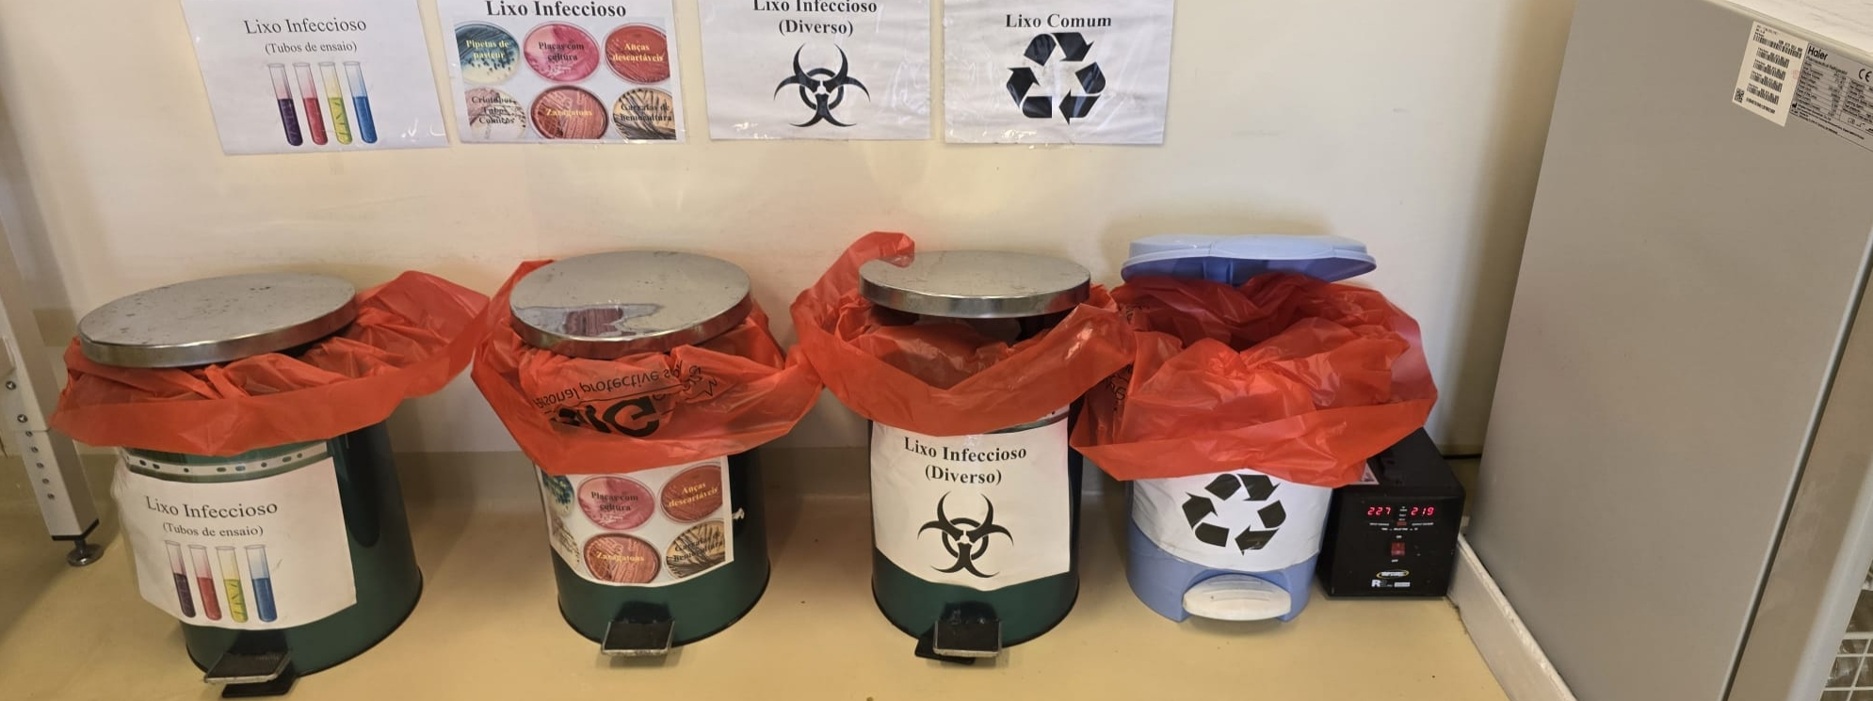
Biosafety

Slide 54
Aims
Testing is performed in facilities that guarantee safety for the staff, the customers, the community and the environment. Sufficient materials, means and skills are available throughout the system to ensure safe and secure procurement, handling, storage, transportation and disposal of samples and materials, both in routine as well as in emergency circumstances.

Slide 55
Question number: B1
Does the biosafety and biosecurity manual cover key requirements for the safe handling of cholera samples (specimens, isolates, strains) based on bio-risk assessment? The requirements may be addressed as part of the national laboratory biosafety and biosecurity manual under bacteriology/ microbiology and does not need to specifically mention cholera, but must detail sufficient controls for appropriate bacteriology level including staff health and vaccinations
Notes:
The manual should address key requirements for the safe handling and use of samples for cholera testing and vibrio cholerae strains. A manual is a book providing guidance and recommendation on best practices regarding laboratory biosafety and biosecurity. Key requirements for the safe handling of biological hazards and safeguarding the laboratory staff and the environment include (1) transportation, (2) handling, (3) testing, (4) containment, (5) biorisk assessment. Biorisk assessment is the process to identify acceptable and unacceptable biosafety risks (risks of accidental infection) and biosecurity risks (risks of unauthorized access, loss, theft, misuse, etc.) And their potential consequences.
Verification: Biosafety legislation, policy and procedures available.
0
1
2
3
4
5
Nothing is present, recorded, documented.
There is a national laboratory biosafety and biosecurity manual, but bacteriology/microbiology concerns are not included.
The manual explicitly addresses bacteriology/microbiology but covers only 1-2 key requirements.
The manual addresses all elements, for both staff safety (biosafety) and the protection of the environment (biosecurity).
Stage 3 and documented risk assessments conducted at facility level.
Stage 4 and the manual is regularly reviewed and updated.

Slide 56
Question number: B2
Is the national laboratory biosafety and biosecurity manual implemented and incorporated into standard operating (SOP) procedures that contain adequate information on cholera laboratory biosafety?
Notes:
The laboratory biosafety manual should be accompanied by separate sops covering all essential components. Sometimes sops are developed before manual is written, but the ideal situation is to have both a manual and sops.
Verification:
Manuals distributed to facilities, testing SOP’s include or refer to safety instructions meeting country regulations.
0
1
2
3
4
5
Nothing is present, recorded, documented.
There is a manual that is out of date with no current SOPs OR there are some out of date SOPs in place with no manual. The manual or SOPS are available in the laboratory, but are not implemented.
There is an up-to-date manual in place with no current cholera SOPs OR some current cholera SOPs are in place with no manual. The manual or SOPS are available in the laboratory and are partially implemented.
There is an up-to-date manual in place, but bacteria/microbiology biosafety and biosecurity are not fully incorporated into current SOPs. The manual and SOPS are available in the laboratory and are fully implemented.
Stage 3 plus bacteria/ microbiology biosafety and biosecurity are fully incorporated into current SOPs and are implemented by laboratories.
All of before and the manual is regularly reviewed and updated at least once.

Slide 57
Question number: B3
Are designated safety officers available in all facilities.
Notes:
Relates to protecting the health and safety of laboratory workers. A designated safety officer is a person who has received official appointment associated with specific tasks explained in a job description. The officer should have received training as needed. The position can be part or full time.
The safety officer functions may be provided be district or regional laboratory advisor who regularly visits (at least quarterly) the laboratory to conduct safety assessments, safety training and consultations. The advisor must be trained in cholera laboratory biosafety and certified as competent.
Verification:
Policy, legislation, terms of reference, job description of safety officer functions safety officer training curriculum schedule or results of safety audits carried out.
0
1
2
3
4
5
Nothing is present, recorded, documented.
Some facilities have a designated safety officer, but they do not have this role formalized in their job description and no formal trainings.
Some Facilities have trained QO, but this is not formalised in their job descriptions.
Some facilities at some tiers of the public sector have trained designated safety officer, with formalized TOR include in their job description and roles.
All facilities at all tiers of the public sector have a designated safety officer with documented training in laboratory safety.
All facilities of the public sector and some private sector have a qualified and designated safety officer who receives regular (e.g., annual) refresher trainings.

Slide 58
Question number: B4
Is there appropriate training available for safety offers (SO)?
Notes:
Laboratory safety officers should receive specific training in biosafety and biosecurity specifically designed for laboratory needs.
Verification:
Policy documents,
Verify training records and history, certification, competence, curriculum and training schedules etc.
0
1
2
3
4
5
Nothing is present, recorded, documented.
Training program is in development.
Sporadically, courses on some aspects biosafety and biosecurity are available, not comprehensive or not available to all QO at all tiers of the system.
Training is available on all aspects of biosafety and biosecurity for safety officers at the higher levels of the network.
A comprehensive training program for biosafety and biosecurity at all levels, either separately or as a specialized track in a broader program, is functional. Competence is evaluated and documented.
All of previous and the programs are regularly reviewed and updated.

Slide 59
Question number: B5
Is safety equipment needed for safely working with cholera/bacteria/microbiology specimens and isolates available and used (e.g., PPE, waste disposal)?
Notes:
The question relates to the availability of the safety equipment recommended by the MoH or cholera program for protection of staff.
Safety equipment: includes but not limited to, masks, gloves, coats, autoclaves, eyewash, spill-kits, first aid kits, sperate waste bins, sharps bins.
Verification:
Policy in safety manual or similar.
0
1
2
3
4
5
Nothing is present, recorded, documented.
Some safety equipment available, but not routinely used.
Basic safety materials, PPE and waste bins are available at all levels.
All safety equipment according is available and properly used by some laboratory workers.
All safety equipment according to national guidelines is available and properly used by all laboratory workers at all levels.
All staff are trained to use all safety equipment, all materials are available and properly used by all laboratory workers at all levels and regularly monitored and replaced when expired.

Slide 60
Question number: B6
Are standardized procedures for collecting, storing and disposal of identified categories of waste available and implemented according to the national standards?
Notes:
Categories of waste include: 1) infectious waste, 2) chemicals, 3) sharps, pharmaceuticals, 4) genotoxic waste, and 5) non-hazardous or general waste. (http://www.who.int/mediacentre/factsheets/fs253/en/) the disposal of different categories of waste needs to be treated differently. Disposal of sharp containers should be particularly examined. Waste management can be monitored by checking the quantity of waste, the proportion that is appropriately separated, the duration of waste disposal from the site, the disposal of particularly hazardous waste.
Verification:
National waste management policy.
0
1
2
3
4
5
Nothing is present, recorded, documented.
National standards or standardized procedures for collecting, storing and disposal of identified categories of waste have been developed, but not implemented.
National standards or standardized procedures for collecting, storing and disposal of identified categories of waste have been implemented in some facilities at some tiers of the cholera diagnostic network.
National standards or standardized procedures for collecting, storing and disposal of identified categories of waste have been implemented in all facilities at all tiers of the cholera diagnostic network.
Stage 3 and conformance to waste management is partially monitored in accordance with level-specific biosafety and biosecurity requirements.
Stage 4 and waste management conformance is fully monitored in accordance with level-specific biosafety and biosecurity requirements in all facilities of the cholera diagnostic network.

Slide 61
Question number: B7
Do laboratories have access to methods and equipment (e.g., Autoclaves or incinerators) for safely disposing of infectious waste?
Notes:
Infectious waste: waste contaminated with blood and other bodily fluids cultures and stocks of infectious agents from laboratory.
Autoclave controls: refer to the use of live microorganisms, typically bacterial spores, to verify that the autoclave is effectively sterilizing equipment.
Where RDTs are used at community level, correct waste management also applies.
Surface burning: burning waste materials directly on the ground in an open area. It’s generally not recommended.
Brick incinerator: a brick incinerator is a simple, low-cost incinerator constructed from bricks. It is designed to burn waste at high temperatures, reducing it to ash, more controlled than surface burning.
Hospital incinerator: Advanced and controlled system designed specifically for the safe disposal of medical and laboratory waste. It operates at high temperatures with advanced filtration systems to minimize the release of harmful emissions, ensuring the complete destruction of hazardous materials
Verification:
Review equipment lists for autoclaves/ incinerator
Verify with laboratories.
0
1
2
3
4
5
Nothing is present, recorded, documented.
There is waste disposal, but separation of waste is not sufficient, autoclaves/ burning is not monitored, equipment is not maintained
Laboratories separate waste, however, autoclaves are not maintained/ cleaned after waste, and/or incinerators are not maintained, or waste is surfaced burned.
All laboratories separate waste appropriately, autoclaves are routinely used to sterilize infectious waste, brick incineration or higher is routinely used.
All laboratories have access to clean and dirty autoclaves and functioning maintained controlled incinerator systems.
Stage 4 plus all waste disposal is documented by date and autoclave controls are routinely performed and recorded with review and action.

Slide 62
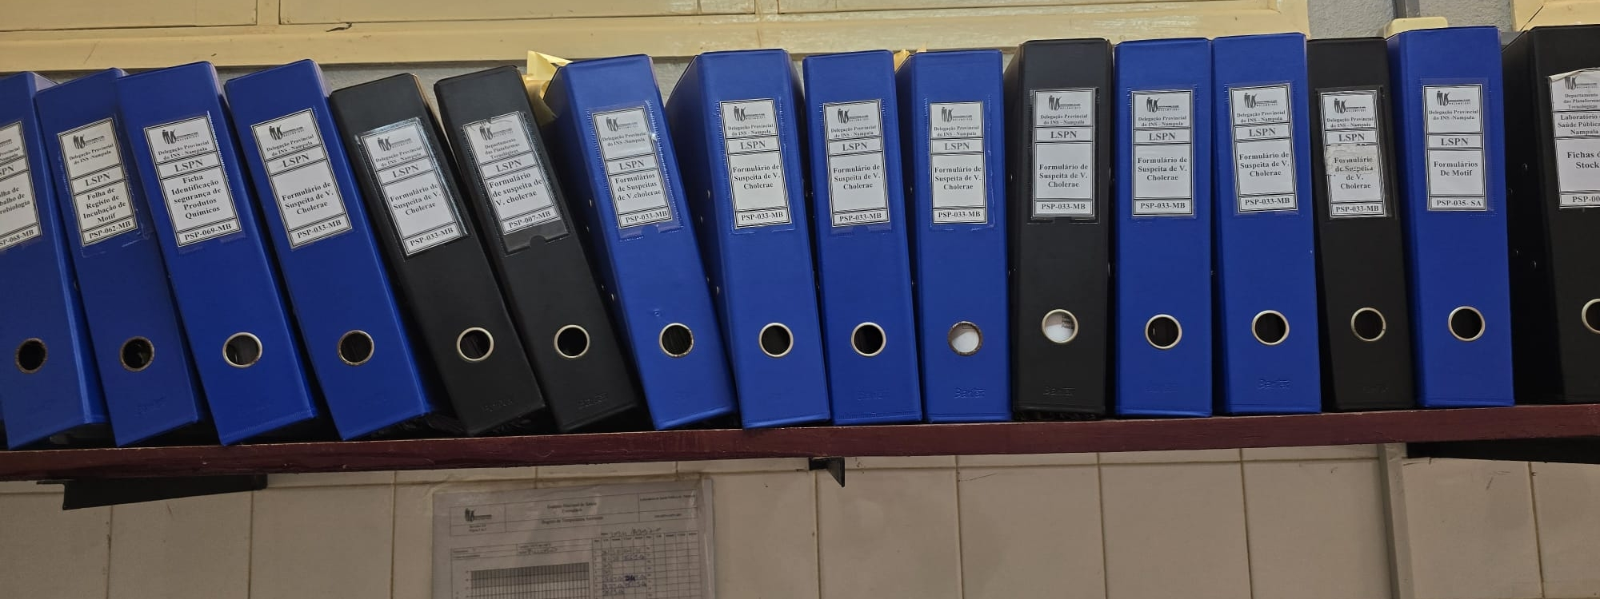
Data management

Slide 63
Aims
A streamlined system ensures that results are reliably recorded and reported, with a focus on standardization. These results are promptly communicated to national surveillance efforts. Notably, any positive findings are swiftly flagged to bolster nationwide monitoring efforts.

Slide 64
Question number: D1
Is there a fully functional cholera data unit that collects and merges laboratory testing data with epidemiological data.
Notes:
The data unit may be within the cholera program, MoH or as a separate unit, but have documented roles and responsibilities as well as dedicated trained staff. A fully functional data unit is equipped with the necessary infrastructure and technology, to collect, combine, analyze laboratory and surveillance data to make programmatic decisions to support cholera control.
Verification:
Data unit roles and responsibilities
Staffing records, training or competency records, data records, data system manuals, budget lines etc.
0
1
2
3
4
5
Nothing is present, recorded, documented.
An ad hoc system is in place, possibly using manual methods or inconsistent digital tools. A few staff members are informally involved but lack clear roles, responsibilities, or training. Integration of laboratory and epidemiological data is minimal or nonexistent.
A basic data unit is established with foundational infrastructure. Some staff are designated with specific roles and responsibilities, but training is limited. Data collection occurs regularly, but integration between laboratory and epidemiological data is still fragmented, leading to incomplete insights.
A functional data unit is operational with trained staff who have clearly defined roles and responsibilities. Both laboratory and epidemiological data are regularly collected and systematically integrated.
The data unit is well-developed, with staff receiving regular training and clearly understanding their roles and responsibilities. Data integration is strong, with minimal gaps. The unit’s infrastructure and processes are robust, and data is consistently accurate and timely.
The data unit is fully optimized, with highly trained staff who are experts in their roles and responsibilities. The unit utilizes cutting-edge technology and best practices, achieving seamless integration of laboratory and epidemiological data. The data is comprehensive and real-time.

Slide 65
Question number: D2
Is there evidence that policies have been communicated, shared and implemented to all levels of the health care system?
Notes:
If question L7, there is no published or correctly aligned guidelines or policy then score cannot be higher than 2
Program should monitor completeness of data and have records to demonstrate all facilities communicate all data on time
Verification:
Procedures that reflect the policy,
Personal training records or curriculum, or demonstrated staff knowledge and adherence to the policy. Verify policy is available with laboratories.
Routine reports from all facilities, tracking of reporting.
0
1
2
3
4
5
Nothing is present, recorded, documented.
Ad hoc, vague or limited indication of policy communication, sharing, or implementation.
Some evidence of policy communication, but training of staff at lower tiers is not documented. Some data is communicated at higher tiers, but not all required data shared consistently or lacking comprehensive coverage across all network.
Evidence of policy communication, and staff education, but not all tiers comply fully with the policy (30-60%).
Policy has been shared and training completed at all levels of network, all tiers communicate some of the data (60-90%) routinely without being asked.
Data sharing and completeness is routinely monitored, Training of sites is regularly updated, with evidence that all tiers share data on time. <95% of data ensuring complete coverage and seamless integration throughout the network.

Slide 66
Question number: D3
Are test request forms standardized based on the national policy for all levels of cholera testing, and being used at all levels throughout the country?
Notes:
Relates to the standardized reporting of diagnostic results. Standardized forms should be available from the national program and be aligned with minimum GTFCC guidelines and cover all tests available for request with appropriate epidemiological information.
Request forms can paper based or through electronic request.
Request forms may include inter-laboratory referral for additional testing where this is implemented.
Epidemiological information: Patient details, location, reason for request, results of previous tests performed etc.
Verification:
Copies of request forms/line lists.
0
1
2
3
4
5
Nothing is present, recorded, documented.
There is a standardised request form in development, but not yet approved or shared, or approved forms do not cover all tests or data required for requests.
Standardised request forms are approved and cover culture and identification but might miss RDT or molecular. Forms are available and used in some tiers or regions but not all.
Standardised request forms are approved and cover all tests in all tiers with all epidemiological data required to request tests. Forms are used for most requests.
Stage 3 and the request forms are fully used at all levels. Epidemiological data is always completed and used in the testing process.
Stage 4 and request forms are regularly reviewed. Data on test request forms are captured and regularly reviewed and analyzed for improved implementation.

Slide 67
Question number: D4
Are reporting forms for all cholera tests standardized based on the national policy for all levels of cholera testing, are they being used at all levels throughout the country? Is verification of results reporting routinely completed?
Notes:
Relates to the standardized reporting of diagnostic results. Standardized forms should be available from the national program and be aligned with minimum GTFCC guidelines.
Report forms can paper based or through electronic systems
Results from all tests performed, including negative results should be clearly reported and results should be unambiguous i.e. indicating a positive result from which test performed and report not done, rather than leave blank A system should be in place for results quality control, to determine the completeness and accuracy of results reported.
Verification:
Copies of reporting forms/line lists.
0
1
2
3
4
5
Nothing is present, recorded, documented.
There is a standardised reporting form in development, but not yet approved or shared, or approved forms do not cover all tests or results or are ambiguous.
Standardised report forms are approved and cover culture and identification but might miss RDT or molecular reporting, or results reported are ambiguous. Forms are available and used in some tiers or regions but not all or reports only returned to requester/data unit not both.
Standardised reporting forms are approved and cover all tests in all tiers with all results clearly indicating which methods were used. Forms are routinely returned to requester and surveillance data unit.
Stage 3 and the report forms are fully used at all levels. All results information data is always completed and unambiguous.
Stage 4 and report forms are regularly reviewed. Data on test report forms are captured and regularly reviewed and analyzed for improved implementation.

Slide 68
Question number: D5
Is the number of suspected cases tested by RDT, culture and/or PCR each week available and used to direct the cholera response?
Notes:
Relates to the rapid reporting of data and actions taken for program management.
Verification:
National data reports for most recent period of testing.
0
1
2
3
4
5
Nothing is present, recorded, documented.
Data is only available from a few high-level sites or is not reported in a timely manner and is inadequate to direct the response in real-time.
Data is available from mid and high-level sites, but not for all tests, however it is not routinely reviewed in context to adapt the response to the needs.
Data is available from most levels of cholera network, review if conducted but not routinely or doesn’t inform response in timely manner.
Data is available from all levels of cholera network, and action taken on latest numbers, but not reviewed in context so is reactionary rather than forecast.
Aggregate number of suspected cases, presumptive cases and confirmed cases are routinely monitored and reviewed with actions and feedback given based on aggregated reports.

Slide 69
Question number: D6
Are aggregate reports reviewed and used to routinely provide feedback to laboratories at regional level/ district level/ facilities/ community to implement improvements?
Notes:
Relates to the rapid reporting of data and actions taken for program management.
Feedback to sites can include verbal, through reports, electronic communications but should be routine and supportive to improve services.
Verification:
National data reports, schedule of completion, examples of feedback to laboratories, logs, planning documents showing actions taken based on aggregate data etc.
0
1
2
3
4
5
Nothing is present, recorded, documented.
Data is further aggregated reviewed for accuracy, timeliness or completeness on an ad hoc basis i.e. for reports but with no feedback provided to improve.
Data is sometimes aggregated, but not following a schedule, data is not reviewed for accuracy, timeliness or completeness with no feedback provided to sites.
Data is further aggregated routinely and is reviewed for accuracy, timeliness or completeness with sporadic feedback provided to sites, but not as routine.
Data is further aggregated and is reviewed, and feedback routinely given to all levels. Data is also analyzed for trends and forecasting with feedback to sites with evidence of action taken.
Reports are continuously generated from data, monitored with appropriate feedback and actions taken and communicated to the facilities to ensure continuous improvement of cholera surveillance.

Slide 70
Question number: D7
Does the national program have documented policy/guidelines on the selection, implementation and use of electronic systems within the cholera surveillance program. This should include: - selection of relevant electronic systems, - budgeting for online system at all levels, - training of staff to use the selected system at all levels, - maintenance and update of the system at all levels, - contingency planning for downtime, - review of data collected, - backup and storage of data in a secure and confidential manner.
Verification:
Selection criteria and scoring of current electronic system,
Request for proposal for electronic systems (RFP)
Notes:
This is only applicable where electronic systems beyond excel and emails are in use for data requests or reporting.
Relating to how selection of all implemented connectivity systems were chosen based on programs needs and criteria to ensure fit for purpose systems were chosen. Existing systems should also be evaluated based on current needs to identify gaps and potential to improve.
0
1
2
3
4
5
Nothing is present, recorded, documented.
Policy, guidelines, procedures and SOPs for selection and implementation connectivity and remote monitoring are in development.
Policy, guidelines, procedures and SOPs for selection and implementation connectivity and remote monitoring have been developed, approved and cover at least 3 of the minimum requirements adequately for successful deployment.
Stage 2 plus covers all minimum functions. All systems in use have been evaluated according to the criteria and scored above 50% with documentation.
Stage 3 plus selected systems all scored above 80% with documentation.
Systems selected by the program fulfil all programmatic selection criteria with extensive documentation. review of guidelines and criteria has been completed at least once.

Slide 71
Question number: D8
Have data fit for purpose connectivity solutions been communicated and implemented at all levels of the cholera diagnostic network to support surveillance request or reporting of tests?
Verification:
Copies of training materials for all connectivity systems in use within the cholera laboratory network. SOP’s personal training records or curriculum, or demonstrated staff knowledge and adherence to the policy.
Notes:
If system doesn’t fill the needs of the program (D7 score 3 or higher) then cannot score above 2 as no matter how well-trained staff are on operation the system doesn’t generate the needed information for the program.
0
1
2
3
4
5
Nothing is present, recorded, documented.
Policies, procedures, training and SOPs for connectivity and remote monitoring are in development. Connectivity may or may not have been implemented prior to development of materials.
Policies and materials are developed and approved. Diagnostics connectivity solutions have been implemented in some laboratories in the cholera diagnostic network however Sops/trainings have not been communicated.
Diagnostic connectivity solutions have been implemented in most laboratories in the cholera diagnostic network with training of some operators.
Stage 3 plus all operators trained, with demonstrated competency.
Stage 4 plus at least 1 review and update of policy, procedures and materials.

Slide 72
Question number: D9
Does the selected electronic system support the reporting of cholera laboratory data to the cholera surveillance unit providing easy access aggregation quality indicators (e.g., Test statistics or key performance indicators, TAT etc.)
Notes:
Relating to the implementation and use of data generated from all levels of the laboratory cascade to aggregate and simplify national level review and reporting.
Verification:
Copies of reports generated by the electronic system, dashboards.
0
1
2
3
4
5
Nothing is present, recorded, documented.
Electronic reporting is implemented but has significant down-time in some or all facilities or data does not capture KPI for review.
Electronic reporting is functional in some or all facilities, but data is not aggregated, or KPI are not available for review.
Electronic reporting is providing timely and complete data, but reports and dashboards must be manually created i.e. in excel from line lists.
Electronic reporting in dashboard or report formats is available to the national level for review of facility KPI with limited manual input.
Electronic reporting is fully functional with no manual inputs required at all levels in the cholera diagnostic network providing easy to access and interpret aggregate reporting of all cholera KPI.

Slide 73

Quality

Slide 74
Aims
The network maintains high-quality diagnostic services specialized in cholera testing, ensuring the accuracy and reliability of results. Continuous improvement efforts are directed at all network facilities, encompassing monitoring of quality indicators, external quality assurance, and regular onsite supervision.
Moreover, a national certification system is established for all laboratories within the network, specifically focusing on reference and referral level labs, which are accredited according to cholera-specific (inter)national standards.

Slide 75
Question number: Q1
Do all the documents and procedures required to ensure the quality of the cholera diagnostic network and testing exist and are they accessible at all testing sites (e.g., National cholera diagnostic algorithm, test requisition forms, recording and reporting forms, quality indicator reporting forms, corrective action forms, etc.)?
Notes:
Documentation must address activities throughout the diagnostic cascade. A document control system is needed to ensure regular review of quality documents (e.g., Sops) and to ensure the correctness of the documentation that support laboratory testing. • Standardized documents, records and forms should be developed at the national level and distributed to all testing sites. • Management and systems SOPs, forms, documents and records must be up-to-date, accurate, customizable and readily accessible at all testing and participating clinical sites. •Quality systems maybe managed by a separate department, but the cholera program must have insight and input into cholera specific requirements
Verification:
Quality management documentation including cholera specific algorithms, SOPs, forms, quality/key indicator reporting, corrective action form Verify availability of the necessary quality documents and a document control system at all levels of the diagnostic network.
0
1
2
3
4
5
Nothing is present, recorded, documented.
A national quality framework is under development but has not been approved, published but some documents and forms are available in an ad-hoc manner i.e. approved reporting forms.
A national quality framework is approved which includes at least 50% of all documents, records, procedures required for a quality system.
Stage 2 plus all cholera specific documents are correct, detailed, available and implemented at all national and regional sites.
Stage 3 plus documents available and implemented to the community level.
Stage 4 plus regular review and updating of documents with refresher training of staff.

Slide 76
Question number: Q2
Do national SOPs exist for all cholera diagnostic technologies and procedures within the network and are they customizable and accessible at all testing sites?
Notes:
Relates to the availability of SOPs to ensure the quality and uniformity of cholera diagnostic procedures in all laboratories. The national program should develop template SOPs and ensure they are distributed to, reviewed and customized appropriately by all laboratories in the diagnostic network.
All SOPs must be aligned to GTFCC testing recommendations, refer to appropriate controls and standards for all methods.
Auxiliary SOP’s: Includes methods for maintenance of equipment used in testing, media preparation, good laboratory practice for temperature monitoring, cleaning, waste disposal etc.
Verification:
National testing advise provided to facilities, distribution lists. verified in facilities
0
1
2
3
4
5
Nothing is present, recorded, documented.
National SOPs for testing methods and auxiliary methods are under development. Sop’s available in labs are not-standardised or are incorrect.
National SOPs for testing methods are developed, distributed but are not customisable by the laboratory so the laboratory cannot fully implement the SOP according to their situation, or are missing key point such as adequate controls.
National SOPs for testing method and auxiliary are developed, aligned with GTFCC, contain all relevant controls and standards, distributed and customisable, but labs have not made customisations, or have removed key areas.
Stage 3 plus all labs have customized and implemented correctly based on GTFCC testing with adequate controls and standards for methods and auxiliary procedures.
Stage 4 plus all SOPs have been revised at least once.

Slide 77
Question number: Q3
Has the national program defined and communicated minimum quality indicators to monitored and evaluated performance of all cholera tests at all levels of the network?
Verification:
National level has determined and communicated minimal quality (performance) indicators: number of tests performed, number of positive tests, number RDTs confirmed by culture, no growth, discordant results, requesting facilities, time for transportation, time to results time to report to surveillance unit, etc.
Notes:
KPI: Key performance indicators, also called quality indicators
KPI should cover pre-analytical, analytical, post analytical areas with an aim to identify potential problems and ensure all aspects of testing are working as expected
KPI should have acceptable ranges set
KPI should be revised to ensure they are still useful, or to update critical action points
0
1
2
3
4
5
Nothing is present, recorded, documented.
Programmatic KPI are in development.
KPI are defined with acceptable ranges customisable by facility, KPI cover 50% of key areas of cholera diagnostics. Some facilities report KPI some of the time.
Stage 2 plus, KPI cover all areas, facilities have set acceptance criteria based on risk, facilities routinely collate their indicators.
Stage 3 plus indicators are routinely communicated to national level from all tiers, KPI are analysed and used locally to improve services.
Stage 4 plus national level used KPI to improve services at all levels. KPI have been revised at least once.

Slide 78
Question number: Q4
Do all laboratories have appropriate risk based internal quality controls in place for all cholera tests?
Notes: Internal quality control analysis of control materials alongside the test materials under examination, especially AST controls with every batch. This includes controls for auxiliary activities which impacts testing, such as autoclave sterility, testing of reagents, media sterility and biochemical activities.
Additional controls must be run after adverse events such as reagents storage fluctuations and when using out-of-date reagents.
Verification:
Review the national policy/guidance Review IQC results within the laboratory.
0
1
2
3
4
5
Nothing is present, recorded, documented.
Limited controls are in place at some facilities or action is not taken when controls are out of range.
Ad hoc controls are implemented in culture laboratories, results are not fully documented, limited evidence of action based on results.
Standardized internal quality controls are included for all cholera tests in most facilities in the cholera diagnostic network, including RDT, culture and molecular.
Control materials are well characterized, conducted for all tests and reagents. Results are recorded in a manner that can be linked back to an individual test. There is evidence of action based on out-of-range controls. Additional controls are done in response to laboratory events.
Stage 4 Appropriate ATCC control strains are available and well maintained. cholera tests are reviewed to detect and correct trends.

Slide 79
Question number: Q5
Are there national EQA programs in place for all cholera diagnostic tests at the different tiers and performed to a satisfactory level? Do reference laboratories participate in international EQA (internationally certified/or accredited EQA -ISO 17043) programs where available?
Notes:
Relates to the periodic monitoring of test quality and accuracy through blinded testing, rechecking or blinded comparisons. EQA: external quality assurance consists of blinded rechecking, proficiency testing or interlaboratory exchanges. EQA program maybe an accredited program, or other locally supported program which is carried out on a set schedule, sufficient data analysis of participating facilities results provided in a timely manner. Laboratory must show evidence of review of results and acting to improve results regardless of the final score.
Verification:
Policy or appropriately implementation EQA programs for microbiology conducted at all laboratories performing cholera testing. Verify results at laboratories.
0
1
2
3
4
5
Nothing is present, recorded, documented.
There is a draft/planned EQA program, but it has not been approved or implemented.
An EQA program for bacteriology and/or molecular tests is available and all facilities participate, but less 50% of labs pass the EQA, feedback and corrective actions are limited.
Step 2, over 75% pass, feedback is always received and acted on.
Step 3 EQA covers all cholera testing, plus over 90% of labs pass EQA, action is taken where results are discordant with evidence of improvement over time.
Stage 4 plus the EQA programs are internationally recognized through EQA- ISO17043, All labs have passed or taken corrective actions over past year.

Slide 80
Question number: Q6
Is there a formal system of supportive supervision within the cholera diagnostic network? - Provide corrective and supportive feedback on performance to the laboratory worker. - Provide updates on technical guidelines etc.
- Identify opportunities for improvement and on-site training. - Review of quality indicators, results of PT, and corrective actions.
Notes:
A system of supportive supervision is an essential element for ensuring quality throughout the diagnostic network. Supportive supervision: - provision of corrective and supportive feedback on the performance is given to the trained laboratory worker. - Updates on the technical guidelines etc.
- Identification of opportunities for improvement in the laboratory setting and on-site training. - Review of quality indicators, results of PT, and corrective actions.
Verification:
Review the NRL plan for visits, reports from previous months, action plans for improvements, verify with laboratories.
0
1
2
3
4
5
Nothing is present, recorded, documented.
There is a draft/planned supervision program, but it has not been approved or is not implemented.
System of supervision defined but not routinely implemented. Ad hoc supervisions are organized in case of problems.
Supervision elements routinely implemented only from the reference laboratory to the rest of the network at least 2 times per year.
Selected supervision elements decentralized and routinely implemented from the higher to lower facilities at least 2 times per year with detailed reports.
Stage 4 plus Visits occur at least quarterly, or based on risk assessment, with a system implemented to record visits, monitor occurrence, determine reoccurring issues at all levels including RDT facilities.

Slide 81
Question number: Q7
Is the position of quality or quality assurance officer filled in in each laboratory? (Part-time or full-time)
Notes:
A quality officer (QO) should be appointed to lead quality efforts at each facility. The QO should have a job description which includes quality activities The QO should be indicated clearly on the facility algorithm This role doesn't have to be a dedicated role in smaller facilities, hospital quality team can also fill this role as long as the activities are sufficient within the laboratory
Verification:
Policy, legislation, terms of reference, job description of safety officer functions safety officer training curriculum schedule or results of safety audits carried out.
0
1
2
3
4
5
Nothing is present, recorded, documented.
There is no official job description or role in the programmatic organogram, but sites may have a person fulfilling the duties.
There are official job descriptions and QO is an official position within the organogram. Most facilities at all tiers have a designated quality officer.
The QO position is included in the staffing organogram and has clearly defined role and responsibilities documented in a job description. There are QO in all facilities. The quality officer undertakes some quality activities, mostly around documentation.
All facilities have a qualified, trained quality officer. The quality officer leads regular meetings (monthly or quarterly) to address quality issues within the facility.
Stage 4 plus the quality officer has documented competency and qualifications, receives regular refresher trainings.

Slide 82
Question number: Q8
Is there appropriate training available for quality managers?
Notes:
Quality officers should be trained on specific aspects of quality management system implemented in the program. Training should cover the 12 quality system essentials: 1) organization, 2) personnel, 3) equipment,(4) purchasing & inventory, 5) process control, 6) information management, 7) documents and records, 8) occurrence management, 9) assessment,(10) process improvement, 11) customer service, and 12) facility and safety. Reference: WHO quality management system: handbook Training should be documented, have a competence evaluation and regular refreshers given to update new approaches.
Verification:
Policy documents,
Verify training records and history, certification, competence, curriculum and training schedules etc.
0
1
2
3
4
5
Nothing is present, recorded, documented.
A QO training program is in development.
Sporadically, courses on some aspects of quality management are available, not comprehensive or not available to all QO at all tiers of the system.
A comprehensive training program for quality management at all levels, either separately or as a specialized track in a broader program, is functional. Competence is evaluated and documented.
All of previous and the program(s) is(are) available up to Master (MSc or MBA) programs. Refresher training is provided on schedule.
All of previous and the programs are regularly reviewed and updated.

Slide 83
Question number: Q9
Are quality management activities implemented in all laboratories providing cholera testing?
Notes:
The quality management system addresses 12 quality system essentials
Regular internal/external audits provide a structured score to monitor progress Regular meetings (monthly or quarterly) should be held to address quality issues and should be led by the quality officer or management. QMS implementation tools include the GLI stepwise process towards laboratory accreditation and SLMTA. ISO 15189 enrollment and certification.
Verification:
Policy documents,
Certification or enrollment into quality programs
Quality program score from internal/external audits
Tools or guidelines used to implement quality management activities. Meeting minutes, improvement projects, Non-conformity, corrective actions etc.
0
1
2
3
4
5
Nothing is present, recorded, documented.
Some quality aspects, but not according to a structured approach.
Only in reference laboratories using a structured approach with QMS implementation tools (e.g. GLI, LQSI, LQMS, SLIPTA, SLMTA, mentoring).
National and regional laboratories are enrolled in a quality program and have achieved 2 or more stars, with active signs of quality management as part of daily activities. At least quarterly meetings are held by the QO to discuss quality issues.
Stage 3 plus SLMTA program (or similar) has been completed, national and regional laboratories have been certified with 4 or more stars, quality program instigated in district and community facilities with active signs of quality management as part of daily activities.
Stage 4 plus ISO 15189 accreditation has been achieved and quality is fully implemented in at least the national facility.

Slide 84
Next steps
Complete excel spreadsheet.
Conduct laboratory visits.
Compile verification tables from laboratory visits.
Review initial national scores and adjust based on evidence of implementation gathered in laboratory visits.
Conduct prioritization and impact assessment.

Slide 85

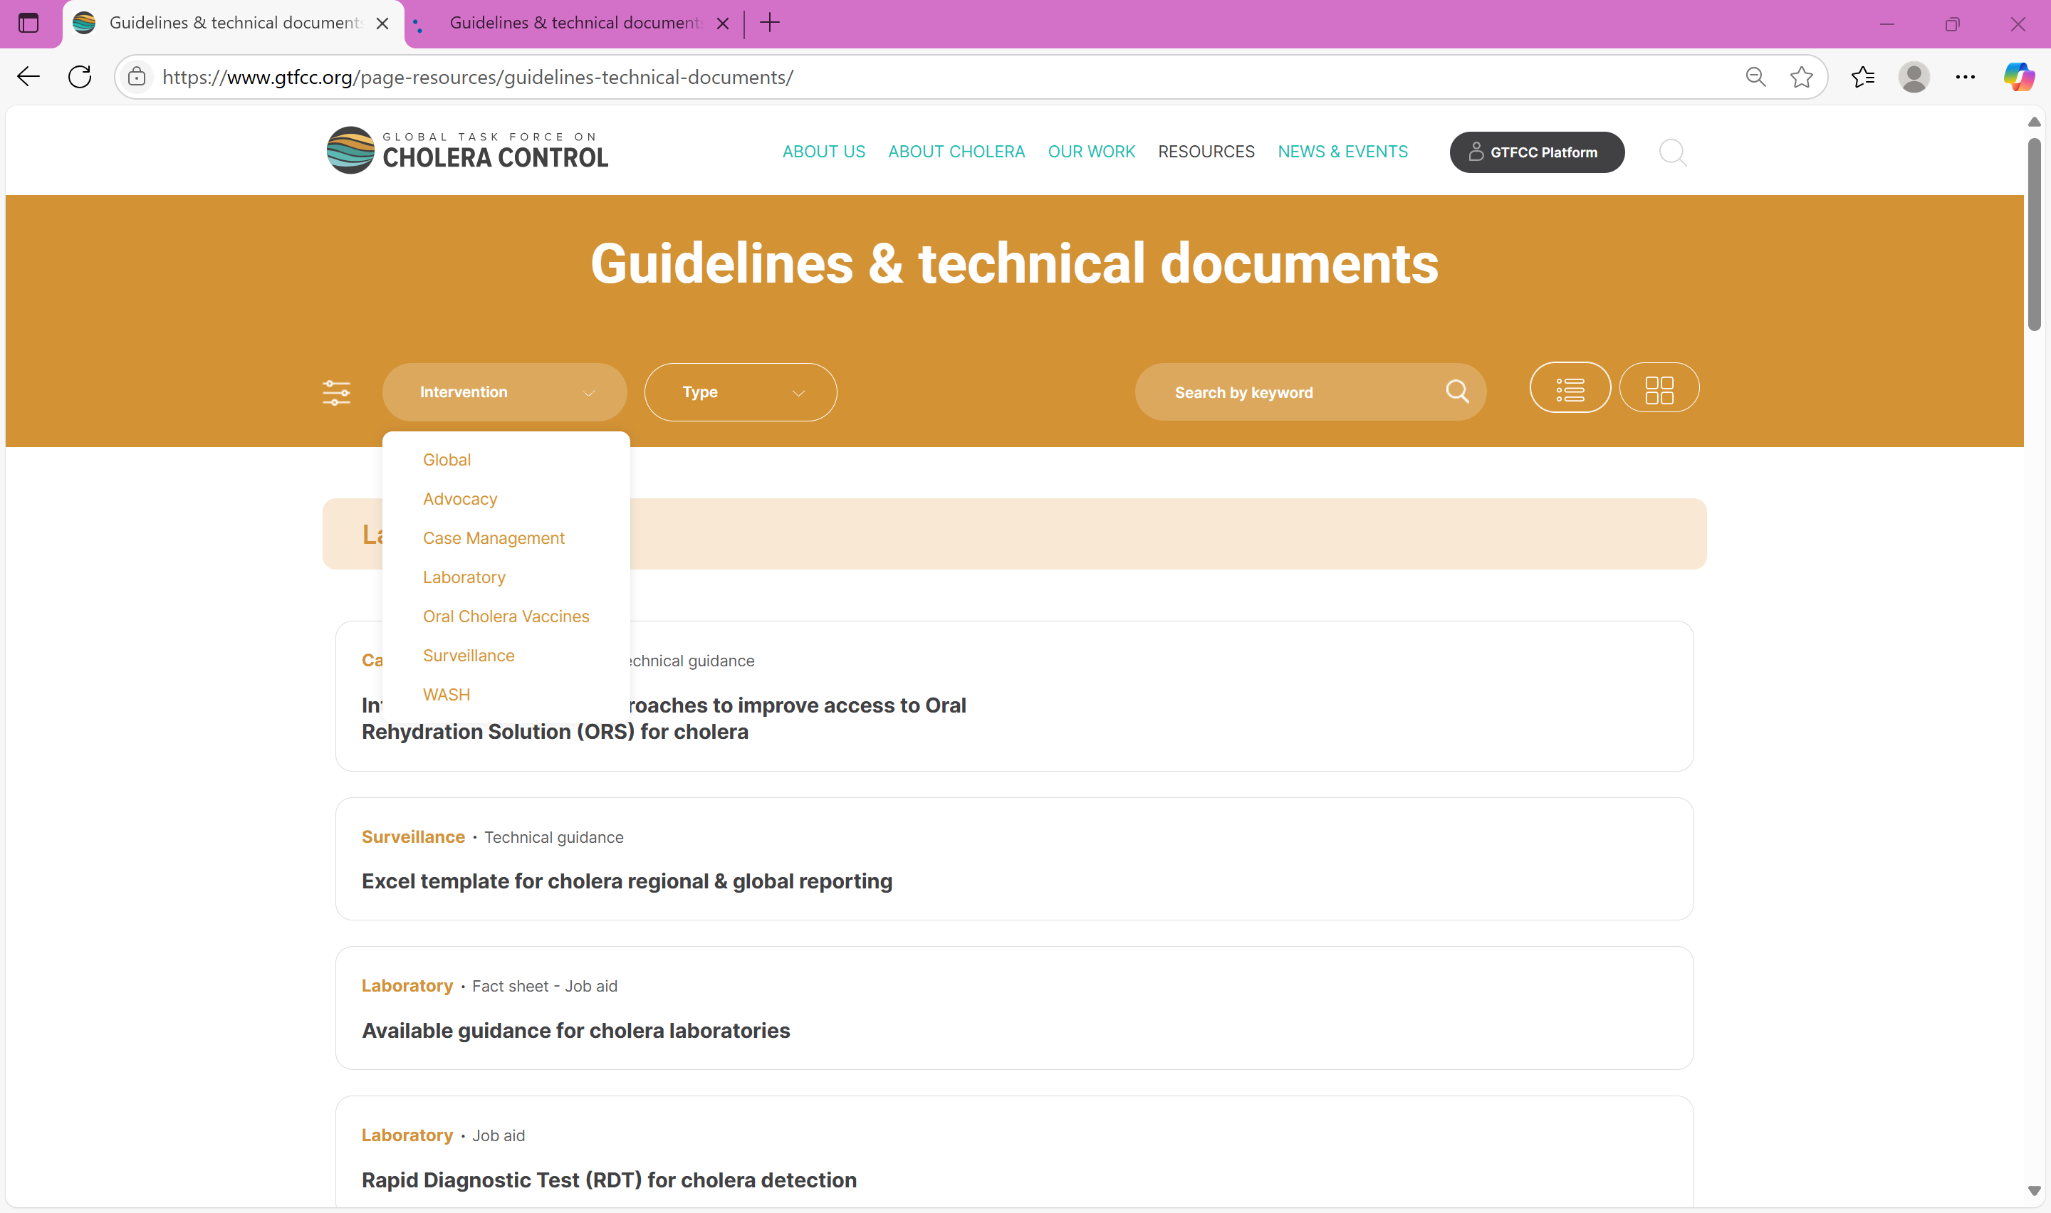

GTFCC support materials
Guidance document - https://www.gtfcc.org/resources/public-health-surveillance-for-cholera/
https://www.gtfcc.org/page-resources/guidelines-technical-documents/
https://www.gtfcc.org/cholera-app/

Slide 86
THANK YOU!

