Slide 1
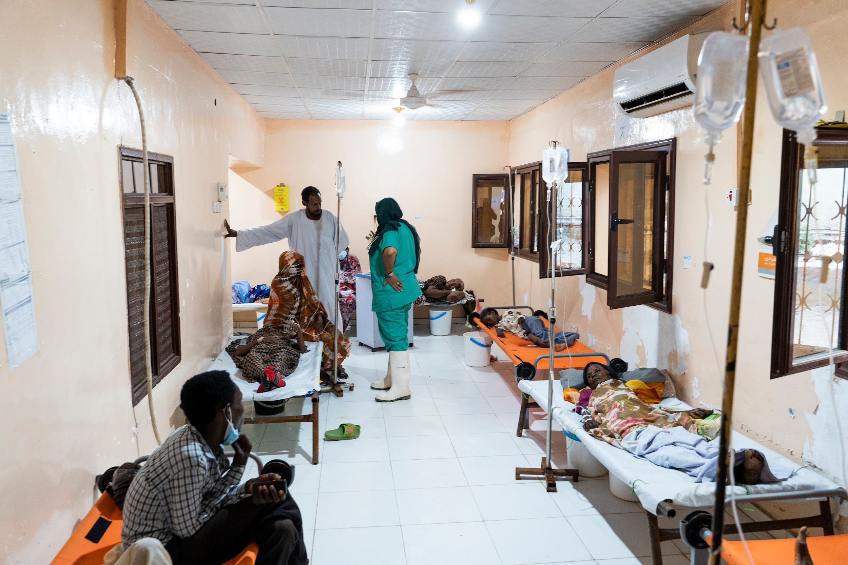

© WHO / Ala Kheir
Recomendações do GTFCC
MÓDULO 1: INTRODUÇÃO À CÓLERA E TESTES DA CÓLERA
V1.1 outubro de 2025
Notes:
Let’s start with our first module, an introduction to cholera and testing for cholera.

Slide 2
Objetivos da aprendizagem
Descrever o que é a cólera e as suas causas
Definir um caso suspeito de cólera
Descrever as circunstâncias em que o teste da cólera é recomendado e porquê
Identificar os tipos de métodos utilizados para testar a cólera
Notes:
By the end of this module, you should be able to
Describe what cholera is and what causes cholera
Define what is a cholera suspect case
Describe the circumstances in which testing for cholera is recommended and why
And finally identify the types of methods used for testing for cholera

Slide 3
Esboço
1
Introdução
2
Introdução ao teste da cólera
3
Avaliação de fim de módulo
Notes:
This first module includes an introduction to cholera followed by an introduction to testing for cholera with a brief quiz to test your new knowledge.

Slide 4
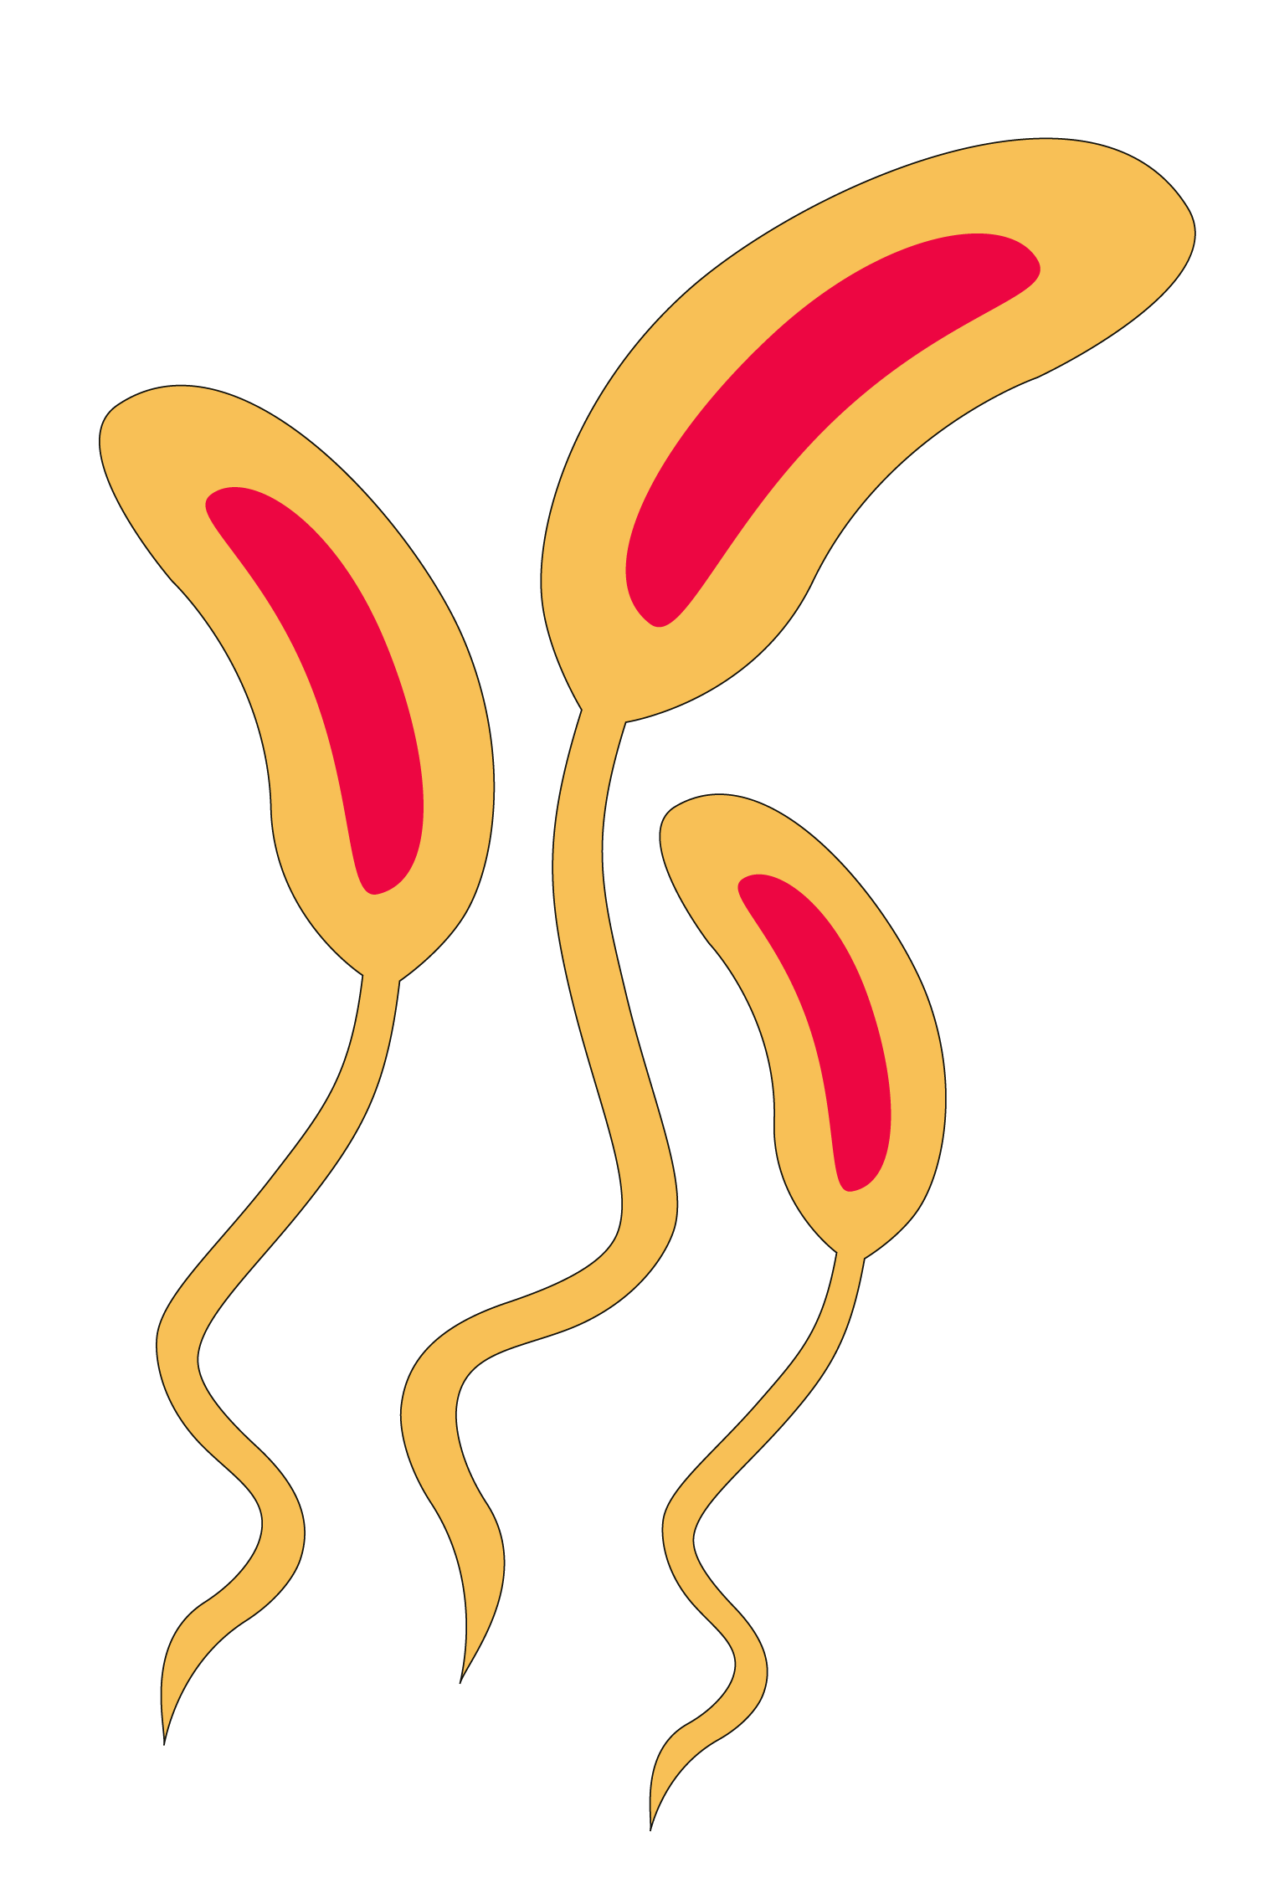
INTRODUÇÃO À CÓLERA
Notes:
Introduction to cholera: Here we will talk about cholera the disease and the bacteria which causes the disease.

Slide 5
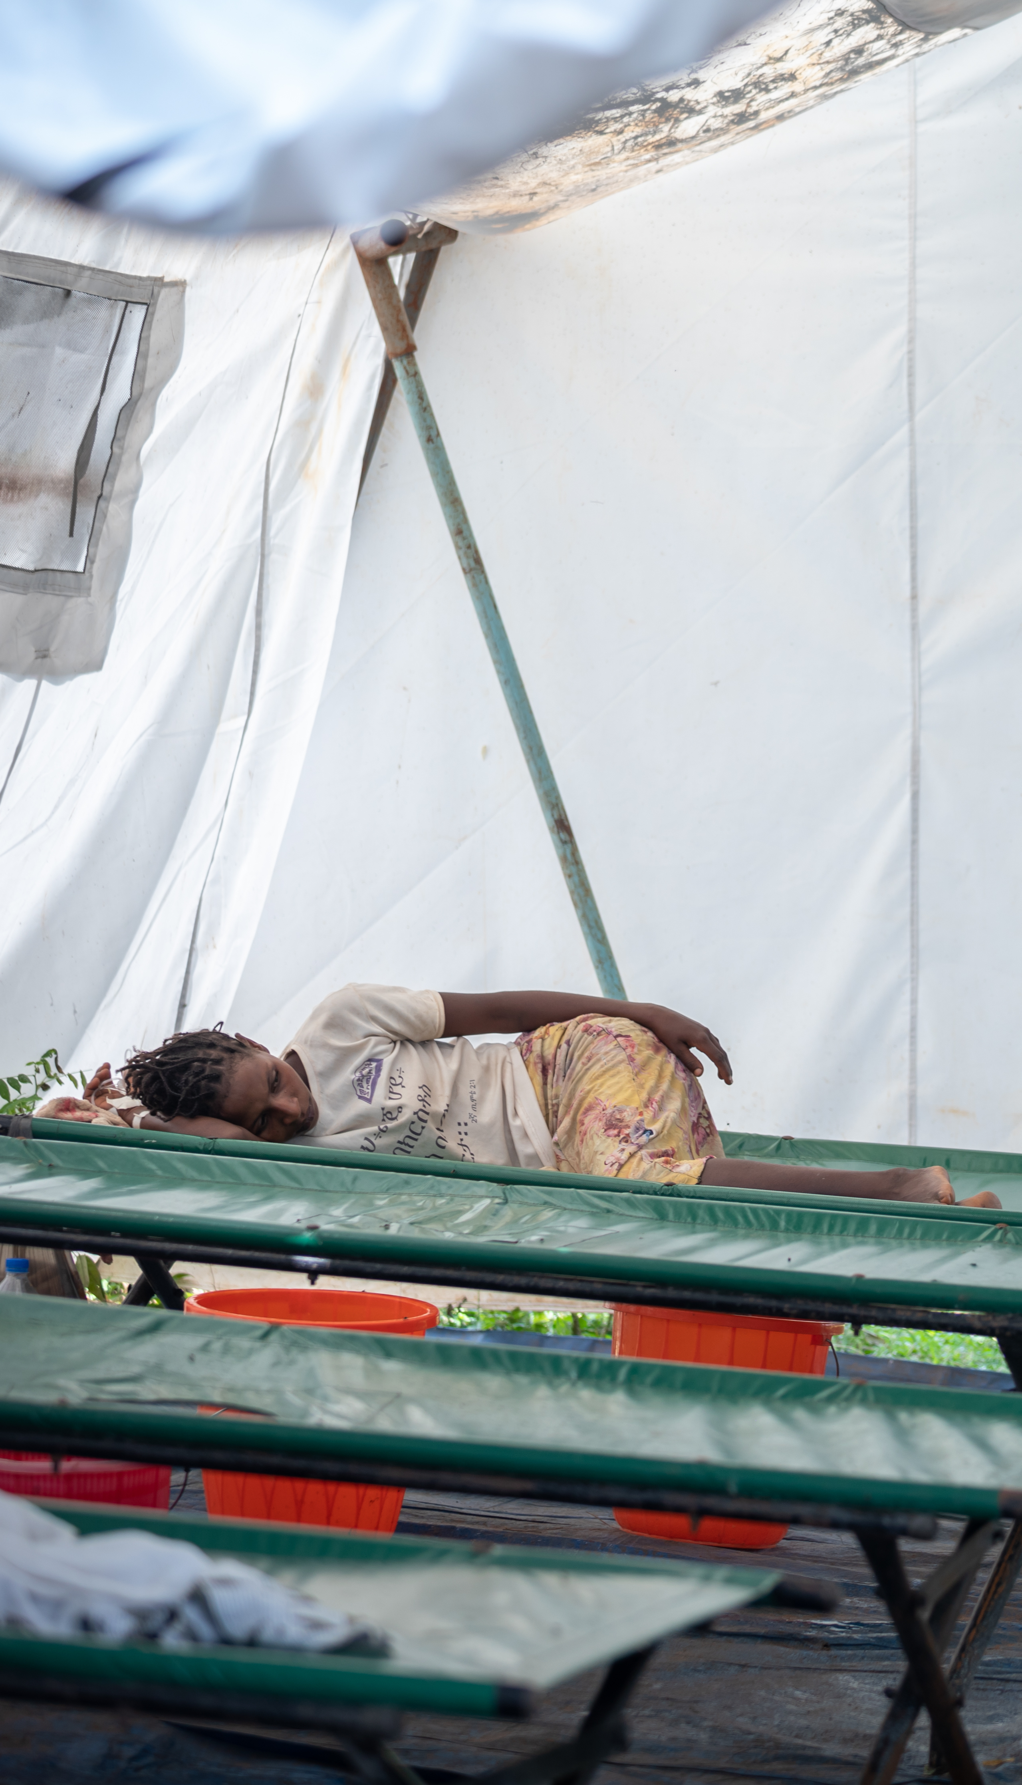
Cólera, a doença
© WHO / Mulugeta Ayene
É uma doença diarreica aguda causada por uma bactéria que é ingerida através de água ou alimentos contaminados.
Propaga-se rapidamente na comunidade.
Pode infetar tanto crianças como adultos.
Pode levar a desidratação grave e à morte de pessoas com a forma grave da doença; se não for tratado, um doente com a forma grave da doença pode ter até 50% de risco de morte por cólera, o que pode acontecer em poucas horas.
Notes:
Cholera the disease is an acute diarrheal infection which is caused by the ingestion of food or water that is contaminated with the toxigenic Vibrio cholerae O1 or O139 bacteria.
Cholera can spread rapidly in a community and can infect both children and adults.
Cholera can lead to severe dehydration and death in up to 50% of patients who develop the severe forms of the disease.
If the severe form of cholera disease is left untreated it can kill within hours.

Slide 6
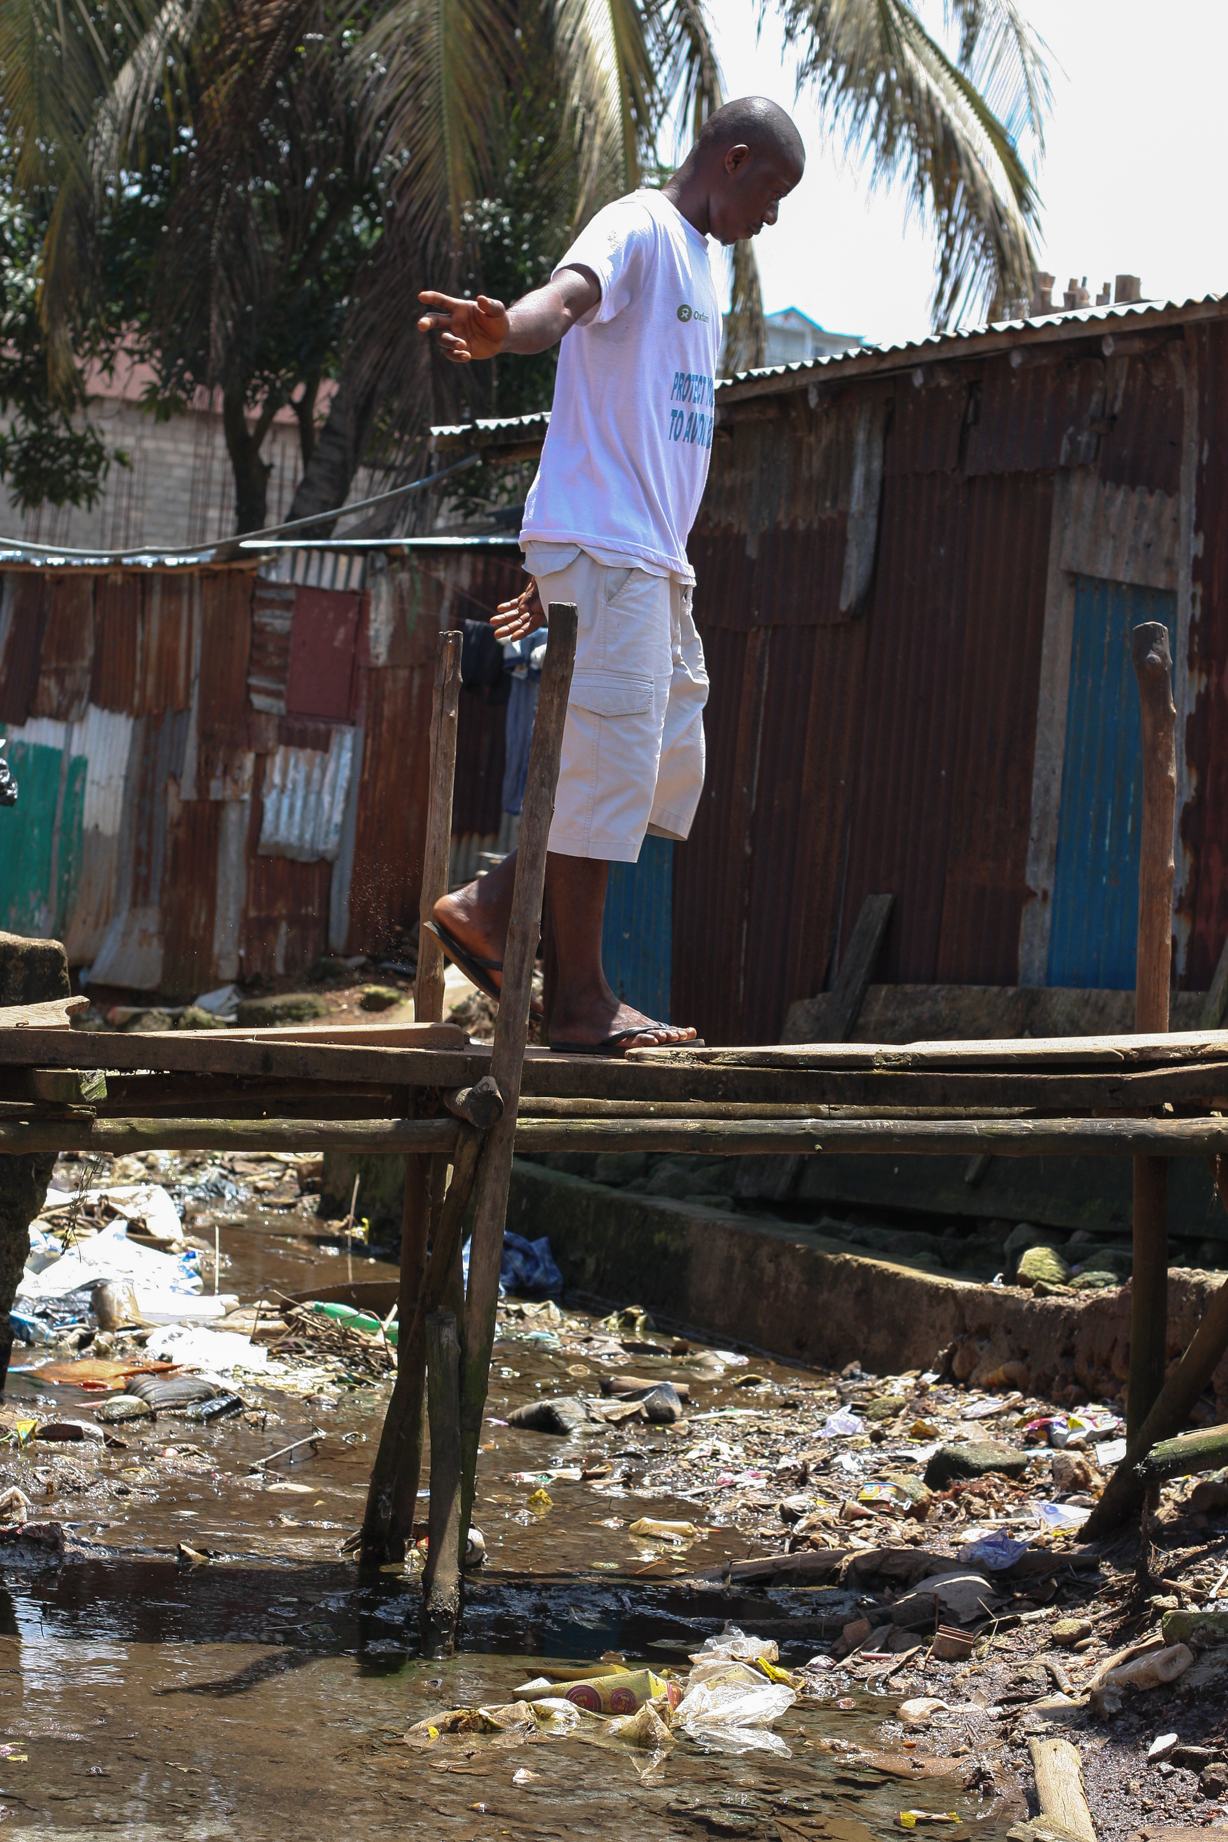







Transmissão da cólera
Rota fecal-oral
Fluidos
Dedos
Fezes
Alimentos
Novo hospedeiro
Moscas
Campo
© WHO / Fid Thompson
Adaptado de Kawata 1978
Notes:
Like we said, cholera is transmitted through the ingestion of contaminated water or food. This happens when the feces of a person sick with cholera are not properly contained or disposed of, and directly or indirectly, through different pathways, contaminate the water or food that other people consume. These other people are then at risk of getting the disease.
Here is one example of how cholera bacteria can spread from one person to infect a community:
It often begins when a person infected with cholera defecates in a poorly constructed latrine or an area near an open water source, such as a shallow well or river. The bacteria in their feces seep into the ground or are carried into the water source by rain or poor drainage, introducing Vibrio cholerae bacteria into the environment.
Once the bacteria enter the water, they multiply, transforming the water into a source of infection. Unaware of the danger, residents continue using the contaminated water for drinking, cooking, and bathing, often without proper water treatment. In such circumstances, poor hand hygiene exacerbates the problem, as individuals who have come into contact with the bacteria indirectly spread it while preparing food or through direct person-to-person interactions. Each individual who becomes infected can shed significant quantities of bacteria in their feces, which further contaminates shared water sources.
In densely populated areas or places with inadequate sanitation infrastructure, the situation escalates rapidly.

Slide 7
Introdução ao Vibrio cholerae
A bactéria
A cólera é causada por bactérias
Género -> Vibrio
Espécie - > cholerae
A Vibrio cholerae é uma espécie bacteriana que inclui mais dos 200 serogrupos até agora descritos
Apenas as estirpes toxicogénicas dos serogrupos O1 e O139 podem causar surtos de cólera
Vibrio cholerae
Obter um diagnóstico laboratorial adequado num primeiro caso suspeito é fundamental para saber se estamos a enfrentar uma estirpe que pode causar um surto de cólera ou não!
O1/O139
Estirpes epidémicas
Toxicogénicas
Notes:
We told you that Cholera the disease is caused by bacteria. Specifically, this bacterium belongs to the Genus “Vibrio” and Species “Cholerae” (this is the identity card of the bacteria). Vibrio cholerae, sometimes called VC, represents a large species of bacteria including at least 206 different serogroups identified so far. Out of the 206, only 2 serogroups actually cause cholera disease and cholera epidemics; these are Vibrio cholerae O1 and Vibrio cholerae O139. In fact, even more precisely, only toxigenic strains of VC O1 and VC O139 can cause cholera. Some of the other bacteria of this species can cause disease in humans, even sometimes diseases that have similar symptoms to cholera, but they do not cause cholera disease or cholera outbreaks.
Knowing this you can see why it can be important to get a proper laboratory diagnosis on a first case to know if your area is facing a strain that can cause an outbreak of cholera or not.

Slide 8
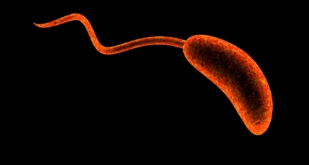
Introduction to Vibrio cholerae, the bacterium
Imagem da bactéria Vibrio cholerae
© CDC
Notes:
This is what Vibrio cholerae bacteria look like under a very high-powered microscope. It is comma shaped (bacillus) with a single flagellum (or tail).

Slide 9
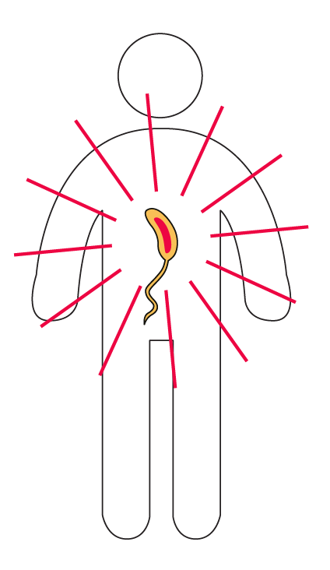
Progressão clínica da cólera
Não há qualquer diferença na doença ou nos sintomas,
quer a cólera seja causada pelo VC O1 ou pelo VC O139.
Curto período
de incubação: 2 horas – 5 dias
80%
sem sintomas
20% com sintomas
80%
forma ligeira
com poucos ou nenhuns sinais de desidratação
20% forma grave
com desidratação que pode causar choque hipovolémico e morte
Notes:
Whether a patient is infected with VC O1 or VC O139, the disease and the symptoms are the same. When a person becomes infected by the bacteria, it can take as little as two hours or as many as five days before that person shows any symptoms of disease. The time between being infected with the bacteria and developing symptoms is what we call the incubation period.
Most people, up to 80%, will not develop any symptoms after infection. The other 20% will show some signs and symptoms of cholera disease. Of these 20% with symptoms, 80% have a mild form of the disease with no or little signs of dehydration.
However, 20% of the individuals who develop symptoms will develop a severe case of cholera with severe dehydration. This can lead to hypovolemic shock and death if left untreated.

Slide 10
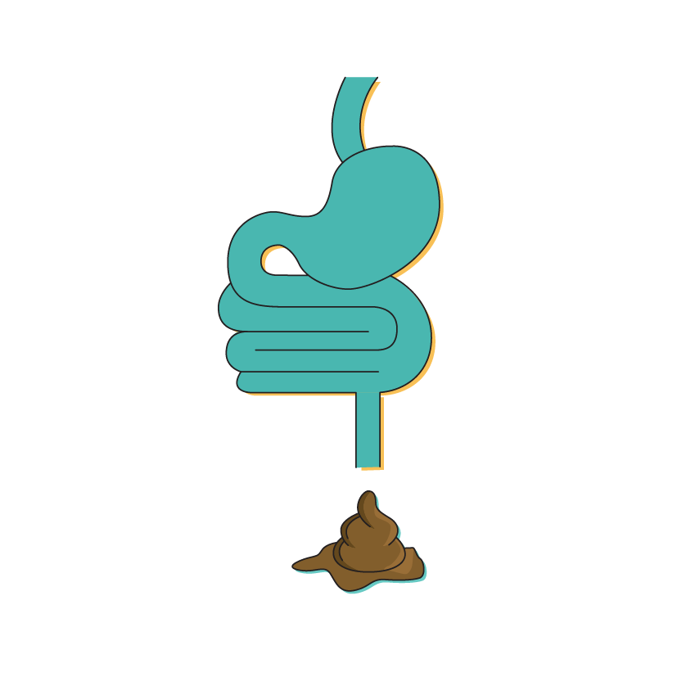
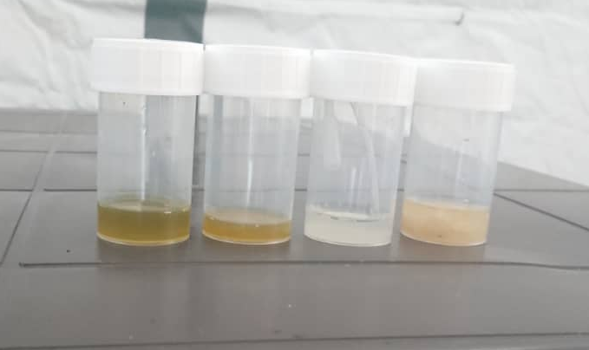
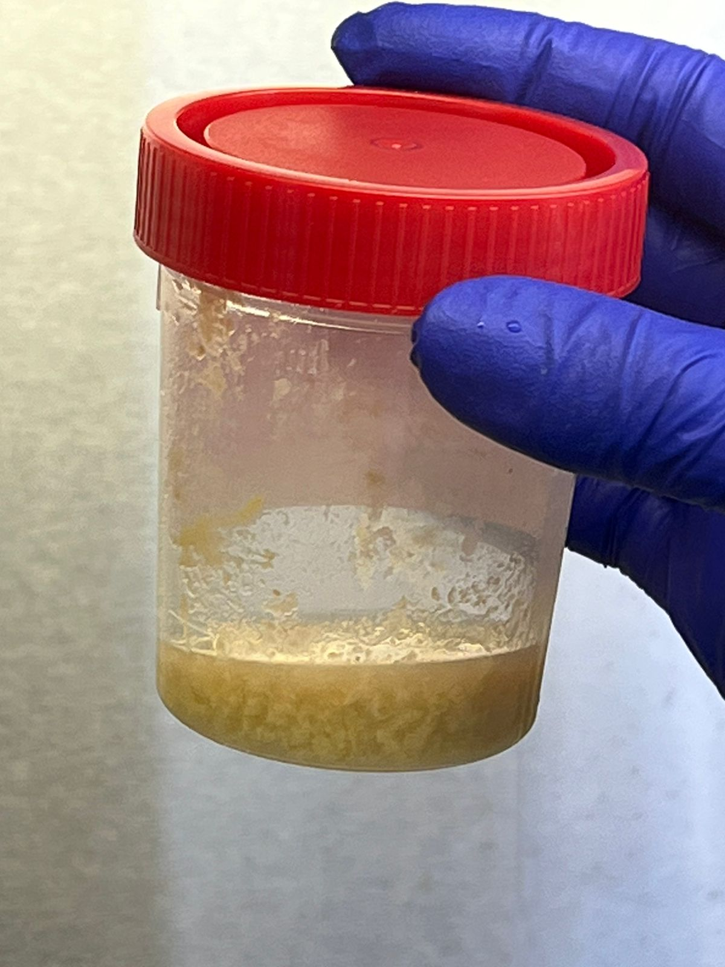



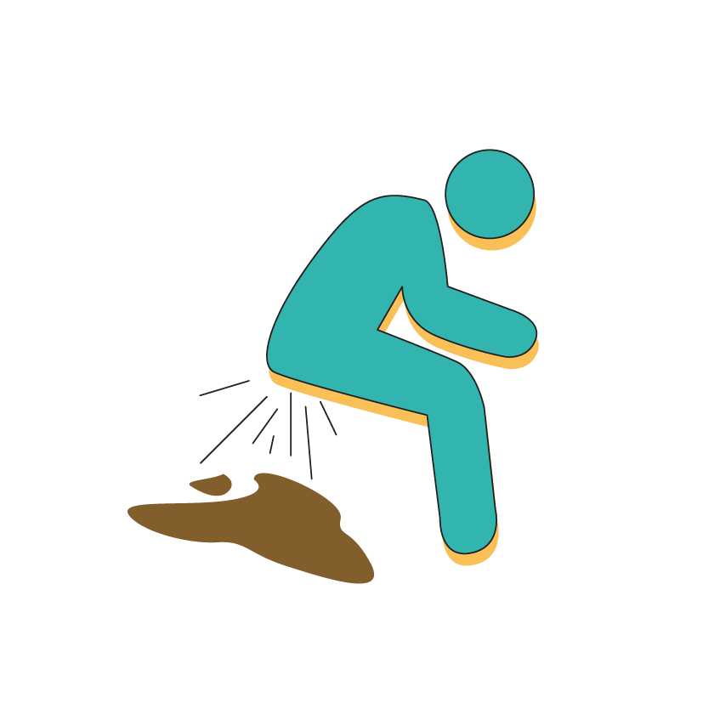
Diarreia aquosa aguda
Diarreia aquosa aguda
Diarreia aquosa aguda (fezes sem sangue) com ou sem vómitos
A diarreia aquosa aguda (DAA) é uma doença em que:
+
+
© Wendelin Moser
aguda = que dura< 7 dias
aquosa = fezes líquidas sem sangue
diarreia = ≥ 3 fezes moles em 24 horas
© Antoine Abou Fayad
Notes:
As well as dehydration, Cholera symptoms include acute watery diarrhoea with or without vomiting. Acute watery diarrhoea is defined as the sudden onset of 3 or more loose or watery stools within a 24-hour period. In some cases, the stool from patients with cholera is called ‘rice water stool’ as it looks like the water in which rice has been boiled, whiteish and quite opaque, but this isn’t always the case as we can see in the image, stool from cholera patients can be a variety of colours.
Stool from patients with Cholera disease does not contain signs of blood, we refer to this as “non-bloody stool”.

Slide 11
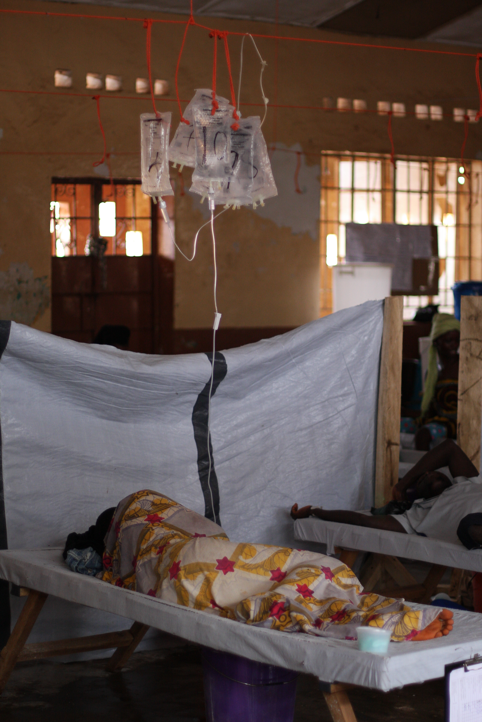
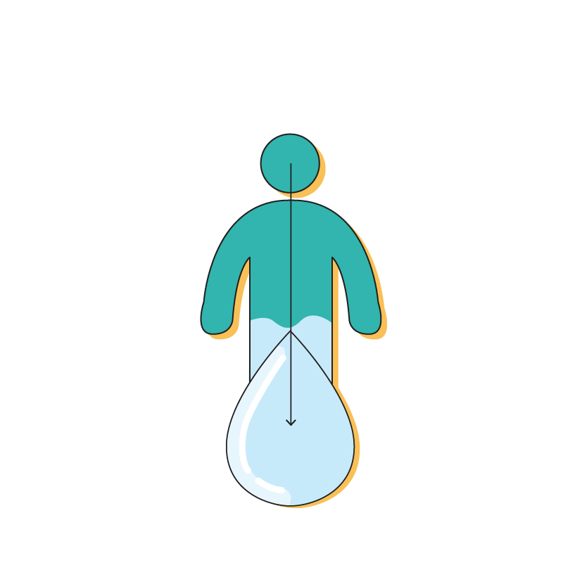
Desidratação grave
Desidratação grave
Um ou mais sinais de perigo:
Letárgico ou inconsciente
Pulso fraco ou ausente
Dificuldade respiratória
OU, pelo menos, dois dos seguintes sinais:
Olhos encovados
Não consegue beber ou está a beber pouco
No pinçamento, a pele volta muito lentamente ao normal
© WHO / Fid Thompson
Notes:
People who go on to develop a severe form of cholera disease will be dehydrated due to the loss of fluids from diarrhoea, vomiting and potentially their reduced ability to drink sufficient fluids to replace this loss.
Severe dehydration is defined as when a patient shows at least one of the following signs:
The patient is lethargic, (very tired and lacking energy) or unconscious
Has an absent or weak pulse
Is in respiratory distress
Severe dehydration is defined as having at least two of the following signs:
Sunken eyes
The patient is not able to drink or is drinking poorly
Or when doing a skin pinch test, the skin goes back slowly

Slide 12
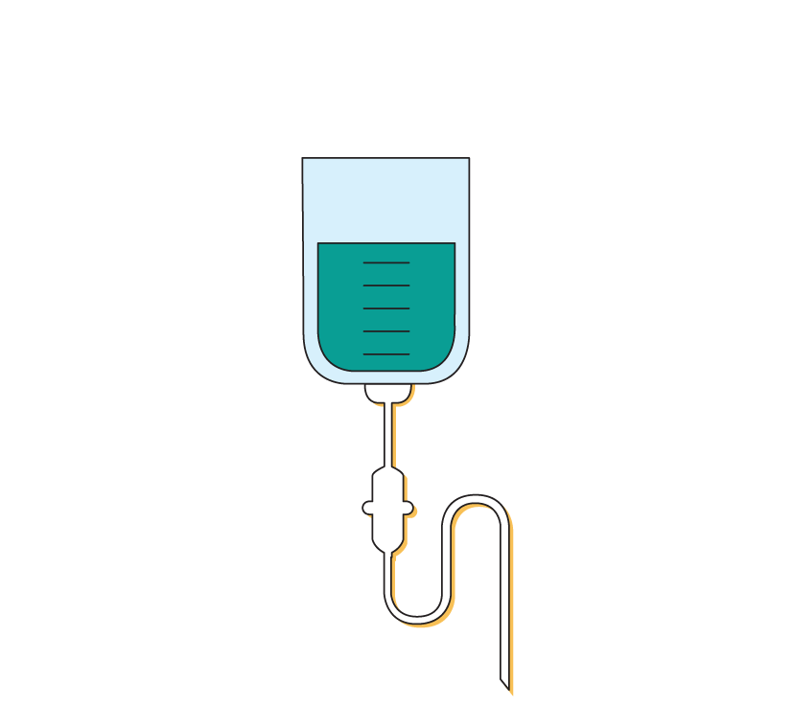

Tratamento da cólera
A cólera tem tratamento.
A primeira linha de tratamento é a reidratação com solução de reidratação oral (SRO).
Os doentes com desidratação grave requerem fluidos IV e antibióticos.
Notes:
It is important to remember cholera is treatable. Patients who die of cholera die from the effects of dehydration.
The first line of treatment for mild cases is rehydration with oral rehydration solution also called ORS.
Patients with severe dehydration or those unable to drink fluids may need additional interventions. Which can include intravenous fluids, usually Ringer`s Lactate and oral antibiotics.
Antibiotics can help reduce the severity and duration of the disease, but not all cases need antibiotics.

Slide 13
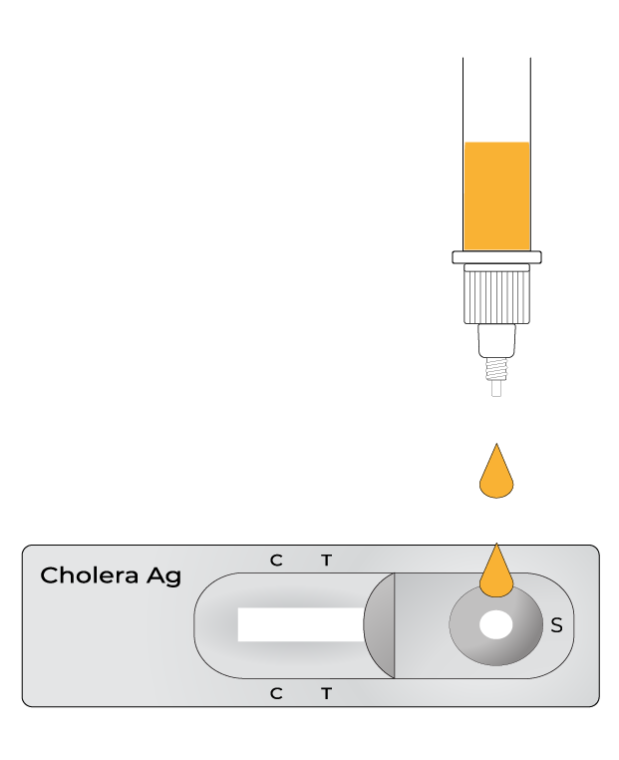
INTRODUÇÃO AOS TESTES DA CÓLERA
Notes:
Moving onto the testing for bacteria responsible for cholera.

Slide 14
As recomendações a seguir descritas foram elaboradas pelo Grupo de Trabalho Mundial para o Controlo da Cólera (GTFCC) e são mais detalhadas no documento “Vigilância em Saúde Pública para a Cólera”
As estratégias de testagem aplicadas no seu país podem ser diferentes. Verifique a existência de eventuais diferenças junto das autoridades de saúde locais.
Notes:
The recommendations described in this section were developed by the Global Task Force on Cholera Control (GTFCC), and they are further detailed in a guidance document called Public Health Surveillance for Cholera.
The testing strategies being applied in your country may vary a little from those recommended here. Be sure to check for differences with your local health authorities and adapt accordingly.

Slide 15
Porquê fazer o teste de cólera?
1
Tratar o doente
Os testes não são realizados para informar a gestão clínica do caso, isto é, os resultados positivos/negativos não alteram o protocolo do tratamento
Identificar um caso suspeito de cólera
2
O tratamento não deve depender do resultado laboratorial do teste da cólera mas sim do nível de desidratação do doente.
3
Testar para a cólera
?
4
Documentar e notificar
Porquê fazer o teste?
Notes:
When you identify a cholera suspect case, it is important to always treat the patient without delay. Then you may find yourself needing to collect a sample from the patient for cholera testing, and finally, it is important to document and report that a suspect cholera case was identified and what is the test result, even if the result is negative.
We will be discussing here:
How do you identify a suspect case of cholera?
When, who and how to test for cholera?
When, what and how to document/report?
Unlike for other diseases, we do not need a cholera test result to treat the patient. We say that tests are not performed to inform clinical case management, meaning that a positive or negative result will not change the treatment protocol. Treatment should depend on the level of dehydration of the patient and will always consist of rehydrating the patient and sometimes giving the patient antibiotics.
So, if not for patient management, why do we need to test for cholera?

Slide 16
Testes para vigilância e não para gestão clínica
Objetivos diferentes para situações epidemiológicas diferentes
NENHUM surto confirmado NENHUM surto provável
Surto CONFIRMADO
ou provável
Detetar o primeiro caso o mais cedo possível
Confirmar casos, detetar prováveis ​​surtos de cólera e declarar um surto
Intervir precocemente para travar a propagação (OCV, WASH etc.)
Monitorizar as tendências e a disseminação do surto
Orientar as intervenções e a alocação de recursos
Monitorizar possíveis mudanças na estirpe
Notes:
For cholera, we test for surveillance purposes to identify an outbreak or to monitor an existing outbreak, this means we test for different reasons depending on the context.
If you are in an area where there is no current outbreak of cholera, then it is imperative to identify any cholera outbreak as early as possible so that the response teams can intervene rapidly in the community to have a better chance of stopping the outbreak early or limiting the spread with interventions such as providing cholera vaccines or even clean drinking water.
We are looking for the first case of cholera.
If you are in an area where there is an existing ongoing outbreak of cholera, we wish to test enough patients to help monitor the evolution of the outbreak, for example to find out if the number of cases is going up or down, or if the outbreak is spreading to new communities. Knowing this will help the response teams direct the resources and interventions to the areas that most need them. For these reasons, we talk about testing for cholera surveillance and not for clinical management. We also want to regularly study the strain to make sure it doesn't change over time, or if a new strain is introduced.

Slide 17
Estratégia adaptada à situação epidemiológica
1
Tratar o doente
Consoante haja ou não um surto de cólera confirmado na zona.
Identificar um caso suspeito de cólera
2
3
Testar a cólera
4
Documentar e notificar
Notes:
If we look at the different steps, from the treatment and identification of a cholera suspect case all the way to testing, documenting and reporting, three of these steps will differ according to the epidemiological situation prevailing in your area. This means that, you will always treat the patient according to their signs and symptom but depending on whether there is an outbreak of cholera or not in your area, you will identify a suspect case, test a suspect case and report cases in slightly different ways.
Let's start by looking at how to identify a suspect case.

Slide 18
Identificar um caso suspeito de cólera
A maioria dos casos de cólera apresenta poucos ou nenhuns sinais ou sintomas. Nos centros de tratamento da cólera ou unidades de saúde, verá principalmente o subconjunto de casos de cólera que desenvolve sintomas mais graves.
Existem definições específicas de casos suspeitos de cólera.
As definições de um caso suspeito de cólera são diferentes, conforme exista ou não um surto de cólera confirmado e em curso na zona.
Notes:
You will recall from the introduction to cholera section, that most cases of cholera will show no or little signs and symptoms. In fact, in the cholera treatment centers or health facilities you will mostly see the subset of cholera cases that develop severe symptoms, those who need most care.
There are specific definitions of cholera suspect cases. These definitions may vary in your country as compared to these GTFCC recommendations, but it is important to remember that a suspect case of cholera is not just anyone with any type of diarrhea.
It is also important to know that how we define a suspect cholera case will be different depending on whether or not you are in an area with an already confirmed, ongoing cholera outbreak or not.

Slide 19

Definições de casos suspeitos de cólera
NENHUM surto confirmado NENHUM surto provável
Surto CONFIRMADO
ou provável
Onde NÃO há surto de cólera provável ou confirmado :
Onde HÁ um surto de cólera provável ou confirmado :
Caso suspeito de cólera
Caso suspeito de cólera
Pessoa com idade ≥ 2 anos:
Pessoa de QUALQUER idade:
OU
E
OU
or
com diarreia aquosa aguda (DAA)
com desidratação grave
que morreu com DAA
com diarreia aquosa aguda (DAA)
que morreu com DAA
Notes:
If you apply GTFCC cholera suspect case definitions and you are in an area where there is currently no outbreak of cholera, then people aged 2 years or older that have acute watery diarrhoea and severe dehydration, or any person, 2 years and older who has died from acute watery diarrhoea should be considered a suspect case.
In an area where there is already an outbreak of cholera, then any person of any age, with AWD or who has died from AWD is considered to be a suspect cholera case.

Slide 20
Teste: de acordo com a situação epidemiológica
NENHUM surto confirmado NENHUM surto provável
Surto CONFIRMADO
ou provável
Testar TODOS os casos
suspeitos de cólera
Testar um SUBCONJUNTO de casos suspeitos de cólera
Notes:
Now you have initiated treatment and identified a suspect case. Who and when do you need to test? And how do you test them?
Remember that when there is no outbreak in the area, our objective is to look for a first case and confirm an outbreak as early as possible so that actions can be taken quickly in the community to have a better chance of stopping the outbreak early or limiting the spread with interventions such as providing clean drinking water or even cholera vaccines.
To do this, you will be asked to sample and test all suspected cases to quickly find the first evidence of a new outbreak.
If you are in an area where there is an existing ongoing outbreak of cholera, there is no longer a need to test all cases. However, testing a portion of suspect cases will help monitor the evolution of the outbreak, for example to find out if the number of cases is going up or down, or if the outbreak is spreading to new communities. Testing and obtaining samples from a few cases will also help the laboratory to verify that the strain is not changing with time.
In these areas, you will be asked to test a portion or a subset of suspected cases.

Slide 21

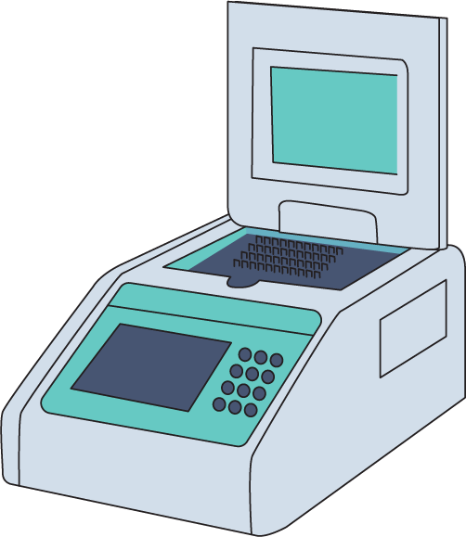
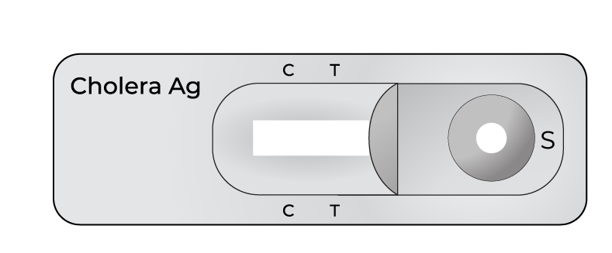
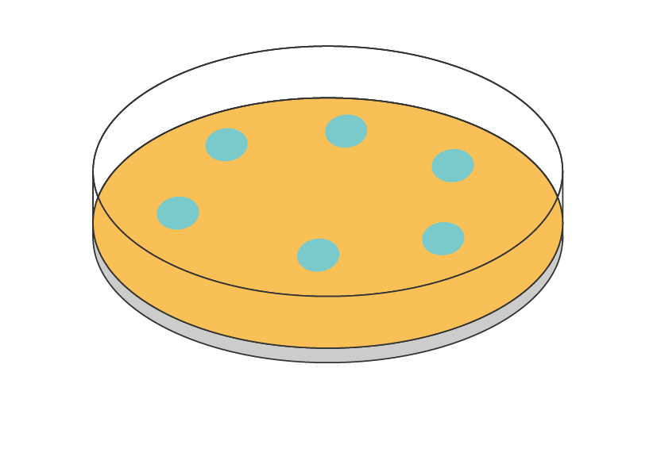
Teste: métodos de testagem
Ferramentas de rastreio:
Testes de diagnóstico rápido
Para identificar surtos suspeitos e prováveis ​​ou monitorizar surtos em curso
Realizados junto do paciente
Testes de confirmação laboratorial:
Cultura/reação em cadeia da polimerase (PCR)
Confirmam a cólera
Realizados em laboratório
Notes:
A clinical diagnosis based on the patient's signs and symptoms is used to identify suspected cholera, and this is enough to start treatment. .
When laboratory testing is needed, common methods used are:
rapid diagnostic tests or RDTs,
culture and polymerase chain reaction or PCR.
RDTs can be performed virtually anywhere and by clinical personnel or rapid response teams or laboratory technicians. They do not confirm cases but are used to quickly identify suspected or probable cholera outbreaks. We will discuss these in detail in Module 3.
Unlike RDTs, culture and/or PCR are used to confirm cholera, but they need to be performed in a laboratory. These are outside the scope of this course.
In all cases, when there is a need to test a patient for cholera, whether this be with RDT or with culture and/or PCR, you will first be asked to collect a sample of stool or swab from the suspect case. This will be discussed in Module 2.

Slide 22
Teste: estratégias de testagem
TDR não disponíveis
NENHUM surto confirmado NENHUM surto provável
Surto CONFIRMADO
ou provável
Testar TODOS os casos
suspeitos de cólera
Testar um SUBCONJUNTO de casos suspeitos de cólera
Colher amostras de todos os casos suspeitos para as enviar a um laboratório para confirmação
Colher amostras de um subconjunto de casos suspeitos semanalmente para as enviar a um laboratório para confirmação (os primeiros 3 casos suspeitos, por semana e por unidade)
Notes:
Not every facility will have RDTs at all times. It is possible you face a situation where you suspect cholera but do not have any RDT to test with due to a stock out for example. But we still have to take action. If we look at the 2 scenario we have outlined – when there is No confirmed outbreak and No probable outbreak the testing strategy is to TEST ALL suspected cases. Since we do not have RDTs we collect the sample as described in the next module and send it to the laboratory for testing. You may need to communicate with the health authorities or laboratory to quickly distribute transport media and ensure quick transport and let the laboratory know a sample is to be sent. If there is a probable outbreak or an outbreak declared in the area you work in, then according to the testing strategy the health facility should collect samples from the first 3 cholera suspects per week and send these samples to the laboratory for testing.
Note, your health authorities may coordinate sample collection days with you to ensure samples do not wait long time periods before being transported.
Next we will look at how this changes if you do have RDTs available on site.

Slide 23
Teste: estratégias de testagem
TDR disponíveis
NENHUM surto confirmado NENHUM surto provável
Surto CONFIRMADO
ou provável
Testar TODOS os casos
suspeitos de cólera
Testar um SUBCONJUNTO de casos suspeitos de cólera
Realizar TDR em todos os casos suspeitos de cólera
Recolher amostras de todos os casos reativos ao TDR para enviar a um laboratório para confirmação
Testar um subconjunto de casos suspeitos todos os dias (os 3 primeiros) com TDR
Colher uma amostra de um subconjunto de casos reativos ao TDR semanalmente para enviar a um laboratório para confirmação (até 3 por zona)
Notes:
Let's now look at the two scenarios and what to do if RDT are available.
We said that in an area where there is no known outbreak of cholera, our objective is to find a first case and for this we need to test every suspected case. What that means for you is that you may be asked to perform an RDT on all suspected cases and then because we will need further laboratory confirmation, you will want to collect a sample from all RDT reactive cases and send to a laboratory for confirmation.
In an area where there is already a known outbreak of cholera, you may be asked to test only a portion of suspected cases every day. The GTFCC recommends testing the first 3 suspected cases every day using RDT. Following this, you may also be asked to collect a sample from a portion of RDT reactive cases every week to send to a laboratory for them to further confirm and study the strain. In this case, the GTFCC recommends sending 3 RDT reactive samples to the laboratory for each area (or surveillance unit) and this every week.
The number of suspected cases recommended to test may vary for your country. Always check what are the procedures in place in your area and at the time you are testing.

Slide 24
Relatório de acordo com a situação epidemiológica
NENHUM surto confirmado NENHUM surto provável
Surto CONFIRMADO
ou provável
Registe imediatamente no livro de resultados
Comunique os casos suspeitos e todos os resultados do TDR diariamente às autoridades de saúde locais.
Registe imediatamente no livro de resultados
Comunique os casos suspeitos e todos os resultados do TDR semanalmente às autoridades de saúde locais.
Notes:
Now you have treated the patient, identified the patient as a suspected cholera case, maybe tested the patient or even sent a sample to a laboratory, the next critical step is to document your findings and report to the local health authorities.
In any case, you should always keep records of the patient and any RDT results, including any negative or non-reactive results.
In an area where there is no known outbreak of cholera, suspect cholera cases all RDT results (reactive, non-reactive, invalid) should be reported to local health authorities on a daily basis.
In an area where there is already a known outbreak of cholera, suspect cholera cases and all RDT results should be reported to local health authorities on a weekly basis.

Slide 25
Resumo
Sem surto
Com surto
1
Tratar o doente
Tratar todos, protocolos de reidratação (ATB)
≥ 2 anos, com DAA e desidratação grave ou que morreram por DAA
De qualquer idade, com DAA ou que morreram por DAA
Identificar um caso suspeito de cólera
2
TDR em todos os casos suspeitos
Colher e enviar amostras de todos os TDR+ para um laboratório
TDR nos primeiros três casos suspeitos do dia
Colher e enviar 3 amostras de TDR+ semanalmente da zona para um laboratório
3
Testar a cólera
Registar imediatamente
Notificar diariamente todos os resultados dos TDR
Registar imediatamente
Notificar semanalmente
4
Documentar e notificar
Notes:
To summarize,
Always treat the patient as soon as possible.
When there is no outbreak, we aim to quickly detect the first case to quickly protect the community and alert other departments to contain the disease and prevent widespread outbreaks. To do this we identify suspect cases, this is anyone 2 years and above with AWD and SEVERE dehydration, or 2 and above who die with AWD. If RDTs are available, we test all suspected cases using the RDTs. We also send the RDT reactive samples to the laboratory for confirmation by Culture and/or PCR. If RDTs are not available, we simply collect samples from all suspected cholera cases and send them to the laboratory for testing as soon as possible. We record all RDT results (reactive or non-reactive) and report any reactive RDT result to the health authorities on the same day.
When there is an outbreak of cholera in the area or surveillance unit, we aim to monitor the outbreak. A suspected cholera case is now defined as any person of any age, with AWD or who has died from AWD. If RDTs are available, we test the first 3 suspected cases of the day in our health facility using RDTs. We also send the reactive RDT sample to the laboratory for confirmation by culture and/or PCR. If RDTs are not available for any reason, we collect samples from the first 3 suspected cases of the week in the health facility and send them to a laboratory for testing. We keep records of all RDT results. Finally, we report all suspect cases and RDT results to health authorities on a weekly basis.

Slide 26

Links para material de apoio do GTFCC
Os próximos dois módulos deste curso visarão:
Colheita, Preparação e Transporte de Amostras para a Cólera (Módulo 2)
Testes de Diagnóstico Rápido (TDR) para a Cólera (Módulo 3)
Para mais informações:
Sobre a cólera Curso OpenWHO “Cólera: Introdução”
Sobre o tratamento de doentes com cólera Auxílios de trabalho clínicos do GTFCC
Sobre a vigilância e respetivas estratégias
Recomendações para “Vigilância da Cólera no Domínio da Saúde Pública” :https://www.gtfcc.org/resources/public-health-surveillance-for-cholera/
Curso " Vigilância da cólera para profissionais de saúde"
Notes:
For further information…

Slide 27
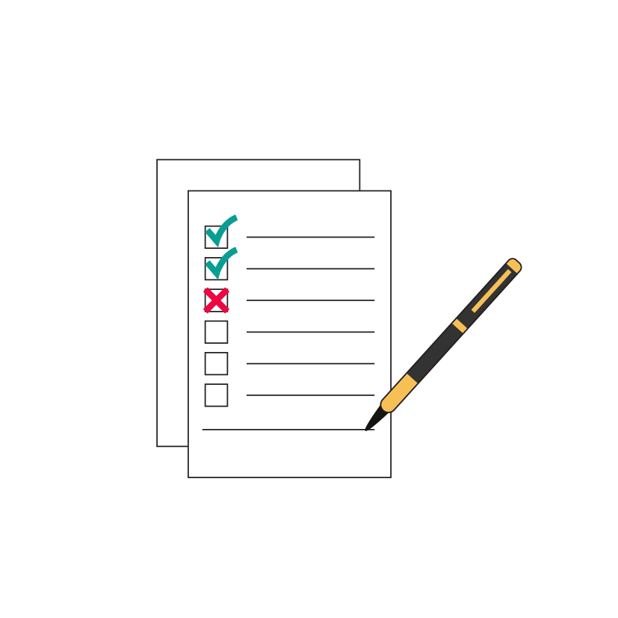
AVALIAÇÃO DE FIM DE MÓDULO
Notes:
End of module assessment.

Slide 28
Avaliação
Apenas os serogrupos O1 e O139 da bactéria Vibrio cholerae podem causar surtos de cólera.
Verdadeiro ou Falso
Um doente que sofre de obstipação provavelmente tem cólera.
Verdadeiro ou Falso
Apenas os doentes com resultado positivo/reativo ao TDR da cólera devem ser tratados utilizando protocolos de reidratação.
Verdadeiro ou Falso
Todos os casos suspeitos de cólera devem ser testados com TDR, independentemente de existir ou não um surto na zona.
Verdadeiro ou Falso

Slide 29
Respostas da Avaliação
Apenas os serogrupos O1 e O139 da bactéria Vibrio cholerae podem causar surtos de cólera.
Verdadeiro; para reavivar a memória, veja o diapositivo 7
Um doente que sofre de obstipação provavelmente tem cólera.
Falso; para reavivar a memória, veja o diapositivo 10
Apenas os doentes com resultado positivo/reativo ao TDR da cólera devem ser tratados utilizando protocolos de reidratação.
Falso; para reavivar a memória, veja o diapositivo 15
Todos os casos suspeitos de cólera devem ser testados com TDR, independentemente de existir ou não um surto na zona.
Falso; para reavivar a memória, veja o diapositivo 23

