Slide 1
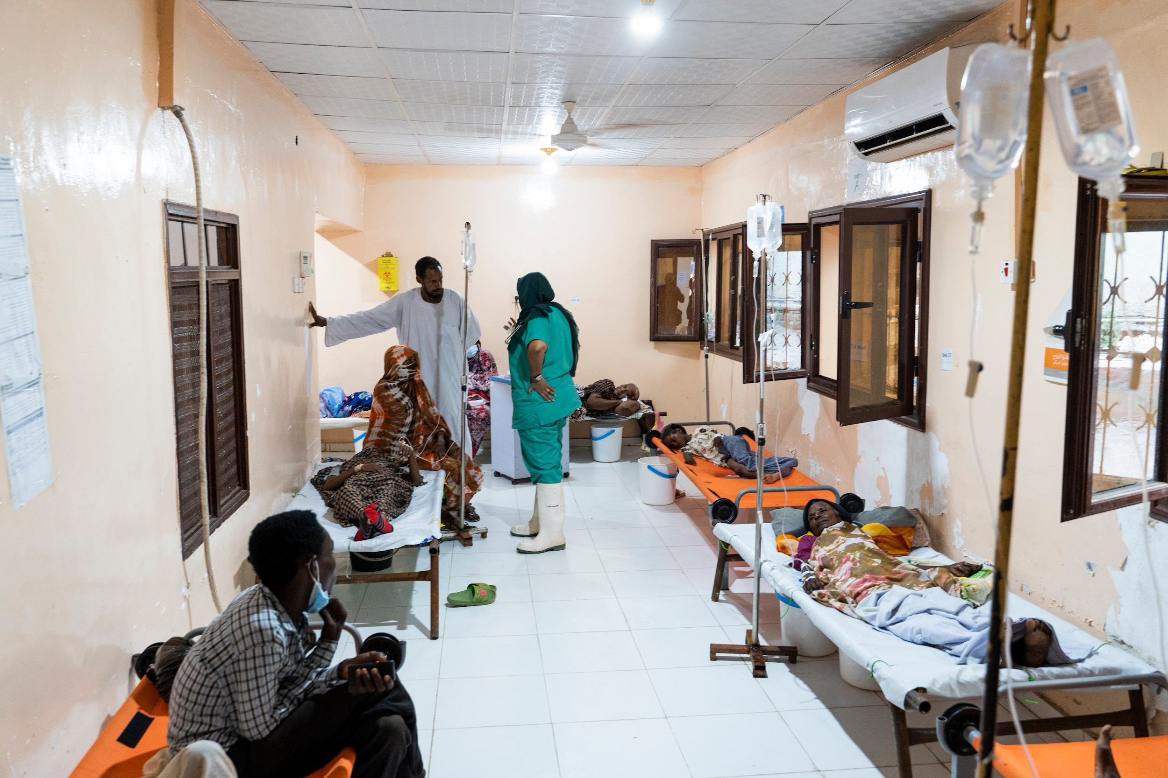

© WHO / Ala Kheir
GTFCC recommendations
INTRODUCTION TO CHOLERA AND TESTING FOR CHOLERA
V1.0 November 2024
Notes:
Let’s start with our first module, an introduction to cholera and testing for cholera.

Slide 2
Learning objectives
Describe what cholera is and what causes cholera
Define what is a cholera suspect case
Describe the circumstances in which testing for cholera is recommended and why
Identify the types of methods used for testing for cholera
Notes:
By the end of this module, you should be able to
Describe what cholera is and what causes cholera
Define what is a cholera suspect case
Describe the circumstances in which testing for cholera is recommended and why
And finally identify the types of methods used for testing for cholera

Slide 3
Outline
1
Introduction
2
Introduction to testing for cholera
3
End of module assessment
Notes:
This first module includes an introduction to cholera followed by an introduction to testing for cholera with a brief quiz to test your new knowledge.

Slide 4

INTRODUCTION TO CHOLERA
Notes:
Introduction to cholera : Here we will talk about cholera the disease and the bacteria which causes the disease.

Slide 5
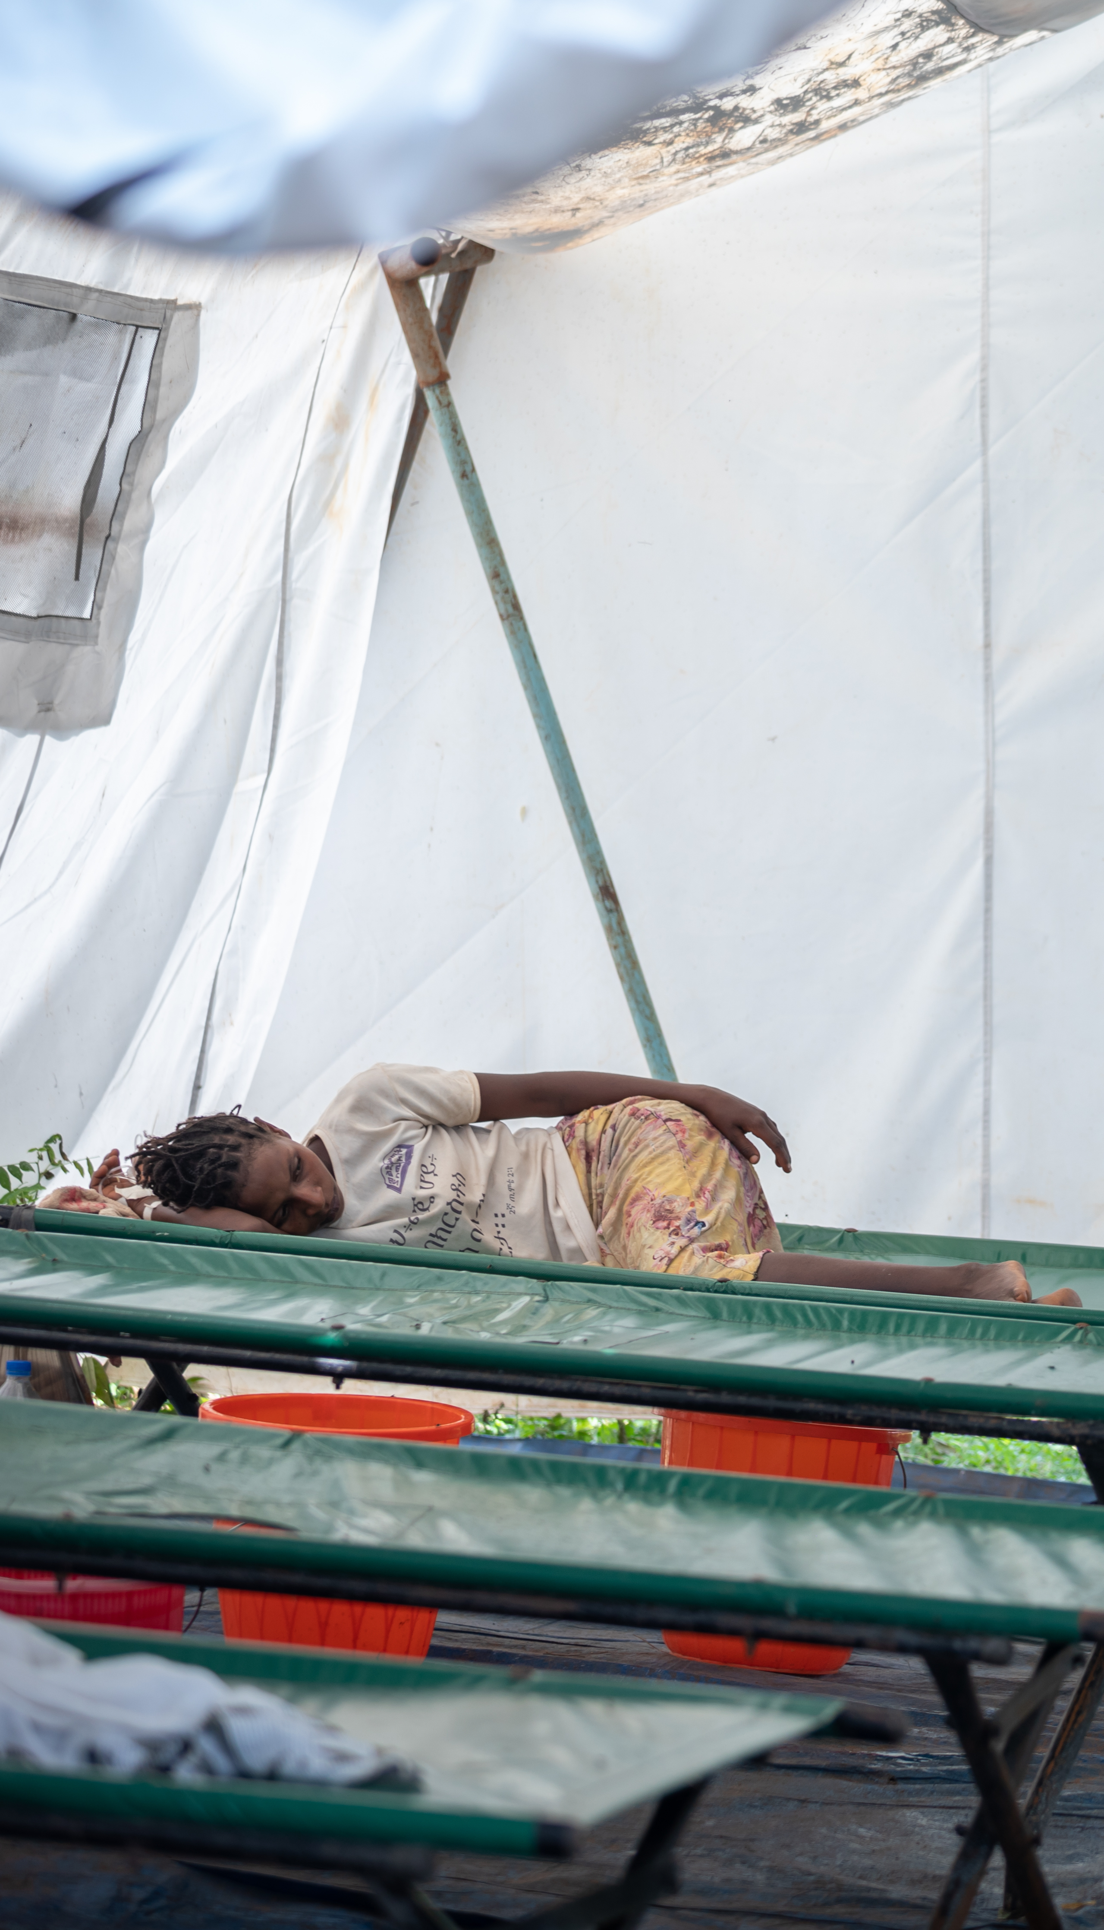
Cholera, the disease
© WHO / Mulugeta Ayene
Is an acute diarrheal disease. It is caused by bacterium that is ingested through contaminated water or food.
Spreads rapidly in the community.
Can infect both children and adults.
Can lead to severe dehydration and death in patients with severe forms of the disease; if left untreated, a patient with a severe form may have up to a 50% risk of dying from cholera and this can happen in a few hours.
Notes:
Cholera the disease is an acute diarrheal infection which is caused by the ingestion of food or water that is contaminated with the toxigenic Vibrio cholerae O1 or O139 bacteria.
Cholera can spread rapidly in a community and can infect both children and adults.
Cholera can lead to severe dehydration and death in up to 50% of patients who develop the severe forms of the disease.
If the severe form of cholera disease is left untreated it can kill within hours.

Slide 6
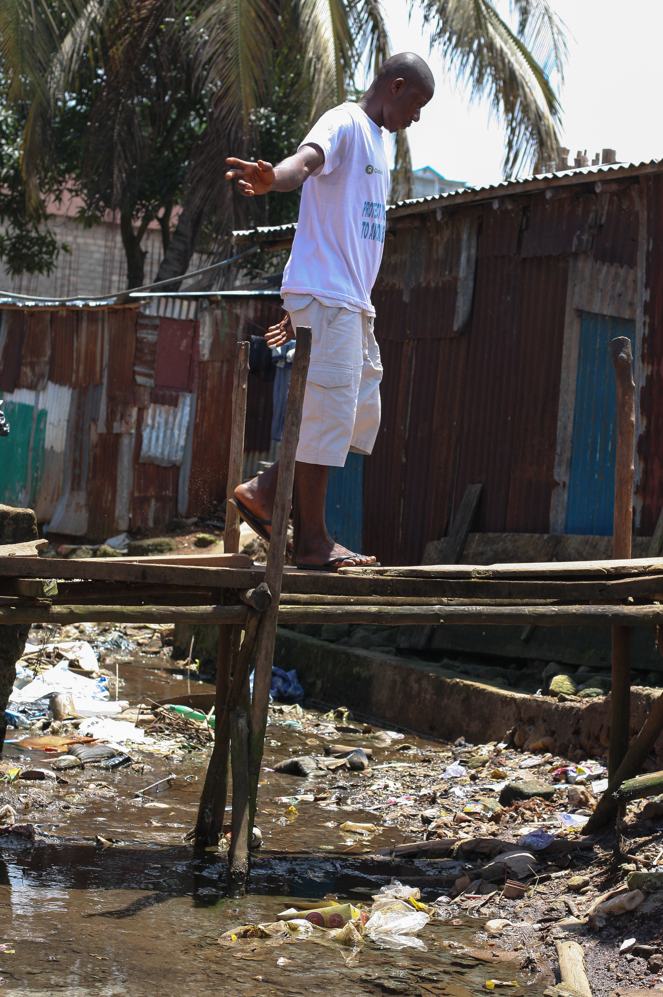







Cholera transmission
Faeco-oral route
Fluids
Fingers
Faeces
Food
New host
Flies
Fields
© WHO / Fid Thompson
Adapted from Kawata 1978
Notes:
Like we said, cholera is transmitted through the ingestion of contaminated water or food. This happens when the feces of a person sick with cholera are not properly contained or disposed of, and directly or indirectly, through different pathways, contaminate the water or food that other people consume. These other people are then at risk of getting the disease.
Here is one example of how cholera bacteria can spread from one person to infect a community:
It often begins when a person infected with cholera defecates in a poorly constructed latrine or an area near an open water source, such as a shallow well or river. The bacteria in their feces seep into the ground or are carried into the water source by rain or poor drainage, introducing Vibrio cholerae bacteria into the environment.
Once the bacteria enter the water, they multiply, transforming the water into a source of infection. Unaware of the danger, residents continue using the contaminated water for drinking, cooking, and bathing, often without proper water treatment. In such circumstances, poor hand hygiene exacerbates the problem, as individuals who have come into contact with the bacteria indirectly spread it while preparing food or through direct person-to-person interactions. Each individual who becomes infected can shed significant quantities of bacteria in their feces, which further contaminates shared water sources.
In densely populated areas or places with inadequate sanitation infrastructure, the situation escalates rapidly.

Slide 7
Introduction to Vibrio cholerae
The bacterium
Cholera is caused by bacteria
          Genus -> Vibrio
          Species - > cholerae
Vibrio cholerae is a bacterial species which includes more than 200 serogroups described so far
Only toxigenic strains of serogroups O1 and O139 can cause cholera outbreaks
Vibrio cholerae
Obtaining a proper laboratory diagnosis on a first suspected case is critical to know whether you are facing a strain that can cause an outbreak of cholera or not!
O1/O139
Epidemic Strains
Toxigenic
Notes:
We told you that Cholera the disease is caused by bacteria. Specifically, this bacteria belongs to the Genus “Vibrio” and Species “Cholerae” (this is the identity card of the bacteria). Vibrio cholerae, sometimes called VC, represents a large species of bacteria including at least 206 different serogroups identified so far. Out of the 206, only 2 serogroups actually cause cholera disease and cholera epidemics; these are Vibrio cholerae O1 and Vibrio cholerae O139. In fact, even more precisely, only toxigenic strains of VC O1 and VC O139 can cause cholera. Some of the other bacteria of this species can cause disease in humans, even sometimes disease that have similar symptoms to cholera, but they do not cause cholera disease or cholera outbreaks.
Knowing this you can see why it can be important to get a proper laboratory diagnosis on a first case to know if your area is facing a strain that can cause an outbreak of cholera or not.

Slide 8
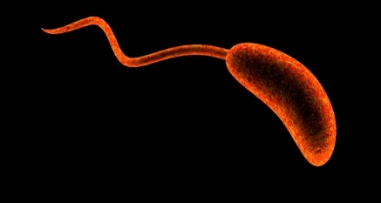
Introduction to Vibrio cholerae, the bacterium
Image of Vibrio cholerae bacterium
© CDC
Notes:
This is what Vibrio cholerae bacteria look like under a very high-powered microscope. It is comma shaped (bacillus) with a single flagellum (or tail).

Slide 9
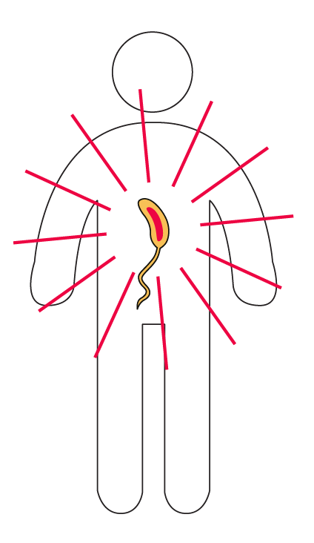
Symptoms of cholera
There is no difference in the disease or the symptoms
when cholera is caused by VC O1 or VC O139.
Incubation
period short:
2 hours – 5 days
80%
No symptoms
20% Symptoms
80%
Mild form
With no or some signs of dehydration
20%
Severe form
With severe dehydration that may lead to hypovolemic shock and death
Notes:
Whether a patient is infected with VC O1 or VC O139, the disease and the symptoms are the same.
When a person becomes infected by the bacteria, it can take as little as two hours or as many as five days before that person shows any symptoms of disease. The time between being infected with the bacteria and developing symptoms is what we call the incubation period.
Most people, up to 80%, will not develop any symptoms after infection. The other 20% will show some signs and symptoms of cholera disease. Of this 20% with symptoms, 80% have a mild form of the disease with no or little signs of dehydration.
However, 20% of the individuals who develop symptoms will develop a severe case of cholera with severe dehydration. This can lead to hypovolemic shock and death if left untreated.

Slide 10
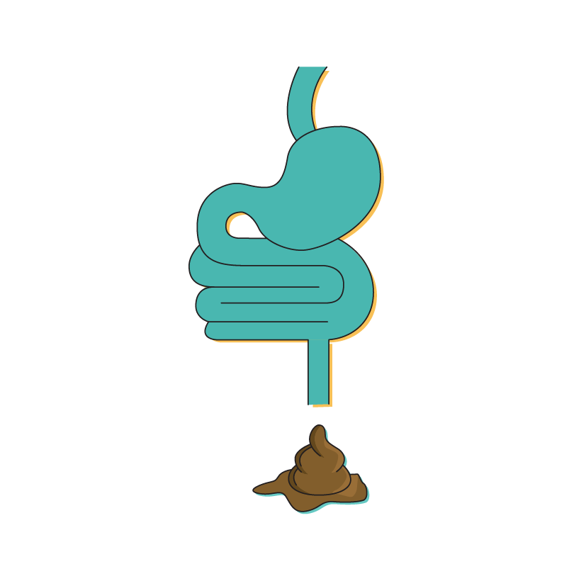
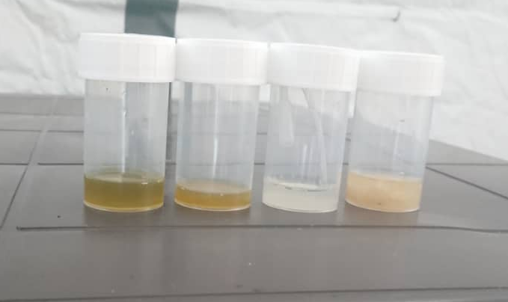
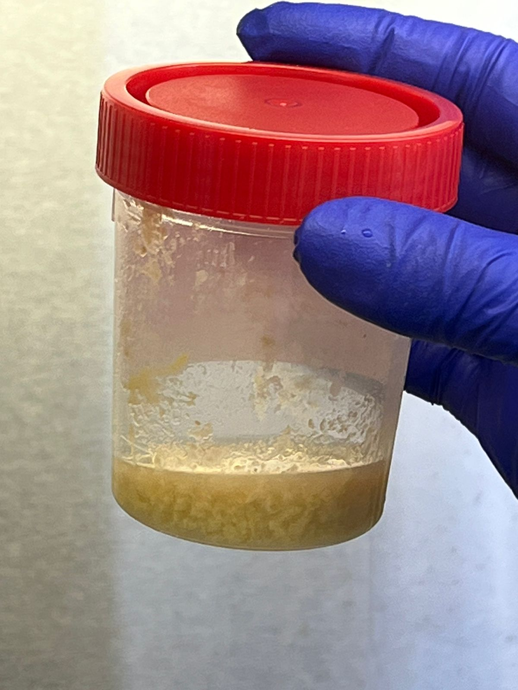



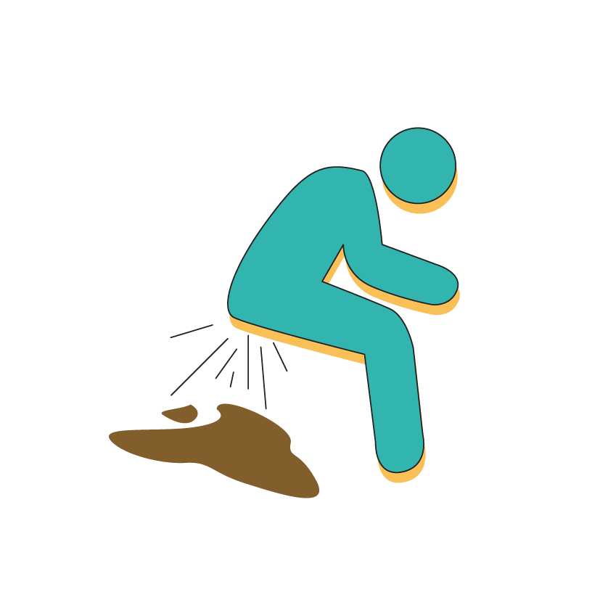
Acute watery diarrhoea
Acute Watery Diarrhoea
  Acute watery diarrhea (non-bloody stool) with or without vomiting
Acute watery diarrhoea (AWD) is an illness in which:
+
+
© Wendelin Moser
acute = lasting < 7 days
watery = non-bloody liquid stools
diarrhoea = ≥ 3 loose stools in 24 hours
© Antoine Abou Fayad
Notes:
As well as dehydration, Cholera symptoms include acute watery diarrhoea with or without vomiting. Acute watery diarrhoea is defined as the sudden onset of 3 or more loose or watery stools within a 24-hour period. In some cases, the stool from patients with cholera is called ‘rice water stool’ as it looks like the water in which rice has been boiled, whiteish and quite opaque, but this isn’t always the case as we can see in the image, stool from cholera patients can be a variety of colours.
Stool from patients with Cholera disease does not contain signs of blood, we refer to this as “non-bloody stool”

Slide 11
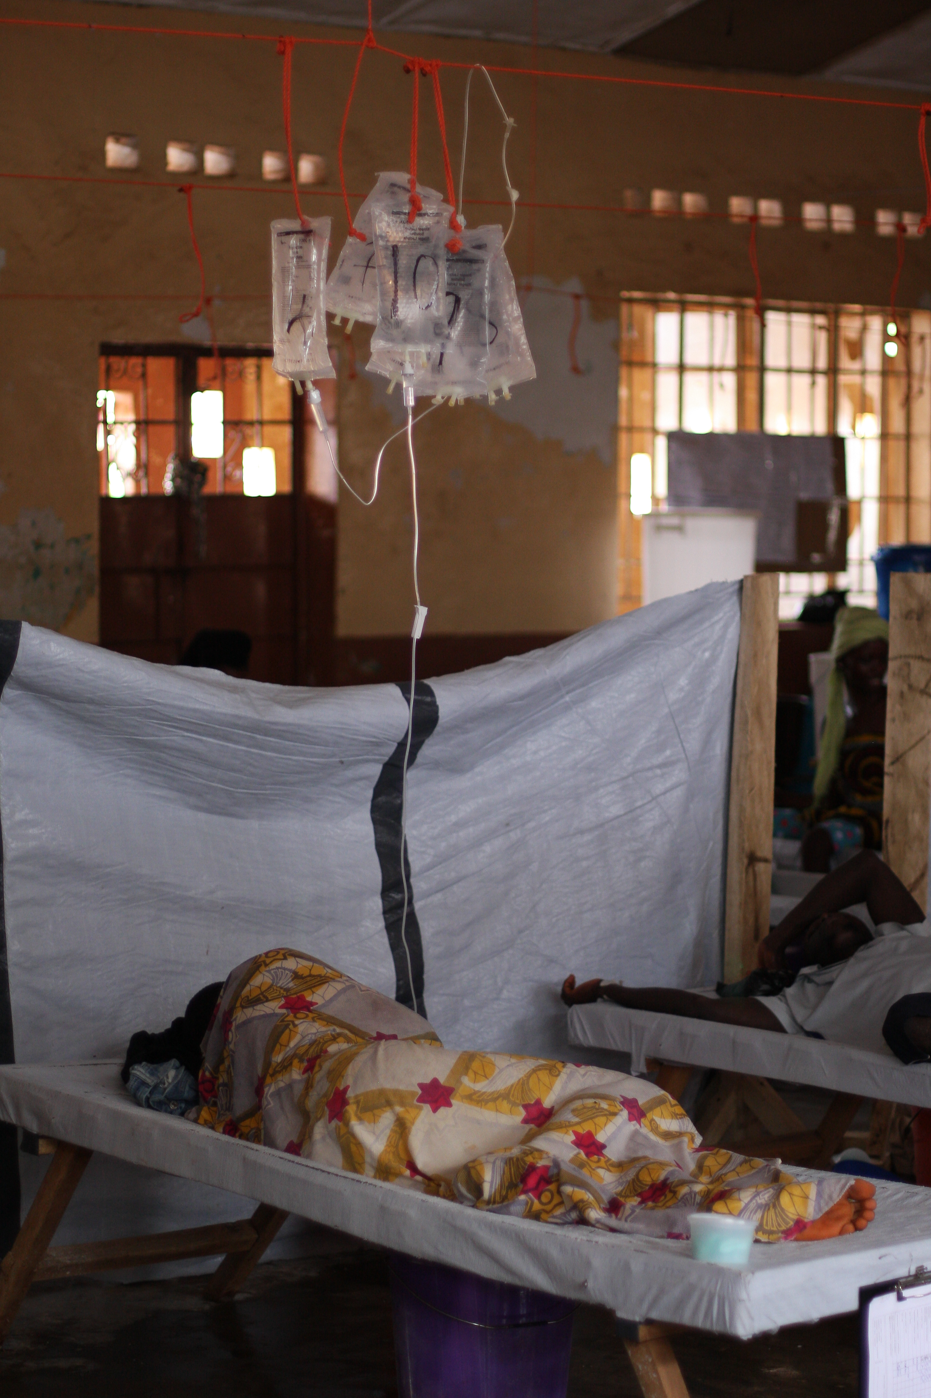
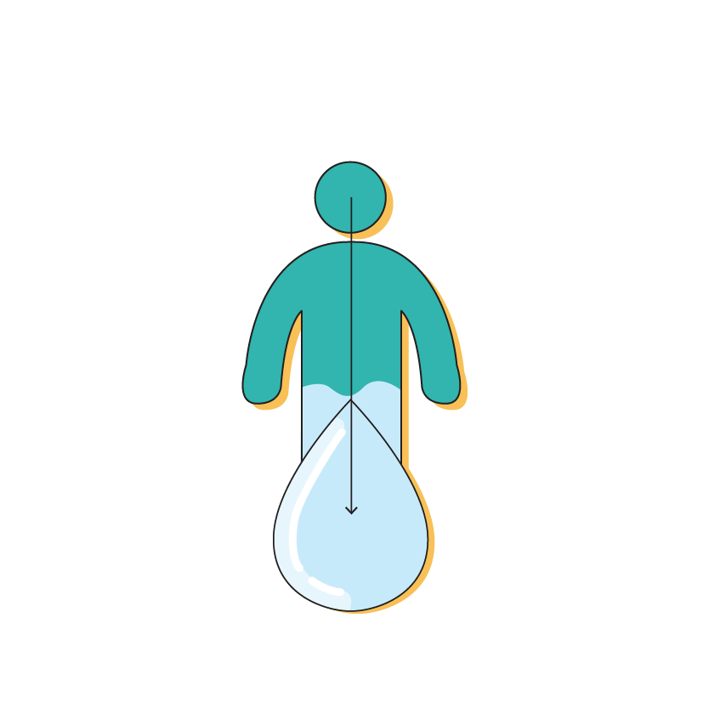
Severe dehydration
Severe Dehydration
One or more danger signs:
Lethargic or unconscious
Absent or weak pulse
Respiratory distress
OR at least two of the following:
Sunken eyes
Not able to drink or drinks poorly
Skin pinch goes back very slowly
© WHO / Fid Thompson
Notes:
People who go on to develop a severe form of cholera disease will be dehydrated due to the loss of fluids from diarrhoea, vomiting and potentially their reduced ability to drink sufficient fluids to replace this loss.
Severe dehydration is defined as when a patient shows at least one of the following signs:
The patient is lethargic, (very tired and lacking energy) or unconscious
Has an absent or weak pulse
Is in respiratory distress
Severe dehydration can also be defined as having at least two of the following signs:
Sunken eyes
The patient is not able to drink or is drinking poorly
Or when doing a skin pinch test the skin goes back slowly

Slide 12
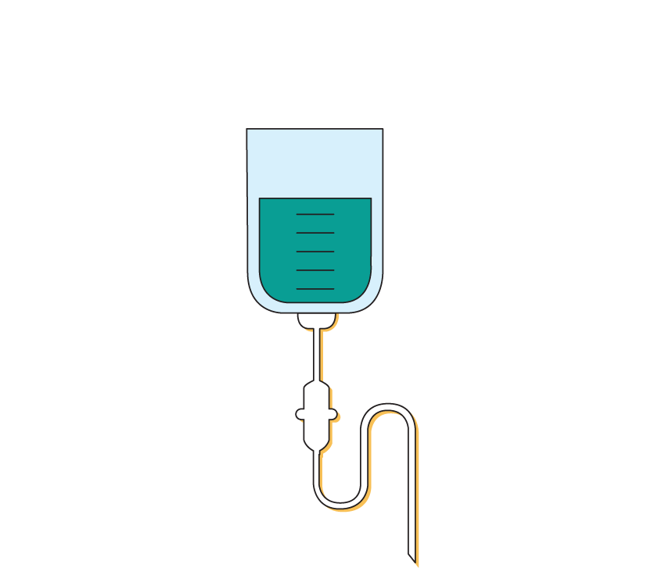

Treatment of cholera
Cholera, the disease, is treatable.
The first line of treatment is rehydration with oral rehydration solution (ORS).
Patients with severe dehydration require IV fluids and antibiotics.
Notes:
It is important to remember cholera is treatable. Patients who die of cholera, die from the effects of dehydration.
The first line of treatment for mild cases is rehydration with oral rehydration solution also called ORS.
Patients with severe dehydration or those unable to drink fluids may need additional interventions. Which can include intravenous fluids, usually Ringer`s Lactate and oral antibiotics.
Antibiotics can help reduce the severity and duration of the disease, but not all cases need antibiotics.

Slide 13
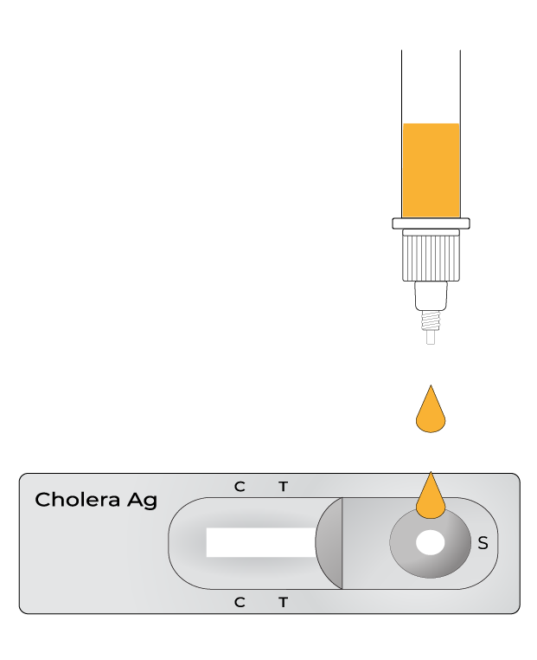
INTRODUCTION TO TESTING FOR CHOLERA
Notes:
Moving onto the testing for bacteria responsible for cholera.

Slide 14
  The recommendations expressed hereafter were developed by the Global Task Force on Cholera Control (GTFCC) and are described in
  “Public Health Surveillance for Cholera”.
  The testing strategies applied in your country may differ, make sure to verify these with your local health authorities.
Notes:
The recommendations described in this section were developed by the Global Task Force on Cholera Control (or GTFCC) and they are further detailed in a guidance document called Public Health Surveillance for Cholera.
The testing strategies being applied in your country may vary a little from those recommended here. Be sure to check for differences with your local health authorities and adapt accordingly.

Slide 15
Why test for cholera?
1
Treat the patient
Tests are not performed to inform clinical case management
i.e. positive /negative results do not change treatment protocol
Identify a cholera suspect case
2
Treatment should not depend on cholera lab result.
Treatment should depend
on the level of dehydration
of the patient.
3
Test for cholera
?
4
Document and report
Why test
Notes:
When you identify a cholera suspect case, it is important to always treat the patient without delay. Then you may find yourself needing to collect a sample from the patient for cholera testing, and finally, it is important to document and report that a suspect cholera case was identified and what is the test result, even if the result is negative.
We will be discussing here:
How do you identify a suspect case of cholera?
When, who and how to test for cholera?
When, what and how to document/report?
Unlike for other diseases, we do not need a cholera test result to treat the patient. We say that tests are not performed to inform clinical case management, meaning that a positive or negative result will not change the treatment protocol. Treatment should depend on the level of dehydration of the patient and will always consist of rehydrating the patient and sometimes giving the patient antibiotics.
So if not for patient management, why do we do we need to test for cholera?

Slide 16
Testing for surveillance and not for clinical management
Different objectives for different epidemiological situations
NO confirmed
NO probable outbreak
CONFIRMED
or probable outbreak
Find the first case as early as possible
Confirm cases, detect probable cholera outbreaks and declare an outbreak
Intervene early to stop the spread (OCV, WASH etc)
Monitor trends and the spread of the outbreak
Guide interventions and allocation of resources
Monitor possible changes in the strain
Notes:
For cholera, we test for surveillance purposes to identify an outbreak or to monitor an existing outbreak, this means we test for different reasons depending on the context.
If you are in an area where there is no current outbreak of cholera, then it is imperative to identify any cholera outbreak as early as possible so that the response teams can intervene rapidly in the community to have a better chance of stopping the outbreak early or limiting the spread with interventions such as providing cholera vaccines or even clean drinking water.
We are looking for the first case of cholera.
If you are in an area where there is an existing ongoing outbreak of cholera, we wish to test enough patients to help monitor the evolution of the outbreak, for example to find out if the number of cases is going up or down, or if the outbreak is spreading to new communities. Knowing this will help the response teams direct the resources and interventions to the areas that most need them. For these reasons we talk about testing for cholera surveillance and not for clinical management. We also want to regularly study the strain to make sure it doesn't change over time, or if a new strain is introduced.

Slide 17
Strategy adapted to epidemiological situation
1
Treat the patient
Depends on whether
or not there is a
confirmed ongoing cholera outbreak in the area.
Identify a cholera suspect case
2
3
Test for cholera
4
Document and report
Notes:
If we look at the different steps, from the treatment and identification of a cholera suspect case all the way to testing, documenting and reporting, three of these steps will differ according to the epidemiological situation prevailing in your area. This means that, you will always treat the patient according to their signs and symptom but depending on whether there is an outbreak of cholera or not in your area, you will identify a suspect case, test a suspect case and report cases in slightly different ways.
Let's start by looking at how to identify a suspect case.

Slide 18
How to identify a cholera suspect case
Most cases of cholera will show no or little signs and symptoms. In the cholera treatment centers or health facilities you will see the subset of cholera cases that develop more severe symptoms.
There are specific definitions of cholera suspect cases.
The definitions of a cholera suspect case are different according to whether
or not there is a confirmed ongoing cholera outbreak in the area.
Notes:
You will recall from the introduction to cholera section, that most cases of cholera will show no or little signs and symptoms. In fact, in the cholera treatment centers or health facilities you will mostly see the subset of cholera cases that develop severe symptoms, those who need most care.
There are specific definitions of cholera suspect cases, these definitions may vary in your country as compared to these GTFCC recommendations but it is important to remember that a suspect case of cholera is not just anyone with any type of diarrhea.
It is also important to know that how we define a suspect cholera case will be different depending on whether or not you are in an area with an already confirmed, ongoing cholera outbreak or not.

Slide 19

Cholera suspect case definitions
NO confirmed
NO probable outbreak
CONFIRMED
or probable outbreak
Where there is NO probable or confirmed cholera outbreak:
Where there IS a probable or confirmed cholera outbreak:
Suspected cholera case
Suspected cholera case
Person aged ≥ 2 years:
A person of ANY age:
OR
AND
OR
or
with acute watery diarrhoea (AWD)
severe dehydration
who died from AWD
with acute watery diarrhoea (AWD)
who died from AWD
Notes:
If you apply GTFCC cholera suspect case definitions and you are in an area where there is currently no outbreak of cholera, then people aged 2 years or older that have acute watery diarrhoea and severe dehydration, or any person, 2 years and older who has died from acute watery diarrhoea should be considered a suspect case.
In an area where there is already an outbreak of cholera, then any person of any age, with AWD or who has died from AWD is considered to be a suspect cholera case.

Slide 20
Test according to epidemiological situation
NO confirmed
NO probable outbreak
CONFIRMED
or probable outbreak
Test ALL suspected
cholera cases
Test A SUBSET of suspected
cholera cases
Notes:
Now you have initiated treatment and identified a suspect case. Who and when do you need to test? And how do you test them?
Remember that when there is no outbreak in the area, our objective is to look for a first case and confirm an outbreak as early as possible so that actions can be taken quickly in the community to have a better chance of stopping the outbreak early or limiting the spread with interventions such as providing clean drinking water or even cholera vaccines.
To do this, you will be asked to sample and test all suspected cases to quickly find the first evidence of a new outbreak.
If you are in an area where there is an existing ongoing outbreak of cholera, there is no longer a need to test all cases. However testing a portion of suspect cases will help monitor the evolution of the outbreak, for example to find out if the number of cases is going up or down, or if the outbreak is spreading to new communities. Testing and obtaining samples from a few cases will also help the laboratory to verify that the strain is not changing with time.
In these areas, you will be asked to test a portion or a subset of suspected cases.

Slide 21

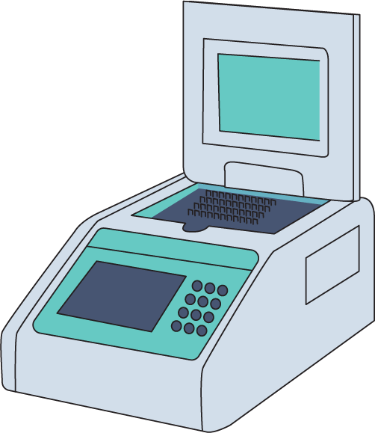
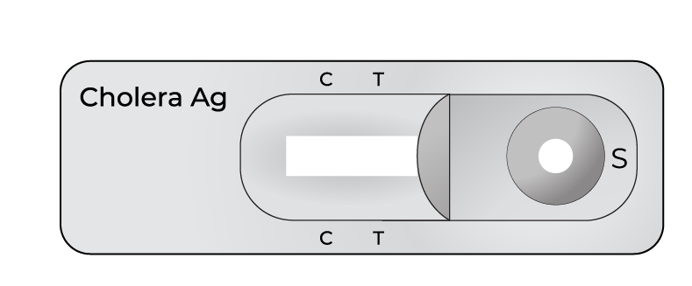
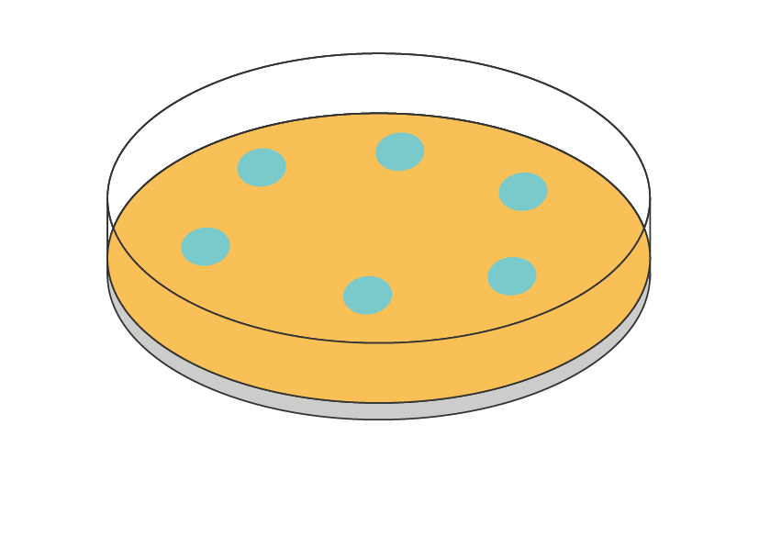
Cholera laboratory diagnosis
Screening tools:
Rapid diagnostic tests
To identify suspected and probable outbreaks or to monitor ongoing outbreaks
Performed close to the patient
Laboratory confirmatory tests:
Culture / polymerase chain reaction (PCR)
Confirm cholera
Performed in a laboratory
Notes:
A clinical diagnosis based on the patients signs and symptoms is used to identify suspected cholera and this is enough to start treatment.
When laboratory testing is needed, common methods used are:
rapid diagnostic tests or RDTs,
Culture and polymerase chain reaction or PCR.
RDTs can be performed virtually anywhere and by clinical personnel or rapid response teams or laboratory technicians. They do not confirm cases but are used to quickly identify suspected or probable cholera outbreaks. We will discuss these in detail in Module 3.
Unlike RDTs, culture and PCR are used to confirm cholera but they need to be performed in a laboratory. These are outside the scope of this course.
In all cases, when there is a need to test a patient for cholera, whether this be with RDT or with culture and PCR, you will first be asked to collect a sample of stool or swab from the suspect case. This will be discussed in Module 2.

Slide 22
Test according to epidemiological situation
RDT not available
NO confirmed
NO probable outbreak
CONFIRMED
or probable outbreak
Test ALL suspected
cholera cases
Test A SUBSET of suspected
cholera cases
Collect sample from all suspect cases to send to a laboratory for confirmation
Collect samples from a subset of suspect cases every week to send to a laboratory for confirmation (the first 3 suspected cases, per week per facility)
Notes:
Not every facility will have RDTs at all times. It is possible you face a situation where you suspect cholera but do not have any RDT to test with due to a stock out for example. But we still have to take action.
If we look at the 2 scenario we have outlined – when there is No confirmed outbreak and No probable outbreak the testing stratergy is to TEST ALL suspected cases. Since we do not have RDTs we collect the sample as discribed in the next module and send it to the laboratory for testing. You may need to communicate with the health authorities or laboratory to quickly distribute transport media and ensure quick transport and let the laboratory know a sample is to be sent.
If there is a probable outbreak or an outbreak declared in the area you work in, then according to the testing strategy the health facility should collect samples from the first 3 cholera suspects per week, and send these samples to the laboratory for testing.
Note, your health authorities may coordinate sample collection days with you to ensure samples do not wait long time periods before being transported.
Next we will look at how this changes if you do have RDTs available on site.

Slide 23
Test according to epidemiological situation
RDT available
NO confirmed
No probable outbreak
CONFIRMED
or probable outbreak
Test ALL suspected
cholera cases
Test A SUBSET of suspected
cholera cases
Perform RDT on all suspect cases of cholera
Collect sample from all RDT reactive cases to send to a laboratory for confirmation
Test a subset of suspect cases every day (first 3) with RDT
Collect a sample from a subset of RDT reactive cases every week to send to a laboratory for confirmation (up to 3, per area)
Notes:
Let's now look at the two scenarios and what to do if RDT are available.
We said that in an area where there is no known outbreak of cholera, our objective is to find a first case and for this we need to test every suspected case. What that means for you is that you may be asked to perform an RDT on all suspected cases and then because we will need further laboratory confirmation, you will want to collect a sample from all RDT reactive (or positive) cases and send to a laboratory for confirmation.
In an area where there is already a known outbreak of cholera, you may be asked to test only a portion of suspected cases every day. The GTFCC recommends testing the first 3 suspected cases every day using RDT. Following this, you may also be asked to collect a sample from a portion of RDT reactive cases every week to send to a laboratory for them to further confirm and study the strain. In this case, the GTFCC recommends sending 3 RDT reactive samples to the laboratory for each area (or surveillance unit) and this every week.
The number of suspected cases recommended to test may vary for your country. Always check what are the procedures in place in your area and at the time you are testing.

Slide 24
Report according to epidemiological situation
NO confirmed
NO probable outbreak
CONFIRMED
or probable outbreak
Record immediately in results register
Report suspect cases and reactive RDT+ results daily to local health authorities
Record immediately in results register
Report suspect cases and all RDT results weekly to local health authorities
Notes:
Now you have treated the patient, identified the patient as a suspected cholera case, maybe tested the patient or even sent a sample to a laboratory, the next critical step is to document your findings and report to the local health authorities.
In any case, you should always keep records for the patient and any RDT results, including any negative or nonreactive results.
In an area where there is no known outbreak of cholera, suspect cholera cases and RDT+ results, should be reported to local health authorities on a daily basis. Negative (non-reactive) results will be reported as per defined routine schedule.
In an area where there is already a known outbreak of cholera, suspect cholera cases and all RDT results should be reported to local health authorities on a weekly basis.

Slide 25
Summary
No outbreak
Outbreak
1
Treat the patient
Treat all, rehydration protocols (ATB)
≥ 2 y/o, with AWD and severe dehydration,
or died from AWD
Any age, with AWD
or died from AWD
2
Identify a cholera suspect case
RDT on all suspect cases
Collect and send sample from all RDT+ to laboratory
RDT on first 3 suspected cases of the day
Collect and send 3 RDT+ samples per week from the area to laboratory
3
Test for cholera
Record immediately
Report daily on RDT+
Record immediately
Report weekly
4
Document and report
Notes:
To summarize,
Always treat the patient as soon as possible.
When there is no outbreak we aim to quickly detect the first case to quickly protect the community and alert other departments to contain the disease and prevent widespread outbreaks. To do this we identify suspect cases, this is anyone 2 years and above with AWD and SEVERE dehydration, or 2 and above who die with AWD. If RDTs are available, we test all suspected cases using the RDT’s. We also send the RDT reactive samples to the laboratory for confirmation by Culture or PCR. If RDTs are not available, we simply collect samples from all suspected cholera cases and send them to the laboratory for testing as soon as possible. We record all RDT results (reactive or non reactive) and report any reactive RDT result to the health authorities on the same day.
When there is an outbreak of cholera in the area or surveillance unit, we aim to monitor the outbreak. A suspected cholera case is now defined as any person of any age, with AWD or who has died from AWD. If RDTs are available, we test the first 3 suspected cases of the day in our health facility using RDTs. We also send the reactive RDT sample to the laboratory for confirmation by culture or PCR. If RDT are not available for any reason, we collect samples from the first 3 suspected cases of the week in the health facility and send them to a laboratory for testing. We keep record of all RDT results. Finally, we report all suspect cases and RDT results to health authorities on a weekly basis.

Slide 26

Links to GTFCC support material
The next two modules of this course will focus on:
Sample Collection, Preparation and Transport for Cholera (Module 2)
Cholera Rapid Diagnostic Tests (RDTs) (Module 3)
For more information:
About cholera OpenWHO course “Cholera: Introduction”
About the treatment of cholera patients GTFCC Clinical job aids
About the surveillance and surveillance strategies
  Recommendations for “Public Health Surveillance for Cholera” : https://www.gtfcc.org/resources/public-health-surveillance-for-cholera/
  Course "Cholera Surveillance for Health Care Workers"
Notes:
For further information…

Slide 27
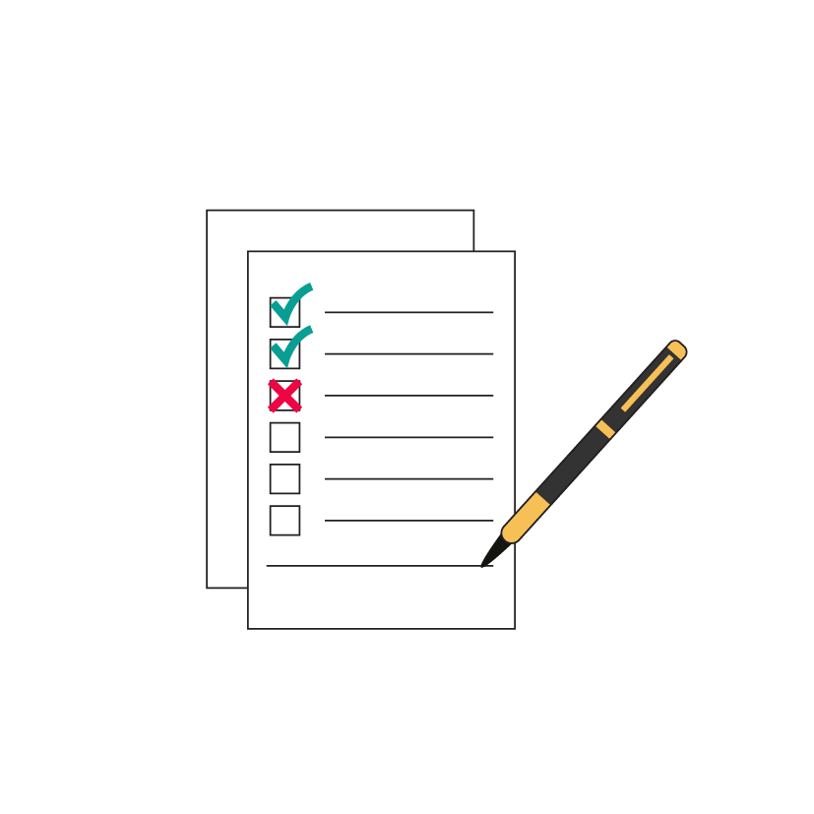
END OF MODULE ASSESSMENT
Notes:
End of module assessment.

Slide 28
Assessment
Only serogroups O1 and O139 of the bacteria called Vibrio cholerae can cause cholera outbreaks.
  True or False
A patient who is suffering from constipation is likely to have cholera.
  True or False
Only patients with a positive/reactive result for cholera RDT should be treated using rehydration protocols.
  True or False
Every cholera suspect case must be tested with RDT, if there is an outbreak in the area or not.
  True or False

Slide 29
Assessment Answers
Only serogroups O1 and O139 of the bacteria called Vibrio cholerae can cause cholera outbreaks.
  True to refresh your memory go to slide 7
A patient who is suffering from constipation is likely to have cholera.
  False to refresh your memory go to slide 10
Only patients with a positive/reactive result for cholera RDT should be treated using rehydration protocols.
  False to refresh your memory go to slide 15
Every cholera suspect case must be tested with RDT, if there is an outbreak in the area or not.
  False to refresh your memory go to slide 23

