Slide 1
Notes:
Welcome to Module 3 of the GTFCC online course on the identification of PAMIs for cholera control.

Slide 2
Notes:
In this module, we will show you the GTFCC PAMI Excel tool, and how to use it.

Slide 3
What will you learn?
Structure and main functions of the PAMI Excel tool
How to upload data in the PAMI Excel tool
How to process calculations in the PAMI Excel tool
How to interpret the outputs generated by the PAMI Excel tool
Notes:
After completing this module, you will be able to:
Describe the structure and the main functions of the PAMI Excel tool;
Upload data in the PAMI Excel tool;
Process calculations in the PAMI Excel tool;
Interpret the outputs generated by the PAMI Excel tool.

Slide 4
PAMI Excel tool
Automatizes all calculations for the identification of PAMIs
Generates summary outputs for discussion at the stakeholder validation
Notes:
The GTFCC PAMI Excel tool is here to help you identify PAMIs for cholera control. It automatizes all calculations for the identification of PAMIs and it generates summary outputs for discussion at the stakeholder validation.

Slide 5
Get ready
Get ready to manipulate the PAMI Excel tool
Make sure to use Windows
The PAMI Excel tool operates under Windows operating system
1. Get the PAMI Excel Tool
2. Get a dataset to manipulate
3. Have the user guide on hand
Identification Tool
Training dataset
User Guide
https://tinyurl.com/PAMIcontrol
Notes:
We encourage you to manipulate the PAMI Excel tool while you are following this module. Get ready for this.
The PAMI Excel tool operates under Windows. Make sure you have access to an operating system that is compatible.
Then, make sure you have on hand the PAMI Excel tool, a training dataset to manipulate, and the user guide of the PAMI Excel tool.
You can download this material online at https://tinyurl.com/PAMIcontrol or by scanning these QR codes.
With this material on hand, you will be able to follow along throughout this module. Do not hesitate to pause the video as needed to explore the tool and practice using it on your own.

Slide 6
Explore the
PAMI Excel tool
Photo adapted from: WHO / Andrew Esiebo
Notes:
To get started, we are going to quickly walk you through the different sheets of the PAMI Excel tool.

Slide 7
Overview of the PAMI Excel tool
Sheet Information
“Read me”
Provides access to reference documents
Provides tips for using the tool
Notes:
The first sheet of the PAMI Excel tool is called “Information”. Basically, this is a ReadMe sheet where you will find links to reference documents and tips on how to use the tool.

Slide 8
Overview of the PAMI Excel tool
Sheet Data input table
This is where to upload your data
Reminder from Module 2
Format your data in accordance
with the GTFCC data model template before upload
Notes:
The next sheet of the PAMI Excel tool is called “Data input table”. This is the sheet where you are going to upload your data for analysis. For the tool to compute the calculations, your data should be formatted in accordance with the GTFCC data model template.

Slide 9
Overview of the PAMI Excel tool
Sheet R.1 | Priority index calculation
This is where all calculations are performed
Notes:
The next sheet of the PAMI Excel tool is called R1 “Priority index calculation”. This is the sheet where all calculations are performed.

Slide 10
Overview of the PAMI Excel tool
Sheets R.2 to R.5
This is where to find the outputs
Each sheet displays different outputs to:
Interpret the calculations
Guide decision-making on PAMIs
Notes:
The following sheets of the PAMI Excel tool are called R2 “Overview tables”, R3 “Priority index summary”, R4 “Additional factors tables” and R5 “Table PAMI export”. These four sheets display the outputs of the PAMI analysis.

Slide 11
Upload data in the PAMI Excel tool
Photo adapted from: WHO / Fabeha Monir
Notes:
To run a PAMI analysis, you have to upload and process your data in the PAMI Excel tool. Let’s see how to do this.

Slide 12
Prepare for the upload
Make sure your data is formatted in accordance with the PAMI data model template
Learn about the data model template in Module 2
Save a local copy of the PAMI Excel tool
If there is a "Protected View" banner, click "Enable Editing"
Notes:
Before using the PAMI Excel tool, make sure that your dataset is formatted in accordance with the PAMI data model template. If you are unsure about what the PAMI data model template is, we encourage you to go back to Module 2 of this course before you continue exploring the PAMI Excel tool.
Save a local copy of the PAMI Excel tool and open it.
If there is a yellow banner which indicates “protected view” when opening the PAMI Excel tool, click “enable editing”.

Slide 13
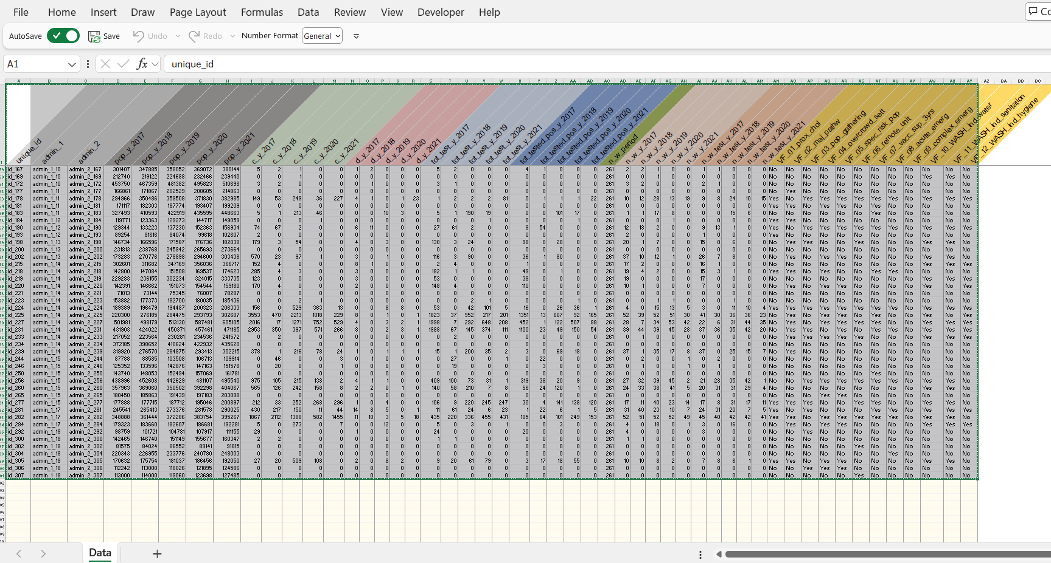
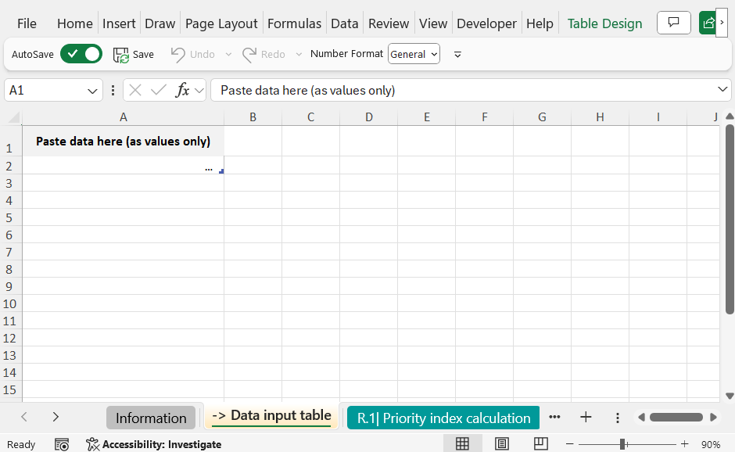
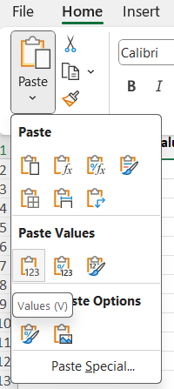
Upload the data
1
Copy your dataset
In your dataset file
Select the entire data range (ctrl +A)
Copy it (ctrl + C)
2
Paste your dataset in the tool
In the PAMI Excel tool
In the sheet Data input table
In the grey Cell A1
Paste the data as values only
2
1
2
3
1
3
Notes:
To upload your data in the PAMI Excel tool, first select and copy your dataset. Press Ctrl + A to select your entire dataset, then press Ctrl + C to copy it.
Next, open the PAMI Excel tool, and go to the sheet “Data input table”.
Go to the grey cell A1, and paste your data as values only.

Slide 14
Include all geo units in the calculations
3
Include all geo units in the calculations
Check the number of rows with data in the sheet Data input table
In the sheet R.1| Priority index calculation select the data in the first row
Drag down the selection until the number of rows with data in the sheet R.1 is the same as the number of rows with data in the Data input table
Notes:
The third step is to include all the geographic units of your dataset in the calculations.
Check how many rows are filled with data in the sheet “data input table”, then go to Sheet R1 “Priority index calculations”.
In Sheet R1, you will see that calculations have been performed for one row. These are calculations for the first geographic unit of your dataset. To expand the calculations to all the geographic units of your dataset, select the data on the 1st row.
Then drag down the selection until the number of rows filled with data in the sheet R1 is the same as the number of rows filled with data in the sheet Data input table.
This expands the calculations to all the geographic units in your dataset.

Slide 15
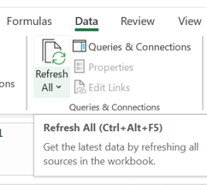
Process the calculations
4
« Refresh » to launch the calculations
Go to the Excel Data tab and click Refresh All
Notes:
Once all geographic units of your dataset have been included in the calculations, the last step is to process the calculations. To do so, in the Excel Data tab, click “Refresh all”.
Now, all PAMI calculations have been performed on your dataset, and outputs have been generated.

Slide 16
Go through
the outputs
Photo adapted from: WHO / Andrew Esiebo
Notes:
Let’s go through the different outputs generated by the PAMI Excel tool.

Slide 17
What is in sheet R.1?
Calculation sheet
All indicators to identify PAMIs are calculated in this sheet
For each row (=each geo unit)
Epidemiological indicators (incidence, mortality, persistence) and their score
Representativeness of testing and testing indicators
Priority index
Number of vulnerability factors present
Notes:
Sheet R1 “Priority index calculation” is a calculation sheet where the following is calculated for each geographic unit of your dataset:
the epidemiological indicators and their respective score;
the representativeness of cholera testing in your dataset and testing indicators;
the priority index;
and, if optional data on the presence or absence of vulnerability factors were included in your dataset, the number of vulnerability factors present.

Slide 18
How to use Sheet R.1?
Do not manipulate nor modify the sheet R.1
Calculations in the sheet R1 are used as the source of data for calculating all outputs (sheets R2 to R5)
Manipulations in the sheet R.1 may interfere with the outputs
Use the sheet R.5 instead
Sheet R.5 shows the same variables as sheet R.1
To sort/manipulate/explore the outputs displayed in the sheet R1, use the sheet R5
Notes:
As R1 is a calculation sheet, we recommend you do not manipulate the outputs displayed in sheet R1 in order not to interfere with the calculations.
Instead, sheet R5 of the PAMI Excel tool, Table PAMI export, shows similar outputs, and can be manipulated as needed.

Slide 19
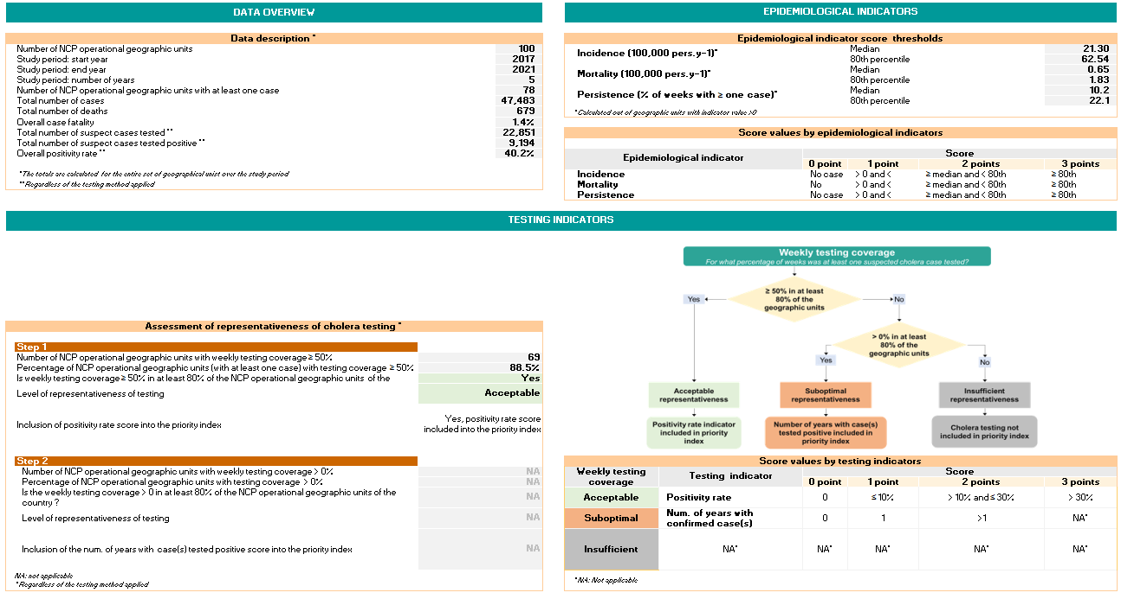
What is in sheet R.2?
All parameters of the PAMI analysis are summarized in the sheet R2
Data overview
Epidemiological
indicators
Summary statistics on the dataset analysed
Scoring scale of epidemiological indicators according to their distribution
Testing indicators
How testing is addressed in the analysis according to the representativeness of cholera testing
Notes:
Sheet R2 “Overview tables” displays key parameters of the analysis performed on your dataset.
The first section, on the upper left side, is “Data overview”. This section provides descriptive information and summary statistics on your dataset.
The second section, on the upper right side, is “Epidemiological indicators”. This section displays the scoring scale of epidemiological indicators according to the distribution parameters of your dataset, namely the median and the 80th percentile of each epidemiological indicator.
The third section “Testing indicator” shows how the representativeness of cholera testing was assessed in your dataset and, as a result, how cholera testing has been addressed in the calculation of the priority index.

Slide 20
How to use Sheet R.2?
Use the figures provided in the Sheet R.2 to:
Detect any inconsistency that may indicate errors in the dataset or its formatting
(data overview)
Understand how the priority index was calculated
(epidemiological indicators, testing indicators)
Extract key figures of the PAMIs analysis for discussion at the stakeholder validation
Document key figures of the PAMIs analysis in the report on PAMI identification
Notes:
Use the data overview section of sheet R2 to verify that it is consistent with your dataset. If you detect any inconsistencies this may indicate errors in the formatting of your dataset or errors at the data upload step, for example maybe you did not include all geographic units of your dataset in the calculations. Investigate the cause of error, and correct it as needed.
Use the epidemiological indicators and testing indicators sections of sheet R2 to understand how the priority index has been calculated depending on the characteristics of your dataset.
You may also extract figures from sheet R2 for discussion at the stakeholder validation and to prepare your report on PAMI identification.

Slide 21
What is in sheet R.3?
1
Stratified by priority index value
Proxy on the feasibility of interventions in PAMIs
Cumulative # of geo units and % of the population in geo units with a priority index ≥ priority index value
Proxy on the potential impact of interventions in PAMIs
Cumulative # and % of cholera cases and deaths in geo units with a priority index ≥ priority index value
2
3
2
3
1
Notes:
Sheet R3 provides essential figures for discussion at the stakeholder validation.
For each priority index value, the table in sheet R3 shows relative and cumulative figures.
Cumulative figures on geographic units and on population are proxy for the feasibility of the future NCP if the priority index threshold value was the selected table line.
Cumulative figures on cholera cases and deaths are proxy for the potential impact of the future NCP if the priority index threshold value was the selected table line.

Slide 22
How to read sheet R.3?
Illustration
If priority index threshold set to ≥ 9
Feasibility of interventions in PAMIs
30 geo units would be PAMIs
33% of the population
Potential impact of interventions in PAMIs
90% of the cholera cases
70% of the cholera deaths
Notes:
For example, using fictive data, here is how to read the table displayed in sheet R3.
If the priority index threshold was set to 9:
30 geographic units would be PAMIs, and 33% of the country population would live in PAMIs;
90% of the cholera cases and 70% of the cholera deaths reported over the PAMI analysis period would have occurred in PAMIs.

Slide 23
How to use Sheet R.3?
Figures in the sheet R.3 are used to set the priority index threshold
Explore and discuss different threshold scenario at the stakeholder validation for setting the priority index threshold
Determine the best balance between feasibility and impact
Document how the priority index was selected in the report on PAMI identification
Notes:
The table in sheet R3 is essential to decide how to set the priority index threshold.
Different scenarios for setting the priority index threshold should be presented at the stakeholder validation and should be discussed in a participative manner for stakeholders to determine the best balance between the feasibility and the potential impact of the future NCP in the country-specific context.
This table should also be included in your report on PAMI identification.

Slide 24
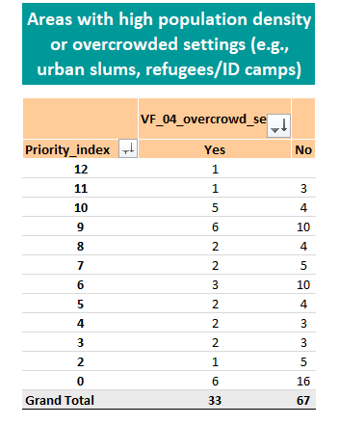
What is in sheet R.4?
Only applicable if vulnerability factors are included in the PAMI analysis
For each vulnerability factor and stratified by priority index value
Number of geo units where the vulnerability factor is present
Notes:
Sheet R4 “Additional factors tables” is only applicable if vulnerability factors are included in your PAMI analysis. This is optional.
If vulnerability factors are included in your PAMI analysis, in Sheet R4 you will find summary figures on the number of geographic units where each vulnerability factor is present - depending on the priority index value of the geographic units.

Slide 25
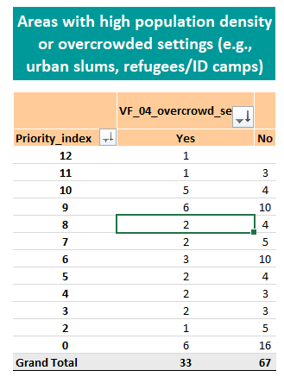
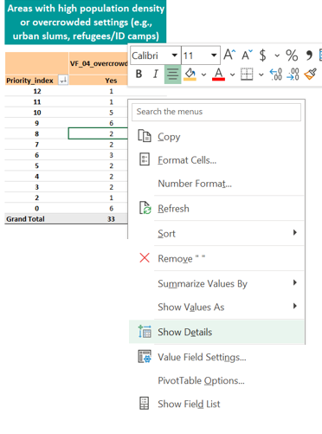
How to manipulate sheet R.4?
To see the geo units where the vulnerability factor is present for a given priority index value
1
2
3
Select the cell you would like to explore
Right-click and choose “Show Details”
A new Excel sheet opens
Notes:
To see in which geographic units a vulnerability factor is present for a given priority index value, go to the cell that you wish to explore, right click and choose show details. Clicking show details will generate a new Excel sheet where you will find detailed information about these geographic units.

Slide 26
How to use Sheet R.4?
If vulnerability factors were included in the PAMI analysis
Use the figures provided in the sheet R.4 to:
Guide the discussions on additional PAMIs at the stakeholder validation
Explore vulnerability factors present in geo units that have a priority index value below the priority index threshold
Notes:
If vulnerability factors are included in your PAMI analysis, use the figures provided in sheet R4 to guide the discussions on additional PAMIs at the stakeholder validation.
In particular, use sheet R4 to explore vulnerability factors present in geographic units that have a priority index below the priority index threshold selected by country stakeholders.

Slide 27
What is in sheet R.5?
Content similar to Sheet R.1
All indicators calculated to identify PAMIs
Notes:
The last sheet of the PAMI Excel tool is sheet R5 “Table PAMI export”. This sheet mirrors the content of the sheet R1 “Priority index calculations”; the same variables are displayed.

Slide 28
How to use Sheet R.5?
Manipulate the data in the sheet R.5
For example, sort or filter the data by priority index value
Export a copy of the sheet R.5
This export can be used for:
Importation in a statistical software
Importation in a GIS software to map PAMIs
Discussing specific geo units at the stakeholder validation
Taking notes at the stakeholder validation
Notes:
You can manipulate the content of sheet R5 as needed. Feel free to explore the outputs by filtering and sorting the values.
You can also export the content of sheet R5 to import it in a statistical software for further analysis or to import it in a GIS software to map PAMIs.
Sheet R5 can also be used to guide discussions at the stakeholder validation, in particular the column “priority index” and the column “number of vulnerability factors present”.
Lastly, you can add columns as needed in sheet R5 in order to take note at the stakeholder validation regarding the final PAMI status of each geographic unit.

Slide 29
Wrap up
The GTFCC PAMI Excel computes all calculations and generates the following outputs
Sheet R.2| Overview tables
Parameters of the PAMI analysis
Useful to understand the analysis performed and for consistency checks
Sheet R.3| Priority index summary
Proxy on feasibility & impact of interventions
Useful to set the priority index threshold at the stakeholder validation
Sheet R.4| Additional factors tables
If vulnerability factors included in the analysis
Summary information on the presence/absence of vulnerability factors
Useful to discuss the inclusion of additional PAMIs at the stakeholder validation
Sheet R.5| Table PAMIs Export
Summarizes all calculations
Useful for GIS mapping, additional analysis, etc
Notes:
As we wrap up this module, here are the important points to remember.
The GTFCC PAMI Excel tool computes all calculations for the identification of PAMIs for cholera control, including indicators, scores, and the priority index for each geographic unit.
It also generates the following outputs:
Sheet R2 “Overview tables” summarizes all parameters of the PAMI analysis. Use this sheet to understand how the analysis was performed depending on the characteristics of your dataset and for consistency checks.
Sheet R3 “Priority index summary” provides proxy on the feasibility and the potential impact of the future NCP depending on the selected priority index threshold. This is an essential sheet to guide decision-making on the priority index threshold value.
Sheet R4 “Additional factors tables” is to be used if vulnerability factors are considered in your PAMI analysis. It provides summary information on the presence or absence of vulnerability factors. Use this sheet to guide discussions on additional PAMIs at the stakeholder validation.
Lastly, sheet R5 “Table PAMIs Export” summarizes all calculations and can be used for additional analysis.

Slide 30
Learn more
Watch videos to see how to use the PAMI Excel tool
https://tinyurl.com/tutoexcelPAMIcontrol
Get ready to use the PAMI Excel tool
Upload data in the PAMI Excel tool
Explore the outputs of the PAMI Excel tool
Notes:
Beyond this module, we encourage you to watch video tutorials to see the PAMI Excel tool in action.
At https://tinyurl.com/tutoexcelPAMIcontrol or by scanning the QR code at the bottom of your screen, you will access three video tutorials: one to help you get ready to use the PAMI Excel tool, one to show you how to upload data in the PAMI Excel tool, and the last one to explore the outputs of the PAMI Excel tool.

Slide 31
Practice
Practice using the PAMI Excel tool with an exercise
Access the exercise
Check your answers
https://tinyurl.com/PAMIcontrolPractice
https://tinyurl.com/PAMIcontrolAnswers
Takes about 15 minutes to complete
Notes:
To practice using the PAMI Excel tool, we also encourage you to take a short exercise.
You can access this exercise at https://tinyurl.com/PAMIcontrolPractice, or by scanning the QR code.
Completing the exercise takes about 15 minutes.
Then check your answers at https://tinyurl.com/PAMIcontrolAnswers or by scanning the QR code.
Practicing using the tool is the best way to get comfortable using it like a pro!

Slide 32
Notes:
We have now completed this module.

