Slide 1
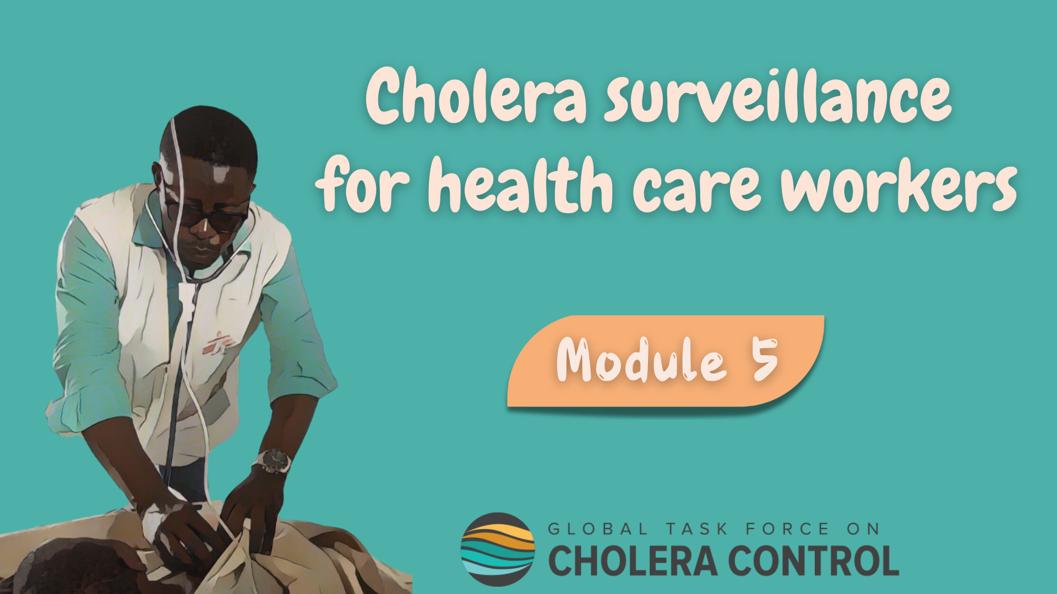
Notes:
Welcome to Module 5 of the GTFCC online course on cholera surveillance for health care workers.

Slide 2
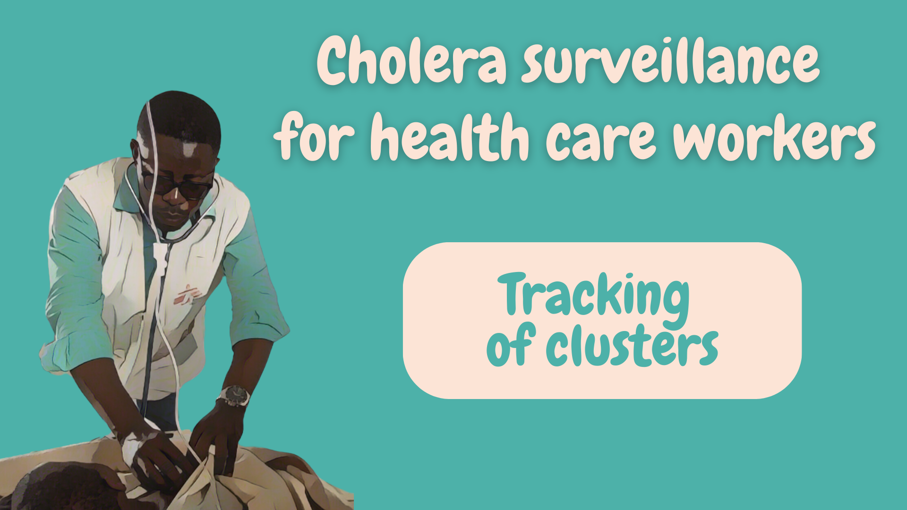
Notes:
In this module, we will dive into how to implement surveillance to track clusters of cholera cases.

Slide 3

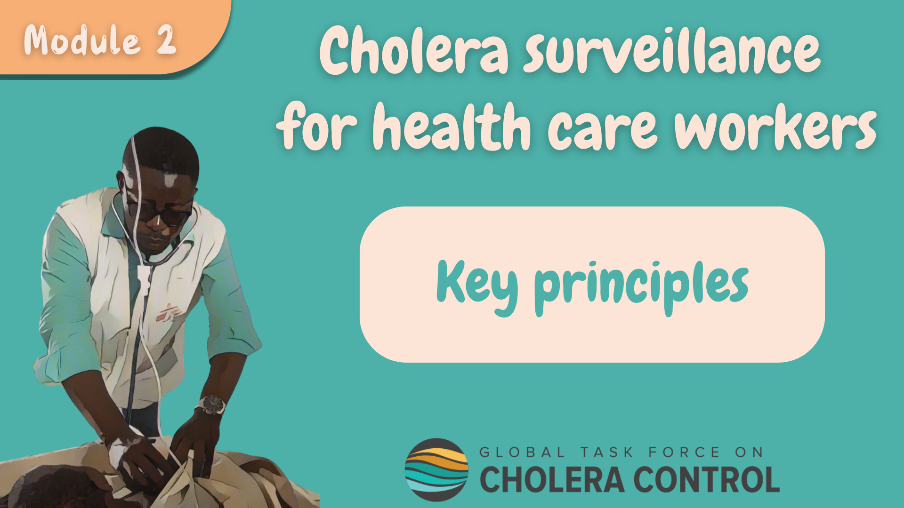
Get ready for this module
Before taking this module, make sure to complete Module 2 ‘Key Principles’
Notes:
While this module focuses on the specificities of cholera surveillance to track cholera clusters, general principles for health care workers to implement cholera surveillance addressed in Module 2 also apply - these principles always apply.
Therefore, if you have not yet already done so, we encourage you to take module 2 of this course before taking this module.

Slide 4

What will you learn?
How to implement surveillance to track clusters including:
    How to identify patients with suspected cholera
    Which patients with suspected cholera to test
    How often to report patients with suspected cholera
Notes:
After completing this module, you will know how to implement surveillance to track clusters including:
How to identify patients with suspected cholera;
Which patients with suspected cholera to test;
And, how often to report patients with suspected cholera.

Slide 5
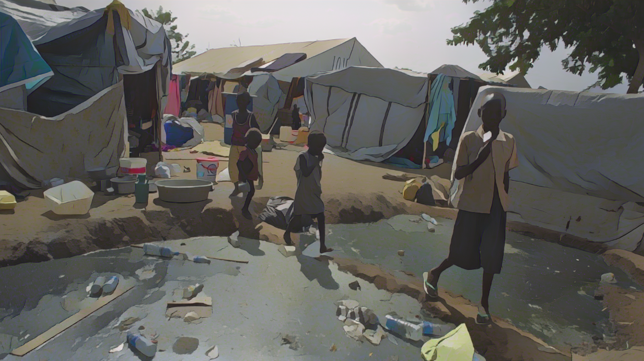
Background
Photo adapted from: WHO / Ali Ngethi
Notes:
Let’s start with a refresher on cholera surveillance to track clusters.

Slide 6



Cluster of cholera cases
A cluster is when a group of cases:
  Infected one another, or
  Were infected with the same source
More likely to occur at the very early stages following the introduction of cholera in a new geographic area
A cluster is a type of outbreak which calls for strong surveillance efforts to
        Guide quick and highly targeted interventions
        Interrupt transmission before it spreads in the community
Notes:
A cholera cluster is when a group of cases infected one another or were infected with the same source.
Clusters are more likely to occur at the very early stages following the introduction of cholera in a new geographic area.
A cluster is a type of cholera outbreak which requires strong surveillance efforts in order to guide quick and highly targeted interventions around the cases. This aims to interrupt cholera transmission before it spreads in the community and becomes more challenging to control.

Slide 7








Surveillance to track clusters
When clustered cholera transmission has been detected in a geographic area
Stay up-to-date
Health authorities regularly update health care workers on the cholera situation in their geographic area
    At any point in time, know:
      The cholera situation in your geographic area
      Whether surveillance is to track a cluster
Photo adapted from: WHO / Francine Tchouta
Notes:
Surveillance is implemented to track cholera clusters when clustered transmission has been detected in a local geographic area.
Health authorities regularly share information and updates on the local cholera situation.
Make sure to stay up-to-date, that way at any point in time you will know the cholera situation in your local geographic area and whether you should implement cholera surveillance to track clusters.

Slide 8


Surveillance objective
Surveillance to track clusters is to orient quick and highly targeted
interventions to stop transmission before it spreads in the community
Identify, test, and report patients with suspected cholera
in accordance with the recommendations in this module
As long as there is clustered transmission
Learn about surveillance in other situations in Modules 3 & 4
If the situation changes, surveillance evolves
Notes:
Surveillance to track clusters is to orient quick and highly targeted interventions around the cases to stop cholera transmission before it starts to spread in the community.
To implement cholera surveillance to track cholera clusters, identify, test, and report any patient with suspected cholera in accordance with the recommendations of this module.
This applies as long as there is clustered cholera transmission in your local geographic area. If the cholera situation changes, for example transmission is over or transmission in the community is occurring, how to implement cholera surveillance evolves. We invite you to learn more about this in Modules 3 and 4.

Slide 9
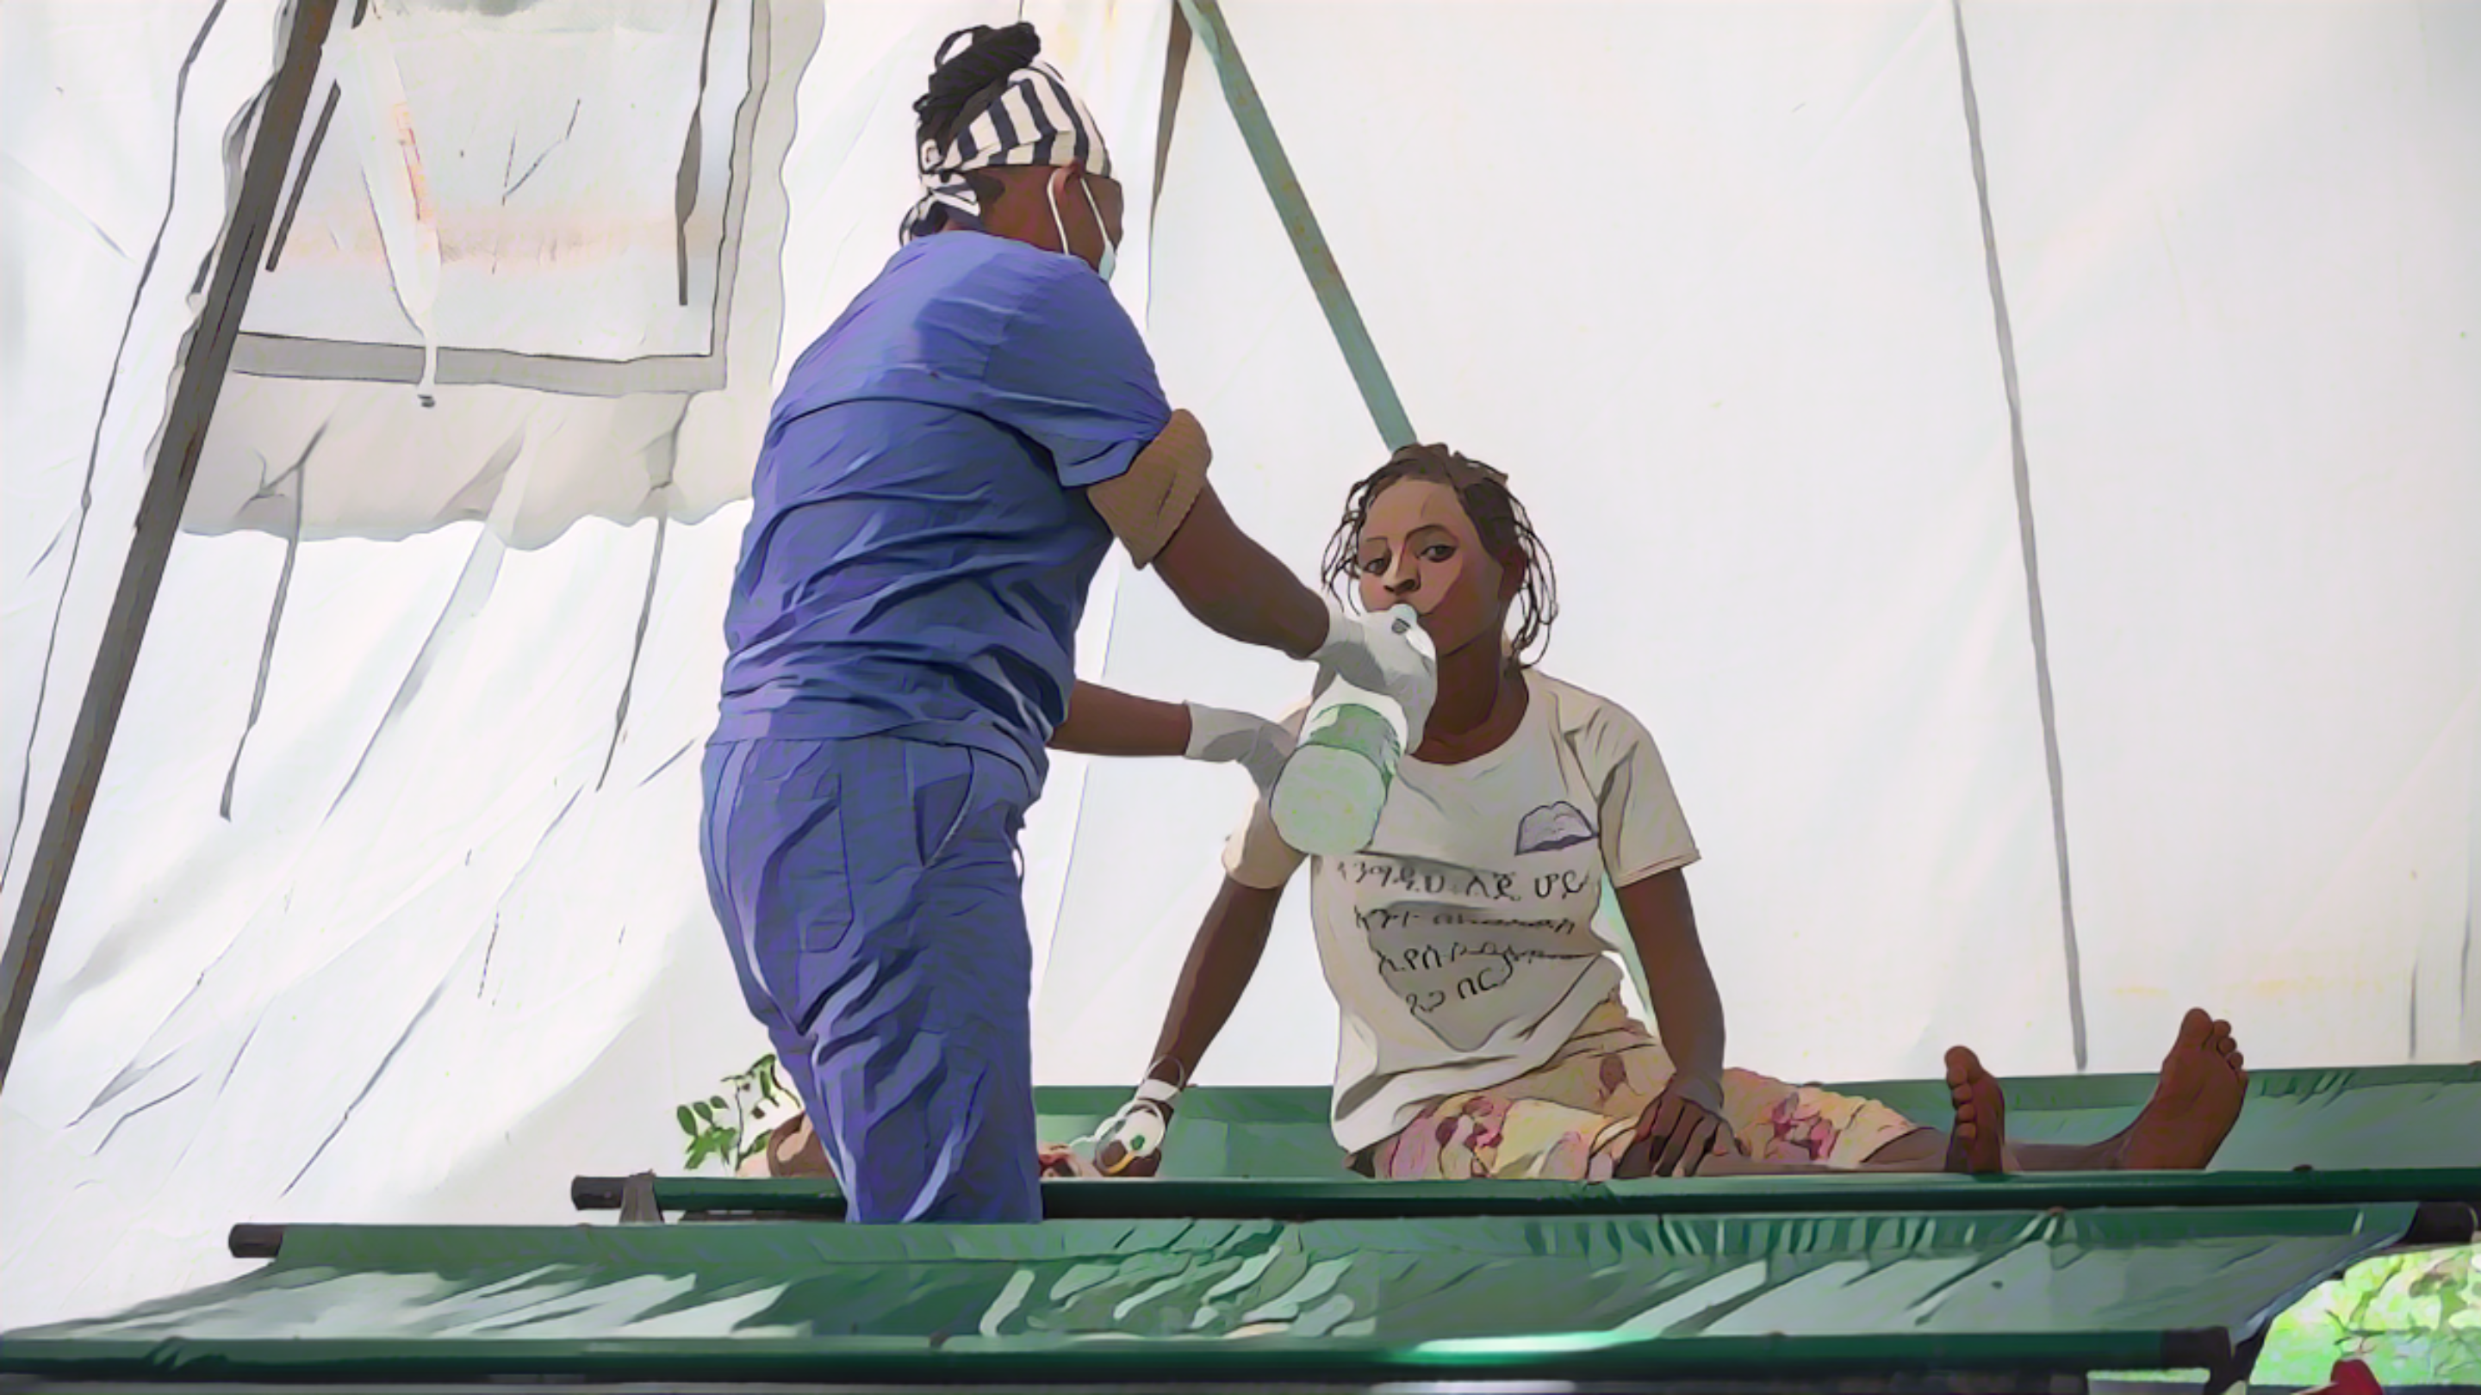
Patients with suspected cholera
Photo adapted from: WHO/Mulugeta Ayene
Notes:
Let’s see how to identify patients with suspected cholera when surveillance is to track cholera clusters.

Slide 10

Case definition
Patients with suspected cholera:
Any patient with AWD (or who died from AWD)
Learn how to recognize AWD in Module 2
NO criteria on age or severe dehydration
  Sensitive detection of suspected cases to effectively interrupt transmission
Notes:
When surveillance is implemented to track cholera clusters, a suspected cholera case is any patient who has acute watery diarrhoea (AWD) or who died from AWD.
If you are unsure about how to identify AWD, we encourage you to go back to module 2.
There are no additional criteria on age or severe dehydration to identify patients with suspected cholera among patients who have AWD.
This is to ensure a sensitive detection of suspected cholera cases and increases chances to effectively interrupt transmission by implementing interventions around the cases.

Slide 11

Testing for
cholera
Photo adapted from: WHO/Fid Thompson
Notes:
Let’s look into the strategy to test patients with suspected cholera when surveillance is to track clusters.

Slide 12
Testing to track clusters
All patients with suspected cholera are tested
  Essential to understand clustered transmission and orient interventions accordingly
If RDTs are available
If RDTs are NOT available
RDTs are used to triage samples for laboratory testing
Samples are not triaged for laboratory testing
ALL patients with suspected cholera are tested by RDT
Samples from ALL patients with RDT+ results are sent to a laboratory for confirmatory testing
Samples from ALL patients with suspected cholera are sent to a laboratory for confirmatory testing
Notes:
When surveillance is to track clusters, all patients who meet the definition of a suspected cholera case are tested for cholera.
Testing all patients with suspected cholera is critical to understand how clustered transmission is occurring, and orient effective interventions accordingly.
If RDTs are available at your facility, use RDTs to triage samples for laboratory testing.
Test all patients who meet the definition of a suspected cholera case with a RDT.
If the RDT result is negative, cholera is ruled out.
If the RDT result is positive, send a sample to a laboratory for confirmatory testing by culture or PCR.
If RDTs are not available at your facility, collect samples from all patient who meet the definition of a suspected cholera case and sent the samples to a laboratory for confirmatory testing.

Slide 13

Reporting
cholera
Photo adapted from: WHO / Genna Print
Notes:
Lastly, let’s look into the reporting of patients with suspected cholera.

Slide 14

Reporting cholera
If a patient with suspected cholera is seen at your facility, the standard information
collected on this patient is reported to the health authority on the same day
Reporting within a day is essential to permit timely interventions around cases
Time is key!
Learn about the standard information to be collected & reported in Module 2
If on a given week, no patient with suspected cholera was seen in your facility
  Report the absence of cases at the end of the week (zero reporting)
To report, use the channels & mechanisms set at your facility (e.g., reporting focal point)
Notes:
If a patient who meets the definition of a suspected cholera case is seen at your facility, collect standard information on this patient and report it to your health authority within a day.
Reporting any patient with suspected cholera within a day is essential to permit timely interventions around cases. Time is key to interrupt transmission.
If you are unsure about the standard information that should be collected on patients with suspected cholera, we invite you to go back to Module 2.
If on a given week, no patient who meets the definition of a suspected cholera case was seen in your facility, report the absence of cases to your health authority at the end of the week. This is zero reporting.
To report patients with suspected cholera to your health authority, use the reporting channels and mechanisms in place at your facility. For example, there may be a reporting focal point.

Slide 15
Wrap up
In geographic areas where there is a cluster of cholera cases, surveillance is to guide highly targeted interventions to interrupt transmission before it spreads in the community
Patients with suspected cholera are any patients with AWD (or who died from AWD)
All patients with suspected cholera are tested for cholera
Standard information on all patients with suspected cholera is reported within 24 hours
If no patient with suspected cholera was seen on a given week, this is reported weekly
Notes:
As we wrap up this module, here are the important points to remember.
In local geographic areas where there is a cluster of cholera cases, surveillance aims to guide highly targeted interventions to interrupt transmission before it spreads in the community and becomes more challenging to control.
When surveillance is implemented to track cholera clusters, all patients with acute watery diarrhoea (AWD) are suspected cholera cases.
All patients meeting the definition of a suspected cholera case are tested.
In addition, standard information is collected on all patients with suspected cholera and reported within 24 hours.
If no patient with suspected cholera was seen at a facility, this is reported weekly.

Slide 16

Notes:
Before moving on to the next module, we encourage you to take a short quiz. There are three questions in this quiz.

Slide 17

Question 1
To track cholera clusters, a patient with suspected cholera is any patient:
    Aged ≥ 2 years old with AWD
    With AWD and severe dehydration
    Aged ≥ 2 years old with AWD and severe dehydration
    With AWD
Notes:
Question 1. To track cholera clusters, a patient with suspected cholera is any patient:
Aged 2 years old or older with Acute Watery Diarrhoea (AWD).
With AWD and severe dehydration.
Aged 2 years old or older with AWD and severe dehydration.
With AWD.

Slide 18

Question 1 – Answer
To track cholera clusters, a patient with suspected cholera is any patient:
    Aged ≥ 2 years old with AWD
    With AWD and severe dehydration
    Aged ≥ 2 years old with AWD and severe dehydration
    With AWD
Notes:
The correct answer is d. When surveillance is to track cholera clusters, any patient with AWD is a suspected cholera case.

Slide 19
Question 2
To track cholera clusters:
  (Select all that apply)
    Any patient with suspected cholera is reported daily
    Any patient with suspected cholera is reported weekly
    The absence of patient with suspected cholera is reported daily
    The absence of patient with suspected cholera is reported weekly
Notes:
Question 2. Select all that apply. To track cholera clusters:
Any patient with suspected cholera is reported daily.
Any patient with suspected cholera is reported weekly.
The absence of patient with suspected cholera is reported daily.
The absence of patient with suspected cholera is reported weekly.

Slide 20
Question 2 – Answers
To track cholera clusters:
    Any patient with suspected cholera is reported daily
    Any patient with suspected cholera is reported weekly
    The absence of patient with suspected cholera is reported daily
    The absence of patient with suspected cholera is reported weekly
Notes:
The correct answers are a and d. When surveillance is to track cholera clusters any patient meeting the definition of a suspected cholera case is reported daily and the absence of patients meeting the definition of a suspected cholera case is reported weekly.

Slide 21
Question 3
To track cholera clusters, any patient with AWD is tested for cholera:
    True
    False
Notes:
Question 3. This is the last question. To track cholera clusters, any patient with AWD is tested for cholera. Is this a) true or b) false?

Slide 22
Question 3 – Answer
To track cholera clusters, any patient with AWD is tested for cholera:
    True
    False
Notes:
The correct answer is a. This is true. When surveillance is to track cholera clusters, any patient with AWD is tested for cholera. This is because any patient with AWD is a suspected cholera case, and all suspected cholera cases should be tested to track clusters effectively.

Slide 23

Notes:
We have now completed this module.

