Slide 1
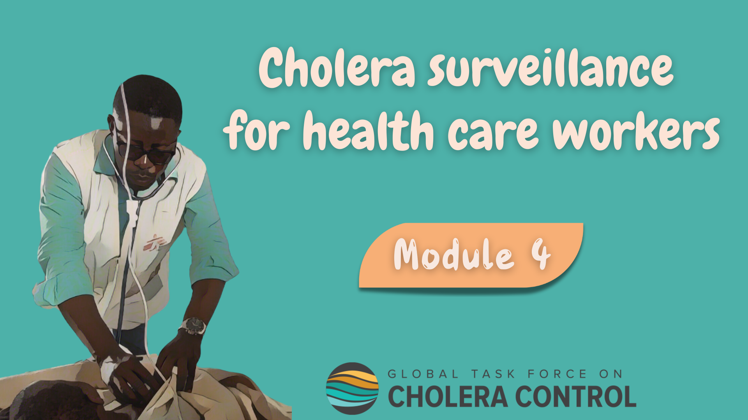
Notes:
Welcome to Module 4 of the GTFCC online course on cholera surveillance for health care workers.

Slide 2
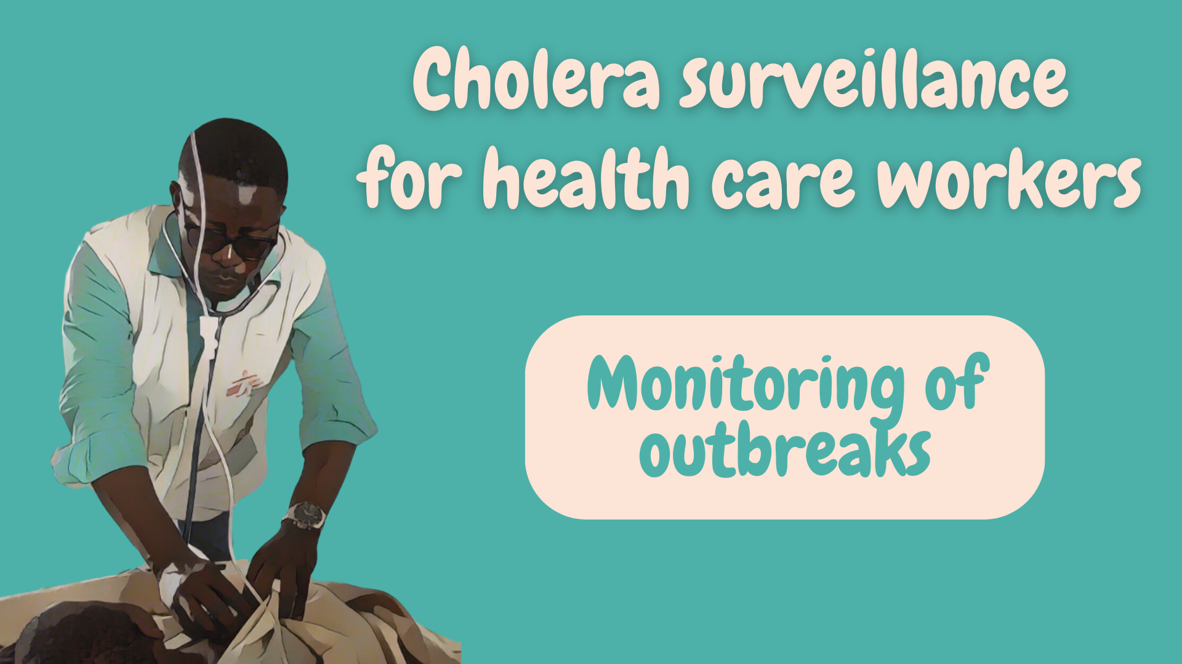
Notes:
In this module, we will dive into how to implement surveillance to monitor a cholera outbreak.

Slide 3

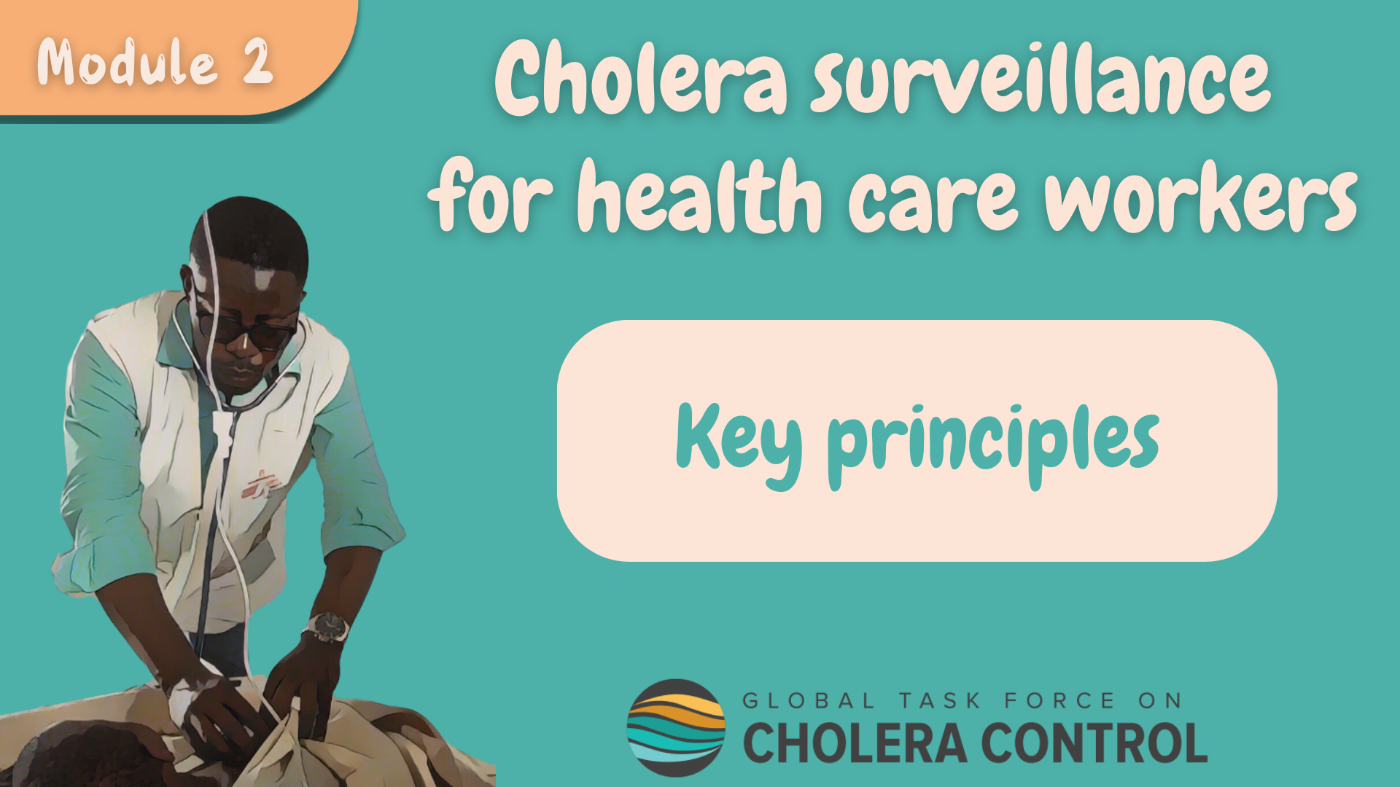
Get ready for this module
Before taking this module, make sure to complete Module 2 ‘Key Principles’
Notes:
While this module focuses on the specificities of cholera surveillance to monitor an outbreak, general principles for health care workers to implement cholera surveillance addressed in Module 2 also apply - these principles always apply. Therefore, if you have not yet already done so, we encourage you to take module 2 of this course before taking this module.

Slide 4

What will you learn?
How to implement surveillance to monitor an outbreak including:
    How to identify patients with suspected cholera
    Which patients with suspected cholera to test
    How often to report patients with suspected cholera
Notes:
After completing this module, you will know how to implement surveillance to monitor a cholera outbreak, including
How to identify patients with suspected cholera;
Which patients with suspected cholera to test;
And, how often to report patients with suspected cholera.

Slide 5

Background
Photo adapted from: WHO/Billy Miaron
Notes:
Let’s start with a refresher on cholera surveillance to monitor an outbreak.

Slide 6









Surveillance for outbreak monitoring
When there is a cholera outbreak in a geographic area
Health authorities regularly update health care workers on the cholera situation in their geographic area
Stay up-to-date
    At any point in time, know:
      The cholera situation in your geographic area
      Whether surveillance is to monitor a cholera outbreak
Photo adapted from: WHO / Francine Tchouta
Notes:
Surveillance is implemented to monitor a cholera outbreak when there is an ongoing outbreak in a local geographic area.
Health authorities regularly share information and updates on the local cholera situation.
Make sure to stay up-to-date, that way at any point in time you will know the cholera situation in your local geographic area and whether you should implement cholera surveillance to monitor an outbreak.

Slide 7


Surveillance objective
Surveillance to monitor an outbreak generates information to
guide multisectoral interventions to end the outbreak
Identify, test, and report patients with suspected cholera
in accordance with the recommendations in this module
As long as there is an outbreak
Learn about surveillance in other situations in Modules 3 & 5
If the situation changes, surveillance evolves
Notes:
Implementing surveillance to monitor a cholera outbreak is to continuously generate information to guide near real time effective multisectoral interventions to end the outbreak.
To implement cholera surveillance to monitor an outbreak, identify, test, and report any patient with suspected cholera in accordance with the recommendations of this module.
This applies as long as there is a cholera outbreak in your local geographic area. If the cholera situation changes, for example the outbreak is over, how to implement cholera surveillance evolves. We invite you to learn more about this in Modules 3 and 5.

Slide 8
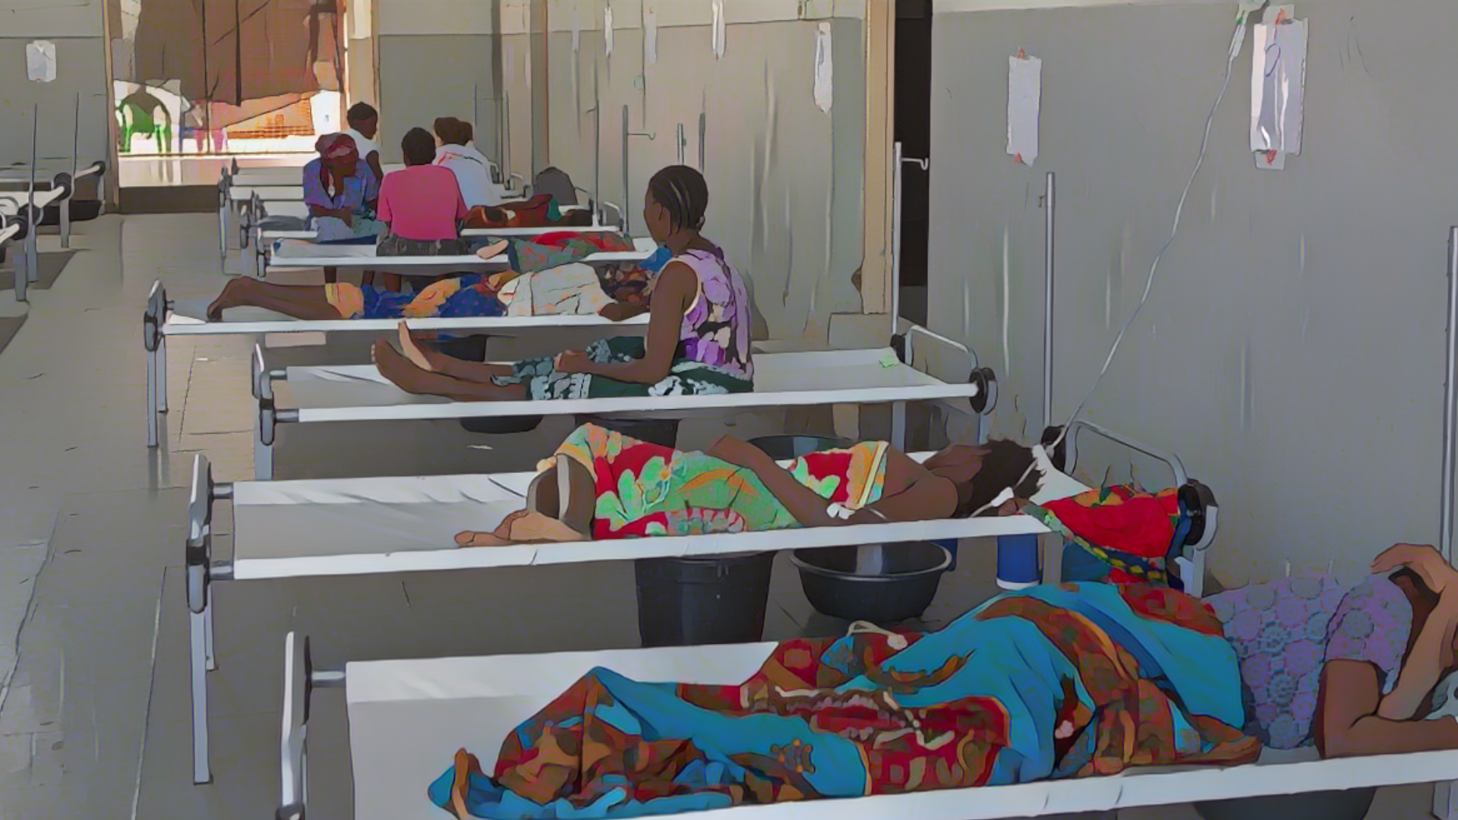
Patients with suspected cholera
Photo adapted from: WHO /Mark Nieuwenhof
Notes:
Let’s see how to identify patients with suspected cholera when surveillance is implemented to monitor an outbreak.

Slide 9

Case definition
Patients with suspected cholera:
Any patient with AWD (or who died from AWD)
Learn how to recognize AWD in Module 2
NO criteria on age or severe dehydration
  Comprehensive overview of the outbreak to effectively guide the response
Notes:
When surveillance is implemented to monitor an outbreak, a suspected cholera case is any patient who has acute watery diarrhoea (AWD) or who died from AWD.
If you are unsure about how to identify AWD, we encourage you to go back to module 2.
There are no additional criteria on age or severe dehydration to identify patients with suspected cholera among patients who have AWD. This is because when there is a cholera outbreak in a local geographic area, it is likely that a patient with AWD has cholera. This allows a sensitive and comprehensive monitoring of the outbreak to guide response measures effectively.

Slide 10

Testing for cholera
Photo adapted from: Raissa Karama Rwizibuka/Wellcome Trust
Notes:
Let’s look into the strategy to test patients with suspected cholera when surveillance is to monitor an outbreak.

Slide 11
Principle for testing
Some of the patients with suspected cholera are tested
No need to test all
Necessary to test some
Treatment plan depends on dehydration
Not on individual laboratory results
Monitor outbreak trends
Monitor circulating strain(s)
Including susceptibility to antimicrobials
Notes:
When surveillance is to monitor a cholera outbreak, it is not necessary to test all patients who meet the definition of a suspected cholera case. Only some patients with suspected cholera need to be tested for cholera.
The reason why it is not necessary to test all patients with suspected cholera is because this is not required to treat the patients. Treatment of patients with suspected cholera depends on their dehydration level, not on laboratory results.
However, it is essential to test some of the patients with suspected cholera in order to monitor the outbreak trends. In addition, this is also necessary to monitor the circulating strain including its susceptibility to antimicrobials to continue to treat patients effectively.

Slide 12



Testing with RDTs
If RDTs ARE available at your facility
Each day, test with a RDT the first 3 patients with suspected cholera seen at your facility
Case definition and time of arrival are the only criteria
Do not apply any additional criteria (e.g., age, severity)
Repeat this every day throughout the outbreak
If less than 3 patients with suspected cholera are seen on a given day:
  Test all of them
Day
If no patient with suspected cholera is seen on a given day:
  No test
Follow the directions of your health authority for laboratory testing on (some) patients RDT+
Notes:
If Rapid Diagnostic Tests (RDT) are available at your health facility, each day, the first three patients who meet the definition of a suspected cholera case are tested with a RDT.
The time of arrival is the only criteria to select 3 patients with suspected cholera for testing. Do not apply any additional criteria such as age or severity. This would bias the monitoring of the outbreak trend.
This daily sampling scheme applies throughout the outbreak.
If on a given day, less than 3 patients meeting the definition of a suspected cholera case are seen at your facility, then test all patients meeting the case definition.
If on a given day, no patient meeting the definition of a suspected cholera case is seen at your facility, then no patient is tested on that day.
Periodically, some samples tested positive by RDT will be subject to additional laboratory testing. On this, follow the directions of your health authority.

Slide 13
Testing without RDTs
If RDTs are NOT available at your facility
Each week, collect and send samples for testing on the
first 3 patients with suspected cholera seen at your facility
Case definition and time of arrival are the only criteria
Do not apply any additional criteria (e.g., age, severity)
Repeat this every week throughout the outbreak
If less than 3 patients with suspected cholera are seen on a given week:
  Collect samples on all of them
Week
If no patient with suspected cholera is seen on a given week:
  Don’t collect samples for testing
Notes:
If RDTs are not available at your health facility, each week, collect and send samples for laboratory testing on the first three patients meeting the definition of a suspected cholera case.
The time of arrival is the only criteria to select 3 patients with suspected cholera for laboratory testing. Do not apply any additional criteria such as age or severity. This would bias the monitoring of the outbreak trend.
Apply this weekly sampling scheme throughout the outbreak.
If on a given week, less than 3 patients meeting the definition of a suspected cholera case are seen at your facility, then collect samples for laboratory testing on all of them.
If on a given week, no patient meeting the definition of a suspected cholera case is seen at your facility, then no patient is tested for cholera on that week.

Slide 14

Reporting cholera
Photo adapted from: WHO / Genna Print
Notes:
Lastly, let’s look into the reporting of patients with suspected cholera.

Slide 15

Reporting cholera
Report standard information collected on all patients with suspected
cholera seen at your facility to the health authority at the end of each week
Essential to monitor the evolution of the outbreak
Learn about the standard information to be collected & reported in Module 2
If on a given week, no patient with suspected cholera was seen in your facility
  Report the absence of cases at the end of the week (zero reporting)
At the beginning or towards the end of the outbreak
  Your health authority may request more frequent reporting (e.g., daily)
To report, use the channels & mechanisms set at your facility (e.g., reporting focal point)
Notes:
Collect standard information on all patients meeting the definition of a suspected cholera case seen at your facility and report this information to your health authority at the end of the week.
Reporting all patients with suspected cholera on a weekly basis is essential for a timely monitoring of the outbreak trends in order to guide interventions accordingly.
If you are unsure about the standard information that should be collected on patients with suspected cholera, we invite you to go back to Module 2.
If on a given week, no patient meeting the definition of a suspected cholera case was seen in your facility, the absence of cases should also be reported to your health authority at the end of the week. This is zero reporting.
At the beginning or towards the end of the outbreak, your health authority may request you to report patients with suspected cholera more frequently, for example on a daily basis, if so, follow the directions of your health authority.
To report patients with suspected cholera to your health authority, use the reporting channels and mechanisms in place at your facility. For example, there may be a reporting focal point.

Slide 16
Wrap up
In geographic areas where there is a cholera outbreak, surveillance is to monitor the outbreak
Patients with suspected cholera are any patients with AWD (or who died from AWD)
SOME of the patients with suspected cholera are tested
  If RDTs are available, first three patients with suspected cholera on each day
  If RDTs are not available, first three patients with suspected cholera on each week
Standard information on all patients with suspected cholera is reported weekly
If no patient with suspected cholera was seen, this is also reported weekly
Notes:
As we wrap up this module, here are the important points to remember.
In local geographic areas where there is an ongoing cholera outbreak, surveillance aims to monitor the outbreak in order to continuously guide effective response measures.
When surveillance is implemented to monitor a cholera outbreak, all patients with AWD are suspected cholera cases.
Some of the patients meeting the definition of a suspected cholera case are tested.
If RDTs are available, the first three patients with suspected cholera seen each day are tested.
If RDTs are not available, the first three patients with suspected cholera seen each week are tested.
In addition, standard information is collected on all patients meeting the definition of a suspected cholera case and is reported on a weekly basis.
If no patient with suspected cholera was seen at a facility on a given week, this is also reported on a weekly basis.

Slide 17

Notes:
Before moving on to the next module, we encourage you to take a short quiz. There are three questions in this quiz.

Slide 18

Question 1
To monitor a cholera outbreak, a patient with suspected cholera is any patient:
    Aged ≥ 2 years old with AWD
    With AWD and severe dehydration
    Aged ≥ 2 years old with AWD and severe dehydration
    With AWD
Notes:
Question 1. To monitor a cholera outbreak, a patient with suspected cholera is any patient:
Aged 2 years old or older with Acute Watery Diarrhoea (AWD).
With AWD and severe dehydration.
Aged 2 years old or older with AWD and severe dehydration.
With AWD.

Slide 19

Question 1 – Answer
To monitor a cholera outbreak, a patient with suspected cholera is any patient:
    Aged ≥ 2 years old with AWD
    With AWD and severe dehydration
    Aged ≥ 2 years old with AWD and severe dehydration
    With AWD
Notes:
The correct answer is d. When surveillance is to monitor an outbreak, any patient with AWD is a suspected cholera case.

Slide 20
Question 2
To monitor a cholera outbreak:
  (Select all that apply)
    Any patient with suspected cholera is reported daily
    Any patient with suspected cholera is reported weekly
    The absence of patient with suspected cholera is reported daily
    The absence of patient with suspected cholera is reported weekly
Notes:
Question 2. Select all that apply. To monitor a cholera outbreak:
Any patient with suspected cholera is reported daily.
Any patient with suspected cholera is reported weekly.
The absence of patient with suspected cholera is reported daily.
The absence of patient with suspected cholera is reported weekly.

Slide 21
Question 2 – Answers
To monitor a cholera outbreak:
    Any patient with suspected cholera is reported daily
    Any patient with suspected cholera is reported weekly
    The absence of patient with suspected cholera is reported daily
    The absence of patient with suspected cholera is reported weekly
Notes:
The correct answers are b and d. When surveillance is to monitor an outbreak, all patients meeting the definition of a suspected cholera case are reported weekly and the absence of patients meeting the definition of a suspected cholera case is also reported weekly.

Slide 22
Question 3
To monitor a cholera outbreak, any patient with AWD is tested for cholera:
    True
    False
Notes:
Question 3. This is the last question. To monitor a cholera outbreak, any patient with AWD is tested for cholera. Is this a) true or b) false?

Slide 23
Question 3 – Answer
To monitor a cholera outbreak, any patient with AWD is tested for cholera:
    True
    False
Notes:
The correct answer is b. This is false. When surveillance is to monitor an outbreak, it is not necessary to test all patients with AWD. Only some of the patients meeting the definition of a suspected cholera case are tested.

Slide 24

Notes:
We have now completed this module.

