Slide 1
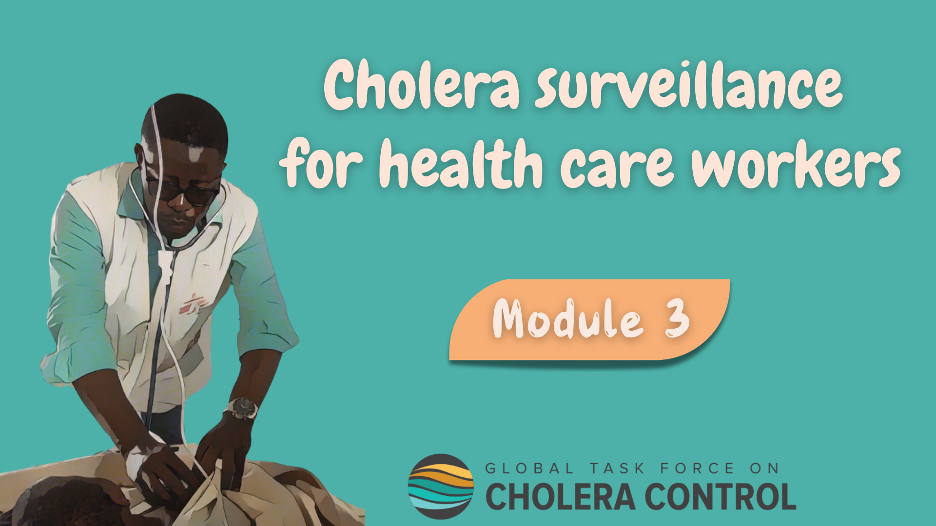
Notes:
Welcome to Module 3 of the GTFCC online course on cholera surveillance for health care workers.

Slide 2
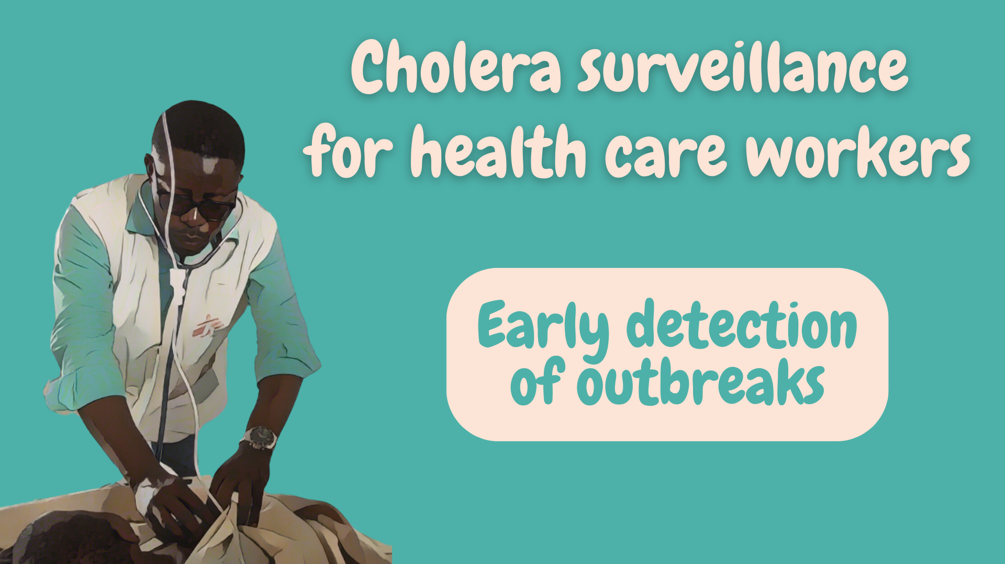
Notes:
In this module, we will dive into how to implement surveillance for the early detection of cholera outbreaks.

Slide 3

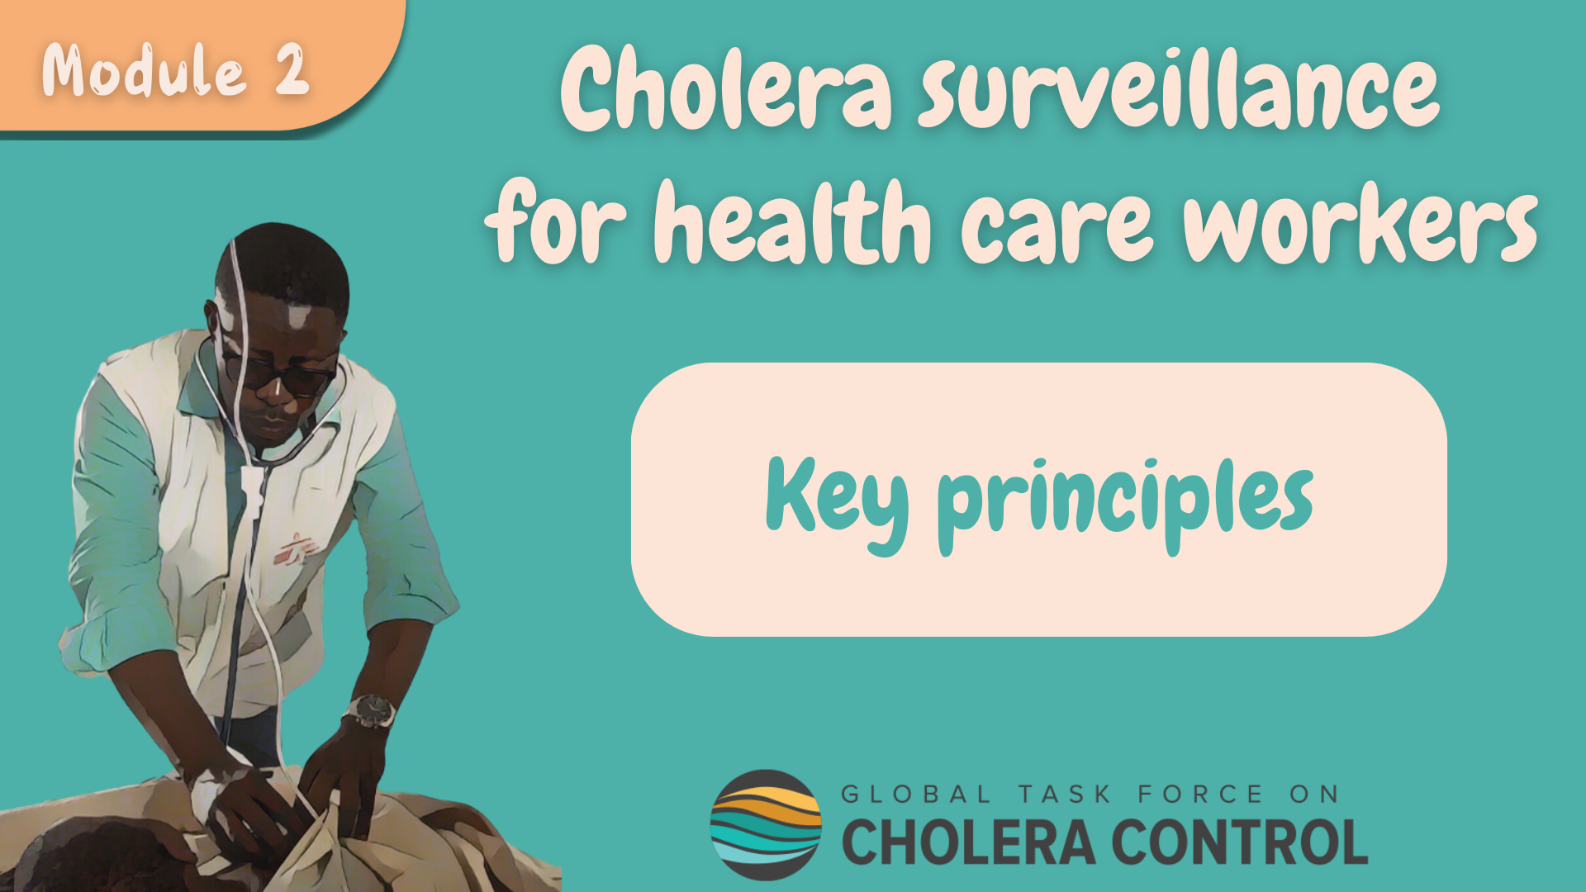
Get ready for this module
Before taking this module, make sure to complete Module 2 ‘Key Principles’
Notes:
While this module focuses on the specificities of cholera surveillance for the early detection of outbreaks, general principles for health care workers to implement cholera surveillance addressed in Module 2 also apply - these principles always apply. Therefore, if you have not yet already done so, we encourage you to take module 2 of this course before taking this module.

Slide 4

What will you learn?
How to implement surveillance for early detection including:
    How to identify patients with suspected cholera
    Which patients with suspected cholera to test
    How often to report patients with suspected cholera
Notes:
After completing this module, you will know how to implement surveillance for the early detection of a cholera outbreak including:
How to identify patients with suspected cholera;
Which patients with suspected cholera to test;
And, how often to report patients with suspected cholera.

Slide 5

Background
Photo adapted from: WHO/Billy Miaron
Notes:
Let’s start with a refresher on cholera surveillance for the early detection of an outbreak.

Slide 6









Surveillance for early detection
When there is NO cholera outbreak in a geographic area
Health authorities regularly update health care workers on the cholera situation in their geographic area
Stay up-to-date
    At any point in time, know:
      The cholera situation in your geographic area
      Whether surveillance is to detect a cholera outbreak
Photo adapted from: WHO / Francine Tchouta
Notes:
Surveillance is implemented for the early detection of a cholera outbreak when there is no ongoing cholera outbreak in a local geographic area.
Health authorities regularly share information and updates on the local cholera situation.
Make sure to stay up-to-date, that way at any point in time you will know the cholera situation in your local geographic area and know whether you should implement cholera surveillance for early detection.

Slide 7


Surveillance objective
Early detection aims to permit rapid implementation of response
measures to reduce spread and limit the number of cases and deaths
Identify, test, and report patients with suspected cholera
in accordance with the recommendations in this module
As long as no cholera outbreak is detected
Learn about surveillance in other situations in Modules 4 & 5
If an outbreak is detected, surveillance evolves
Notes:
Implementing surveillance for the early detection of a cholera outbreak aims to permit the rapid implementation of response measures in order to reduce the spread of the outbreak and limit the number of cholera cases and deaths.
To implement cholera surveillance for early detection, identify, test, and report any patient with suspected cholera in accordance with the recommendations of this module.
This applies as long as no cholera outbreak is detected in your local geographic area. If an outbreak is detected in your geographic area, how to implement cholera surveillance evolves. We invite you to learn more about this in Modules 4 and 5.

Slide 8
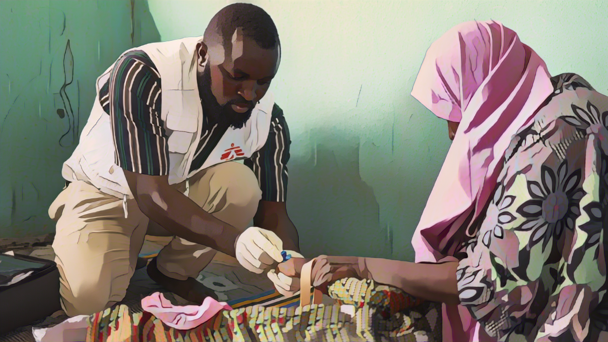
Patients with suspected cholera
Photo adapted from: Abba Adamu Musa
Notes:
Let’s see how to identify patients with suspected cholera when surveillance is for early detection.

Slide 9

Case definition
Patients with suspected cholera
  Patients aged 2 years or older with AWD and severe dehydration
  or
  Patients aged 2 years or older who died from AWD
Learn how to recognize AWD & severe dehydration in Module 2
Various diseases can cause AWD, especially in young children
Criteria on age & severe dehydration
    More likely that patients with suspected cholera have cholera
    Avoids triggering frequent false alarms for cholera
    Makes surveillance and testing for early detection more efficient
Notes:
When surveillance is implemented for early detection, a suspected cholera case is any patient aged 2 years or older who has acute watery diarrhoea (AWD) and severe dehydration or any patient aged 2 years or older who died from AWD.
If you are unsure about how to identify AWD or severe dehydration, we encourage you to go back to module 2.
Various diseases can cause AWD, especially in young children. That is why, in addition to AWD, criteria on age and dehydration apply. It is more likely that patients with AWD who meet these criteria do have cholera. Therefore, applying criteria on age and severe dehydration level avoids triggering frequent false alarms for cholera. This makes the early detection system more efficient.

Slide 10

Testing for cholera
Photo adapted from: WHO/Fid Thompson
Notes:
Let’s look into the testing of patients with suspected cholera when surveillance is for the early detection of a cholera outbreak.

Slide 11
Testing for early detection
All patients with suspected cholera are tested
  Critical to determine whether or not cholera is circulating
If RDTs are available
If RDTs are NOT available
RDTs are used to triage samples for laboratory testing
Samples are not triaged for laboratory testing
ALL patients with suspected cholera are tested by RDT
Samples from ALL patients with RDT+ results are sent to a laboratory for confirmatory testing
Samples from ALL patients with suspected cholera are sent to a laboratory for confirmatory testing
Notes:
Importantly, when surveillance is for the early detection of a cholera outbreak, all patients who meet the definition of a suspected cholera case are tested for cholera.
Testing all patients with suspected cholera is critical to determine whether or not cholera is circulating.
If RDTs are available at your facility, use RDTs to triage samples for laboratory testing.
Test all patients who meet the definition of a suspected cholera case with a RDT.
If the RDT result is negative, cholera is ruled out.
If the RDT result is positive, collect samples and send them to a laboratory for confirmatory testing by culture or PCR.
If RDTs are not available at your facility, collect samples from all patients who meet the definition of a suspected cholera case and send the samples to a laboratory for confirmatory testing.

Slide 12
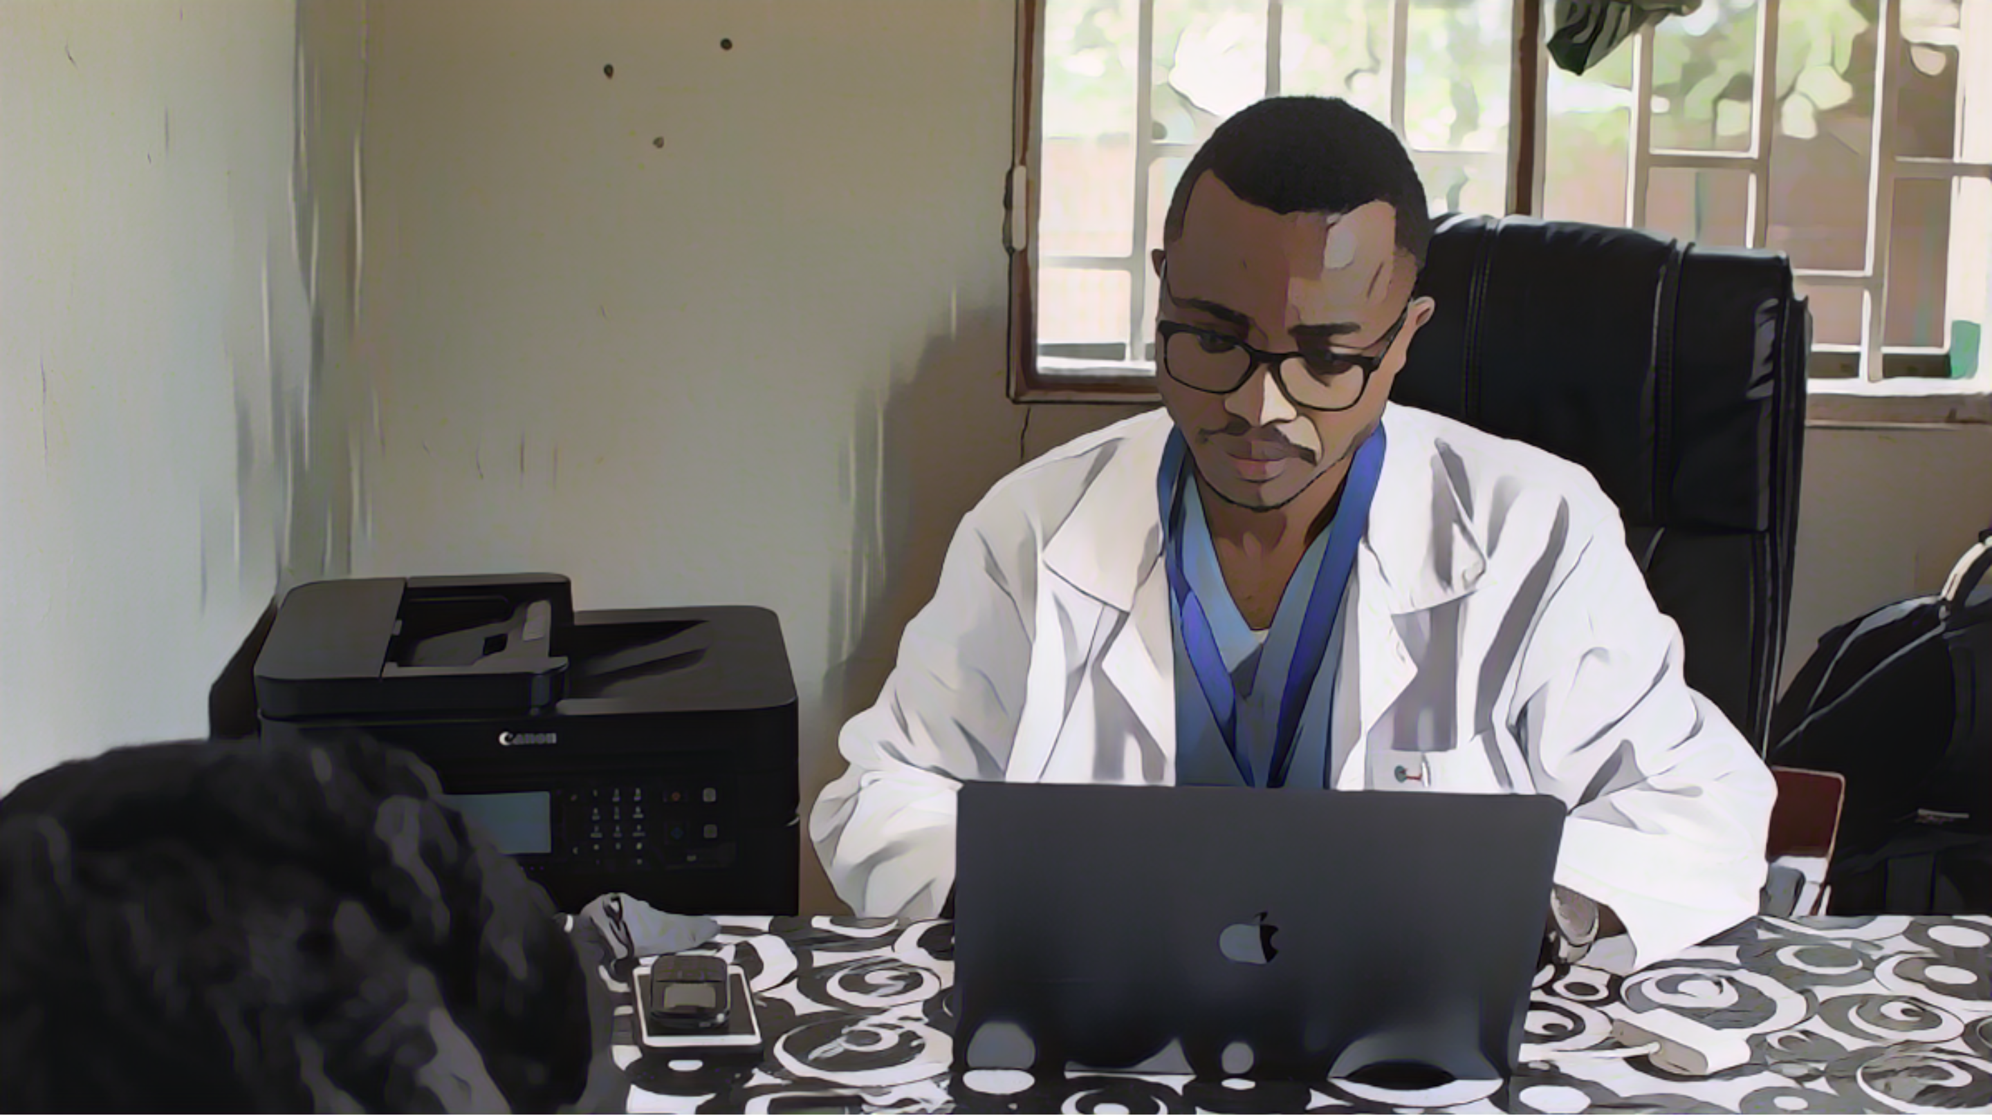
Reporting cholera
Photo adapted from: Raissa Karama Rwizibuka/Wellcome Trust
Notes:
Lastly, let’s look into the reporting of patients with suspected cholera.

Slide 13

Reporting cholera
If a patient with suspected cholera is seen at your facility, the standard information
collected on this patient is reported to the health authority on the same day
Reporting within a day is essential not to delay the detection of an outbreak
Time is key!
Learn about the standard information to be collected & reported in Module 2
If on a given week, no patient with suspected cholera was seen in your facility
  Report the absence of cases at the end of the week (zero reporting)
To report, use the channels & mechanisms set at your facility (e.g., reporting focal point)
Notes:
If a patient who meets the definition of a suspected cholera case is seen at your facility, collect standard information on this patient and report this information to your health authority within a day.
Reporting any patient with suspected cholera within a day is essential in order not to delay the detection of a potential outbreak. Time is key for early detection.
If you are unsure about the standard information that should be collected on patients with suspected cholera, we invite you to go back to Module 2.
If on a given week, no patient meeting the definition of a suspected cholera case was seen in your facility, report the absence of cases to your health authority at the end of the week. This is zero reporting.
To report patients with suspected cholera to your health authority, use the reporting channels and mechanisms in place at your facility. For example, there may be a reporting focal point.

Slide 14
Wrap up
In geographic areas where there is NO cholera outbreak, surveillance is for early detection
Patients with suspected cholera are aged 2 years or older with AWD and severe dehydration
(or died from AWD)
All patients with suspected cholera are tested for cholera
Standard information on any patient with suspected cholera is reported within 24 hours
If no patient with suspected cholera was seen on a given week, this is reported weekly
Notes:
As we wrap up this module, here are the important points to remember.
In local geographic areas where there is no cholera outbreak, surveillance aims to detect any cholera outbreak early so that it can be responded to rapidly.
When surveillance is for the early detection of a cholera outbreak, any patient aged 2 years or older with AWD and severe dehydration or who died from AWD is a suspected cholera case.
All patients meeting the definition of a suspected cholera case are tested for cholera.
In addition, standard information is collected on all patients meeting the definition of a suspected cholera case; this information is reported within 24 hours.
If no patient with suspected cholera was seen at a facility, this is reported on a weekly basis.

Slide 15

Notes:
Before moving on to the next module, we encourage you to take a short quiz. There are three questions in this quiz.

Slide 16

Question 1
For the early detection of a cholera outbreak, a patient with suspected cholera is any patient:
    Aged ≥ 2 years old with AWD
    With AWD and severe dehydration
    Aged ≥ 2 years old with AWD and severe dehydration
    With AWD
Notes:
Question 1. For the early detection of a cholera outbreak, a patient with suspected cholera is any patient:
Aged 2 years old or older with Acute Watery Diarrhoea (AWD)
With AWD and severe dehydration
Aged 2 years old or older with AWD and severe dehydration
With AWD

Slide 17

Question 1 – Answer
For the early detection of a cholera outbreak, a patient with suspected cholera is any patient:
    Aged ≥ 2 years old with AWD
    With AWD and severe dehydration
    Aged ≥ 2 years old with AWD and severe dehydration
    With AWD
Notes:
The correct answer is c. When surveillance is for early detection, criteria on age and dehydration level apply to identify patients with suspected cholera. Patients with suspected cholera are those aged 2 years old or older with AWD and severe dehydration.

Slide 18
Question 2
For the early detection of a cholera outbreak:
  (select all that apply)
    Any patient with suspected cholera is reported daily
    Any patient with suspected cholera is reported weekly
    The absence of patient with suspected cholera is reported daily
    The absence of patient with suspected cholera is reported weekly
Notes:
Question 2. Select all that apply. For the early detection of a cholera outbreak:
Any patient with suspected cholera is reported daily
Any patient with suspected cholera is reported weekly
The absence of patient with suspected cholera is reported daily
The absence of patient with suspected cholera is reported weekly

Slide 19
Question 2 – Answers
For the early detection of a cholera outbreak:
    Any patient with suspected cholera is reported daily
    Any patient with suspected cholera is reported weekly
    The absence of patient with suspected cholera is reported daily
    The absence of patient with suspected cholera is reported weekly
Notes:
The correct answers are a and d. When surveillance is for early detection, any patient meeting the definition of a suspected cholera case is reported daily and the absence of patients meeting the definition of a suspected cholera case is reported weekly.

Slide 20
Question 3
For the early detection of a cholera outbreak, any patient with AWD is tested for cholera:
    True
    False
Notes:
Question 3. This is the last question. For the early detection of a cholera outbreak, any patient with AWD is tested for cholera. Is this a) true or b) false?

Slide 21
Question 3 – Answer
For the early detection of a cholera outbreak, any patient with AWD is tested for cholera:
    True
    False
Notes:
The correct answer is b, this is false. When surveillance is for early detection, any patient meeting the definition of a suspected cholera case is tested for cholera. However, this is not any patient with AWD since, in addition to AWD, criteria on age and dehydration level also apply.

Slide 22

Notes:
We have now completed this module.

