Slide 1
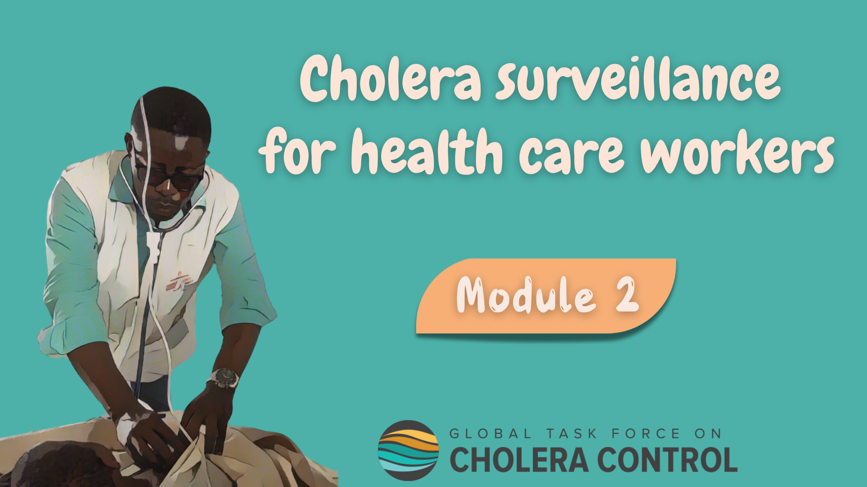
Notes:
Welcome to Module 2 of the GTFCC online course on cholera surveillance for health care workers.

Slide 2

Notes:
This module focuses on principles that always apply to implement surveillance for cholera, independent of the cholera situation.

Slide 3

What will you learn?
Identify patients with suspected cholera
Collect standard information on patients with suspected cholera
Test patients with suspected cholera
Notes:
After completing this module, you will know how to:
identify patients with suspected cholera;
collect standard information on patients with suspected cholera;
and, how to test patients with suspected cholera.

Slide 4

Cholera signs and symptoms
Photo adapted from: WHO/Mulugeta Ayene
Notes:
Let’s start with the signs and symptoms of cholera.

Slide 5


Acute Watery Diarrhoea
A sign to suspect cholera is Acute Watery Diarrhoea (AWD)
AWD is not any type of diarrhoea
Acute: Lasts for less than 7 days
Watery: Stools are non-bloody and liquid (and may contain mucous)
Diarrhoea: There are ≥3 loose stools within a 24-hour period
Notes:
A key sign to suspect cholera is Acute Watery Diarrhoea, also referred to as AWD.
AWD is not any type of diarrhoea.
It is acute if it lasts for less than 7 days.
It is watery if stools are non-bloody and liquid and may contain mucous.
It is diarrhoea if there are 3 loose stools or more within a 24-hour period.

Slide 6

AWD & dehydration
Health care workers assess the level of dehydration of patients with AWD
and determine the rehydration plan accordingly
A patient has severe dehydration if
One or more danger signs
Lethargic or unconscious
Absent or weak pulse
Respiratory distress
Patients with severe dehydration need intravenous rehydration
Or
At least two of the following
Sunken eyes
Not able to drink or drinks poorly
Skin pinch goes back very slowly
Other patients with AWD are treated with oral rehydration solution
Notes:
Acute Watery Diarrhoea can cause dehydration.
It is important to assess the level of dehydration of patients with AWD in order to determine the appropriate rehydration plan.
In particular, a patient has severe dehydration if one danger sign or more is present, namely being lethargic or unconscious, or having an absent or weak pulse, or having a respiratory distress.
If no danger sign is present, a patient has severe dehydration if at least two of the following signs are present: having sunken eyes, or not being able to drink or drinking poorly, or having a skin pinch which goes back very slowly.
Patients who have severe dehydration need intravenous rehydration.
Other patients are usually treated with oral rehydration.

Slide 7
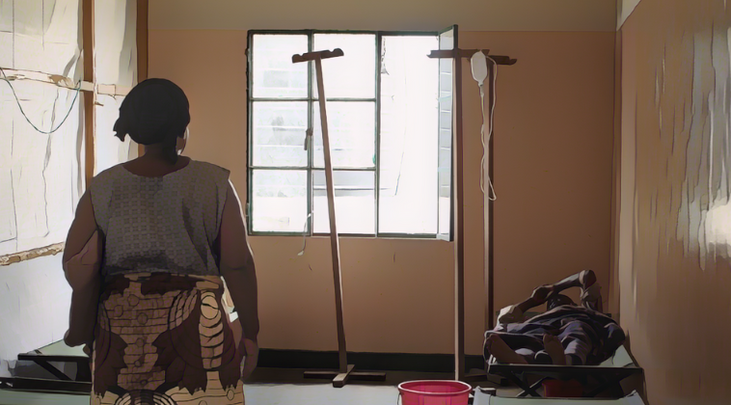
Patients with
Suspected cholera
Photo adapted from: Raissa Karama Rwizibuka/Wellcome Trust
Notes:
Let’s look into how to identify patients with suspected cholera.

Slide 8
Cholera case definitions
Depending on the cholera situation, different cholera case definitions apply
In areas where there is no cholera outbreak
In areas where there is a cholera outbreak
Patients aged 2 years or older with AWD and severe dehydration
or
Patients aged 2 years or older who died from AWD
Patients with AWD (or who died from AWD)
Criteria on age and severe dehydration
NO criteria on age and severe dehydration
Limit false suspected cholera outbreaks
Avoid overwhelming early detection systems
For sensitive monitoring
Notes:
To identify patients with suspected cholera, surveillance case definitions are applied. Importantly, depending on the local cholera situation, there are different definitions of suspected cholera cases.
In geographic areas where there is no ongoing cholera outbreak, suspected cholera cases are patients aged 2 years or older with AWD and severe dehydration, or patients aged 2 years or older who died from AWD.
In geographic areas where there is an ongoing cholera outbreak, suspected cholera cases are any patients with AWD or who died from AWD.
The key difference between these case definitions is that in geographic areas where there is no ongoing cholera outbreak, age and severe dehydration are taken into account to identify patients with suspected cholera. These criteria limit the number of false suspected cholera outbreaks. This avoids overwhelming the surveillance system with false alarms which would decrease the effectiveness of early detection.
On the other hand, in geographic areas where there is a cholera outbreak, age and severe dehydration are not considered to identify patients with suspected cholera. This is to ensure a sensitive monitoring of an outbreak.

Slide 9

Information collection
Photo adapted from: WHO/Nitsebiho Asrat
Notes:
It is important to collect standard information on all patients with suspected cholera. Let’s look into this.

Slide 10


Collection of information
When a patient who meets the cholera case definition is identified,
standard information is collected with a case report form or a line list
Patient information
Age
Sex
Place of residence
Learn where to access standard data collection tools in Module 6
Clinical information
Date of symptom onset
Hospitalisation
Dehydration level
Outcome (alive, died after arriving at health facility, died before reaching the health facility)
This information is reported to health authorities
Information on tests
Tests performed/requested
Results
Notes:
Health care workers collect standard information on any patient meeting the definitions of a suspected cholera case. Standard information means that the same information is always collected regardless of whether or not there is a cholera outbreak.
This information is collected by filling a cholera case report form or a cholera linelist.
You will learn where to find standard data collection tools in Module 6.
The information collected includes some information on the patients such as age, sex, and place of residence.
Some clinical information is also collected such as the date of symptom onset, whether the patient has been hospitalized for treatment, the dehydration level of the patient, and the outcome of the disease.
Lastly, some information on the tests performed and their results are also recorded.
The standard information collected on suspected cholera cases is then reported to the health authority.

Slide 11
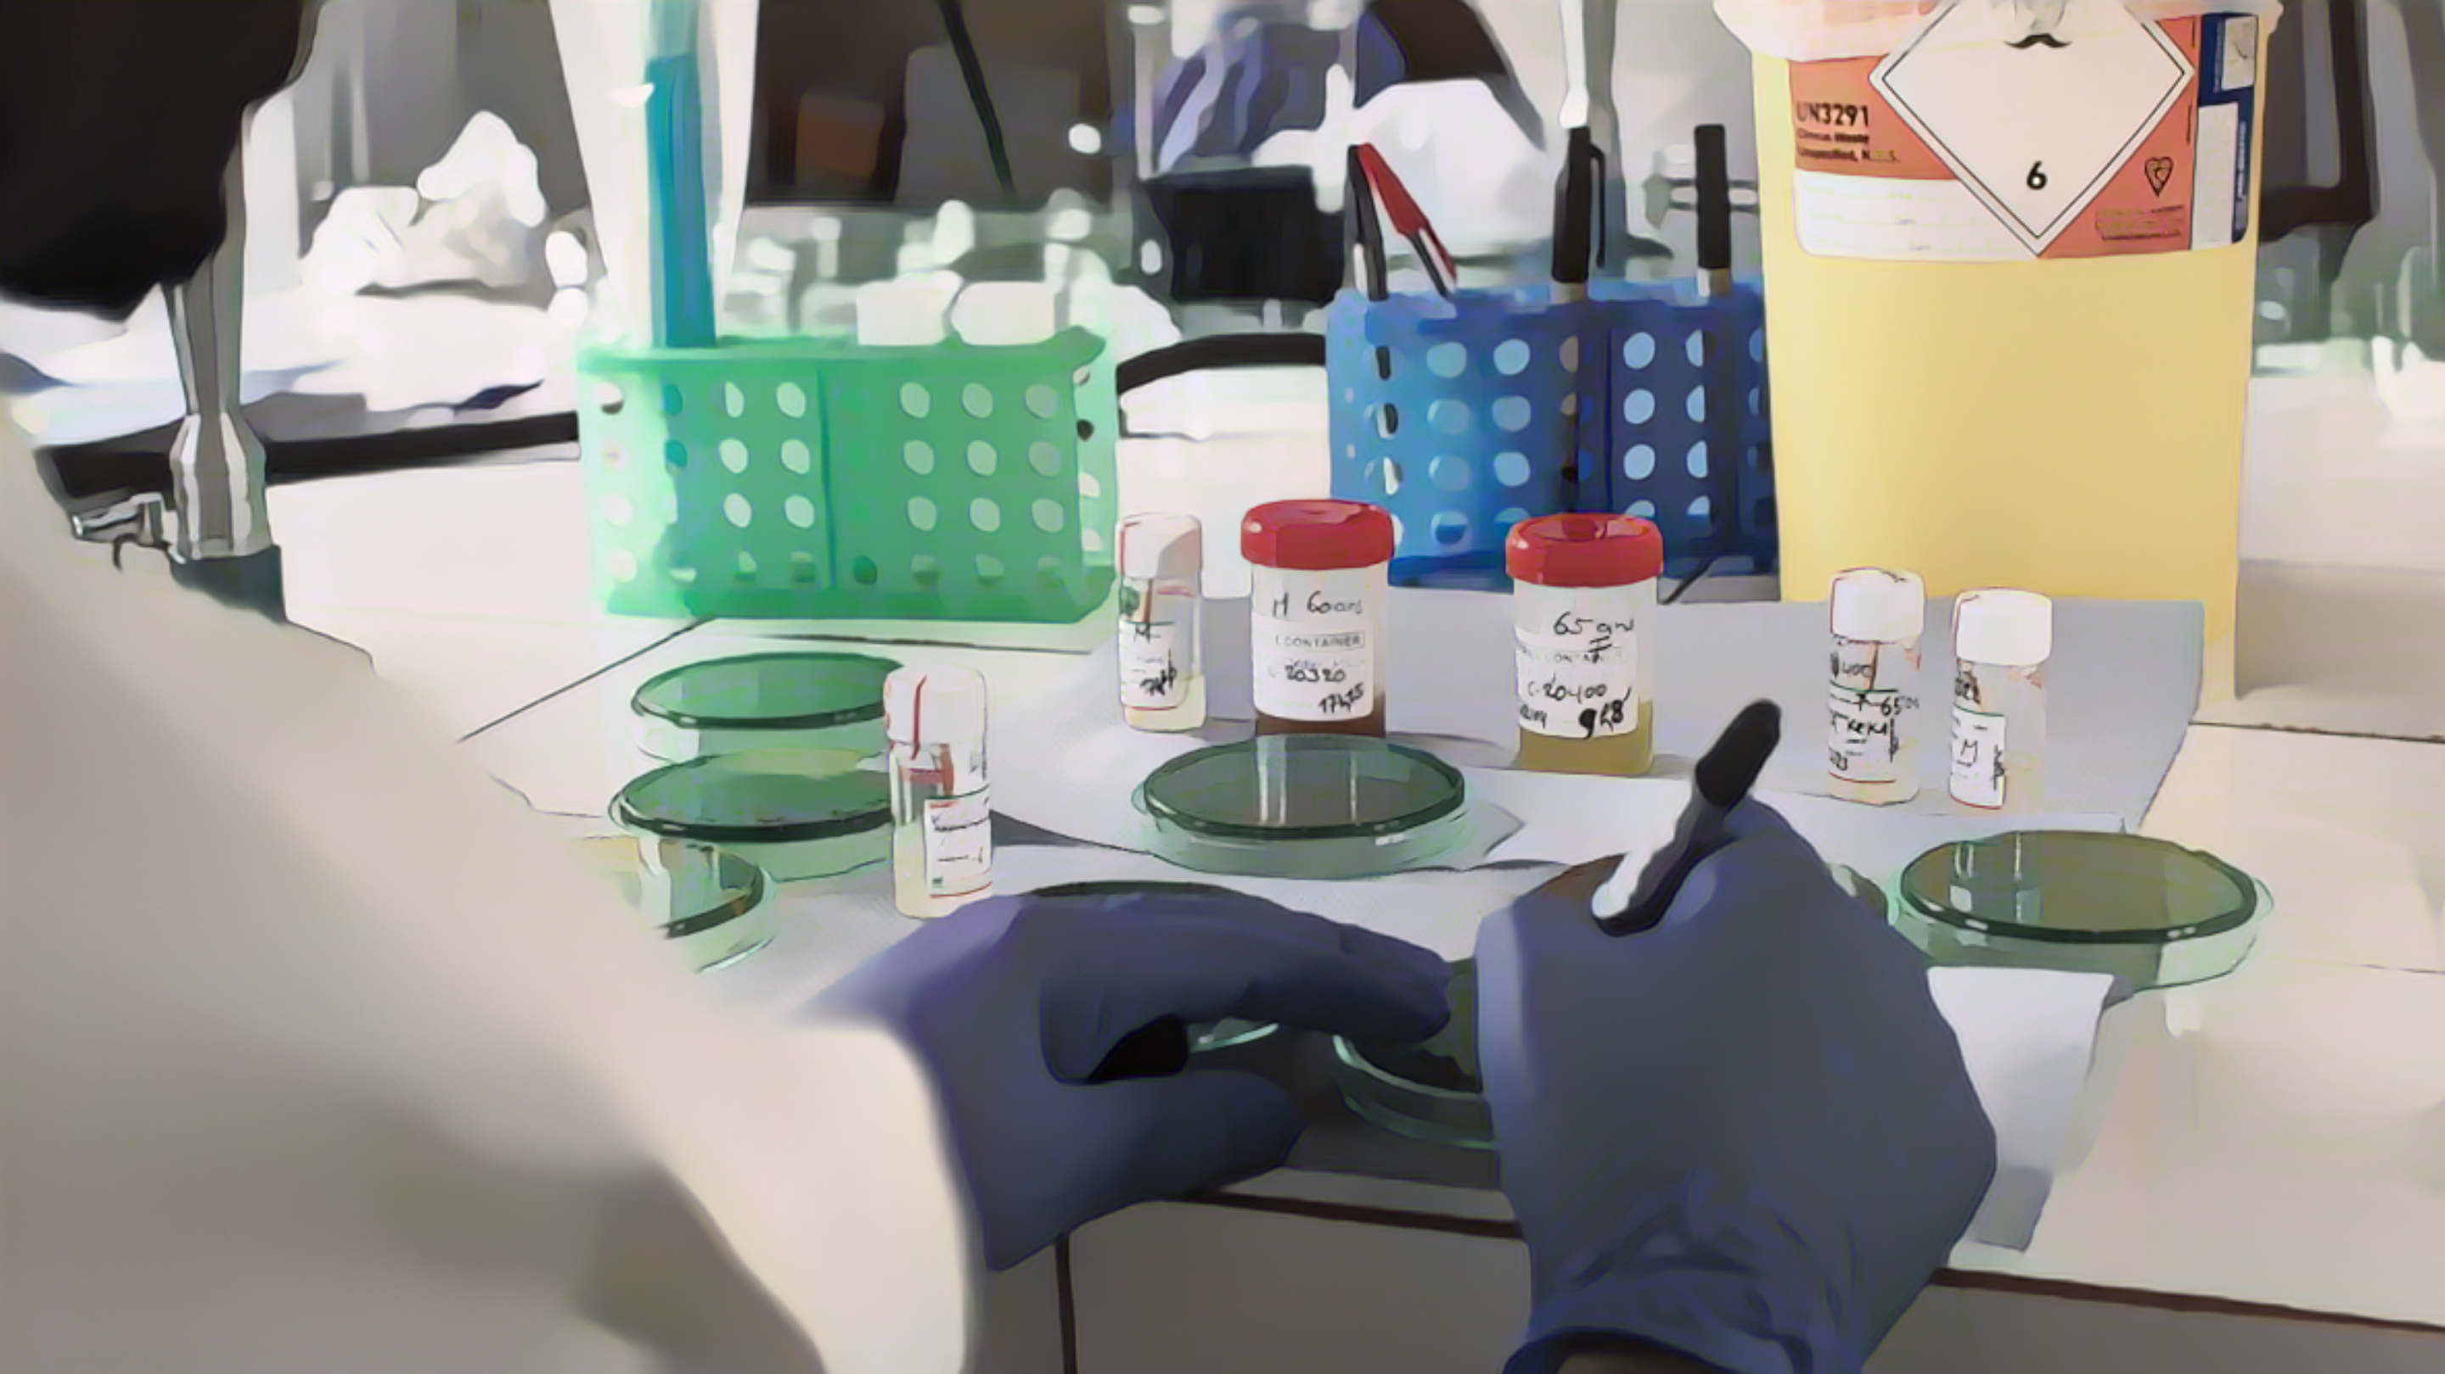
Testing
Photo adapted from: Raissa Karama Rwizibuka/Wellcome Trust
Notes:
We will now look into key principles for testing patients with suspected cholera.

Slide 12
Testing for cholera
Why to test for cholera
For surveillance
  AWD can be caused by different diseases
  Testing is necessary to characterize the cholera situation
But not for treatment
  Cholera test results do not influence the treatment
  Treatment depends on dehydration level
Learn about testing strategies in Modules 3, 4, 5
Who to test for cholera
Patients who meet the definition of a suspected cholera case
Among those, which patients to test depends on the cholera situation
Notes:
Because AWD can be caused by different diseases, testing for cholera is important for surveillance in order to characterize the cholera situation.
However, for case management, testing is not as critical. Indeed, the treatment of patients with suspected cholera depends on their dehydration level and is not influenced by cholera test results.
Cholera tests are performed on patients who meet the definition of a suspected cholera case.
Among those, which suspected cholera cases should be tested depends on the cholera situation.
You will learn about testing strategies applicable in different cholera situations in the next modules of this course.

Slide 13
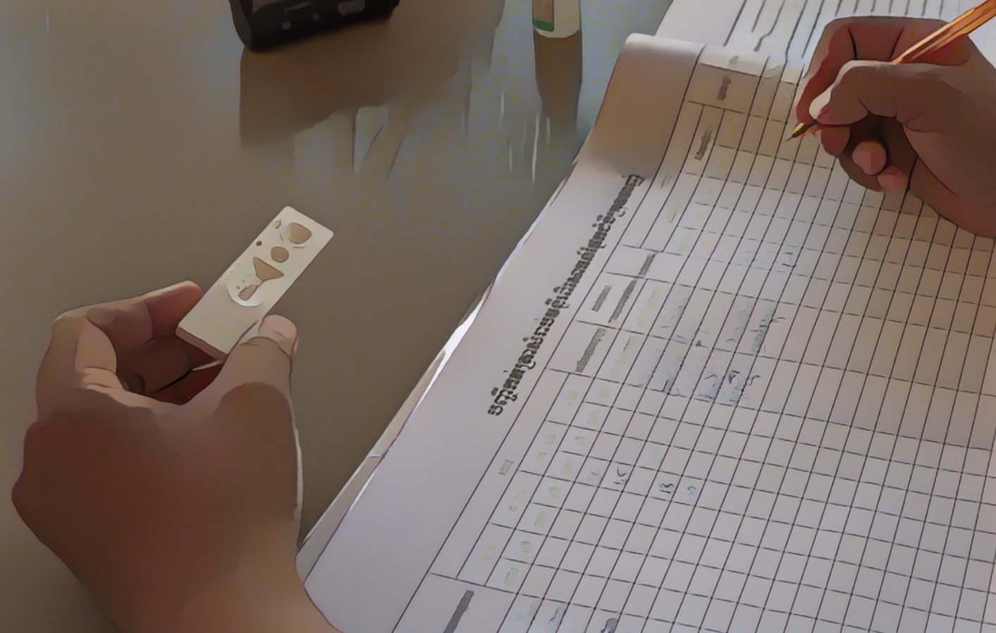
Rapid Diagnostic Tests
RDTs are useful screening tools but cannot be used to confirm cholera
RDTs
Can be performed at health facility level
  Rapid and easy to use
Performed
  On stool samples
  From patients with suspected cholera
Used to triage samples for laboratory confirmation (i.e., RDT+)
Photo adapted from: WHO/ Blink Media - Cindy Liu
Learn where to access information on RDT use in Module 6
RDT results
Negative: sufficient to rule out cholera
Recorded with standard information (i.e., pos and neg results)
Notes:
Rapid Diagnostic Tests for cholera, RDT, may be available at your facility. If so, they are useful screening tools. However, they cannot be used to confirm cholera.
RDT can be performed at the health facility; they are rapid and easy to use.
They are performed on stool samples from patients who meet the definition of a suspected cholera case.
RDT are used to triage samples to be sent for laboratory confirmation, namely those tested positive by RDT.
If a cholera RDT is negative, cholera can be ruled out and there is no need to send the sample for laboratory confirmation.
All RDT results, positive or negative, are recorded as part of the standard information collected on patients with suspected cholera, and should be reported.
You will learn where to access information on how to perform RDT in Module 6.

Slide 14

Laboratory confirmation
For cholera to be confirmed, samples are sent to a laboratory
for confirmatory testing (culture/PCR)
Samples for confirmatory testing
  Fresh stools
  Rectal swabs
Sample collection
  Within the first 4 days of illness
  Before antibiotic therapy
Photo adapted from: WHO / Fid Thompson
Do NOT wait for the results to initiate treatment
Learn where to access information on how to handle samples in Module 6
Notes:
For cholera to be confirmed, samples collected on patients who meet the definition of a suspected cholera case are sent to a laboratory for confirmatory testing by culture or PCR.
Tests are performed on fresh stools or rectal swabs.
Samples for laboratory confirmation should be collected within the first four days of illness and before initiating antibiotic therapy.
Importantly, do not wait for the test results to treat the patient. Treatment depends on the dehydration level, not on test results.
You will learn where to access information on how to handle samples for laboratory confirmation in Module 6.

Slide 15
Wrap up
Cholera causes Acute Watery Diarrhoea (AWD) and may lead to severe dehydration
Standard information is recorded on any patient with suspected cholera
  Case report form or line list
To confirm cholera, stool samples are sent to a laboratory for testing
If RDTs are available, confirmatory testing is on samples tested positive by RDT
Notes:
As we wrap up this module, here are the important points to remember.
Cholera causes Acute Watery Diarrhoea (AWD) which may lead to severe dehydration.
Health care workers record standard information on any patient with suspected cholera. This can be in a case report form or in a line list.
To confirm cholera, stool samples are sent to a laboratory for testing.
If RDT are available, they are useful screening tools to triage samples for laboratory confirmation. Only samples tested positive by RDT are sent for confirmatory testing.

Slide 16

Notes:
Before moving on to the next module, we encourage you to take a short quiz. There are three questions in this quiz.

Slide 17

Question 1
What is Acute Watery Diarrhoea (AWD)?
  Select all that apply
Acute
    It is acute if it lasts for less than 14 days
    It is acute if it lasts for less than 7 days
Watery
    It is watery if stools are non-bloody and liquid (and may contain mucous)
    It is watery if stools don’t contain mucous
Diarrhoea
    It is diarrhoea if there are ≥ 3 loose stools within a 48-hour period
    It is diarrhoea if there are ≥3 loose stools within a 24-hour period
Notes:
Question 1. Select all that apply. What is Acute Watery Diarrhoea?
It is acute if it lasts for less than 14 days
It is acute if it lasts for less than 7 days
It is watery if stools are non-bloody and liquid (and may contain mucous)
It is watery if stools don’t contain mucous
It is diarrhoea if there are 3 loose stools or more within a 48-hour period
It is diarrhoea if there are 3 loose stools or more within a 24-hour period

Slide 18

Question 1 – Answers
What is Acute Watery Diarrhoea (AWD)?
Acute
    It is acute if it lasts for less than 14 days
    It is acute if it lasts for less than 7 days
Watery
    It is watery if stools are non-bloody and liquid (and may contain mucous)
    It is watery if stools don’t contain mucous
Diarrhoea
    It is diarrhoea if there are ≥ 3 loose stools within a 48-hour period
    It is diarrhoea if there are ≥3 loose stools within a 24-hour period
Notes:
The correct answers are b, c, and f. It is acute if it lasts for less than 7 days. It is watery if stools are non-bloody and liquid and may contain mucous. It is diarrhoea if there are 3 loose stools or more within a 24-hour period.

Slide 19
Question 2
How is standard information on suspected cholera cases tested by Rapid Diagnostic Test (RDT) recorded?
    Standard information on suspected cholera cases is only recorded on patients tested positive by RDT
    Standard information on suspected cholera cases is always recorded regardless of the RDT result
Notes:
Question 2. How is standard information on suspected cholera cases tested by Rapid Diagnostic Test (RDT) recorded?
Standard information on suspected cholera cases is only recorded on patients tested positive by RDT
Standard information on suspected cholera cases is always recorded regardless of the RDT result

Slide 20
Question 2 – Answer
How is standard information on suspected cholera cases tested by Rapid Diagnostic Test (RDT) recorded?
    Standard information on suspected cholera cases is only recorded on patients tested positive by RDT
    Standard information on suspected cholera cases is always recorded regardless of the RDT result
Notes:
The correct answer is b. Standard information on suspected cholera cases is always recorded regardless of the RDT result.

Slide 21
Question 3
What is the recommended approach for samples tested negative by Rapid Diagnostic Test (RDT)?
    RDTs are screening tests, therefore samples tested negative by RDT should be retested by culture / PCR
    RDTs can be used to rule out cholera, therefore it is not necessary to retest by culture / PCR samples tested negative by RDT
Notes:
Question 3. This is the last question. What is the recommended approach for samples tested negative by RDT?
RDTs are screening tests therefore samples tested negative by RDT should be retested by culture and/or PCR
RDTs can be used to rule out cholera therefore it is not necessary to retest by culture and/PCR samples tested negative by RDT

Slide 22
Question 3 – Answer
What is the recommended approach for samples tested negative by Rapid Diagnostic Test (RDT)?
    RDTs are screening tests, therefore samples tested negative by RDT should be retested by culture / PCR
    RDTs can be used to rule out cholera, therefore it is not necessary to retest by culture / PCR samples tested negative by RDT
Notes:
The correct answer is b. RDT can be used to rule out cholera therefore it is not necessary to retest by culture or PCR samples tested negative by RDT.

Slide 23

Notes:
We have now completed this module.

