Slide 1
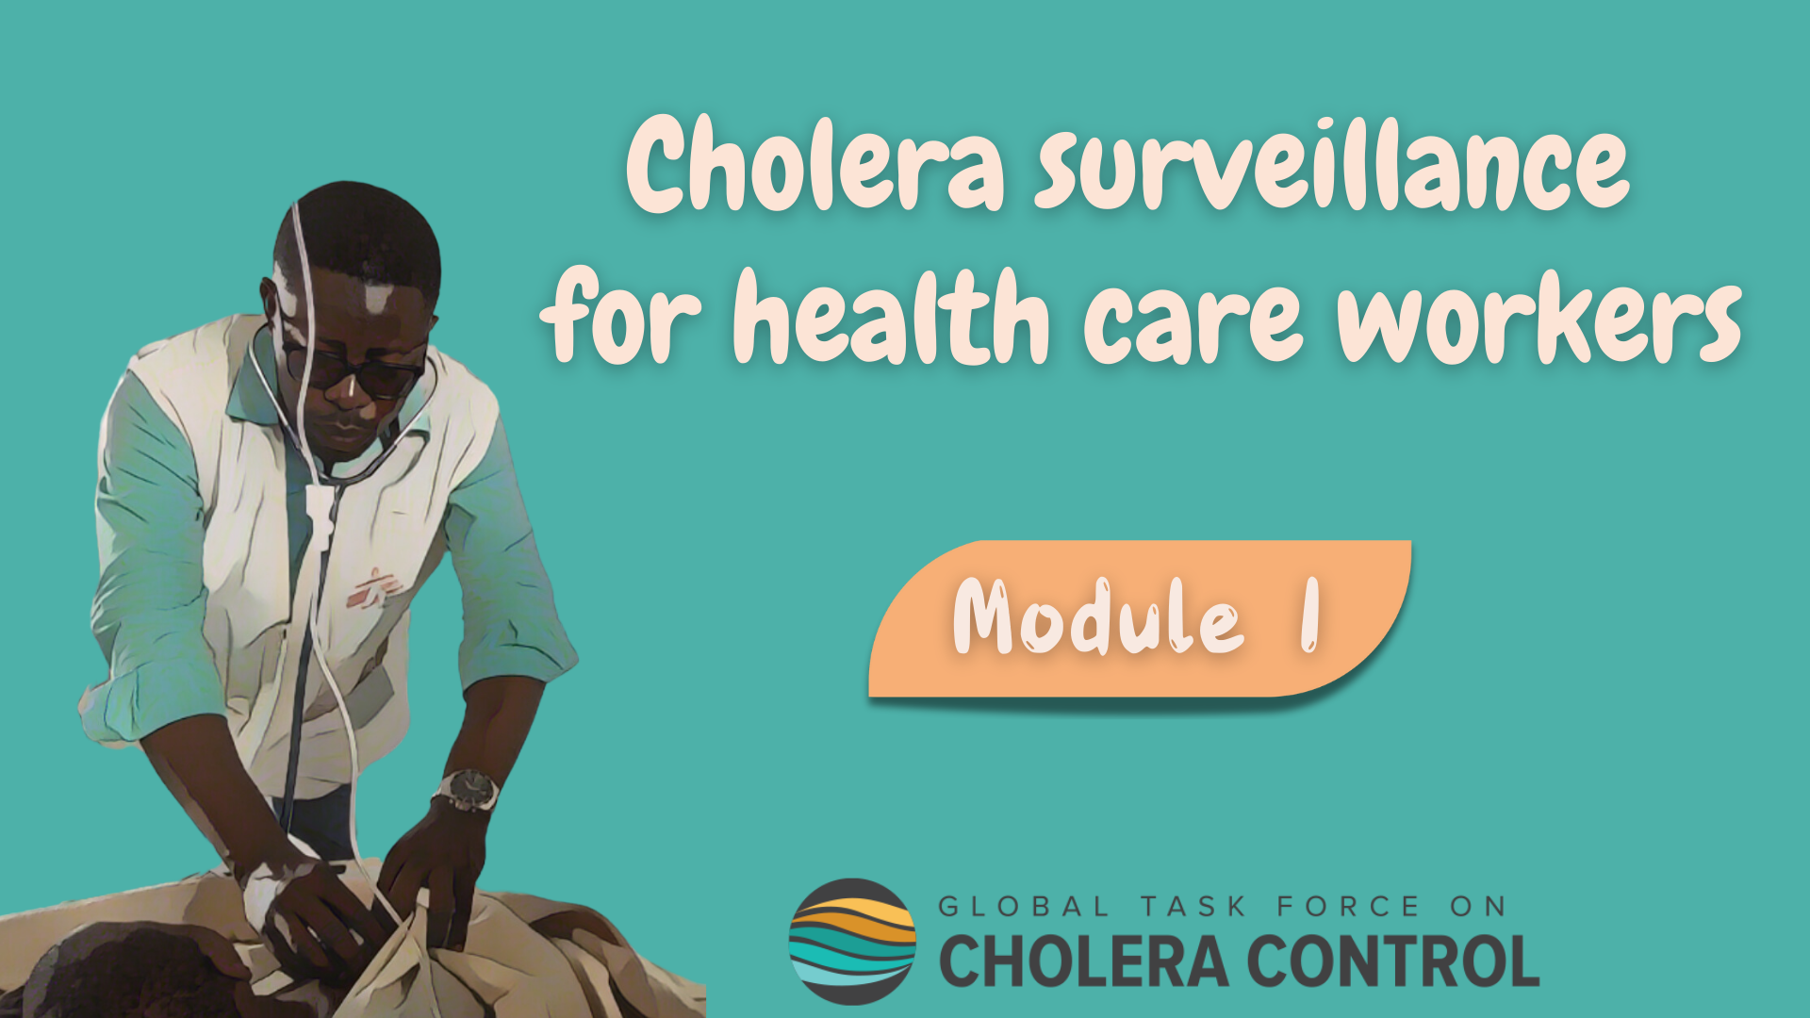
Notes:
Welcome to Module 1 of the GTFCC online course on cholera surveillance for health care workers.

Slide 2
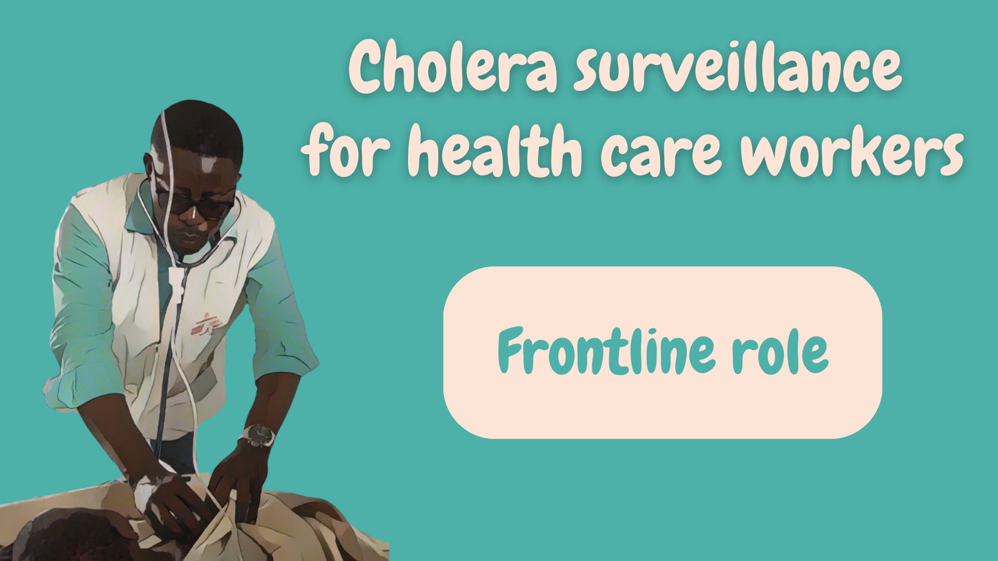
Notes:
In this module, we will walk you through the objectives of cholera surveillance and the reasons why health care workers play such an essential role in cholera surveillance.

Slide 3
What will you learn?
Objectives of cholera surveillance in different situations
Key role of health care workers in cholera surveillance
Notes:
After completing this module, you will be familiar with the objectives of cholera surveillance in different situations and you will be aware of the key role that health care workers play in cholera surveillance.

Slide 4
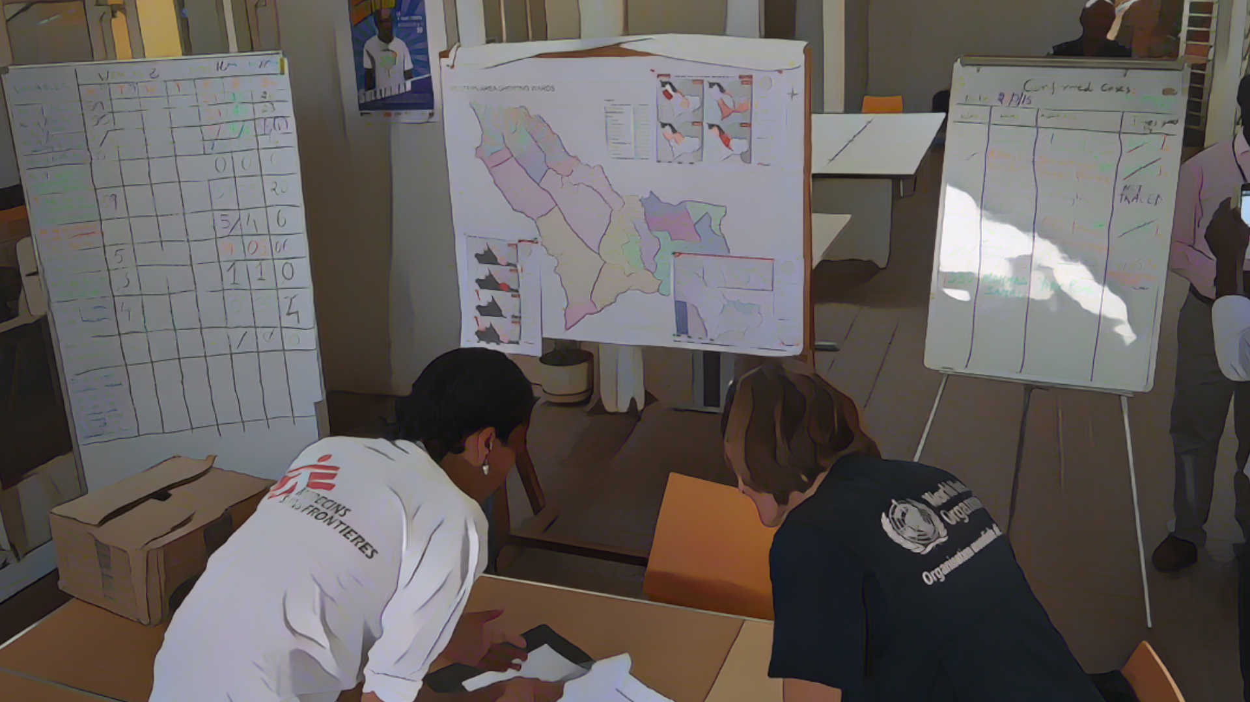
Background
Photo adapted from: WHO /Dante Licona
Notes:
Before we dive in, let us remind you what cholera is and what surveillance is.

Slide 5
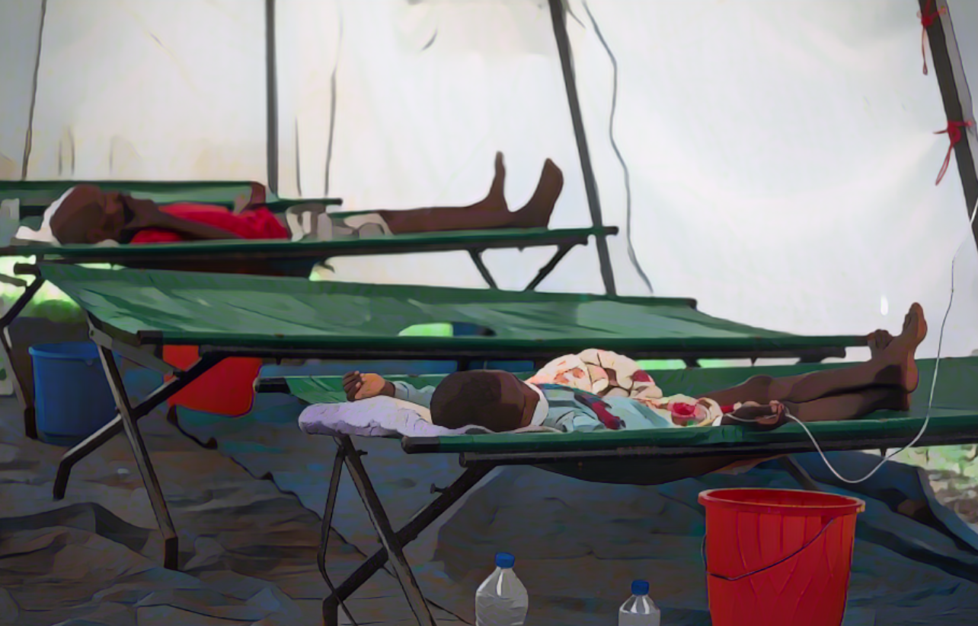
Cholera
Acute diarrhoeal infection
Spread through contaminated food and water
Caused by the bacterium Vibrio cholerae
(toxigenic, serogroup O1 or O139)
Can spread rapidly and cause large outbreaks
Severe forms of the disease can lead to severe dehydration and death within hours if not treated
It is preventable and easily treatable (rehydration)
Photo adapted from: WHO/Mulugeta Ayene
Notes:
Cholera is an acute diarrheal infection which spreads through contaminated food and water.
It is caused by the bacterium toxigenic Vibrio cholerae, serogroup O1 and 0139.
Cholera can spread rapidly and cause large outbreaks.
Severe forms of the disease can lead to severe dehydration and death within hours if not treated. However, it is preventable and easily treatable with rehydration protocols.

Slide 6


Disease surveillance
Continuous and systematic collection, analysis, and interpretation of health-related
data with prompt dissemination of results to guide public health response
Essential to
Understand outbreak dynamics (who is affected, where, when)
Design effective control interventions
Notes:
Surveillance is the continuous and systematic collection, analysis and interpretation of health-related data with prompt dissemination of results to guide public health response.
Surveillance is essential to understand the dynamics of disease outbreaks by describing who is affected, where and when. This understanding is critical to design effective interventions to control outbreaks.

Slide 7





Health workers & surveillance
Health care workers play a frontline role in surveillance by
identifying and reporting patients that have a disease under surveillance
v
v
A person
Health care workers
Health care workers
Health authorities
Feels ill and seeks care at a health facility
Identify that the patient has a disease under surveillance
Collect standard information on the patient
Report it to health authorities
Analyze this information to detect and respond to outbreaks
Notes:
Health care workers play an essential role in disease surveillance. They are at the frontline to identify and report patients that have a disease under surveillance.
Here is how the surveillance process goes.
A person feels ill and go to a health facility to seek care.
At this facility, health care workers identify that the patient has a disease under surveillance.
They collect standard information about this patient and report it to their health authority.
Health authorities then analyze this information to detect and respond to disease outbreaks.

Slide 8
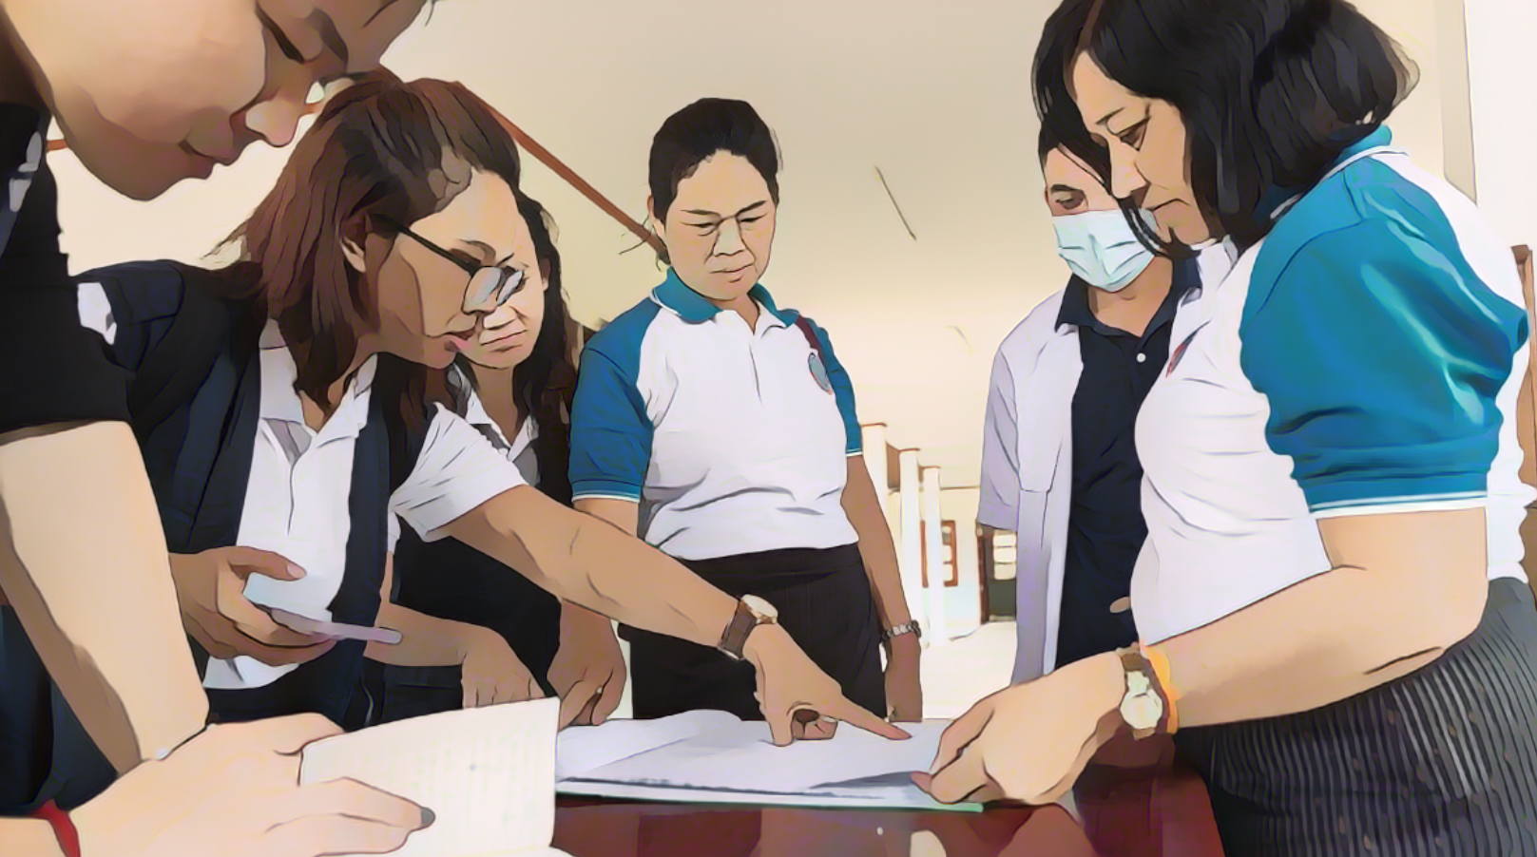
Objectives
of cholera surveillance
Photo adapted from: WHO /Enric Catala
Notes:
Let’s look into the objectives of cholera surveillance more specifically.

Slide 9


Overview
Cholera surveillance generates information to guide an effective response to
reduce the number of cholera cases and deaths, and limit the spread of the disease
Depending on the cholera situation in an area, the surveillance objective evolves
  In geographic areas without an outbreak
    Surveillance is for the early detection of any new outbreak for rapid response
  In geographic areas with an outbreak that is not yet widespread (“cases in cluster”)
    Surveillance is to track clusters to stop transmission with targeted interventions
  In geographic areas with an outbreak
    Surveillance is to monitor the outbreak to guide the response
9
Notes:
The general objective of cholera surveillance is always to generate information to guide an effective public health response in order to reduce the number of cholera cases and cholera deaths and limit the spread of cholera.
Depending on the cholera situation in a local geographic area, the specific objectives of cholera surveillance evolve.
In geographic areas where there is no ongoing cholera outbreak, surveillance aims to detect any cholera outbreak early so that it can be responded to rapidly.
In geographic areas where a cholera outbreak is starting but has not yet spread in the community and cholera cases are occurring in clusters, surveillance aims to track the clusters in order to interrupt transmission with highly targeted interventions around the cases.
Lastly, in geographic areas where there is an ongoing cholera outbreak, surveillance aims to monitor the outbreak in order to guide the public health response.

Slide 10

Early detection
Outbreaks detected early can be controlled rapidly
Spread & impact mitigated
Notes:
Early detection is an essential surveillance objective because when outbreaks are detected early, they can be controlled rapidly which is critical to mitigate their spread and their impact.

Slide 11
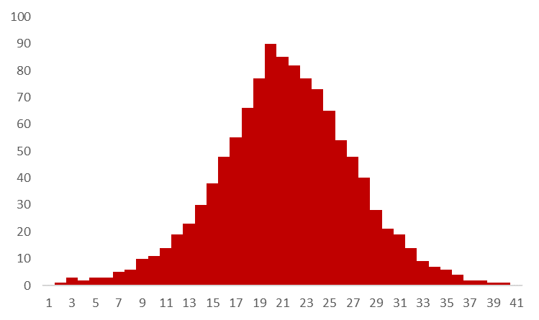
Early detection
Illustration
Late
response
Late
detection
Number of cases
Days
Notes:
Let’s illustrate the importance of early detection with a fictive example.
This chart represents the potential number of cholera cases by day if a cholera outbreak was detected with delay which would result in a delayed public health response.

Slide 12
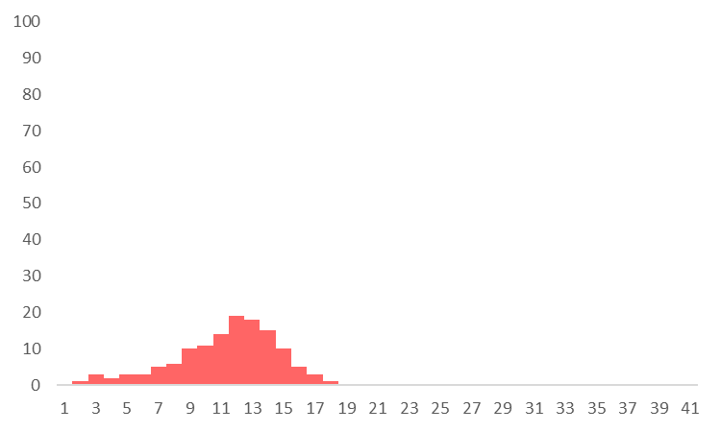
Early detection
Illustration
Early
detection
Number of cases
Rapid
response
Days
Notes:
On the other hand, this chart represents the potential number of cholera cases by day if an outbreak was detected early which would enable a rapid public health response.

Slide 13

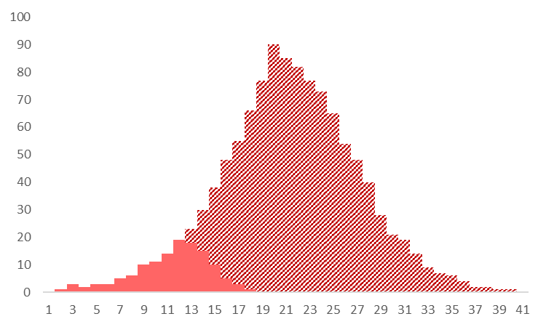
Early detection
Illustration
Early
Delayed
Potential cases prevented with early detection and rapid response
Number of cases
Days
Notes:
If we compare the number of cases by day in these two situations, we can see that with early detection and rapid response, the number of cholera cases remained much lower compared to if the outbreak would have been detected and responded to with delay. This illustrates that early detection and rapid response help prevent further cholera cases.

Slide 14
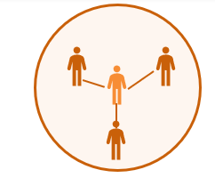
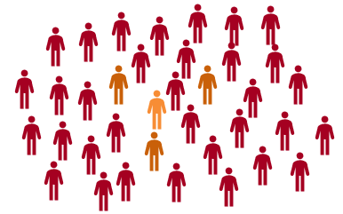
Tracking clusters
When a group of cases infected one another or got infected by the same source this is called a “cluster”
Usually at the very early stages following the introduction of cholera in a new geographic area
Cluster
With robust surveillance and highly targeted interventions, it is possible to interrupt transmission at cluster stage before it spreads in the community
Widespread outbreak in the community
Notes:
Moving on to cholera clusters and the surveillance objective in that situation.
There is a cholera cluster when a group of cases infected one another or got infected by the same source. Clusters are more likely to occur at the very early stages following the introduction of cholera in a new geographic area.
If clustered transmission is not interrupted rapidly, cholera might spread in the community and cause a large outbreak that would be more challenging to control.
With robust surveillance that can guide highly targeted interventions around cases, it is possible to interrupt transmission at cluster stage before it spreads in the community.

Slide 15
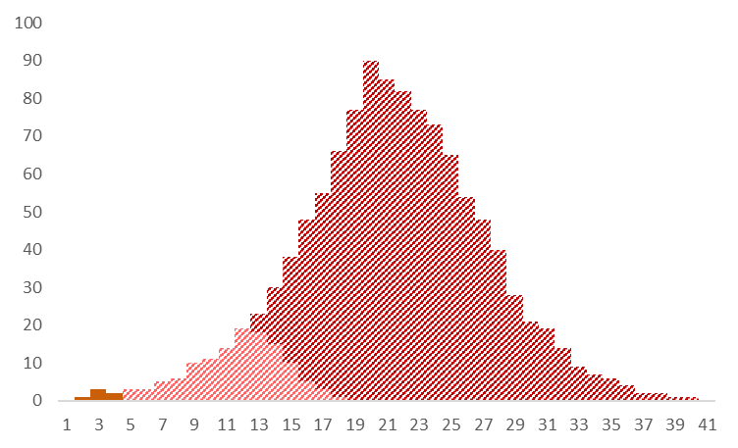
Tracking clusters
Illustration
Potential cases prevented by interrupting transmission at cluster stage
Number of cases
Transmission interrupted at cluster stage
Days
Notes:
Going back to our previous example, if surveillance is sufficiently performant to track clusters in order to guide highly targeted interventions around cases, then the number of cholera cases that can be prevented is even higher.

Slide 16
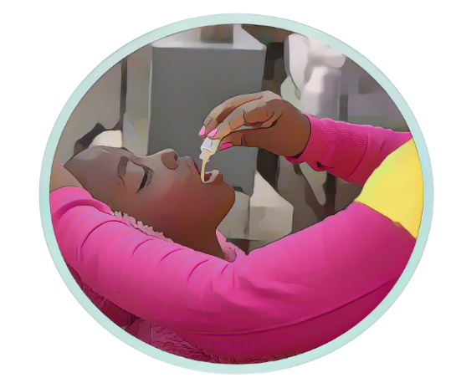
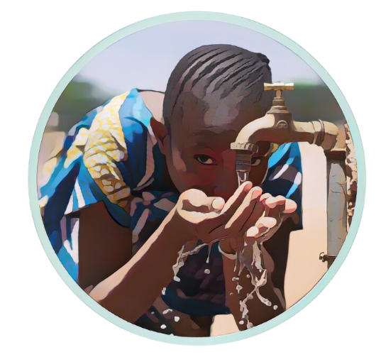
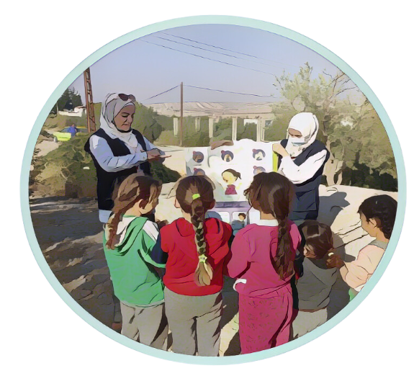
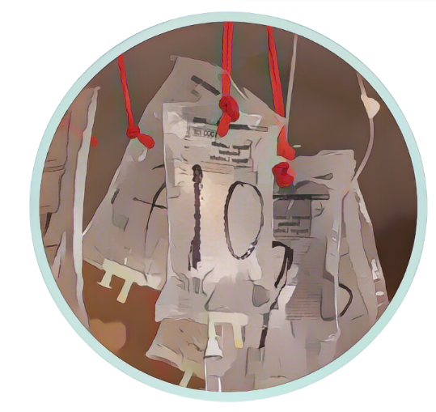
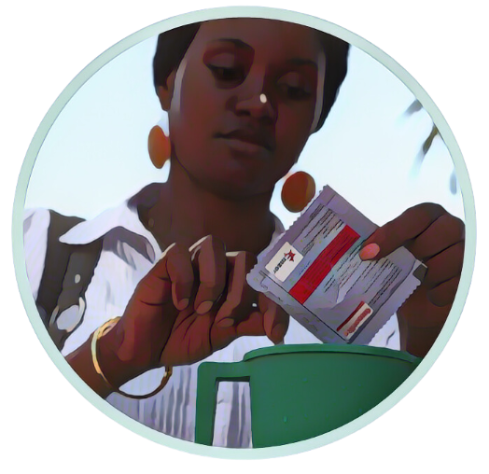
Monitoring outbreaks
During an outbreak, the information generated by surveillance is used to
target multisectoral strategies to control the outbreak
Surveillance guides all interventions from vaccination campaigns, to water, sanitation and hygiene efforts, community engagement, and case management
For example, for case management
  Identify locations where cholera treatment facilities and referral system need to be set up
  Quantify needs for treatment supplies
  Identify potential issues with access to health care or treatment of patients
Notes:
As the last surveillance objective, during an outbreak, if cholera has spread in the community, surveillance continuously generates information that is used to target effective multisectoral strategies to control and end the outbreak.
Surveillance is pivotal to guide interventions across all cholera control and prevention pillars from vaccination campaigns, to water, sanitation and hygiene efforts, community engagement, and case management.
For example, regarding case management, surveillance provides information to identify locations where cholera treatment facilities and referral system need to be set up, to quantify the needs for treatment supplies as well as to identify potential issues with access to health care or treatment of patients in order to fix them.

Slide 17
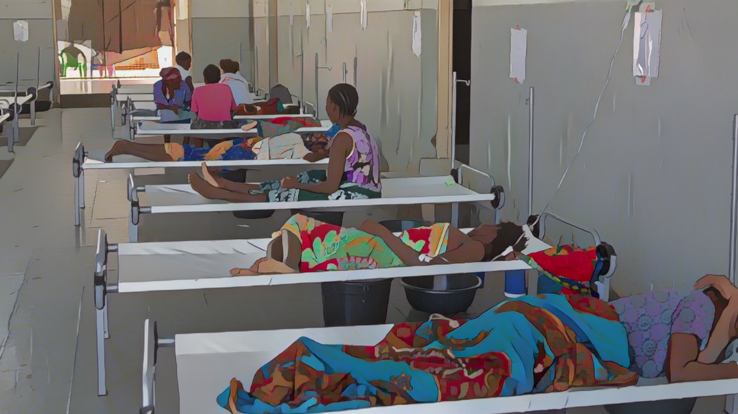
Role of health care workers in cholera surveillance
Photo adapted from: WHO /Mark Nieuwenhof
Notes:
Health care workers are instrumental in cholera surveillance. Let’s see what their key role is.

Slide 18
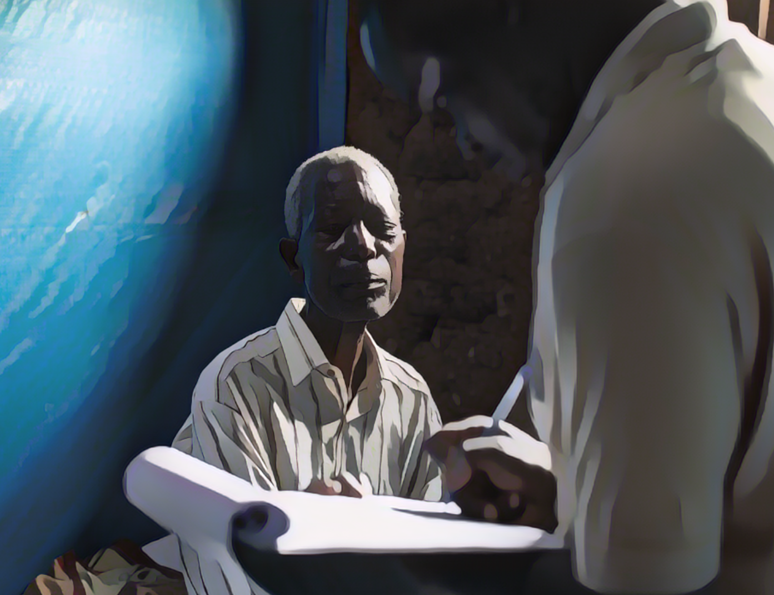
Key surveillance role
Beyond treating patients with cholera, by contributing to surveillance
health care workers also contribute to preventing further cholera cases & deaths
Health facility workers are at the frontline to:
Identify patients with suspected cholera
Collect standard information on these patients
Report this information
Collect samples
  Test them by rapid diagnostic tests (RDT)
  And/or send samples to a laboratory for testing
Photo adapted from: Raissa Karama Rwizibuka/Wellcome Trust
Notes:
Beyond treating patients with cholera, health care workers also contribute to preventing further cholera cases and deaths by contributing to cholera surveillance.
Health care workers contribute to cholera surveillance by identifying patients with suspected cholera, collecting standard information on these patients and reporting this information. They also collect samples on patients with suspected cholera and test them by rapid diagnostic tests and send samples to a laboratory for testing.

Slide 19
Learn more
In the next modules, you will learn
how to contribute to cholera surveillance as a health care worker
How to identify, record, and test
patients with suspected cholera?
How to implement cholera surveillance
in different situations?
Module 2. General principles
(independent of the cholera situation)
Module 3. Surveillance for early detection
Module 4. Surveillance to monitor outbreaks
Module 5. Surveillance to track clusters
Notes:
In the next modules, you will learn more about how health care workers contribute to cholera surveillance.
In module 2, we will walk you through general principles to identify patients with suspected cholera, record standard information on these patients, and test them. These principles always apply, regardless of the ongoing cholera situation.
Then, in modules 3 to 5, we will walk you through specificities to implement cholera surveillance depending on the ongoing cholera situation and the corresponding surveillance objective. In Module 3, we will focus on surveillance for the early detection of cholera outbreaks. In module 4, we will address surveillance to monitor cholera outbreaks. Lastly, in module 5, we will cover surveillance to track cholera clusters.

Slide 20
Wrap up
Cholera can cause large outbreaks and lead to deaths
The role of health facility workers goes beyond treating patients with cholera
They also identify, record, report and ensure the testing of patients with suspected cholera
By contributing to cholera surveillance, they contribute to:
  Detecting outbreaks early so that they can be controlled rapidly
  Tracking clusters to interrupt transmission before cholera spreads in the community
  Monitoring outbreaks to generate information to design effective control strategies
Notes:
As we wrap up this module, here are the important points to remember.
Cholera can cause large outbreaks and be deadly.
Health care workers play a critical role beyond treating cholera patients. They are at the frontline to identify, record, report and ensure the testing of patients with suspected cholera.
By contributing to cholera surveillance, health care workers contribute to detecting cholera outbreaks early so that they can be controlled rapidly; tracking clusters to interrupt transmission before cholera spreads in the community; monitoring cholera outbreaks to generate information to design effective strategies to control outbreaks.

Slide 21

Notes:
Before moving on to the next module, we encourage you to take a short quiz. There are four questions in this quiz.

Slide 22

Question 1
Beyond treating patients with suspected cholera, health care workers are also at the frontline to:
  (Select all that apply)
    Identify patients with suspected cholera
    Record information on patients with suspected cholera
    Report information on patients with suspected cholera
    Collect samples for testing on patients with suspected cholera
10 sec
Notes:
Question 1. Select all that apply. Beyond treating patients with suspected cholera, health care workers are also at the frontline to:
Identify patients with suspected cholera
Record information on patients with suspected cholera
Report information on patients with suspected cholera
Collect samples for testing on patients with suspected cholera

Slide 23

Question 1 – Answers
Beyond treating patients with suspected cholera, health care workers are also at the frontline to:
    Identify patients with suspected cholera
    Record information on patients with suspected cholera
    Report information on patients with suspected cholera
    Collect samples for testing on patients with suspected cholera
Notes:
All answers apply. Beyond treating patients with suspected cholera, health care workers are also at the frontline to identify patients with suspected cholera, record and report information on these patients, and collect samples for testing on these patients.

Slide 24
Question 2
In geographic areas where there is no cholera outbreak, surveillance is for the:
    a) Early detection of outbreaks
    b) Monitoring of outbreaks
    c) Tracking of clusters
This is critical to:
    d) Generate information to guide effective interventions across all cholera control pillars
    e) Interrupt transmission before cholera spreads in the community and becomes more challenging to control
    f) Respond rapidly to any new outbreak to mitigate its spread and impact
Notes:
Question 2. In geographic areas where there is no cholera outbreak, surveillance is for the:
a) Early detection of outbreaks
b) Monitoring of outbreaks
c) Tracking of clusters
This is critical to:
d) Generate information to guide effective interventions across all cholera control pillars
e) Interrupt transmission before cholera spreads in the community and becomes more challenging to control
f) Respond rapidly to any new outbreak to mitigate its spread and impact

Slide 25
Question 2 – Answers
In geographic areas where there is no cholera outbreak, surveillance is for the:
    a) Early detection of outbreaks
    b) Monitoring of outbreaks
    c) Tracking of clusters
This is critical to:
    d) Generate information to guide effective interventions across all cholera control pillars
    e) Interrupt transmission before cholera spreads in the community and becomes more challenging to control
    f) Respond rapidly to any new outbreak to mitigate its spread and impact
Notes:
The correct answers are a and f. In geographic areas where there is no cholera outbreak, surveillance is for the early detection of outbreaks, this is critical to respond rapidly to any new outbreak to mitigate its spread and impact.

Slide 26
Question 3
In geographic areas where there is a cholera outbreak, surveillance is for the:
    a) Early detection of outbreaks
    b) Monitoring of outbreaks
    c) Tracking of clusters
This is critical to:
    d) Generate information to guide effective interventions across all cholera control pillars
    e) Interrupt transmission before cholera spreads in the community and becomes more challenging to control
    f) Respond rapidly to any new outbreak to mitigate its spread and impact
10 sec
Notes:
Question 3. In geographic areas where there is a cholera outbreak, surveillance is for the:
a) Early detection of outbreaks
b) Monitoring of outbreaks
c) Tracking of clusters
This is critical to:
d) Generate information to guide effective interventions across all cholera control pillars
e) Interrupt transmission before cholera spreads in the community and becomes more challenging to control
f) Respond rapidly to any new outbreak to mitigate its spread and impact

Slide 27
Question 3 – Answers
In geographic areas where there is a cholera outbreak, surveillance is for the:
    a) Early detection of outbreaks
    b) Monitoring of outbreaks
    c) Tracking of clusters
This is critical to:
    d) Generate information to guide effective interventions across all cholera control pillars
    e) Interrupt transmission before cholera spreads in the community and becomes more challenging to control
    f) Respond rapidly to any new outbreak to mitigate its spread and impact
Notes:
The correct answers are b and d. In geographic areas where there is a cholera outbreak, surveillance is for the monitoring of the outbreak. This is critical to generate information to guide effective interventions across all cholera control pillars.

Slide 28
Question 4
In geographic areas where cholera has just been introduced and hasn’t yet spread in the community, surveillance is for the:
    a) Early detection of outbreaks
    b) Monitoring of outbreaks
    c) Tracking of clusters
This is critical to:
    d) Generate information to guide effective interventions across all cholera control pillars
    e) Interrupt transmission before cholera spreads in the community and becomes more challenging to control
    f) Respond rapidly to any new outbreak to mitigate its spread and impact
Notes:
Question 4. This is the last question. In geographic areas where cholera has just been introduced and hasn’t yet spread in the community, surveillance is for the:
a) Early detection of outbreaks
b) Monitoring of outbreaks
c) Tracking of clusters
This is critical to:
d) Generate information to guide effective interventions across all cholera control pillars
e) Interrupt transmission before cholera spreads in the community and becomes more challenging to control
f) Respond rapidly to any new outbreak to mitigate its spread and impact

Slide 29
Question 4 – Answers
In geographic areas where cholera has just been introduced and hasn’t yet spread in the community, surveillance is for the:
    a) Early detection of outbreaks
    b) Monitoring of outbreaks
    c) Tracking of clusters
This is critical to:
    d) Generate information to guide effective interventions across all cholera control pillars
    e) Interrupt transmission before cholera spreads in the community and becomes more challenging to control
    f) Respond rapidly to any new outbreak to mitigate its spread and impact
Notes:
The correct answers are c and e. In geographic areas where cholera has just been introduced and hasn’t yet spread in the community, surveillance is for the tracking of clusters. This is critical to interrupt transmission before cholera spreads in the community and becomes more challenging to control.

Slide 30

Notes:
We have now completed this module.

