Slide 1
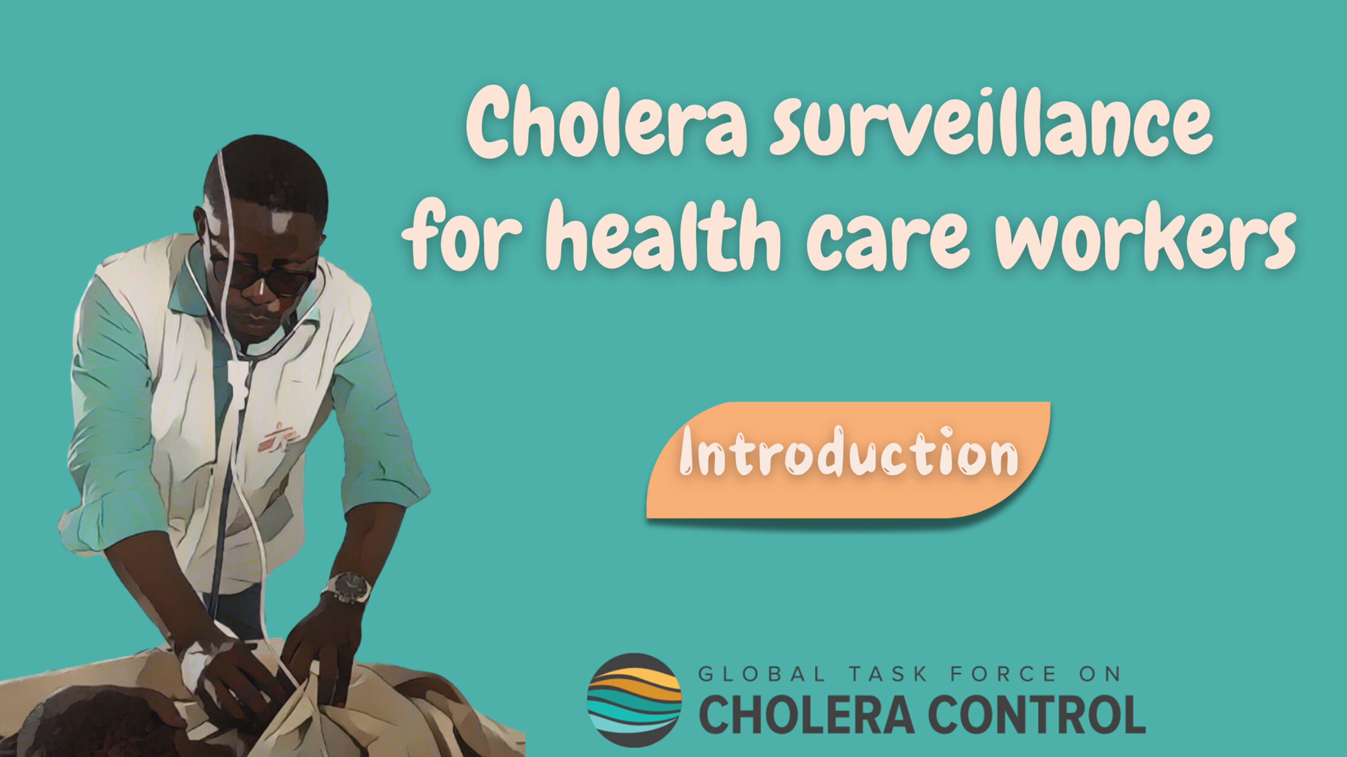
Notes:
Welcome to the GTFCC online course on cholera surveillance for health care workers.

Slide 2

Notes:
This module provides an overview of the course, and will help you get ready to take this course.

Slide 3

Who is this course for?
Health care workers working in facilities providing outpatient or inpatient care
    Health centres
    Hospitals
    Clinics
    Private practices
    Cholera Treatment Centres (CTCs)
    Cholera Treatment Units (CTUs)
    Oral Rehydration Points (ORPs)
    Etc
Notes:
This course is for health care workers working in any facility that provides outpatient or inpatient care. For example, health centres, hospitals, clinics, private practices, Cholera Treatment Centres, Cholera Treatment Units, Oral Rehydration Points, and so on.

Slide 4
What will you learn?
Objectives of cholera surveillance
Key role of health care workers in cholera surveillance
Signs and symptoms to identify patients with suspected cholera
Standard information to be collected on patients with suspected cholera
Timelines to report patients with suspected cholera in different situations
Which patients to test for cholera in different situations
Where to access supplementary resources about cholera surveillance
Notes:
In this course, you will learn about:
The objectives of cholera surveillance;
The key role that health care workers play in cholera surveillance;
The signs and symptoms that you should recognize to identify patients with suspected cholera;
The standard information that should be collected on patients with suspected cholera;
The applicable timelines to report patients with suspected cholera in different situations;
Which patients to test for cholera in different situations;
And, where to access supplementary resources about cholera surveillance.

Slide 5

What are the modules?
1 hour
15’
10’
10’
Module 1
Role of health care workers in cholera surveillance
Module 2
General principles for cholera surveillance
Module 3
Surveillance for the early detection of cholera outbreaks
10’
10’
5’
Module 4
Surveillance to monitor cholera outbreaks
Module 5
Surveillance
to track cholera clusters
Module 6
Resources
Notes:
There are six modules in this course.
In Module 1, we will outline the important role that health care workers play in cholera surveillance.
In Module 2, we will go through general principles for cholera surveillance. These principles always apply regardless of the cholera situation.
In Module 3, we will explain how to implement surveillance to ensure the early detection of a cholera outbreak.
In Module 4, we will explain how to implement surveillance to monitor a cholera outbreak.
In Module 5, we will explain how to implement surveillance to track clusters of cholera cases.
Lastly, in Module 6, we will show you where to access supplementary resources.
This course takes about 1 hour to complete.

Slide 6


How to nagivate this course?
Modules 1 & 2
Modules 3 to 5
Generic
Context-specific
Independent of the cholera situation
Depend on the cholera situation
Take Modules 1 & 2 first
Notes:
Module 1 and Module 2 address generic principles for cholera surveillance which apply independent of the ongoing cholera situation.
Module 3 to Module 5 address context-specific recommendations. These are recommendations which depend on the ongoing cholera situation and the corresponding surveillance objective.
We therefore encourage you to take Module 1 and Module 2 before moving on to Modules 3 to 5.

Slide 7

How to use this course?
Course based on the recommendations on cholera surveillance of the Global Task Force on Cholera Control
Does not substitute for the national or local protocols
Always follow the directions of your Health Authority
Notes:
This course is based on the recommendations on cholera surveillance of the Global Task Force on Cholera Control (GTFCC).
The recommendations of the GTFCC do not substitute for the national or local protocols applicable in your country.
Therefore, always follow the directions of your health authority to implement cholera surveillance in accordance with local procedures in place.

Slide 8


Get additional support
For any question on cholera surveillance or for technical assistance,
contact the GTFCC Secretariat
GTFCCsecretariat@who.int
Notes:
For any questions or to request technical assistance on cholera surveillance, we invite you to contact the GTFCC Secretariat at GTFCCsecretariat@who.int; we are here to support you.

Slide 9

Notes:
We have now completed this brief introduction.

