Slide 1
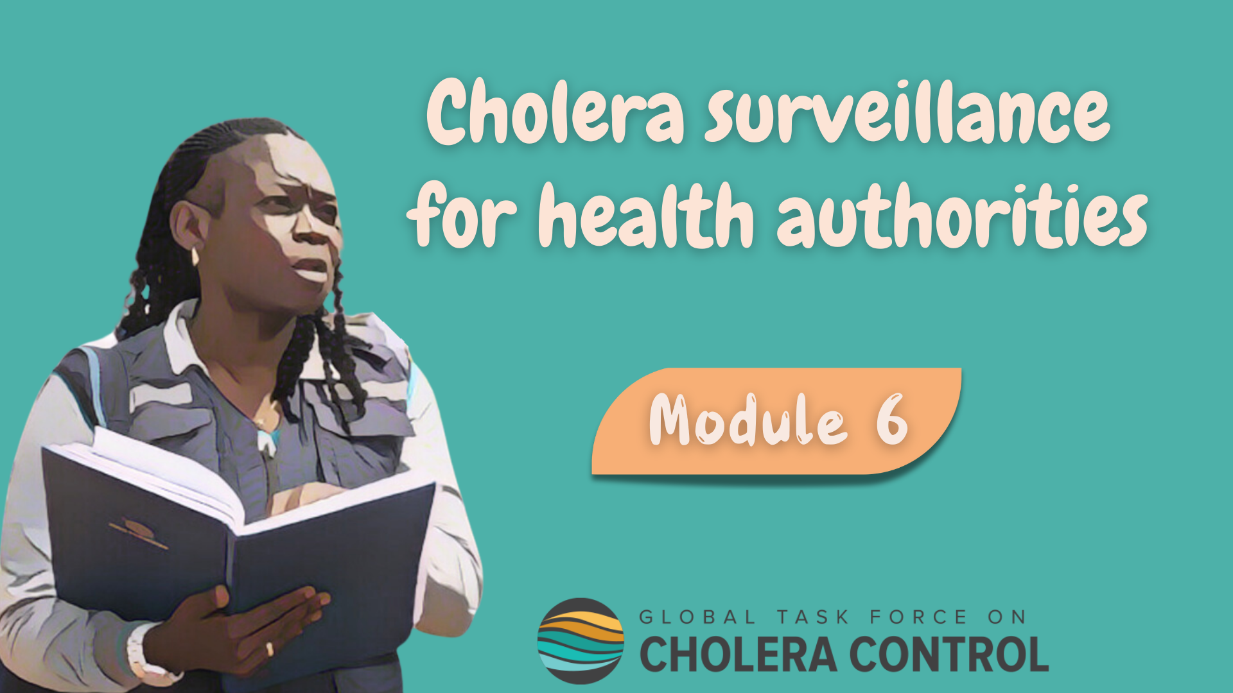
Notes:
Welcome to Module 6 of the GTFCC online course on cholera surveillance for health authorities.

Slide 2

Notes:
In this module, we will show you how to access supplementary material.

Slide 3
What will you learn?
Where to find supporting material on cholera surveillance
Notes:
After completing this module, you will know where to find supporting material on cholera surveillance.

Slide 4

GTFCC App
Photo adapted from: WHO / Genna Print
Notes:
Let’s start with the GTFCC App.

Slide 5
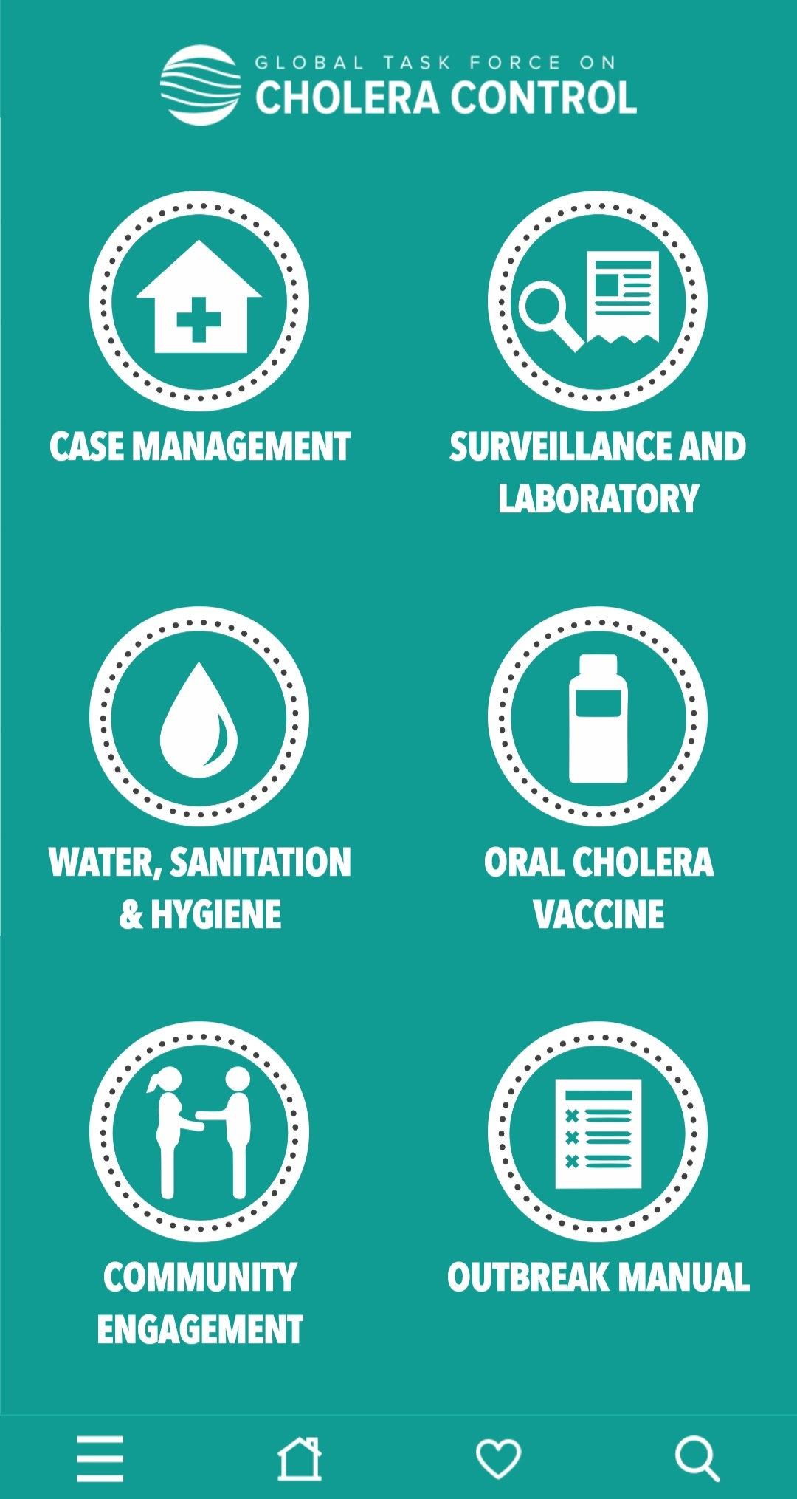
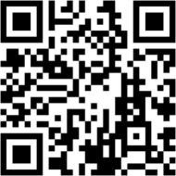

GTFCC App
Phone-based application for health professionals
Free of charge
Compatible with Android and iOS
Can be used offline
Summary guidance and practical tools including:
  Surveillance
  Testing
https://www.gtfcc.org/cholera-app/
Notes:
The GTFCC App is a phone-based application designed for health professionals.
It is free of charge and compatible with android and IOS.
Once downloaded, this app can be used offline.
It includes summary guidance and practical tools on all cholera control and prevention pillars including surveillance and testing.
This app can be found by searching GTFCC cholera in your usual app store, via the link below, or by scanning this QR code.

Slide 6

GTFCC website
Photo adapted from: WHO / Andrew Esiebo
Notes:
Supplementary resources can also be found on the GTFCC website.

Slide 7
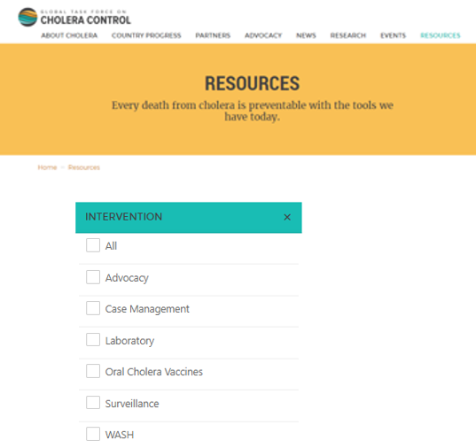
GTFCC website – Resources tab
https://www.gtfcc.org/resources
Detailed technical guidance including on:
  Surveillance
  Testing
Notes:
We invite you to consult the resources section of the GTFCC website.
You can access it at https://www.gtfcc.org/resources/.
In this website section, you will find detailed and up-to-date GTFCC technical guidance, including on surveillance and testing.

Slide 8

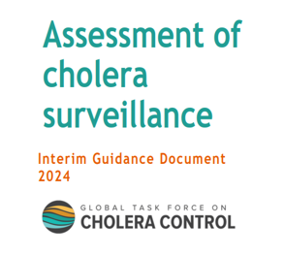
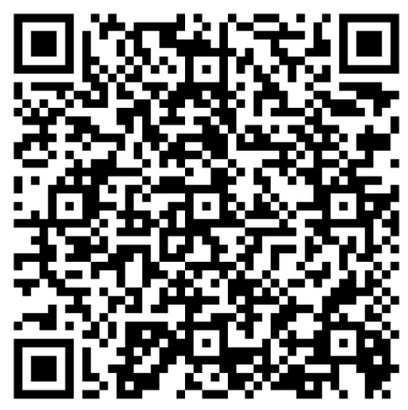
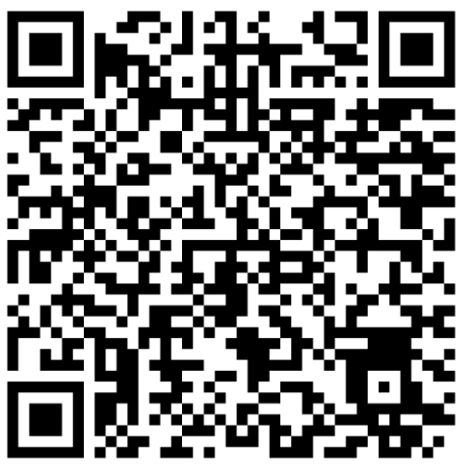
Cholera surveillance
https://tinyurl.com/CholeraSurveillance
Technical guidance
Assessment of surveillance
Detailed technical guidance on cholera surveillance
Standard method for countries to self-assess cholera surveillance system/strategy
Notes:
Key resources on cholera surveillance available on the GTFCC website include a detailed technical guidance on cholera surveillance as well as a standard method for countries to self-assess cholera surveillance systems and strategies to help countries identify priority gaps to strengthen cholera surveillance.
You can access these resources by scanning these QR codes or at https://tinyurl.com/CholeraSurveillance.

Slide 9
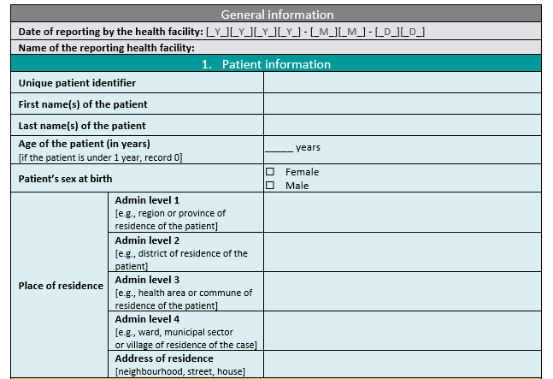
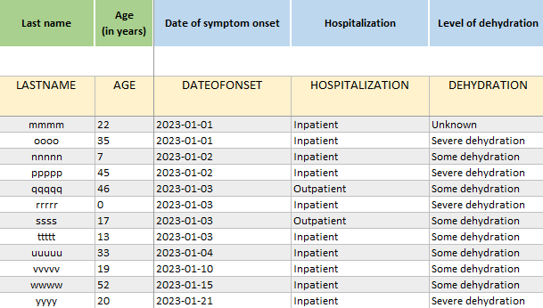
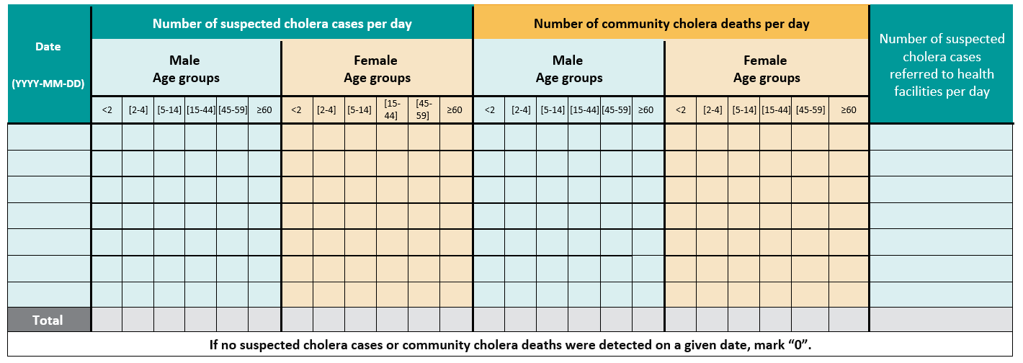
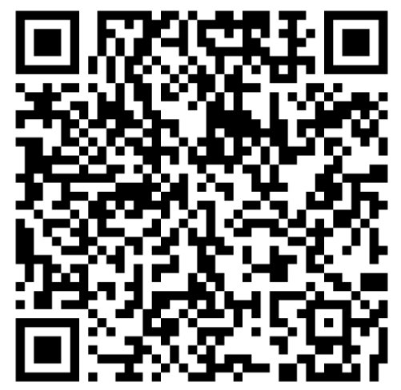
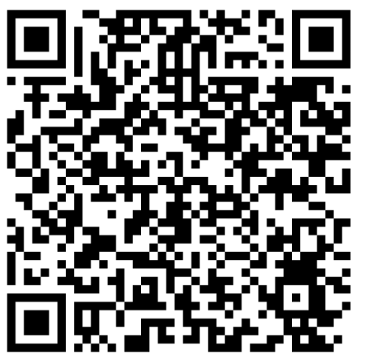
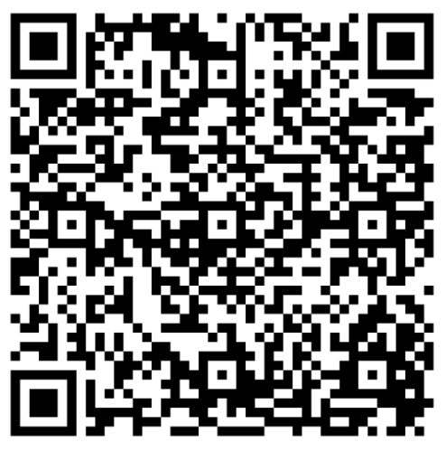
Reporting tools
https://tinyurl.com/CholeraSurveillance
Case report form
Excel linelist
Community-based reporting form
      For health facility-based surveillance
      Form and linelist include same variables
For community-based surveillance
Convenient for use when number of cases is low
Convenient for use when number of cases is higher
Notes:
You can also access standard cholera reporting tools.
This includes a template case report form and a template line list in Excel. The case report form and the linelist are for reporting standard case-based data via health facility-based surveillance. The case report form and the linelist contain the same variables.
The case report form is usually more convenient for use when the number of suspected cholera cases is low while the line list is generally more convenient for use when the number of cases is higher.
You will also find a template community-based form for reporting aggregate data via community-based surveillance.
You can access these standard reporting tools by scanning these QR codes or at https://tinyurl.com/CholeraSurveillance.

Slide 10
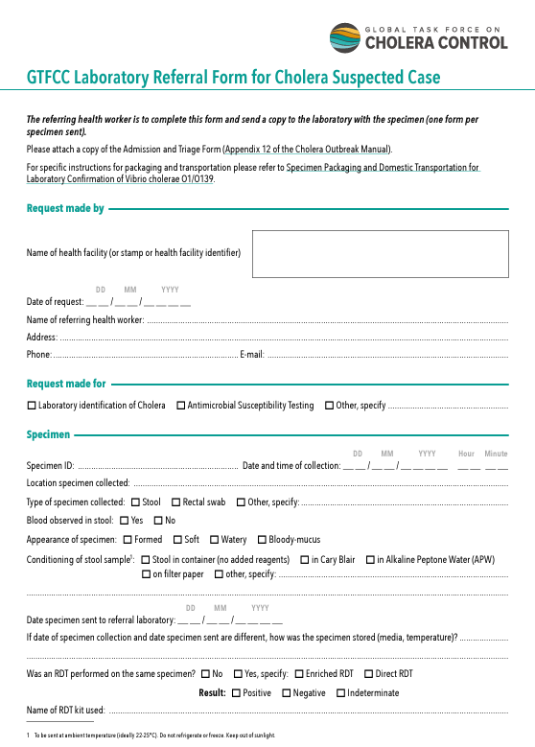
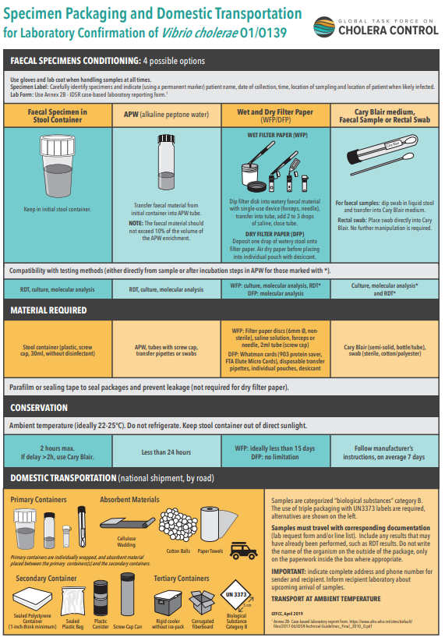
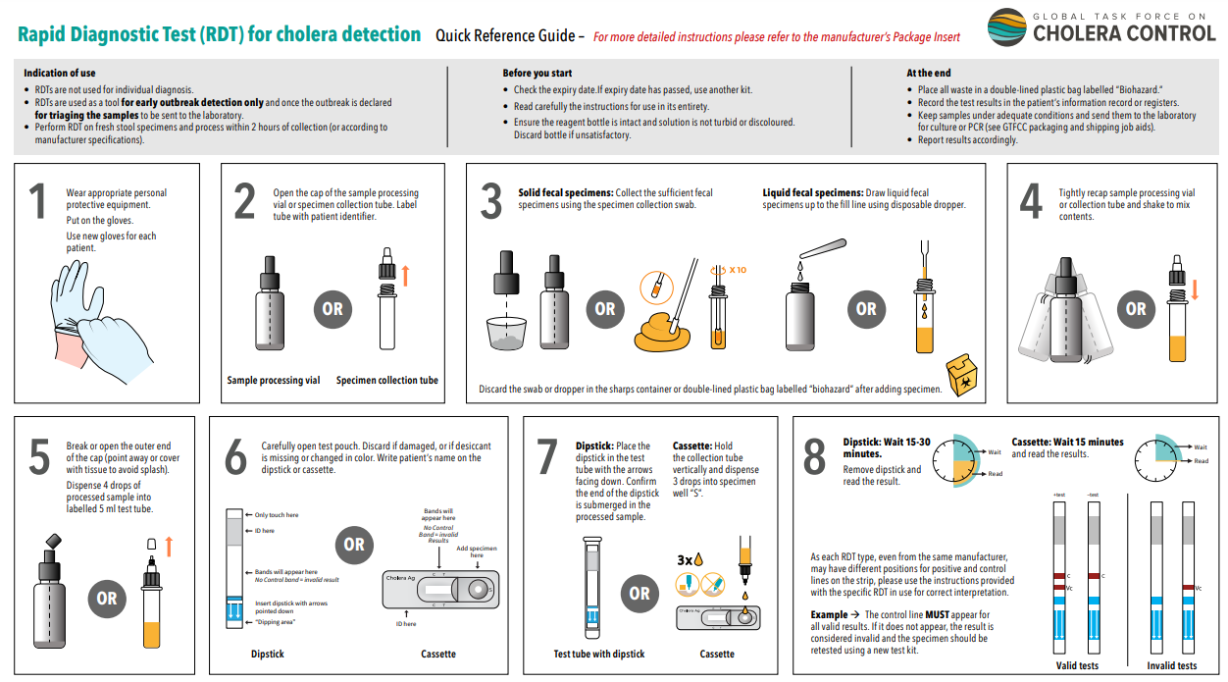
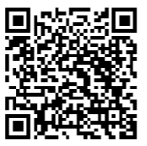
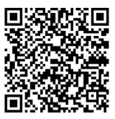
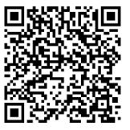
Testing
RDT - Job aid
Referral form for testing
Handling samples
Notes:
Key resources on testing for cholera available on the GTFCC website include:
Step-by-step instructions for performing RDTs;
A referral form for testing to accompany stool samples to a laboratory for testing;
Guidance on how to collect specimen and prepare and package them for transportation.
You can access these resources by scanning these QR codes.

Slide 11
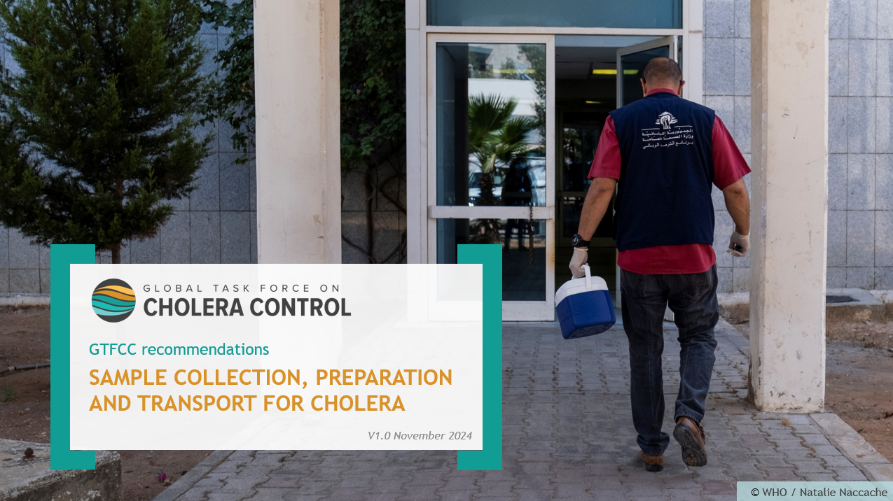
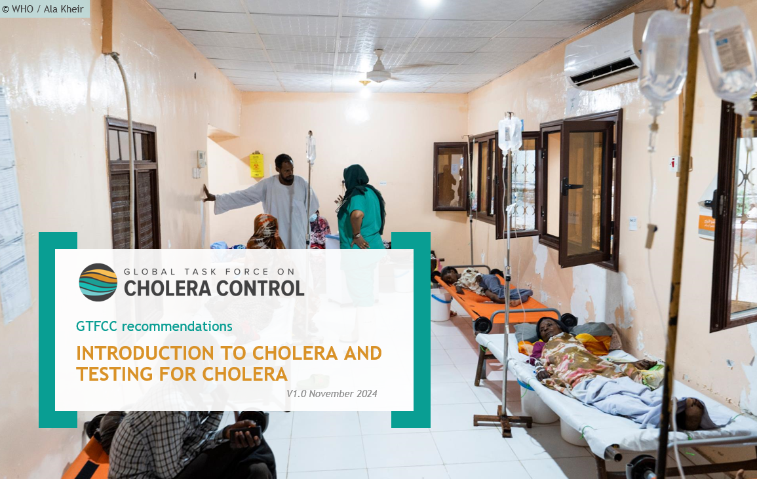
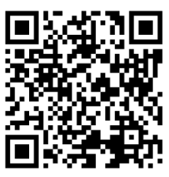
Trainings on testing
Trainings on sample collection and testing for cholera
Notes:
On the GTFCC website, you will also find some training material on sample collection and testing for cholera. You can access these trainings by scanning this QR Code.

Slide 12
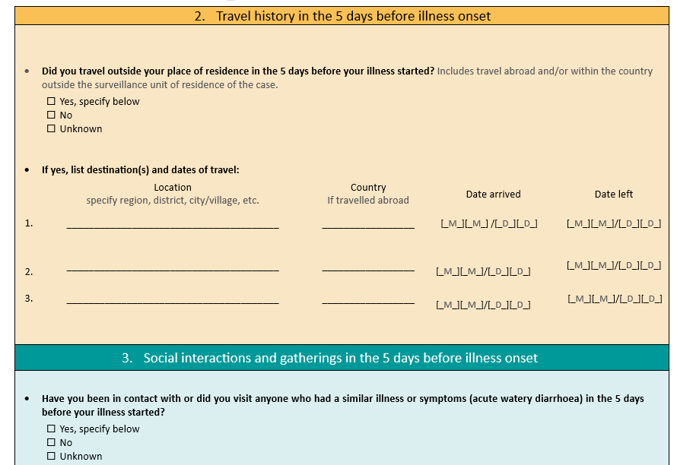
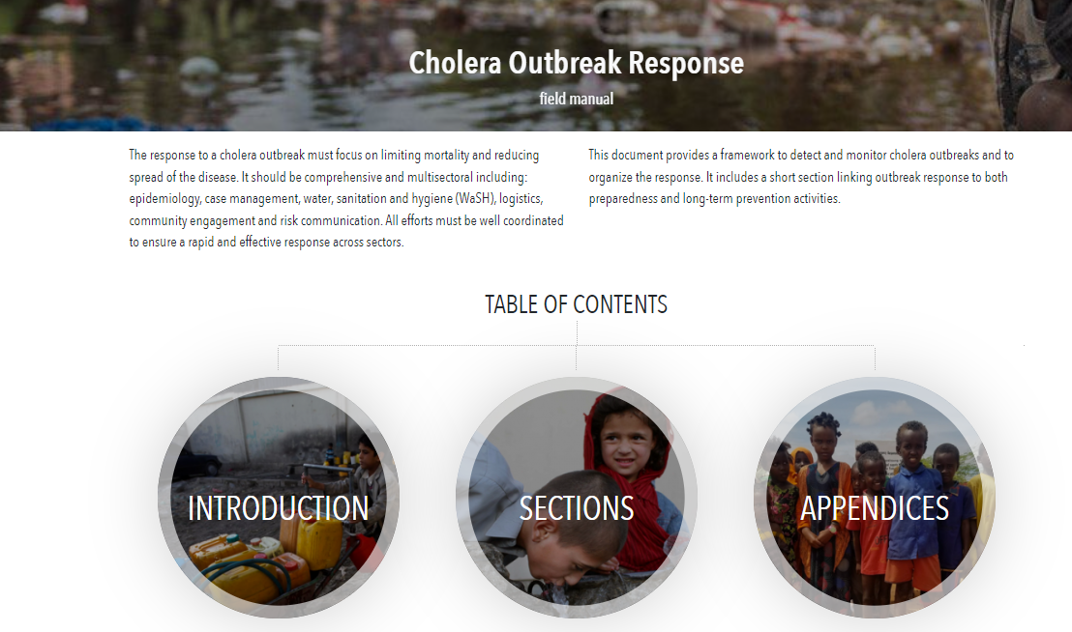
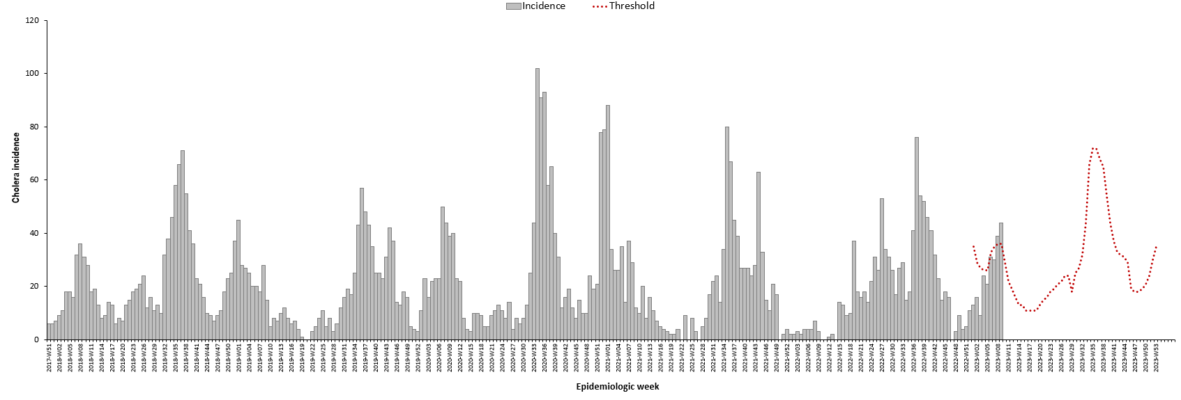
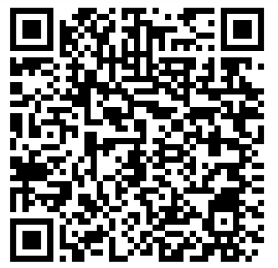
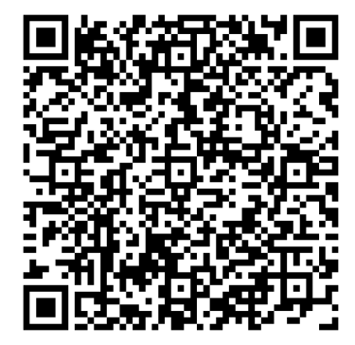
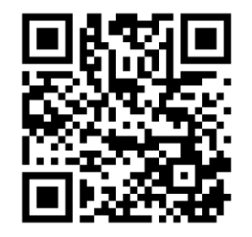
Investigation & response
https://tinyurl.com/CholeraSurveillance
Excel tool to detect the deterioration of an outbreak
Field manual
Case investigation form
Standard questionnaire
Automatizes calculations of weekly baseline thresholds
Guidance for field investigation and response to an outbreak
Notes:
To support the investigation and the response, on the GTFCC website, you will find:
a template case investigation form which corresponds to a standard questionnaire to investigate suspected cholera cases;
an Excel tool to facilitate the detection of the deterioration of a cholera outbreak by automatizing the calculation of weekly baseline thresholds using historical data;
And a field manual which provides guidance for the field investigation of a cholera outbreak and for the response to an outbreak.
You can access these resources by scanning these QR codes or at https://tinyurl.com/CholeraSurveillance.

Slide 13
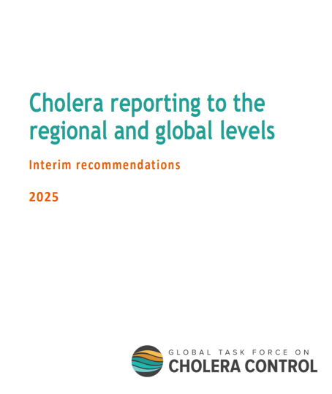
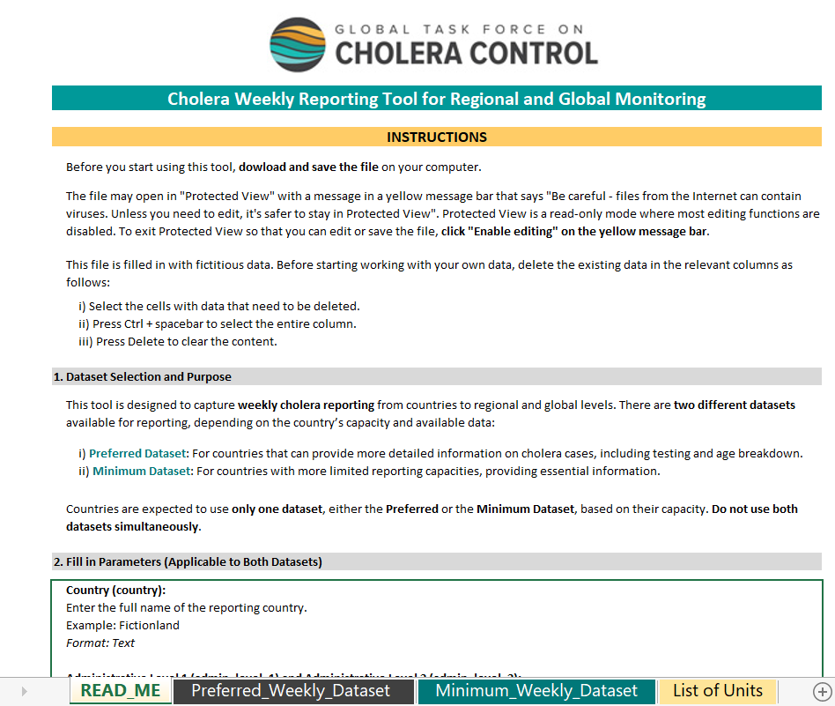
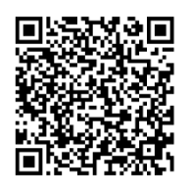
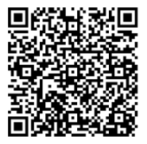
Regional & global reporting
https://tinyurl.com/CholeraSurveillance
Recommendations
Reporting tool
Standard aggregate datasets for weekly reporting to the regional and global levels
Excel tool for reporting the recommended datasets
Notes:
Reporting regularly on your country cholera situation to the regional and global levels is essential including to enhance cross-border information-sharing and guide multi-country preparedness and response.
On the GTFCC website, you will find recommendations on standard aggregate datasets to be reported on a weekly basis to the regional and global levels as well as an Excel tool to facilitate the reporting of these datasets.
You can access these resources by scanning these QR codes or at https://tinyurl.com/CholeraSurveillance.

Slide 14

GTFCC network
Photo adapted from: MOH Cameroon Ngomba
Notes:
Lastly, the GTFCC network is always here to support you.

Slide 15


GTFCC network
The GTFCC and its network of partners is here to support you
For any question or technical assistance,
contact the GTFCC Secretariat
GTFCCsecretariat@who.int
Notes:
For additional information on cholera surveillance or to request technical assistance, please contact the GTFCC Secretariat at GTFCCsecretariat@who.int.

Slide 16

Notes:
We have now completed the last module. Thank you for taking this course. We hope that you found it useful.

