Slide 1
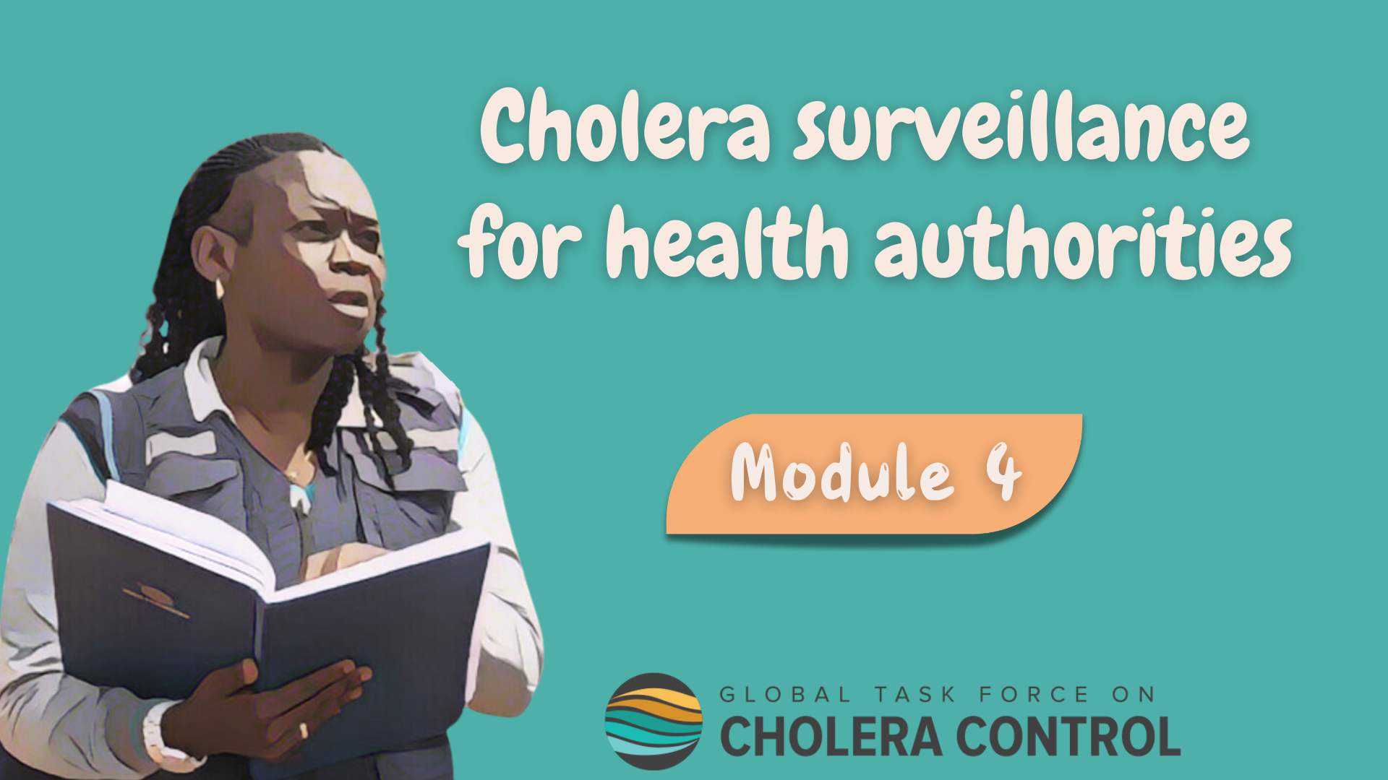
Notes:
Welcome to Module 4 of the GTFCC online course on cholera surveillance for health authorities.

Slide 2
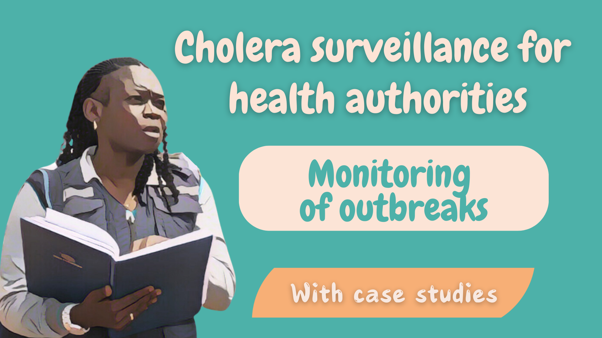
Notes:
In this module, we will dive into surveillance to monitor a cholera outbreak.

Slide 3

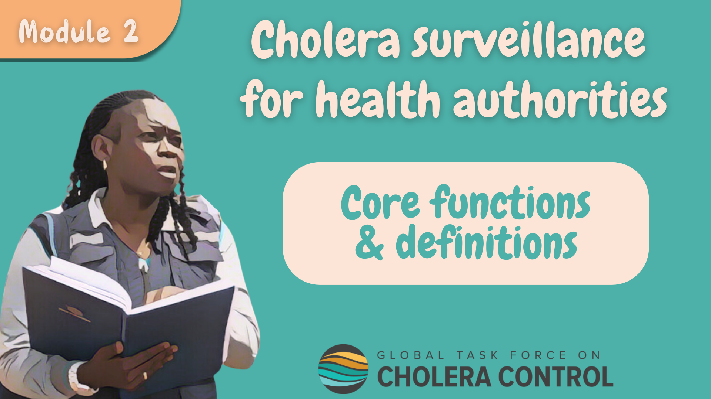
Get ready for this module
Before taking this module, complete Module 2 ‘Core functions’
Notes:
This module goes through the different core functions of health authorities in cholera surveillance and describe how strategies are adapted when the surveillance objective is to monitor an outbreak. As a prerequisite to follow this module, you should be familiar with the core functions of health authorities in cholera surveillance. Therefore, if you have not yet already done so, we encourage you to take module 2 of this course before taking this module.

Slide 4

What will you learn?
Surveillance strategies to monitor a cholera outbreak
How health authorities
  Monitor that these strategies are effectively implemented
  Analyze data and investigate to interpret outbreak dynamics
  Disseminate findings to guide the response
Notes:
After completing this module, you will be familiar with surveillance strategies to monitor cholera outbreaks including:
How health authorities monitor that these strategies are effectively implemented;
How health authorities analyze surveillance data and investigate as needed to interpret the outbreak dynamics;
And how health authorities disseminate findings to guide the response.

Slide 5

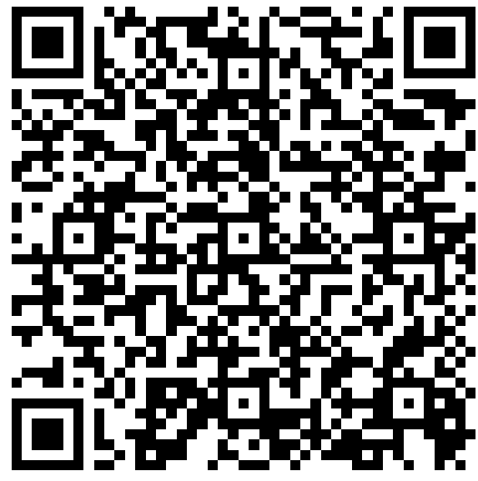
Get ready to practice
Case studies
  Based on fictional scenarios
  To deepen your understanding of how health authorities monitor cholera outbreaks
Use the GTFCC Surveillance Guidance
https://tinyurl.com/cholerasurv2024
Notes:
Case studies are offered throughout this module. They are based on fictional scenarios. These case studies will help you better understand how health authorities monitor cholera outbreaks.
We encourage you to download the GTFCC guidance on cholera surveillance. Having it on hand will help you take the case studies. You can download the GTFCC surveillance guidance at https://tinyurl.com/cholerasurv2024 or by scanning this QR code.

Slide 6

Surveillance to monitor outbreaks
Where
Why
In surveillance units where there is a
probable or confirmed cholera outbreak
To generate information to orient control measures
  To mitigate impact and spread
  With community transmission
    or
  Deemed community transmission by default
    e.g., epidemiological links not investigated
How
In accordance with this module
Notes:
Surveillance is implemented to monitor a cholera outbreak in any surveillance unit where there is a probable or confirmed outbreak with community transmission or considered to be community transmission by default.
For example, transmission is by default considered as community transmission in surveillance units where epidemiological links between cases are not investigated.
The surveillance objective is then to continuously generate information to orient control measures to mitigate the impact and the spread of the outbreak
For surveillance to reach this objective effectively, it should be implemented in accordance with the recommendations outlined in this module.

Slide 7

Reporting
and testing strategies
Photo adapted from: WHO / Mulugeta Ayene
Notes:
Let’s look into how suspected cholera cases are reported and tested when the surveillance objective is to monitor a cholera outbreak.

Slide 8

Case definition
Suspected cholera case
Any person with AWD (or who died from AWD)
NO criteria on age or severe dehydration
  Sensitive and comprehensive monitoring of the outbreak
    To guide the response effectively
Notes:
When the surveillance objective is to monitor an outbreak, a suspected cholera case is any person who has acute watery diarrhoea (AWD) or who died from AWD.
There are no additional criteria on age or severe dehydration to identify suspected cholera cases.
This is because when there is a cholera outbreak in a surveillance unit, it is likely that a person with AWD has cholera. This allows a sensitive and comprehensive monitoring of the outbreak to guide response measures effectively.

Slide 9
Reporting
Suspected cholera cases reported to the health authority on a weekly basis
Routine reporting
  Health facility-based and community-based surveillance
  Weekly reporting
    Avoids overwhelming reporting sites
    Provides sufficiently timely information to routinely monitor the outbreak
Zero reporting
  Absence of suspected cases reported weekly
Increased frequency
  At the onset and towards the end of an outbreak, daily reporting
    Supports timely and targeted interventions to end the outbreak
Notes:
For the routine monitoring of an outbreak, suspected cholera cases are reported to the health authority on a weekly basis.
This applies both for health facility-based reporting and community-based reporting. Reporting on a weekly basis avoids overwhelming reporting sites but still provides sufficiently timely information to monitor the dynamics of an outbreak.
If on a given week, no suspected cholera case was detected, the absence of cases is reported on a weekly basis. This is zero reporting.
At the onset or towards the end of an outbreak, reporting suspected cases on a daily basis is encouraged. Increasing the reporting frequency at these outbreak phases is to support the implementation of timely and targeted interventions to end the outbreak.

Slide 10



Case-based Vs aggregate
Case-based health facility reporting and aggregate community reporting
Learn about reporting in Module 2
Exceptional circumstances
Aggregate health facility-based reporting
If case-based health facility reporting cannot be sustained
  Overstretched reporting capacity
  Case-based reporting resumes as soon as possible
Notes:
As a general principle, case-based data is reported by health facility-based surveillance and aggregate data is reported by community-based surveillance.
For a refresher on this, we encourage you to go back to module 2.
If under exceptional circumstances, during an outbreak, case-based health facility reporting cannot be sustained due to overstretched reporting capacity, aggregate health facility-based reporting may be considered.
Case-based reporting should then resume as soon as possible.

Slide 11
Principles for testing
Some suspected cholera cases are tested
No need to test ALL
Necessary to test SOME
Treatment depends on dehydration
  NOT on individual test results
Monitor positivity rate
Monitor circulating strain
  Including susceptibility to antimicrobials
Selection of suspected cases for testing
  Systematic sampling scheme
    Applied consistently in time and space
Notes:
When the surveillance objective is to monitor a cholera outbreak, it is not necessary to test all suspected cholera cases. Only some suspected cases need to be tested.
The reason why it is not necessary to test all suspected cases is because this is not required to treat cholera. Treatment depends on the dehydration level, not on individual test results.
However, it is essential to test some suspected cases in order to monitor the positivity rate to interpret the trends of an outbreak. In addition, this is also necessary to monitor the circulating strain including its susceptibility to antimicrobials in order to continue to treat cholera effectively.
Suspected cases for testing are selected according to a systematic sampling scheme applied consistently throughout the outbreak. A systematic sampling scheme means that the same sampling scheme is applied consistently in time and space.

Slide 12
Testing strategy
If RDTs available
If RDTs NOT available
RDT
  First 3 suspected cases
  Per day per health facility
Culture or PCR
  First 3 suspected cases
  Per week per health facility
Culture or PCR
  3 RDT+
  Per week per surveillance unit
Antimicrobial susceptibility
  3 culture+ or PCR+
  Per month per surveillance unit
Antimicrobial susceptibility
  3 culture+ or PCR+
  Per month per surveillance unit
Notes:
In surveillance units where Rapid Diagnostic Tests (RDT) are available, each day and at each health-facility, the first three suspected cholera cases are tested with a RDT.
In addition, 3 suspected cholera cases tested positive by RDT are tested every week by culture or PCR.
Three cholera cases confirmed by culture or PCR are also tested every month for antimicrobial susceptibility.
In surveillance units where RDTs are not available, each week and at each health-facility, the first three suspected cholera cases are tested by culture or PCR.
In addition, three cholera cases confirmed by culture or PCR are also tested every month for antimicrobial susceptibility.

Slide 13

Oversight of reporting & testing
by health authorities
Photo adapted from: WHO / Genna Print
Notes:
A core function of health authorities in cholera surveillance is to continuously ensure that suspected cholera cases are reported and tested in accordance with applicable strategies. Let’s look into this.

Slide 14


Oversight
Awareness and capacity building
Health authorities ensure that
  All reporting sites and laboratories in the surveillance unit
  Are aware and in capacity to implement reporting and testing in accordance with applicable strategies
Monitoring
Health authorities monitor surveillance performance indicators
  At least on a weekly basis
  Take supportive measures as needed
Notes:
Health authorities are responsible for ensuring that all reporting sites in the surveillance unit including for health facility-based surveillance and community-based surveillance as well as laboratories performing cholera testing are fully aware of the applicable strategies to report and test suspected cholera cases to monitor outbreak, and are in-capacity to implement reporting and testing accordingly.
Health authorities then monitor surveillance performance indicators at least on a weekly basis to verify that reporting and testing is implemented according to applicable strategies. If any reporting site or laboratory does not implement reporting or testing in accordance with applicable strategies, health authorities then take supportive measures to improve reporting or testing.

Slide 15



Oversight of reporting & testing by health authorities
Notes:
Let’s practice with a case study to better understand how health authorities routinely oversee reporting and testing.

Slide 16



You are a public health officer on your first day of deployment in a surveillance unit with a confirmed cholera outbreak with community transmission
You review the surveillance performance indicators
All surveillance performance indicators’ targets have been reached, except for one
What is the nature of the issue?
What can be its impact?
Is this only an issue with health facility-based reporting?
What are you going to do?
Notes:
In this scenario, you are a local health authority officer on your first day of deployment to support local health authorities in a surveillance unit with a confirmed cholera outbreak with community transmission.
You start by reviewing surveillance performance indicators. You notice that all surveillance performance indicators’ targets have been reached in recent weeks except for one indicator.
The completeness of health facility-based reporting has been below the target since week 4.
What is the nature of the issue?
What can be the impact of this issue?
Is this only an issue with health-facility based reporting?
What are you going to do?
Pause the video, and take the time you need to reflect about this scenario and the appropriate course of action.

Slide 17




Issue
Some health facilities do not report
2) Impact
Underreporting
  Magnitude of the outbreak (number of cases) underestimated
    Outbreak response not calibrated effectively
  If localized spatially, spatial extension of the outbreak underestimated
    Outbreak response not targeted effectively
  Likely to hamper the control of the outbreak
Notes:
An issue with completeness of reporting means that some health facilities do not report on the presence or absence of suspected cholera cases.
This leads to under-reporting and is likely to result in an underestimate of the magnitude of the outbreak. As a result, the outbreak response will not be calibrated effectively.
In addition, if underreporting is localized spatially meaning that health facilities which do not report are localized in a specific area of the surveillance unit, the spatial extension of the outbreak gets underestimated and the outbreak response will not be targeted effectively
Overall, incomplete reporting is a major issue likely to hamper the control of an outbreak.

Slide 18

3) Is this only an issue with health-facility based reporting?
Also an issue with health authorities’ oversight of reporting
Incomplete health facility-based reporting ongoing for 4 weeks
    Health authorities may not have investigated the issue
    If they did, they have not been able to resolve it yet
Health authorities responsible for supporting surveillance stakeholders
    If an issue persists, there is also an issue with how stakeholders are supported
Notes:
Incomplete health facility-based reporting also indicates an issue with the oversight of reporting by health authorities.
Incomplete health facility-based reporting has been ongoing for 4 weeks, from week 4 to week 7.
Health authorities may not have investigated the issue to address it or if they did investigate the issue, they have not been able to resolve it yet.
Health authorities are responsible for supporting surveillance stakeholders in implementing reporting and testing. Therefore, if an issue with reporting or testing persists over time, there is also an issue with how effectively health authorities support surveillance stakeholders.

Slide 19

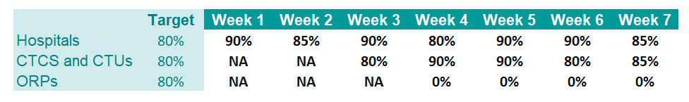
4) What to do?
Break down the indicator of concern
  At a finer geographic scale and/or by health facility type
  To better assess where/what the issue might be to determine how to resolve it
End of case study (hypothetical scenario)
Completeness of health facility-based reporting by health facility type
Oral Rehydration Points (ORPs) set up on week 4 do not report
ORPs workers were not aware of reporting requirements
Issue resolved by providing ORPs guidance and tools for reporting
Notes:
An advisable first step is to break down the indicator of concern at a finer geographic scale or by health facility type to better assess where and what the issue might be. This would help investigate the cause of the issue to determine how to resolve it.
In this scenario, here is how it went. The indicator of concern, that is completeness of health facility-based reporting, was broken down by health facility type.
This showed that hospitals consistently met the target for completeness of reporting.
Cholera Treatment Centers (CTCs) and Cholera Treatment Units (CTUs) were set up on week 3 and consistently met the target for completeness of reporting.
Oral Rehydration Points (ORPs) were set up on week 4 and since then none of them reported.
The issue was identified as the absence of reporting by ORPs. Local health authorities contacted ORPs to understand what was happening, and realized that ORPs workers were not aware that they should undertake reporting. The issue was then resolved by providing them with guidance and tools for reporting cholera.
Overall, this illustrates that as long as surveillance performance indicators are closely monitored, issues with how reporting and testing are performed get detected. From there, it is then possible to work it out and find solutions.

Slide 20

Data analysis and
interpretation
Photo adapted from: WHO / NOOR / Alixandra Fazzina
Notes:
Moving on to the next core function of health authorities in cholera surveillance, let’s look into the analysis and interpretation of surveillance data when the surveillance objective is to monitor an outbreak.

Slide 21


Weekly analysis
  Health authorities analyze the data weekly at the surveillance unit level
  and, where possible, at lower level (e.g., health facility catchment areas)
  Data considered
    Data reported by health facility-based surveillance
    Data reported by community-based surveillance
    Test results reported by laboratories
    Signals detected by event-based surveillance
  Community-based & health facility-based surveillance data analyzed separately and interpreted jointly
Notes:
To monitor a cholera outbreak, surveillance data and test results are analyzed on a weekly basis at the surveillance unit level and, where possible, at lower level, for example at the level of health facility catchment areas.
The surveillance data considered in the analysis are the suspected cholera cases reported by health facility-based and community-based surveillance, any cholera test results as well as cholera signals detected by event-based surveillance.
Importantly, the data reported by community-based surveillance and the data reported by health facility-based surveillance are analyzed separately but they are interpreted jointly to interpret the outbreak dynamics.

Slide 22

Descriptive analysis
Outbreak described by person, place, time and compared with previous weeks
Person
    Suspected cases
    Health facility deaths (after arrival at a health facility)
    Community deaths (before arrival at a health facility)
    Suspected cases tested and tested positive
        RDT
        Culture/PCR
Place (maps)
    Suspected and confirmed cases
    Community and health facility deaths
Time (epidemic curves)
    Suspected and confirmed cases
    Week of onset
Notes:
The routine analysis of surveillance data aims to describe the outbreak by person, place and time and compare the current outbreak’s dynamics with previous weeks.
Key figures to describe the outbreak by person include:
the number of suspected cases;
the number of health facility deaths – those are cholera deaths that occurred after arrival at a health facility;
the number of community deaths, those are cholera deaths that occurred before reaching a health facility;
and the number of suspected cases tested and those tested positive - differentiating those tested by RDT and those tested by culture or PCR.
To describe the outbreak by place, the spatial distribution of suspected and confirmed cases and of community deaths and health facility deaths are mapped.
Lastly, to describe the outbreak over time, the weekly distribution of suspected and confirmed cases are represented on epidemic curves, preferably by week of onset.

Slide 23
Morbidity indicators
Morbidity indicators monitored to assess the extent of the outbreak in the population
Incidence rate
Cumulative incidence rate
Total number of cases since the beginning of the outbreak (or beginning of the year)
Number of new cases in a week
Population
Population
Interpretation
  Speed of transmission
    Comparaison between geographic areas
Interpretation
Impact of the outbreak
    Less informative for weekly monitoring
Notes:
Morbidity indicators are calculated and monitored at the surveillance unit level or lower level as part of the weekly data analysis in order to assess the extent of the outbreak in the population.
The weekly incidence rate is calculated as the number of new cases reported on a given week in a given geographic area over the population living in this area.
Monitoring the incidence rate is essential to compare the speed of transmission between geographic areas and to assess whether transmission is increasing or decreasing over time.
Another common morbidity indicator is the cumulative incidence rate. It is calculated as the total number of cases reported in a geographic area since the beginning of the outbreak or since the beginning of the year over the population living in this area.
The cumulative incidence rate is insightful to assess the impact of the outbreak, however this indicator is less informative than the incidence rate for monitoring the dynamics of an ongoing outbreak.

Slide 24
Mortality indicators
Mortality indicators monitored to orient case management and community engagement
Case Fatality Ratio (CFR)
Number of community deaths
Number of deaths that
occured at a health facility
Number of community deaths
Number of cases (health facility)
Calculation
  Does not include
    Dead on arrival at health facility
Calculation
  Includes
    Deaths reported by community-based surveillance
    Dead on arrival at health facility
Interpretation
  Clinical care
Interpretation
  Access to care and care seeking
Notes:
Mortality indicators are calculated and monitored at the surveillance unit level or lower level as part of the weekly data analysis. Weekly values are compared with previous weeks and with cumulative values. Monitoring mortality indicators is helpful to orient case management and community engagement interventions as needed.
Two mortality indicators are closely monitored.
The case fatality ratio or CFR. It is calculated as the number of cholera deaths that occurred at a health facility over the number of cases reported by health facility-based surveillance. Cases that were dead on arrival at a health facility are not included in the calculation of the CFR.
Monitoring the CFR is essential to identify challenges with the quality of clinical care.
The other mortality indicator that is monitored is the number of community deaths. Community deaths include cholera deaths reported by community-based surveillance and deaths on arrival at a health facility.
Monitoring the number of community deaths is essential to identify challenges with access to care or care seeking.

Slide 25
Test positivity indicators
Test positivity indicators are monitored to interpret cholera outbreak trends
Positivity rate by RDT
Positivity rate by culture or PCR
Number of cases tested positive by RDT
Number of cases tested positive by culture or PCR
Number of cases tested by RDT
Number of cases tested by culture or PCR
Interpretation
Compare trends in positivity rates with the epidemic curve
  Interpret cholera outbreak trends compared to trends in other diseases causing AWD
Notes:
Test positivity indicators are calculated and monitored at the surveillance unit level or lower level as part of the weekly data analysis. Weekly values are compared with previous weeks and with cumulative values. Monitoring test positivity indicators is insightful to interpret the cholera outbreak trends.
The positivity rate by RDT is calculated as the number of suspected cases tested positive by RDT over the number of suspected cases tested by RDT.
The positivity rate by culture or PCR is calculated as the number of suspected cases tested positive by culture or PCR over the number of suspected cases tested by culture or PCR.
The positivity rate’s trends are compared with the epidemic curve in order to interpret the cholera outbreak trend compared to trends in other diseases causing AWD that may occur concomitantly in the surveillance unit.

Slide 26


Interpretation
Findings of the analysis interpreted on a weekly basis
  Why have the observed trends occurred?
  What does this imply for interventions?
Contextual information
  Surveillance performance indicators
  Affected and at-risk geographic areas
  Affected and at-risk populations
  Interventions implemented
Notes:
The findings of the data analysis are interpreted every week.
Interpreting the findings aims to formulate hypothesis regarding why the observed trends have occurred. This is then used to guide and adapt the outbreak response as needed.
To interpret the findings of the data analysis, contextual information is considered, such as the surveillance performance indicators, information on affected and at-risk geographic areas as well as affected and at-risk populations. Interventions that have been implemented and their impact are also considered.

Slide 27

Outbreak deterioration
A deterioration of an outbreak may be detected as part of the weekly analysis
Epidemiological situation worsens over at least 2 consecutive weeks
  Marked increase in weekly incidence
  Spatial extension of the outbreak
  Marked increase in CFR
  Marked increase in the number of community deaths
  Shift in the socio-demographic profile of cases
Outbreak response to be strengthened and adapted
Notes:
As part of the weekly data analysis, a deterioration of the outbreak may be detected.
An outbreak deterioration means that the epidemiological situation has worsened over at least two consecutive weeks. For example, this may be:
A marked increase in weekly incidence;
A spatial extension of the outbreak;
A marked increase in the CFR;
A marked increase in the number of community deaths;
Or a shift in the socio-demographic profile of cases.
A deterioration indicates that response activities are not sufficiently effective. This should be investigated as a warning that the response may have to be strengthened and adapted.

Slide 28
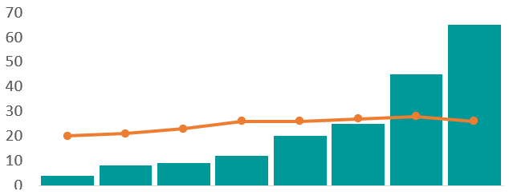


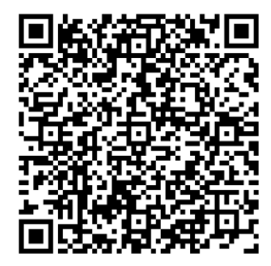
Quantitative detection
In surveillance units regularly affected by cholera with weekly historical data (for ≈ 5 years),
baseline thresholds are used to detect a deterioration
Baseline threshold
  Expected baseline level
Deterioration
  An indicator exceeds baseline threshold
  For ≥ 2 consecutive weeks
Number of cases
Week 1
Week 2
Week 3
Week 4
Week 5
Week 6
Week 7
Week 8
Epi week
Weekly incidence
Weekly baseline threshold
Deterioration
A GTFCC Excel tool automatizes the calculation
of baseline incidence thresholds
Notes:
In surveillance units regularly affected by cholera and where weekly historical data are available for about the past 5 years, the deterioration of an outbreak can be detected in a quantitative manner using baseline thresholds.
Baseline thresholds correspond to the expected baseline level in a given surveillance unit on a given week. An indicator below the baseline threshold is considered as within the expected normal range.
If an indicator exceeds the baseline threshold for at least 2 consecutive weeks, this indicates a deterioration.
Let’s illustrate this with a fictive example, on this figure, the weekly incidence during an ongoing outbreak is represented by the green epidemic curve. In orange is the baseline incidence threshold. On weeks 7 and 8, the incidence has been above the baseline threshold. This might correspond to a deterioration and should be investigated.
A GTFCC Excel tool is available to automatize the calculations of baseline incidence thresholds. You can download this tool by scanning this QR Code.

Slide 29
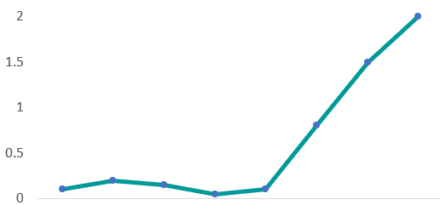
Qualitative detection
In surveillance units not regularly affected by cholera or without historical data (for ≈ 5 years),
a deterioration of an outbreak is detected in a qualitative manner
Deterioration
  Marked increase in an indicator
  Detected visually by assessing weekly trends
CFR (%)
Week 38
Week 39
Week 40
Week 41
Week 42
Week 43
Week 44
Week 45
Epi week
CFR
Deterioration
Notes:
In surveillance units not regularly affected by cholera or where weekly historical data are not available for about the past 5 years, the deterioration of an outbreak can be detected in a qualitative manner.
A marked increase in an indicator can be detected visually when assessing trends in weekly indicators.
Let’s illustrate this with a fictive example. This figure represents the weekly CFR during an ongoing outbreak. On weeks 43, 44 and 45, there has been a marked increase in the CFR. This might correspond to a deterioration and should be investigated.

Slide 30
Analyze and interpret surveillance data
to monitor an outbreak
Notes:
Let’s practice with a case study to better understand how health authorities continuously analyze and interpret surveillance data to monitor a cholera outbreak.

Slide 31
You are a public health officer on your first day of deployment in a surveillance unit with a confirmed cholera outbreak with community transmission
You read the latest situation report
Cholera mortality remains high
Since the beginning of the outbreak, 321 suspected cholera cases have been reported in the surveillance unit, including 16 cholera deaths in total (CFR: 5%)
In the last epidemiological week (week 7), 52 suspected cholera cases have been reported, including 3 cholera deaths (CFR: 6%)
Priority for follow up: Quality of care
What is your interpretation of the CFR?
What would you like to check?
Notes:
In this scenario, you are a public health officer on your first day of deployment to support local health authorities in a surveillance unit with a confirmed cholera outbreak with community transmission.
To familiarize yourself with the local outbreak situation, you read the latest cholera situation report.
Regarding mortality, the report states that it remains high. Since the beginning of the outbreak, 321 suspected cholera cases have been reported in the surveillance unit, including 16 cholera deaths in total (CFR 5%). In the last epidemiological week (week 7), 52 suspected cholera cases have been reported, including 3 cholera deaths (CFR 6%). According to the report improving the quality of care is a priority for follow up.
What is your interpretation of the CFR? What would you like to check?
Pause the video, take the time you need to reflect about this scenario and consult the GTFCC Surveillance guidance as needed.

Slide 32


CFR interpretation
With the information provided, CFR challenging to interpret
    Unclear whether “16 cholera deaths in total” include all type of cholera deaths
    If all type of deaths included, CFR might be misleading
2) To be checked
    Type of deaths and CFR calculation
    Cholera deaths by time, place, and person
Notes:
5% is a high CFR value and is of great concern. However, the information provided in the situation report is ambiguous and as a result the CFR is challenging to interpret. In particular, it is unclear whether “16 cholera deaths in total” means all type of cholera deaths. If all type of cholera deaths were included in the calculations of the CFR as opposed to only cholera deaths that occurred at a health facility as recommended, the CFR would be misleading.
To better understand cholera mortality in the surveillance unit, an advisable first step would be to review the cholera database to check the type of the deaths that were reported, understand how the CFR was calculated, and better assess deaths by time, place, and person.

Slide 33
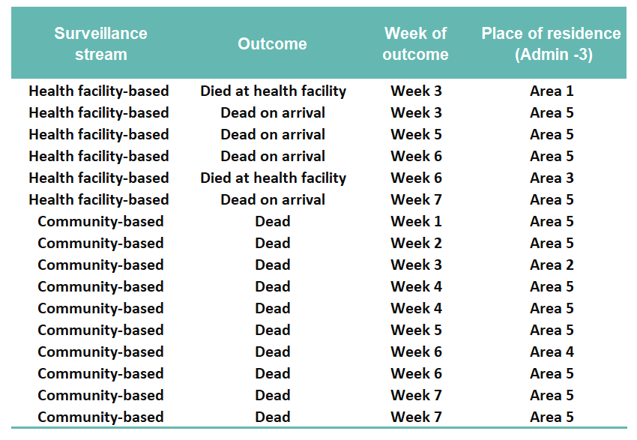
Continuation of scenario
You went through the cholera database and extracted information on the 16 cholera deaths
You noted that the 321 suspected cases mentioned in the situation report were reported by health-facility based surveillance
How many health facility deaths and how many community deaths have been reported?
What is the CFR?
Considering the mortality indicators you computed, and the spatial distribution of cholera deaths, what do you recommend as a priority for follow up?
Notes:
You went through the cholera database and extracted key information on the cholera deaths reported in the surveillance unit since the beginning of the outbreak, and summarized this information in this table.
You also noted that the 321 suspected cholera cases mentioned in the situation report were reported by health-facility based surveillance.
Based on the information you have compiled, how many health facility deaths and how many community deaths have been reported?
What is the CFR in the surveillance unit?
Considering the mortality indicators you computed and the spatial distribution of cholera death, what do you recommend as a priority for follow up?
Pause the video, take the time you need to reflect about this scenario and consult the GTFCC Surveillance guidance as needed.

Slide 34


Number of health facility deaths and community deaths
2 deaths at health facility
4 deaths on arrival
10 deaths in the community
Dead on arrival are community deaths
2 health facility deaths
14 community deaths
CFR
CFR calculation
  Deaths at health facility (2)
  Suspected cases reported by health facility-based surveillance (321)
CFR: 0.6%
≠ situation report (5%)
Notes:
Among the 16 cholera deaths:
2 were deaths that occurred at a health facility;
4 were dead on arrival at a health facility;
and 10 were deaths in the community.
Dead on arrival at a health facility are considered community deaths.
Overall, there have been 2 health facility deaths and 14 community deaths.
The CFR is calculated as the number of health facility deaths (2) over the number of suspected cholera cases reported by health facility-based surveillance (321).
The CFR in the surveillance unit is 0.6%, instead of 5% as stated in the situation report.
This illustrates that errors in the calculation of the CFR can be highly misleading.

Slide 35

Priorities for follow up considering mortality indicators
Mortality indicators
  CFR: 0.6%
  14 community deaths, including 12 (86%) in geographic Area 5
Priorities for follow up
  Access to care
    Are there sufficiently accessible treatment facilities in Area 5?
    Should CTCs/CTUs or ORPs be set up, and where?
  Care seeking behavior
    Are community members of Area 5 reluctant to seek care, and why?
Notes:
You computed two mortality indicators: the CFR which is 0.6%, and the number of community deaths, that is 14. You also noticed that 12 community deaths were reported in geographic area 5 of the surveillance unit.
A top priority for follow up is the number of community deaths in geographic area 5.
Access to care in geographic area 5 should be assessed to explore whether there are sufficiently accessible treatment facilities or if cholera treatment centers, cholera treatment units or Oral Rehydration Points need to be set up.
Health care seeking behavior also needs to be assessed to explore whether community members in geographic area 5 may be reluctant to seek care at a health facility, and if so why.
By correcting calculations of mortality indicators, you identified a major priority for follow up while the situation report focused on the quality of clinical care.

Slide 36
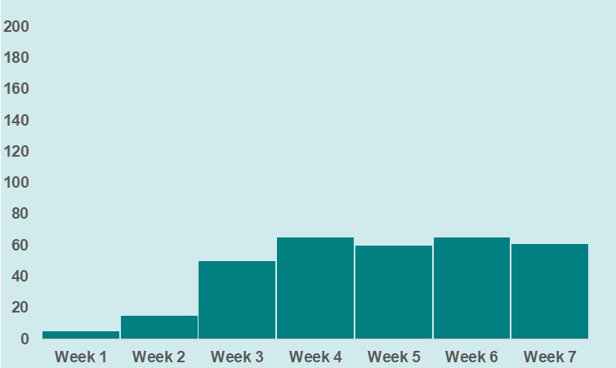
Continuation of scenario
You continue to read the latest situation report
Cholera incidence remains stable
Since the beginning of the outbreak, 321 suspected cholera cases have been reported in the surveillance unit by health facility-based surveillance
In the last epidemiological week (week 7), 61 suspected cholera cases have been reported by health facility-based surveillance
From review of surveillance performance indicator (1st case study)
What is your interpretation of the incidence trend?
What would you like to do?
Notes:
You continue to go through the latest situation report.
Regarding cholera incidence, the report states that it remains stable. Since the beginning of the outbreak, 321 suspected cholera cases have been reported in the surveillance unit by health facility-based surveillance. In the last epidemiological week (week 7), 61 suspected cholera cases have been reported by health facility-based surveillance.
Do you remember your review of surveillance performance indicator in the first case study?
The completeness of reporting by health facility-based surveillance in the surveillance unit is as follows.
What is your interpretation of the incidence trend?
What would you like to do?
Pause the video, and take the time you need to reflect about this scenario.

Slide 37


Interpretation of incidence trend
Trend in incidence derived from health facility-based surveillance lacks reliability
It cannot be concluded that incidence has remained stable
What to do?
Compare trends in incidence derived from health facility-based with those derived from community-based surveillance
No surveillance data were reported from ORPs (1st case study)
  Check ORPs records to retrieve the weekly number of suspected cases at ORPs
Notes:
Considering the issues with completeness of health facility-based reporting, trends in incidence derived from health facility-based surveillance lack reliability since week 4.
Therefore, it cannot be concluded with confidence that incidence has remained stable in the surveillance unit as stated in the situation report.
To better understand the cholera situation in the surveillance unit, you could compare trends in incidence derived from health facility-based surveillance with the trends in incidence derived from community-based surveillance. In addition, since in the first case study it was identified that no surveillance data was reported by ORPs since week 4, you could actively check ORPs records to try to retrieve the weekly number of suspected cholera cases treated at ORPs.

Slide 38
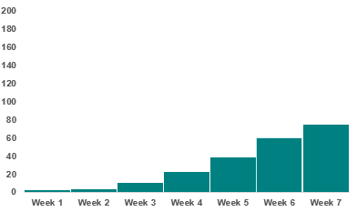
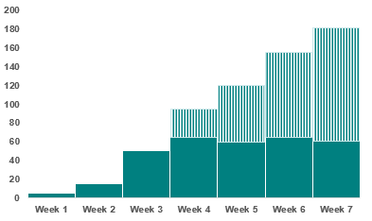

Continuation of scenario
You managed to retrieve community-based surveillance data and surveillance data from ORPs
Health facility-based surveillance data initially reported
ORP data retrieved
Number of suspected cholera cases reported
by community-based surveillance
Number of suspected cholera cases reported by
health facility-based surveillance with ORP data retrieved
Increasing trend in cholera incidence
How does this compare with baseline?
Notes:
You did manage to retrieve community-based surveillance data and surveillance data from ORPs, and plotted this data on epidemic curves.
This epidemic curve represents the number of suspected cholera cases reported by community-based surveillance, showing an increasing trend in incidence.
This epidemic curve represents the number of suspected cholera cases reported by health facility-based surveillance when adding the number of suspected cases identified at ORPs, also showing an increasing trend.
The interpretation that incidence was stable, as stated in the situation report, was misleading because surveillance performance indicators were not taken into account to interpret the situation.
You are wondering how the current trend compares with baseline levels in this surveillance unit.

Slide 39
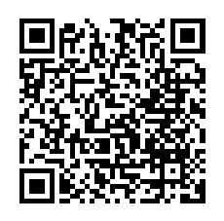
Continuation of scenario
You compare weekly incidence with historical baseline using the GTFCC Excel tool, already filled with historical data for previous years (2020-2024)
    Download the GTFCC Excel tool with prefilled data
Weekly incidence (2025)
    Week 1: 5
    Week 2: 15
    Week 3: 50
    Week 4: 95
    Week 5: 120
    Week 6: 155
    Week 7: 181
https://tinyurl.com/gtfccincidence
    Go to the sheet Data
      Add 2025 weekly incidence (weeks 1 to 7)
      Do not modify data for previous years (2020-2024)
Explore the sheets Weekly summary, Weekly graph (full time series), Weekly graph (last 52 weeks)
As of week 7, is there a deterioration of the cholera outbreak?
Notes:
To assess this, you determine to compare the weekly incidence in the surveillance unit with the historical baseline.
Health authority colleagues provided you with the GTFCC Excel tool for calculating weekly incidence thresholds filled with historical data for the surveillance unit over the period 2020 - 2024.
Download the GTFCC Excel tool with prefilled data for previous years at https://tinyurl.com/gtfccincidence or by scanning this QR Code.
Go to the sheet Data.
Add incidence data for 2025 on weeks 1 to 7. As shown on the right side, that is 5 on week 1, 15 on week 2, etc. While doing so, do not modify data for previous years in the Excel tool.
Explore the following sheets of the GTFCC Excel tool: Weekly summary, Weekly graph (full time series), Weekly graph (last 52 weeks). As of week 7, is there a deterioration of the outbreak?
Pause the video, and take the time you need to download the prefilled Excel tool, enter data for 2025 and explore the different sheets of the tool.

Slide 40
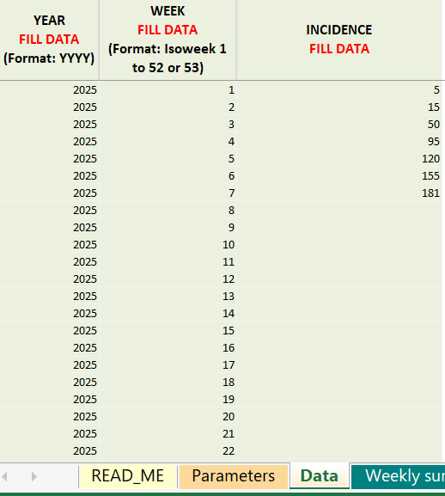

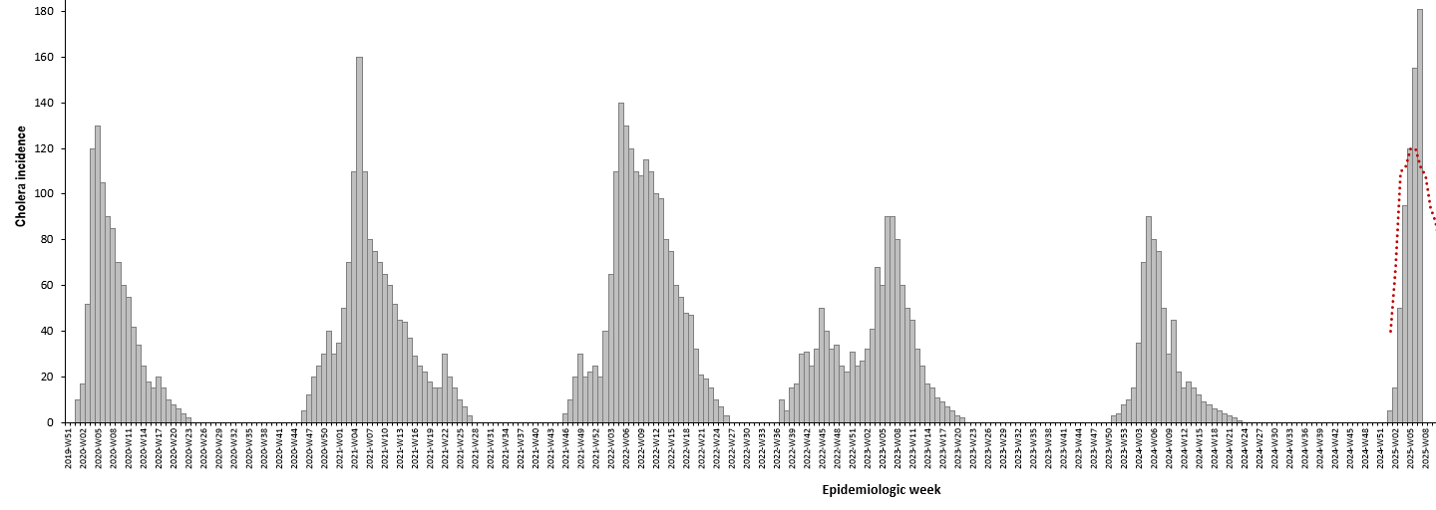
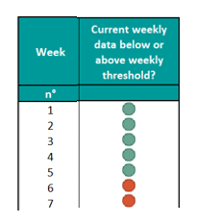
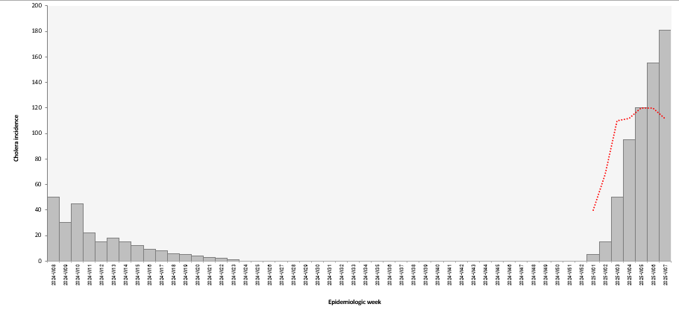
Sheet data
Sheet Weekly summary
Sheets Weekly graph (full time series)
and Weekly graph (last 52 weeks)
2025 data entered (week 1 -7)
Incidence above threshold
for two consecutive weeks
Current outbreak compared with historical baseline
There is a deterioration
Full time series
Below threshold
Above threshold
Last 52 weeks
Notes:
After entering the data for 2025 in the sheet data, in the sheet Weekly summary, you can see that as of week 7, incidence has been above the baseline threshold for two consecutive weeks. This is indicative of a deterioration of the outbreak. In the sheets Weekly graph (full time series) and Weekly graph (last 52 weeks), you can see how the current outbreak compares with the baseline threshold.
Overall, this illustrates the importance of careful interpretation of surveillance data. Although at a first glance, the incidence appeared stable in the surveillance unit, by digging further you managed to identify that the outbreak is actually deteriorating which should be rapidly investigated.

Slide 41

Investigation
Photo adapted from: WHO / NOOR / Alixandra Fazzina
Notes:
Let’s look into investigation, another core function of health authorities in cholera surveillance.

Slide 42


Case investigation
On a routine basis, performing case investigation is not necessary to monitor an outbreak
Case investigations performed when additional information needed to understand the cholera situation
Onset of an outbreak
  All suspected cases
  To orient initial field investigation and immediate control measures
Deterioration of an outbreak
  A subset of suspected cases
  To orient field investigations and control measures
Towards the end of an outbreak
  All confirmed cases
  To orient highly targeted interventions to end the outbreak
Notes:
Regarding case investigation, on a routine basis, this is not undertaken to monitor a cholera outbreak. The monitoring of an outbreak routinely relies on surveillance data reported by health facility-based surveillance, community-based surveillance, and laboratories.
However, under specific circumstances, additional information may be needed to better assess the cholera situation. Then, case investigations are performed.
Performing case investigations is recommended at the onset of an outbreak. Investigating all suspected cases at the onset phase is helpful to orient initial field investigation and immediate control measures.
Performing case investigations may also be considered if a deterioration of the outbreak is detected. Investigating a subset of suspected cases may be insightful. The cases investigated are selected based on the characteristics of the indicator showing a deterioration. The findings of the case investigation are then used to orient a field investigation and control measures.
Lastly, towards the end of an outbreak, when the number of cases is low, performing case investigations on all confirmed cases might be useful to orient highly targeted interventions to end the outbreak.

Slide 43

Field investigation
A field investigation is performed at the onset of an outbreak or if it deteriorates
Onset of an outbreak
  Assess the risks
  Orient the response accordingly
Deterioration of an outbreak
  Assess the conditions that led to the deterioration
  Adapt the response accordingly
Notes:
Regarding field investigation, it should be undertaken at the onset of an outbreak and if a deterioration of an outbreak is detected.
At the onset of an outbreak, the findings of a field investigation are critical to assess the risks and orient the response accordingly.
If a deterioration of an outbreak is detected, the findings of a field investigation are insightful to determine the conditions that led to the deterioration, and adapt the response accordingly.

Slide 44
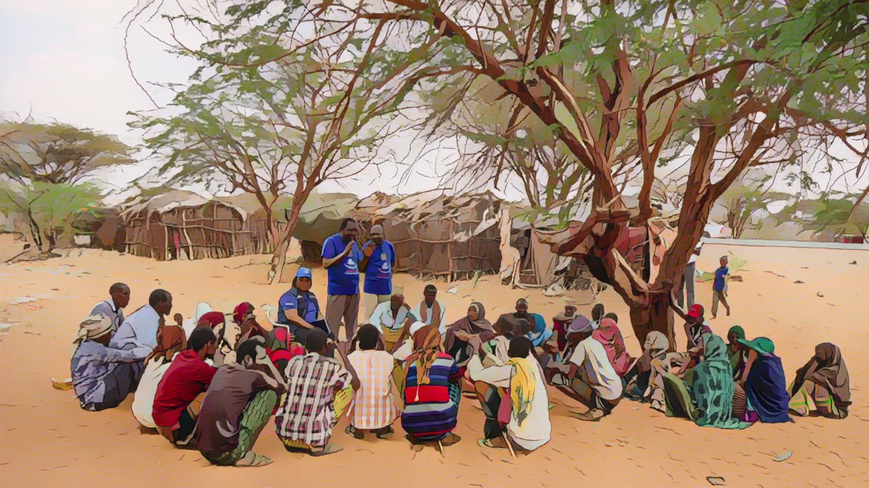
Dissemination
of outcomes
and response
Photo adapted from: WHO / NOOR / Billy Miaron
Notes:
Moving on to the last core function of health authorities in cholera surveillance, disseminating the surveillance outcomes for public health response.

Slide 45

Update stakeholders
Situation reports disseminated weekly
Stakeholders
  Upper-level health authority
  Multisectoral stakeholders, partners, agencies involved in the response
  Health professionals, community health workers / volunteers
  Etc
Notes:
During an outbreak, health authorities prepare epidemiological reports that describe and interpret the outbreak situation at least on a weekly basis and make sure to disseminate them to a broad range of stakeholders.
Stakeholders to be informed include the upper-level health authority; stakeholders, partners, agencies from all sectors involved in responding to the outbreak; as well as health professionals including community health workers or volunteers.

Slide 46

Orient the response
Information used to guide multisectoral interventions and monitor their impact
Case management
  Where to set up treatment facilities or referral system
  Quantify needs for treatment supplies
  Identify issues with access to health care or treatment
Community engagement
  Where to promote behaviors and practices to prevent cholera
  Where to encourage early care seeking
WaSH
  Where to provide emergency WaSH
Vaccination
  Identify areas and populations to be targeted by vaccination
Notes:
This information should then be considered in a multisectoral manner to guide the decision-making on effective interventions across all pillars to control the outbreak.
For example, regarding the case management pillar, the information generated by surveillance can be used to identify locations where cholera treatment facilities or referral system need to be set up; to quantify needs for treatment supplies; and to identify potential issues with access to health care or treatment of patients.
Regarding the community engagement pillar, the information generated by surveillance can be used for example to identify affected and at-risk communities where behaviors and practices to prevent cholera should be promoted in priority and where early care seeking should be encouraged.
Regarding the WASH pillar, the information generated by surveillance can be used for example to identify locations where emergency access to clean water, sanitation and hygiene should be provided in priority.
Lastly, regarding the vaccination pillar, the information generated by surveillance can be used for example to identify geographic areas and populations to be targeted by reactive vaccination.
We cannot stress enough that using surveillance data to continuously guide interventions across all pillars and to monitor the impact of these interventions are absolutely critical to successfully end a cholera outbreak.

Slide 47

End of outbreak
A probable or confirmed outbreak is over when, for a minimum of
4 consecutive weeks, all suspected cases tested negative (RDT, culture, or PCR)
Period longer than four weeks advisable
    If surveillance performance targets not met
    or
    If testing lacks reliability
Notes:
As a general principle, a probable or confirmed cholera outbreak can be considered over, when for a minimum of four consecutive weeks, all suspected cholera cases have a negative test result by RDT, culture, or PCR.
However, where there are issues with the performance of surveillance or concerns over the reliability of testing for cholera, a period longer than 4 weeks is advisable to gain sufficient confidence that the outbreak has reached its end.

Slide 48


Adaptive surveillance
End of outbreak
Surveillance strategies adapted for the early detection of an outbreak
  Inform and train surveillance stakeholders
  Health facility workers
  Community health workers / volunteers
  Laboratories
Learn about surveillance for early detection in Module 3
Notes:
Once a probable or confirmed cholera outbreak is over, the surveillance strategies need to be adapted as the surveillance objective becomes to detect any new outbreak early. Health authorities should inform and train surveillance stakeholders on the new surveillance strategies.
Surveillance stakeholders to be sensitized include health facility workers, community health workers or volunteers, and laboratories.
For a refresher on these surveillance strategies, we encourage you to go back to module 3.

Slide 49





Wrap up
Routinely
If a deterioration is detected
Oversee
reporting
and testing
Transmit, analyze, interpret data
Disseminate outcomes
Respond
Investigate
Monitor that suspected cases are reported weekly and a subset of suspected cases are tested
Analyze the reported data and test results on a weekly basis and interpret the outbreak dynamics
Perform a field investigation to assess the cause of the deterioration to adapt the response accordingly
Inform all stakeholders of the cholera situation on a weekly basis
Guide multisectoral interventions across all pillars
Notes:
As we wrap up this module, here is a summary of the key role of health authorities when the surveillance objective is to monitor an outbreak.
On a routine basis, health authorities monitor that suspected cases are reported on a weekly basis and that a subset of suspected cases are tested. Health authorities analyze the reported data and test results on a weekly basis to interpret the outbreak dynamics. Health authorities then update weekly all stakeholders on the cholera situation and this is used to guide multisectoral interventions across all pillars to control the outbreak.
If a deterioration of the outbreak is detected, health authorities perform a field investigation to determine the conditions that led to the deterioration in order to adapt the response accordingly.

Slide 50

Notes:
Before moving on to the next module, we encourage you to take a short quiz. There are three questions in this quiz.

Slide 51

Question 1
When the surveillance objective is to monitor a cholera outbreak, health authorities review surveillance performance indicators to monitor that:
Select all that apply
    Suspected cholera cases are reported within 24 hours
    Suspected cholera cases are reported on a weekly basis
    The absence of suspected cholera cases is reported within 24 hours
    The absence of suspected cholera cases is reported on a weekly basis
    All suspected cholera cases are tested for cholera
    A subset of suspected cholera cases selected according to a systematic sampling scheme are tested for cholera
Notes:
Question 1. Select all that apply. When the surveillance objective is to monitor a cholera outbreak, health authorities review surveillance performance indicators to monitor that:
Suspected cholera cases are reported within 24 hours.
Suspected cholera cases are reported on a weekly basis.
The absence of suspected cholera cases is reported within 24 hours.
The absence of suspected cholera cases is reported on a weekly basis.
All suspected cholera cases are tested for cholera.
A subset of suspected cholera cases selected according to a systematic sampling scheme are tested for cholera.

Slide 52

Question 1 – Answers
When the surveillance objective is to monitor a cholera outbreak, health authorities review surveillance performance indicators to monitor that:
    Suspected cholera cases are reported within 24 hours
    Suspected cholera cases are reported on a weekly basis
    The absence of suspected cholera cases is reported within 24 hours
    The absence of suspected cholera cases is reported on a weekly basis
    All suspected cholera cases are tested for cholera
    A subset of suspected cholera cases selected according to a systematic sampling scheme are tested for cholera
Notes:
The correct answers are b, d and f. When the surveillance objective is to monitor a cholera outbreak, health authorities review surveillance performance indicators to monitor that suspected cholera cases are reported on a weekly basis, that the absence of suspected cholera cases is also reported on a weekly basis, and that a subset of suspected cholera cases selected according to a systematic sampling scheme are tested for cholera.

Slide 53
Question 2
When the surveillance objective is to monitor a cholera outbreak, health authorities:
    Add up data reported by health facility-based surveillance and data reported by community-based surveillance and analyze them jointly to have a comprehensive description of the outbreak situation
    Analyze data reported by health facility-based surveillance and data reported by community-based surveillance separately but interpret them jointly to have a sound understanding of the outbreak situation
Notes:
Question 2. When the surveillance objective is to monitor a cholera outbreak, health authorities:
Add up data reported by health facility-based surveillance and data reported by community-based surveillance and analyze them jointly to have a comprehensive description of the outbreak situation.
Analyze data reported by health facility-based surveillance and data reported by community-based surveillance separately but interpret them jointly to have a sound understanding of the outbreak situation.

Slide 54
Question 2 – Answer
When the surveillance objective is to monitor a cholera outbreak, health authorities:
    Add up data reported by health facility-based surveillance and data reported by community-based surveillance and analyze them jointly to have a comprehensive description of the outbreak situation
    Analyze data reported by health facility-based surveillance and data reported by community-based surveillance separately but interpret them jointly to have a sound understanding of the outbreak situation
Notes:
The correct answer is b. Health authorities analyze data reported by health facility-based surveillance and data reported by community-based surveillance separately but interpret them jointly to have a sound understanding of the outbreak situation.

Slide 55
Question 3
If a deterioration of a cholera outbreak is detected:
    Surveillance modalities should be adapted, and all suspected cholera cases should be tested to verify that the deterioration is due to cholera
    A case investigation should be performed on all suspected cholera cases reported in the surveillance unit
    A field investigation should be rapidly performed
Notes:
Question 3. This is the last question. If a deterioration of a cholera outbreak is detected:
Surveillance modalities should be adapted and all suspected cholera cases should be tested to verify that the deterioration is due to cholera;
A case investigation should be performed on all suspected cholera cases reported in the surveillance unit;
A field investigation should be rapidly performed.

Slide 56
Question 3 – Answer
If a deterioration of a cholera outbreak is detected:
    Surveillance modalities should be adapted, and all suspected cholera cases should be tested to verify that the deterioration is due to cholera
    A case investigation should be performed on all suspected cholera cases reported in the surveillance unit
    A field investigation should be rapidly performed
Notes:
The correct answer is c. If a deterioration of a cholera outbreak is detected, a field investigation should be rapidly performed.

Slide 57

Notes:
We have now completed this module.

