Slide 1
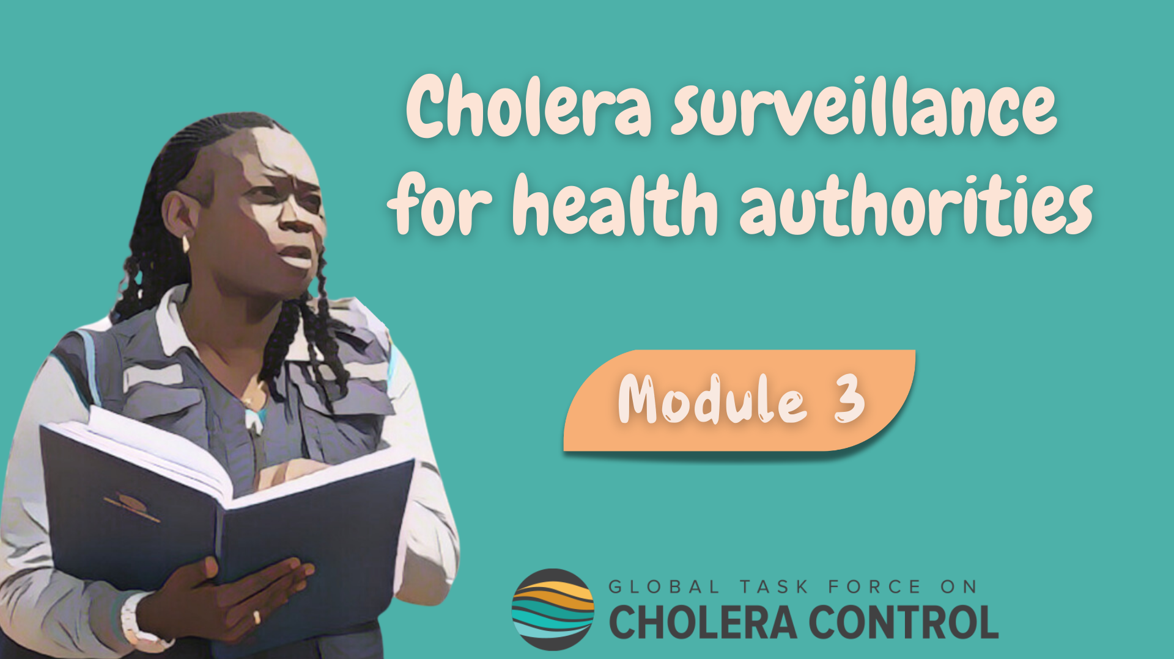
Notes:
Welcome to Module 3 of the GTFCC online course on cholera surveillance for health authorities.

Slide 2
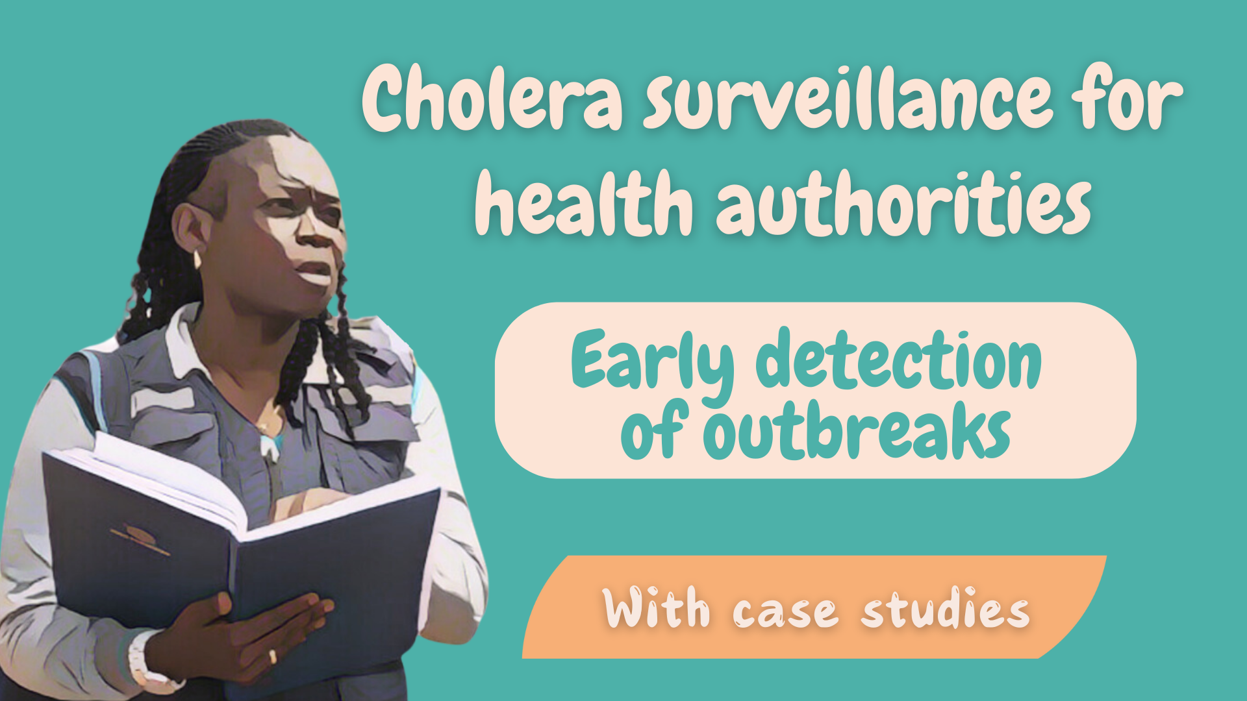
Notes:
In this module, we will dive into surveillance for the early detection of cholera outbreaks.

Slide 3

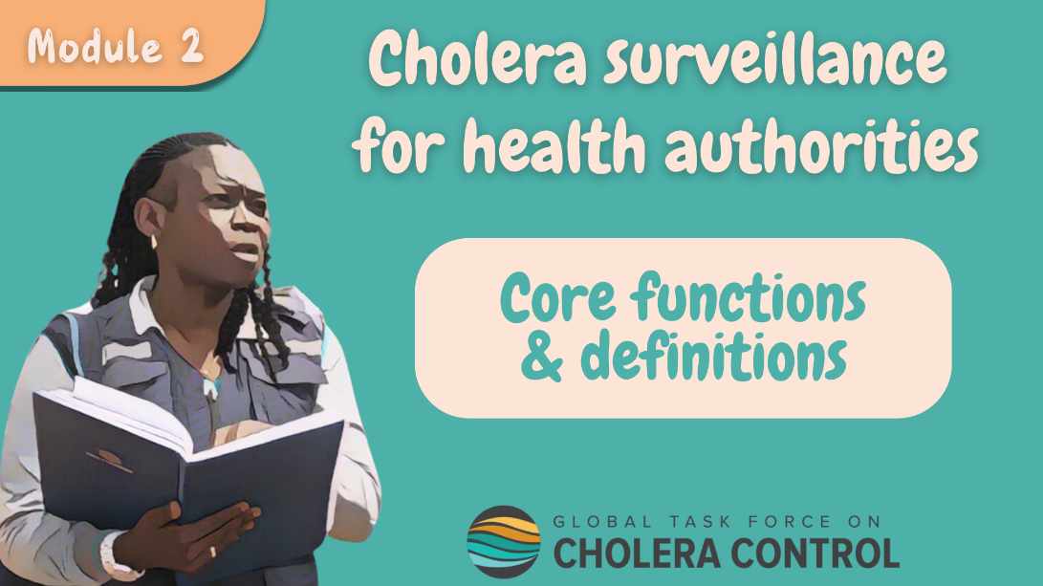
Get ready for this module
Before taking this module, complete Module 2 ‘Core functions’
Notes:
This module goes through the different core functions of health authorities in cholera surveillance and describe how strategies are adapted when the objective is to detect a cholera outbreak early. As a prerequisite to follow this module, you should be familiar with the core functions of health authorities in cholera surveillance. Therefore, if you have not yet already done so, we encourage you to take module 2 of this course before taking this module.

Slide 4

What will you learn?
Surveillance strategies for the early detection of cholera outbreaks
How health authorities
  Monitor that these strategies are effectively implemented
  Analyze, verify, and interpret data to detect a potential outbreak
  Investigate, disseminate findings, and coordinate rapid response
  if an outbreak is detected
Notes:
After completing this module, you will be familiar with surveillance strategies for the early detection of a cholera outbreak including:
How health authorities monitor that these strategies are effectively implemented;
How health authorities analyze, verify and interpret surveillance data to rapidly detect a potential cholera outbreak;
And how health authorities investigate, disseminate findings, and coordinate rapid response when an outbreak is detected.

Slide 5

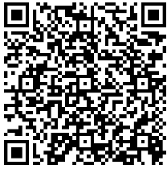
Get ready to practice
Case studies
  Based on fictional scenarios
  To deepen your understanding of how health authorities detect cholera outbreaks
Use the GTFCC Surveillance Guidance
https://tinyurl.com/cholerasurv2024
Notes:
Case studies are offered throughout this module. They are based on fictional scenarios. These case studies will help you better understand how health authorities detect cholera outbreaks.
We encourage you to download the GTFCC guidance on cholera surveillance. Having it on hand will help you take the case studies. You can download the GTFCC surveillance guidance at https://tinyurl.com/cholerasurv2024 or by scanning this QR code.

Slide 6

Surveillance for early detection
Where
Why
Why
In surveillance units where there is NO probable or confirmed outbreak
To detect a cholera outbreak early
For response measures to contain its spread to be implemented rapidly
How
In accordance with this module
Notes:
Surveillance is implemented for the early detection of a cholera outbreak in any surveillance unit where there is no ongoing probable or confirmed outbreak in order to detect any cholera outbreak early, so that response measures to contain its spread can be implemented rapidly.
For surveillance to reach this objective effectively, it should be continuously implemented in accordance with the recommendations outlined in this module.

Slide 7

Reporting
and testing strategies
Photo adapted from: WHO / Mulugeta Ayene
Notes:
Let’s see how suspected cholera cases are reported and tested when the surveillance objective is to detect a cholera outbreak.

Slide 8

Case definition
Suspected cholera case
  Person ≥ 2-year-old with AWD and severe dehydration
  or
  Person ≥ 2-year-old who died from AWD
Various diseases can cause AWD, especially in young children
Criteria on age & severe dehydration
    Avoid triggering frequent false alarms
    Make surveillance and testing for early detection more efficient
Notes:
When the surveillance objective is to detect a cholera outbreak, a suspected cholera case is any person aged 2 years or older who has acute watery diarrhoea (AWD) and severe dehydration or any person aged 2 years or older who died from AWD.
Various diseases can cause AWD, especially in young children. This is why, in addition to AWD, criteria on age and severe dehydration apply. It is more likely that patients with AWD who meet these criteria do have cholera. Therefore, applying criteria on age and severe dehydration level avoids triggering frequent false alarms for cholera. This makes the early detection system more efficient.

Slide 9

Reporting
Suspected cholera cases reported to the health authority within 24 hours
Reporting within a day is essential not to delay the detection of an outbreak
Time is key!
If on a given week, no suspected cholera case was seen
  Absence of suspected cases reported to the health authority weekly
      Zero reporting
      Health facility-based surveillance and community-based surveillance
Notes:
Any suspected cholera case detected by health-facility based surveillance, community-based surveillance or event-based surveillance should be reported to the health authority within a day.
Prompt reporting is essential in order not to delay the detection of a potential outbreak. Time is key for early detection.
If on a given week, no suspected cholera case was detected, the absence of cases should be reported to the health authority at the end of the week. This is zero reporting. Zero reporting should be performed by all reporting sites at health facility level and community level.

Slide 10
Testing
ALL suspected cholera cases are tested
Screening by RDT
Additional tests
If RDTs ARE available
  On ALL suspected cases
On first sample culture+ and/or PCR+
Antimicrobial susceptibility testing
Confirmatory testing
Testing for toxigenicity
if no confirmed outbreak in other surveillance unit(s)
and
no epidemiological link to a confirmed case or source of exposure in another country
If RDTs ARE available
  On ALL suspected cases RDT+
If RDTs NOT available
  On ALL suspected cases
By culture (incl seroagglutination) and/or PCR
Notes:
When the surveillance objective is to detect a cholera outbreak, all suspected cholera cases are tested. Exhaustive testing is critical to determine whether or not cholera is circulating.
Where rapid diagnostic tests (RDTs) are available, RDTs are used to triage samples for laboratory testing, and any suspected cholera case is tested by RDT.
Confirmatory testing is then performed on any suspected case tested positive by RDT.
Where RDTs are not available, samples are not triaged for confirmatory testing, and confirmatory testing is performed on all suspected cholera cases.
Confirmatory testing is by culture and seroagglutination or PCR.
In addition, additional tests are performed if a sample is tested positive by culture and PCR. First, testing for antimicrobial susceptibility is performed. In addition, if there is no confirmed cholera outbreak in another surveillance unit and no epidemiological link to a confirmed cholera case of source of exposure in another country, toxigenicity testing is also performed.

Slide 11

Oversight of reporting & testing
by health authorities
Photo adapted from: WHO / Genna Print
Notes:
A core function of health authorities in cholera surveillance is to continuously ensure that suspected cholera cases are reported and tested in accordance with applicable strategies. Let’s look into this.

Slide 12


Oversight
Awareness and capacity building
Health authorities ensure that
  All reporting sites and laboratories in the surveillance unit
  Are aware and in capacity to implement reporting and testing in accordance with applicable strategies
Monitoring
Health authorities monitor surveillance performance indicators
  At least on a weekly basis
  Take supportive measures as needed
Notes:
Health authorities are responsible for ensuring that all reporting sites in the surveillance unit including for health facility-based surveillance and community-based surveillance as well as laboratories performing cholera testing are fully aware of the applicable strategies to report and test suspected cholera cases to detect an outbreak, and are in-capacity to implement reporting and testing accordingly.
Health authorities then monitor surveillance performance indicators at least on a weekly basis to verify that reporting and testing is implemented according to applicable strategies. If any reporting site or laboratory does not implement reporting or testing in accordance with applicable strategies, health authorities then take supportive measures to improve reporting or testing.

Slide 13



Oversight of reporting & testing by health authorities
Notes:
Let’s practice with a case study to better understand how health authorities continuously oversee reporting and testing.

Slide 14


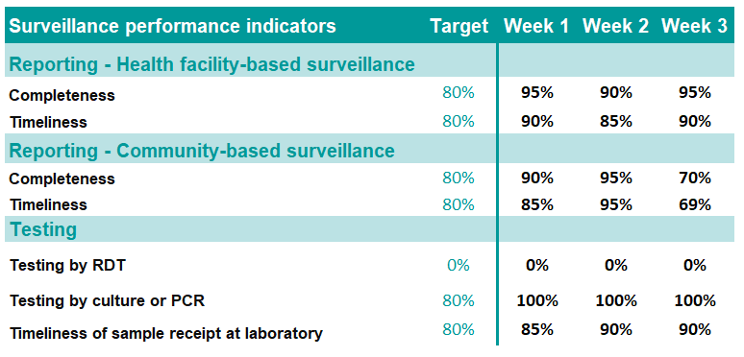

You are a local health authority officer in a surveillance unit with no cholera outbreak
It’s Monday, on week 4
You review surveillance performance indicators for the previous week
Do you have any concern regarding how reporting and testing have been implemented on week 3?
If so, what would do next?
Notes:
In this scenario, you are a local health authority officer working in a surveillance unit where there is no probable or confirmed cholera outbreak.
Today is Monday. We are on week 4. As on every week, you review surveillance performance indicators for the previous week, that is week 3.
Regarding health facility-based surveillance, on week 3, the completeness of reporting was 95% and the timeliness of reporting was 90%.
Regarding community-based surveillance, on week 3, the completeness of reporting was 70% and the timeliness of reporting was 69%.
Regarding testing, on week 3, 0% of the suspected cholera cases were tested by RDT and 100% of the suspected cholera cases were tested by culture or PCR. Lastly, 90% of the samples for testing were received at the laboratory within the expected timelines.
Consider the column on the left showing the minimum performance target for each indicator.
Do you have any concern regarding how reporting and testing have been implemented in week 3?
If so, what would you do next?
Pause the video, and take the time you need, to reflect about this scenario and the appropriate course of action.

Slide 15

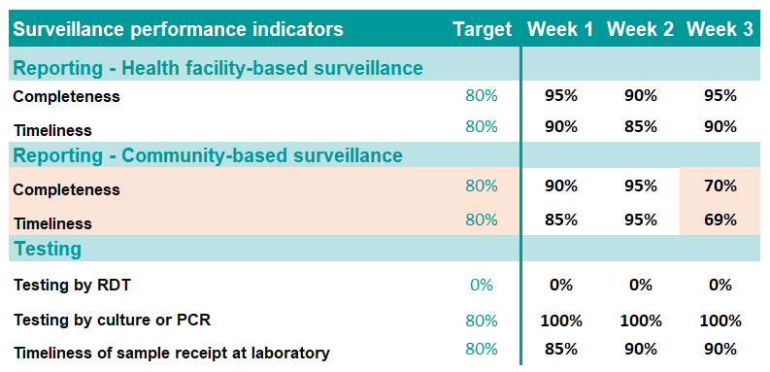

Concerns on week 3
Completeness and timeliness of community-based reporting
    Dropped below the target on week 3
For other performance indicators, minimum performance targets have been reached
  Overall health facility-based reporting and testing performed according to applicable strategies
Absence of testing by RDT does not raise concerns
  Target for RDT testing is 0: RDT testing not implemented in the surveillance unit
Notes:
Regarding how reporting and testing have been implemented on week 3, the completeness and the timeliness of reporting by community-based surveillance are concerning. They have dropped below the minimum target.
For all other performance indicators, minimum performance targets have been reached. This indicates that overall health facility-based reporting and testing have been performed according to applicable strategies.
The absence of testing by RDT is not of concern. The target for RDT testing is 0. This means that testing by RDT is not implemented in this surveillance unit.

Slide 16
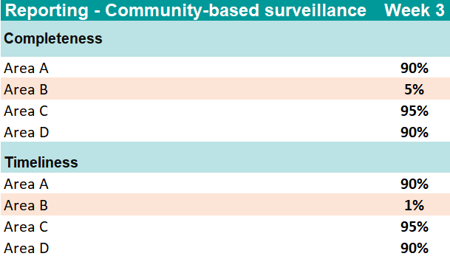
2) What to do
Break down the indicators of concern at a finer geographic scale
  To better assess where the issue might be
  Will help investigate the issue to resolve it
End of case study (hypothetical scenario)
4 geographic areas in the surveillance unit
Indicators of concern for each geographic area
Issue: In Area B
Area B contacted by health authority
  Most volunteers had their phone stolen
  Reporting performed by text messages
Next step: Volunteers rapidly reequipped
Notes:
What could you do about this as a local health authority officer?
An advisable first step would be to break down the indicators of concern at a finer geographic scale to better assess where the issue might be. This would help investigate the cause of the issue to resolve it.
In this scenario, here is how it went. There are 4 geographic areas in the surveillance unit. The performance indicators of concern, that is completeness and timeliness of community-based reporting on week 3, were broken down for each geographic area, as shown in the table.
In geographic areas A, C and D, the completeness and timeliness of community-based reporting were satisfactory. However, in geographic area B, the completeness of community-based reporting was only 5% and the timeliness only 1%.
It was therefore determined that the issue was localized in geographic area B, an area prone to insecurity.
The local health authority contacted area B and found out that most community-based surveillance volunteers had their phone stolen whilst community-based reporting was performed by text messages. The cause of the issue was identified!
As a next step, volunteers should be rapidly reequipped.
Overall, this illustrates that as long as surveillance performance indicators are closely monitored, issues with how reporting and testing are performed get detected. From there, it is then possible to work it out and find solutions.

Slide 17

Data analysis and
interpretation
Photo adapted from: WHO / NOOR / Alixandra Fazzina
Notes:
Moving on to the next core function of health authorities in cholera surveillance, let’s look into the analysis and interpretation of surveillance data when the surveillance objective is to detect a cholera outbreak.

Slide 18


Analysis
Health authorities immediately analyze and interpret the data
to detect a potential suspected, probable, or confirmed outbreak
Learn about outbreak definitions in Module 2
  Data considered
      Data reported by health facility-based surveillance
      Data reported by community-based surveillance
      Test results reported by laboratories
      Signals from event-based surveillance
Notes:
For the early detection of a cholera outbreak, time is key. Therefore, as soon as a suspected cholera case or a cholera test result is reported, health authorities immediately analyse and interpret the data to detect a potential suspected, probable, or confirmed outbreak.
If you are unsure about what is a suspected, probable or confirmed outbreak, we encourage you to go back to module 2 for a refresher on outbreak definitions.
The surveillance data considered in the analysis are the suspected cholera cases reported by health facility-based surveillance and community-based surveillance, any cholera test result reported by laboratories as well as any cholera signal detected by event-based surveillance.

Slide 19

Verification & notification
As soon as a potential suspected, probable, or confirmed cholera outbreak is
detected, health authorities undertake verification and immediate notification
Verification
Immediate notification
Verify that case definition and outbreak definition are met
Immediately notify
next upper level
Including by contacting reporting site(s)/laboratories
Verified suspected, probable, or confirmed cholera outbreak
Notes:
If the analysis of the data indicates a potential suspected, probable, or confirmed cholera outbreak in a surveillance unit, this should be verified immediately, and if it is verified it should be notified.
The verification of a potential suspected, probable, or confirmed cholera outbreak focuses on verifying that the relevant case and outbreak definitions are met. This is done by contacting the reporting sites or the laboratory as needed.
Any verified suspected, probable, or confirmed cholera outbreak should be immediately notified to the next upper level.

Slide 20
Analyze and interpret surveillance data
to detect a suspected cholera outbreak
Notes:
Let’s practice with a case study to better understand how health authorities analyze and interpret surveillance data to detect a suspected cholera outbreak.

Slide 21
You are a local health authority officer in a surveillance unit with no cholera outbreak so far
RDTs: Not available in your surveillance unit
On 10 October, you have received 2 cholera case report forms from one hospital
First suspected cases reported in October
Key information from case report forms
Case A
  Sex: Male
  Age: -
  Date of onset: 09 October
  Dehydration: Severe
Case B
  Sex: Female
  Age: 43 years old
  Date of onset: 09 October
  Dehydration: Some
What is your interpretation of the cholera situation?
What would you do next?
Notes:
In this scenario, you are a local health authority officer working in a surveillance unit where no cholera outbreak has been detected so far.
RDT are not available in your surveillance unit. Today is the 10th of October and you have just received two cholera case report forms from one hospital. These are the first suspected cholera cases that have been reported this month so far.
Here are some key information extracted from the case report forms.
The first reported case is a male, information on his age is missing. He started to have AWD on the 9th of October and had severe dehydration at admission.
The second reported case is a 43-year-old female who also started to have AWD on 9 October and who had some dehydration at admission.
What is your interpretation of the cholera situation in your surveillance unit, and what would you do next?
Pause the video, take the time you need to reflect about this scenario, and consult the GTFCC Surveillance guidance as needed.

Slide 22


Cholera situation
Unclear
  Two patients have been reported as suspected cholera cases
    May correspond to a suspected cholera outbreak
  Insufficient information to assess if they match the suspected case definition
    Age of case A?
    Dehydration level of case B?
Premature to conclude that there is a suspected outbreak
Imprudent to conclude that there is no suspected outbreak
2) What to do next
Contact the hospital reporting focal point
  To learn more and better assess the situation
  Verification
Notes:
Based on the reported information, the cholera situation is unclear.
Two suspected cholera cases reported in the surveillance unit within 7 days may correspond to a suspected cholera outbreak. However, there is insufficient information to determine if they meet the definition of suspected cholera cases. The age of case A and the dehydration level of case B should be determined to assess if they match the definition of suspected cholera cases.
At this stage, based on the information available it would be premature to conclude that there is a suspected outbreak and it would be imprudent to conclude that there is no suspected outbreak. You need to know more!
An advisable next step would be to immediately contact the hospital reporting focal point to learn more. In other words, the recommended next step is to rapidly perform a verification.

Slide 23
Continuation of scenario
The hospital reporting focal point provided additional information
Additional information
Case A
    6 years old
Case B
  Respiratory distress at admission
Is there a verified suspected cholera outbreak?
What are your key messages to the reporting focal point?
Notes:
You immediately contacted the hospital reporting focal point and he provided additional information.
In particular, he informed you that the first patient is 6-year-old, and the second patient had respiratory distress at admission.
With this information, is there a verified suspected cholera outbreak in your surveillance unit?
What would be your key messages to the hospital reporting focal point?
Pause the video, take the time you need to reflect about this scenario and consult the GTFCC Surveillance guidance as needed.

Slide 24
Is there a verified suspected cholera outbreak?
Severe dehydration
Case A is ≥ 2-year-old
Case B had one danger sign indicating severe dehydration
One or more danger signs
  Lethargic or unconscious
  Absent or weak pulse
  Respiratory distress
OR at least two of the following
  Sunken eyes
  Not able to drink or drinks poorly
  Skin pinch goes back very slowly
T
  Suspected cholera case definition met
  Verified suspected cholera outbreak
Notes:
The first case is older than 2-year-old.
The second case had one danger sign indicating severe dehydration at admission.
They both are suspected cholera cases.
Since there have been 2 suspected cholera cases in your surveillance unit within 7 days, there is a verified suspected cholera outbreak.

Slide 25


2) Key messages to reporting focal point
Congratulate on
  Cholera case report forms sent to local health authorities in a timely manner
Sensitize on
  Criteria to assess the level of dehydration
  How to fill cholera case report forms in a comprehensive manner
Check whether
  Patients rehydrated by IV considering severe dehydration
  Samples collected and sent to a laboratory for testing
Notes:
Regarding key messages to the hospital reporting focal point, you may congratulate him on sending the case report forms to local health authorities in a timely manner.
However, you should sensitize him, and ask him to sensitize his colleagues, on how to assess and record the level of dehydration at admission and on how to fill cholera case report forms in a comprehensive manner.
Also check with the reporting focal point whether the patients received intravenous rehydration and whether samples were collected and sent to a laboratory for testing.
Overall, this illustrates that verifying that case definitions are met is essential for health authorities to be able to characterize the cholera situation in their surveillance unit in a reliable manner.

Slide 26
Analyze and interpret surveillance data
to detect a probable cholera outbreak
Notes:
Let’s move on to another case study. This time, it focuses on how health authorities analyze and interpret surveillance data to detect a probable cholera outbreak.

Slide 27
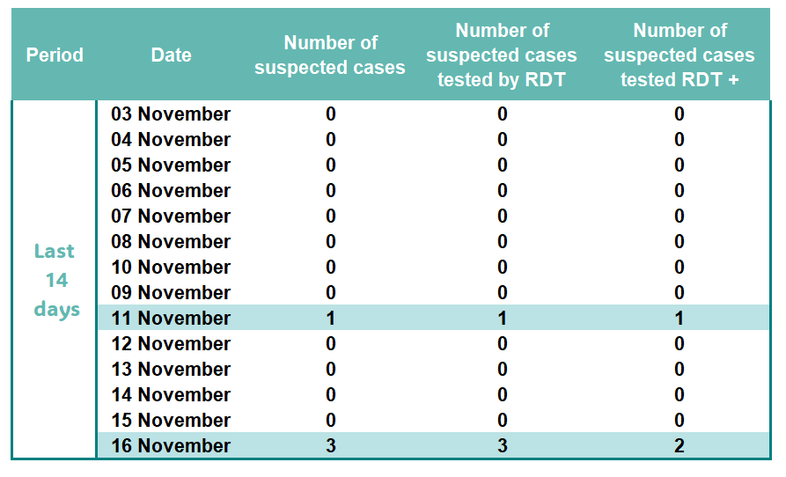
You are a local health authority officer in a surveillance unit with no probable or confirmed cholera outbreak so far
Today is 16 November
You review the data reported in the last 14 days (data was verified)
What is the cholera situation
as of 16 November?
Notes:
In this scenario, you are a local health authority officer working in a surveillance unit where no probable or confirmed cholera outbreak has been detected so far.
Today is the 16th of November. You review the data reported in your surveillance unit in the last 14 days. This data has already been verified.
On the 11th of November, one suspected case who tested positive by RDT was reported, therefore there is a suspected cholera outbreak in your surveillance unit.
On the 16th of November, three suspected cases have been reported , and two of them tested positive by RDT.
What is the cholera situation in your surveillance unit as of 16 November?
Pause the video, take the time you need to reflect about this scenario, and consult the GTFCC Surveillance guidance as needed.

Slide 28
Cholera situation as of 16 November
Probable outbreak
  In the past 14 days
    4 suspected cases tested by RDT
    3 tested positive by RDT
  Threshold for a probable outbreak reached
# of suspected cases tested
# of RDT+
3-7
8-10
11-14
15-17
18-21
≥ 3 RDT+
≥ 4 RDT+
≥ 5 RDT+
≥ 6 RDT+
≥ 7 RDT+
There is a probable cholera outbreak
Make sure that samples were collected for confirmatory testing
Respond without waiting for laboratory results
Notes:
Over the past 14 days, in total, in your surveillance unit 4 suspected cholera cases were tested by RDT and 3 of them tested positive. The threshold for a probable outbreak has been reached. There is a probable outbreak in your surveillance unit.
Make sure that samples have been collected for confirmatory testing, but launch a cholera outbreak response immediately without waiting for the laboratory results.

Slide 29

Investigation
Photo adapted from: WHO / NOOR / Alixandra Fazzina
Notes:
Let’s move on to investigation, an essential core function of health authorities to better assess the cholera situation.

Slide 30

Case investigation
As soon as a verified (suspected, probable, or confirmed) cholera outbreak is detected,
health authorities conduct case investigation on ALL suspected cases within 24 hours
Classify suspected cases by origin of infection
  Locally acquired
  Imported
    Domestically or internationally
Rapidly orient field investigation
Notes:
As soon as a verified suspected, probable, or confirmed cholera outbreak is detected in a surveillance unit, health authorities conduct a case investigation on all suspected cholera cases within 24 hours of reporting.
The information generated by the case investigations is used to classify cases by origin of infection. That is assessing whether the case is locally acquired which means that he was infected in the surveillance unit where he was reported or if the case is an imported case if he was infected outside of the surveillance unit where he was reported. A domestically imported case was infected in another surveillance unit of the country while an internationally imported case was infected in another country.
The information generated by the case investigations is also used to rapidly orient a field investigation.

Slide 31

Field investigation
If
  Verified (suspected, probable, or confirmed) cholera outbreak detected
  and
  Case investigations did not conclude that all cases were imported
Multisectoral field investigation within 24 hours
Assess
  Source(s) of contamination
  Context of transmission
  Risk factors for spread
Notes:
If a verified suspected, probable, or confirmed cholera outbreak has been detected in a surveillance unit and case investigations did not conclude that all cases were imported, a multisectoral field investigation is initiated within 24 hours to assess potential sources of contamination, contexts of transmission, and risk factors for spread.

Slide 32
Use the findings of case investigations
to classify cases by origin of infection
Notes:
Let’s practice with a case study to better understand how health authorities use the findings of case investigations to classify cases by origin of infection.

Slide 33
You are a local health authority officer in a surveillance unit with a verified suspected cholera outbreak
1 suspected cholera case reported and tested positive by RDT
No other suspected cholera case reported so far
Case investigation performed
Case report form
Gender: Female
Age: 39 years old
Date of onset: 25 July
Date of visit: 28 July
Deydration: Severe
RDT result: Positive O1
Specimen for testing: Yes (result pending)
Case investigation
Travel in the 5 days before onset: Yes
Dates of travel: 10-27 July
Destination: Village with cholera outbreak in a neighboring surveillance unit (same country)
Comments: Purpose of travel, attend funeral of a relative who died from cholera
What is the geographic origin of infection of this case?
If this case is laboratory confirmed, will there be a confirmed cholera outbreak in your surveillance unit?
Notes:
In this scenario, you are a local health authority officer working in a surveillance unit where a verified suspected cholera outbreak has just been detected. Indeed, one suspected cholera case was reported and tested positive by RDT one day ago. So far, that is the only suspected case. You have immediately performed a case investigation.
Here is some key information about this case which was recorded in the case report form. It is a 39 year-old female. She started to have AWD on the 25th of July. She visited a hospital on the 28 of July and had severe dehydration at admission. She tested positive by RDT. A sample was collected for confirmatory testing and test results are pending.
Now, here is what you learned by performing a case investigation. She travelled in the 5 days before the onset of her illness. From 10 to 27 July, she went in a neighboring surveillance unit, in a village currently affected by a major cholera outbreak. She went there in order to attend the funeral of a relative who died from cholera.
What is the geographic origin of infection of this case?
If this case got laboratory confirmed, will there be a confirmed cholera outbreak in your surveillance unit?
Pause the video, take the time you need to reflect about this scenario and consult the GTFCC Surveillance guidance as needed.

Slide 34
Classification of geographic origin of infection
Domestically imported
Imported
  Not in the surveillance unit before onset of illness
    Not infected in the surveillance unit
Domestically imported
  Did not travel abroad
    Infected in another surveillance unit
Cholera situation if this case is confirmed
No confirmed cholera outbreak in this surveillance unit
Confirmed cholera outbreak if a confirmed case was locally acquired in the surveillance unit considered
Notes:
This is a domestically imported case.
It is an imported case, because she was not in the surveillance unit before onset of illness. Therefore, she was not infected in the surveillance unit.
This is a domestically imported case because she did not travel abroad. She was infected in another surveillance unit in the same country.
If this case got laboratory confirmed, there wouldn’t be a confirmed cholera outbreak in your surveillance unit. This is because there is a confirmed cholera outbreak in a surveillance unit if a confirmed cholera case was locally acquired in this surveillance unit.
This illustrates that case investigation provides critical information to classify cases by origin of infection for health authorities to be able to characterize the cholera situation.

Slide 35
Use the findings of case investigation
to orient field investigation
Notes:
Let’s move on to another case study to better understand how health authorities use the findings of case investigations to orient the field investigation.

Slide 36
You are a local health authority officer in a surveillance unit with no outbreak so far
Today is 27 March, 3 suspected cholera cases have just been reported (verified)
Suspected case 1
Reporting facility: Hospital A
Gender: Male
Age: 21 years old
Place of residence: Village 1
Date of onset: 25 March
Date of visit: 27 March
Deydration: Severe
RDT result: Positive O1
Specimen for testing: Yes
Suspected case 2
Reporting facility: Clinic B
Gender: Female
Age: 32 years old
Place of residence: City 2
Date of onset: 26 March
Date of visit: 27 March
Deydration: Severe
RDT result: Positive O1
Specimen for testing: Yes
Suspected case 3
Reporting facility: Clinic C
Gender: Female
Age: 17 years old
Place of residence: Village 3
Date of onset: 25 March
Date of visit: 27 March
Deydration: Severe
RDT result: Not performed
Specimen for testing: Yes
What is the current cholera situation in your surveillance unit?
What would you do to better characterize the situation?
In which locality the field investigation team should go first?
Notes:
In this scenario, you are a local health authority officer working in a surveillance unit where there was no active cholera outbreak so far.
Today is the 27th of March, and 3 suspected cholera cases have just been reported in your surveillance unit. Verification has been performed and here is key information from the case report forms.
The first suspected case was reported by hospital A. It is a 21-year-old male who lives in village 1. He started to have AWD on the 25th of March and visited the hospital on the 27th of March. He had severe dehydration at admission. He tested positive by RDT and a sample was collected for confirmatory testing.
The second suspected case was reported by clinic B. It is a 32-year-old female who lives in City 2. She started to have AWD on the 26th of March and visited the clinic on the 27th of March. She had severe dehydration at admission. She tested positive by RDT and a sample was collected for confirmatory testing.
The third suspected case was reported by clinic C. It is a 17-year-old female who lives in Village 3. She started to have AWD on the 25th of March and visited the clinic on the 27th of March. She had severe dehydration at admission. No RDT was performed but a sample was collected for confirmatory testing.
Based on this information, what is the current cholera situation in your surveillance unit?
What would you do to better characterize the current cholera situation?
In which locality, the field investigation team should go first?
Pause the video, and take the time you need to reflect about this scenario and the best course of actions.

Slide 37



Current cholera situation
Suspected cholera outbreak
  ≥ 2 suspected cases reported within 7 days
  ≥ 1 suspected case tested RDT+ (but probable outbreak threshold not met)
To better characterize the situation
Determine whether there is a probable outbreak
  Contact clinic C to follow up on RDT testing
Determine if any suspected case is locally acquired
  Perform case investigations
Determine if there is confirmed cholera outbreak
  Follow up on results of confirmatory testing
Locality the field investigation team should go to first
No solid recommendation can be made
  Case investigations are required to orient the field investigation
Notes:
There is a suspected cholera outbreak in your surveillance unit. This is because more than 2 suspected cases have been reported within 7 days. Furthermore, more than one suspected case tested positive by RDT.
Several steps should be considered to better characterize the cholera situation.
One suspected case wasn’t tested by RDT. You could follow up on this with clinic C. This would help assess whether there is a probable cholera outbreak.
In addition, to better characterize the cholera situation, you need to determine whether any case was locally acquired in your surveillance unit; this requires a case investigation to be performed.
Lastly, make sure to follow up on the results of confirmatory testing to determine whether there is a confirmed cholera outbreak.
Regarding where the field investigation team should go first, no solid recommendation can be made based on the information reported on the case report forms. You must collect additional information with case investigations to be able to orient the field investigation.

Slide 38
Continuation of previous scenario
You performed case investigations
Suspected case 1
Travel history: Village 3 (19 - 22 March)
Occupation: Seller at principal market of Village 3
Main source of drinking water: Piped into dwelling
Other source: Water kiosk at Village 3 market
Suspected case 2
Travel history: Village 3 (17 - 21 March)
Occupation: Seller at principal market of Village 3
Main source of drinking water: Piped to neighbor
Other source: Water kiosk at Village 3 market
Suspected case 3
Travel history: None (stayed in Village 3)
Main source of drinking water: Piped into dwelling
Other source : Water kiosk at Village 3 market
Comment: Visited the principal market on 22 March
In which locality the field investigation team should go first?
Which location of this locality the team should pay attention to?
Notes:
You performed a case investigation on the three suspected cases. Here is key information you collected.
The first suspected case travelled to village 3 from 19 to 22 March to work at the principal market of village 3. His main water source in the 5 days before onset of illness was water piped into dwelling and he also had water from a water kiosk at the market when in village 3.
The second suspected case also travelled to village 3 to work at the principal market and stayed there from 17 to 21 March. Her main water source in the 5 days before onset of illness was water piped to neighbor and she also had water from a water kiosk at the market when in village 3.
The third suspected case who as you may recall lives in village 3 did not travel in the 5 days before onset of illness. Her main water source in the 5 days before onset of illness was water piped into dwelling. She also had water from a water kiosk at the market of village 3 when she went to the market on 22 March.
Based on this information, in which locality do you recommend the field investigation team go first? Which location of this locality the field investigation team should pay particular attention to?
Pause the video, and take the time you need to reflect about this scenario.

Slide 39


Locality the field investigation team should go to first
Village 3
  All suspected cases have been in Village 3
  One suspected case has only been in Village 3
Location the field investigation team should pay attention to
Village 3 market, including water kiosk
Notes:
As a priority, the field investigation team should go to village 3. This is because the three suspected cases have been in village 3 in the 5 days before onset of illness and one suspected case has only been in village 3.
In village 3, the field investigation team should pay particular attention to the market including the market water kiosk.
Overall, this illustrates that case investigations provide critical information to generate hypotheses in order to rapidly orient a field investigation and initiate response measures.

Slide 40
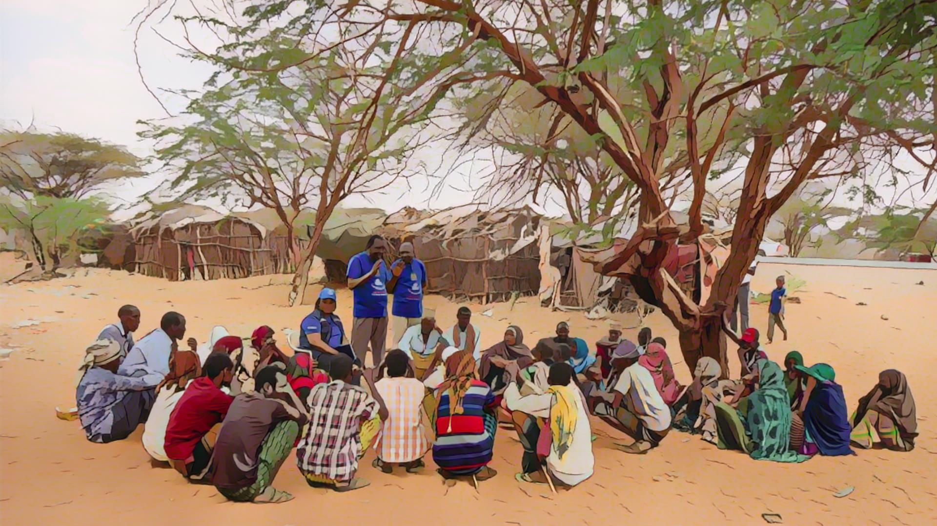
Dissemination
of outcomes
and response
Photo adapted from: WHO / NOOR / Billy Miaron
Notes:
Lastly, let’s look into the last core function of health authorities in cholera surveillance, disseminating the surveillance outcomes for public health response.

Slide 41


Inform stakeholders
As soon as a (suspected, probable, or confirmed) cholera outbreak is detected
all stakeholders immediately informed
Essential to trigger prompt actions
to rapidly respond to the outbreak
Stakeholders
  Upper-level health authority
  Multisectoral stakeholders, partners, agencies involved in responding to cholera
  Health professionals, community health workers / volunteers
  Etc
Notes:
As soon as a suspected, probable, or confirmed cholera outbreak is detected in a surveillance unit, all stakeholders should be immediately informed on the cholera situation. This is essential to trigger prompt actions to rapidly respond to the outbreak.
Stakeholders to be informed include the upper-level health authority; stakeholders, partners, agencies from all sectors involved in responding to cholera; health professionals, community health workers or volunteers involved in surveillance.

Slide 42

Response to a suspected outbreak
Suspected cholera outbreak
Immediate public health measures for acute diarrhoeal diseases
without waiting for laboratory confirmation
  Not specific to cholera
    Raising awareness on rehydration protocols
    Promoting handwashing with soap
    Raising awareness on food hygiene
    Education about how diarrhoeal infections spread
    Etc
Notes:
If a suspected cholera outbreak is detected in a surveillance unit, immediate public health measures for acute diarrhoeal diseases are implemented without waiting for laboratory confirmation.
Public health measures for acute diarrhoeal diseases are not specific to cholera. They include awareness raising on rehydration protocols, promotion of handwashing with soap, sensitization on food hygiene, education about how diarrhoeal infections spread, and so on.

Slide 43

Response to a probable or confirmed outbreak
Probable or confirmed cholera outbreak
Rapid, comprehensive, and multisectoral cholera outbreak response
Triggered without waiting for laboratory confirmation if it is a probable outbreak
  Including
      Case management
      Surveillance
      Community engagement
      WaSH
      Vaccination
Notes:
If a probable or confirmed cholera outbreak is detected in a surveillance unit, a rapid, comprehensive, and multisectoral cholera outbreak response is implemented. This is launched without waiting for laboratory confirmation if it is a probable outbreak.
A multisectoral response to cholera includes interventions to strengthen case management, surveillance and community engagement, WASH interventions and, as relevant, vaccination.

Slide 44

Adaptive surveillance
Suspected outbreak
No change in surveillance strategies
Increase awareness of surveillance stakeholders on surveillance strategies
Surveillance stakeholders
  Health facilities
  Community health workers / volunteers
  Laboratories
Surveillance strategies
  Case definition
  Data collection
  Reporting timelines
  Testing strategy
Notes:
If a suspected cholera outbreak is detected in a surveillance unit, the surveillance strategies do not change. However, health authorities make sure to increase the awareness of surveillance stakeholders on applicable strategies.
Stakeholders to be sensitized include health facility workers, community health workers and volunteers, as well as laboratories.
These stakeholders should be re-sensitized on the case definition, the data to be collected, the reporting timelines and the testing strategy.

Slide 45

Adaptive surveillance
Probable or confirmed outbreak
Surveillance strategies adapted
  Inform and train surveillance stakeholders
  Health facility workers
  Community health workers / volunteers
  Laboratories
Learn about surveillance strategies in Modules 4 & 5
Notes:
If a probable or a confirmed cholera outbreak is detected in a surveillance unit, the surveillance strategies need to be adapted. Health authorities should inform and train surveillance stakeholders on the new surveillance strategies.
Surveillance stakeholders to be sensitized include health facility workers, community health workers and volunteers, and laboratories.
You will learn more about the applicable surveillance strategies in module 4 and module 5.

Slide 46





Wrap up
Routinely
If suspected, probable, or confirmed outbreak detected
Oversee
reporting
and testing
Transmit, analyze, interpret data
Investigate
Disseminate outcomes
Respond
Analyze, verify, and interpret the reported data and test results immediately to detect a potential outbreak
Monitor that suspected cases are reported daily and that ALL suspected cases are tested
Perform case investigation on all suspected cases and field investigation
Rapidly inform all stakeholders on the cholera situation
Coordinate
rapid response
Notes:
As we wrap up this module, here is a summary of the key role of health authorities when the surveillance objective is to detect a cholera outbreak.
On a routine basis, health authorities monitor that any suspected cholera case is reported within a day and that all suspected cholera cases are tested. Health authorities analyze, verify, and interpret the reported data and test results immediately to detect a potential suspected, probable or confirmed cholera outbreak.
If a suspected, probable or confirmed outbreak is detected, health authorities rapidly conduct a case investigation on all suspected cases and they perform a field investigation. They rapidly inform all stakeholders of the cholera situation and coordinate a rapid public health response.

Slide 47

Notes:
Before moving on to the next module, we encourage you to take a short quiz. There are three questions in this quiz.

Slide 48

Question 1
When the surveillance objective is to detect a cholera outbreak, health authorities review surveillance performance indicators to monitor that:
Select all that apply
    Suspected cholera cases are reported within 24 hours
    Suspected cholera cases are reported on a weekly basis
    The absence of suspected cholera cases is reported within 24 hours
    The absence of suspected cholera cases is reported on a weekly basis
    All suspected cholera cases are tested for cholera
    A subset of suspected cholera cases selected according to a systematic sampling scheme are tested for cholera
Notes:
Question 1. Select all that apply. When the surveillance objective is to detect a cholera outbreak, health authorities review surveillance performance indicators to monitor that:
Suspected cholera cases are reported within 24 hours.
Suspected cholera cases are reported on a weekly basis.
The absence of suspected cholera cases is reported within 24 hours.
The absence of suspected cholera cases is reported on a weekly basis.
All suspected cholera cases are tested for cholera.
A subset of suspected cholera cases selected according to a systematic sampling scheme are tested for cholera.

Slide 49

Question 1 – Answers
When the surveillance objective is to detect a cholera outbreak, health authorities review surveillance performance indicators to monitor that:
    Suspected cholera cases are reported within 24 hours
    Suspected cholera cases are reported on a weekly basis
    The absence of suspected cholera cases is reported within 24 hours
    The absence of suspected cholera cases is reported on a weekly basis
    All suspected cholera cases are tested for cholera
    A subset of suspected cholera cases selected according to a systematic sampling scheme are tested for cholera
Notes:
The correct answers are a, d and e. When the surveillance objective is to detect a cholera outbreak, health authorities review surveillance performance indicators to monitor that suspected cholera cases are reported within 24 hours, that the absence of suspected cholera cases is reported on a weekly basis, and that all suspected cholera cases are tested for cholera.

Slide 50
Question 2
When the surveillance objective is to detect a cholera outbreak, health authorities:
    a) Analyze, verify, and interpret reports of suspected cholera cases and test results immediately to detect a suspected, probable, or confirmed cholera outbreak
    b) Compile and analyze reports of suspected cholera cases and test results weekly to interpret the disease situation in a robust manner
Notes:
Question 2. When the surveillance objective is to detect a cholera outbreak, health authorities:
a) Analyze, verify, and interpret reports of suspected cholera cases and test results immediately to detect a suspected, probable or confirmed cholera outbreak.
b) Compile and analyze reports of suspected cholera cases and test results weekly to interpret the disease situation in a robust manner.

Slide 51
Question 2 – Answer
When the surveillance objective is to detect a cholera outbreak, health authorities:
    a) Analyze, verify, and interpret reports of suspected cholera cases and test results immediately to detect a suspected, probable, or confirmed cholera outbreak
    b) Compile and analyze reports of suspected cholera cases and test results weekly to interpret the disease situation in a robust manner
Notes:
The correct answer is a. When the surveillance objective is to detect a cholera outbreak, health authorities analyze, verify, and interpret reports of suspected cholera cases and test results immediately to detect a suspected, probable or confirmed cholera outbreak.

Slide 52
Question 3
At the onset of a verified suspected, probable, or confirmed cholera outbreak, health authorities perform case investigation:
    On all suspected cholera cases
    On all confirmed cholera cases
    On a subset of suspected cholera cases
Notes:
Question 3. This is the last question. At the onset of a verified suspected, probable or confirmed cholera outbreak, health authorities perform case investigation:
On all suspected cholera cases.
On all confirmed cholera cases.
On a subset of suspected cholera cases.

Slide 53
Question 3 – Answer
At the onset of a verified suspected, probable, or confirmed cholera outbreak, health authorities perform case investigation:
    On all suspected cholera cases
    On all confirmed cholera cases
    On a subset of suspected cholera cases
Notes:
The correct answer is a. At the onset of a verified suspected, probable or confirmed cholera outbreak, health authorities perform case investigation on all suspected cholera cases.

Slide 54

Notes:
We have now completed this module.

