Slide 1
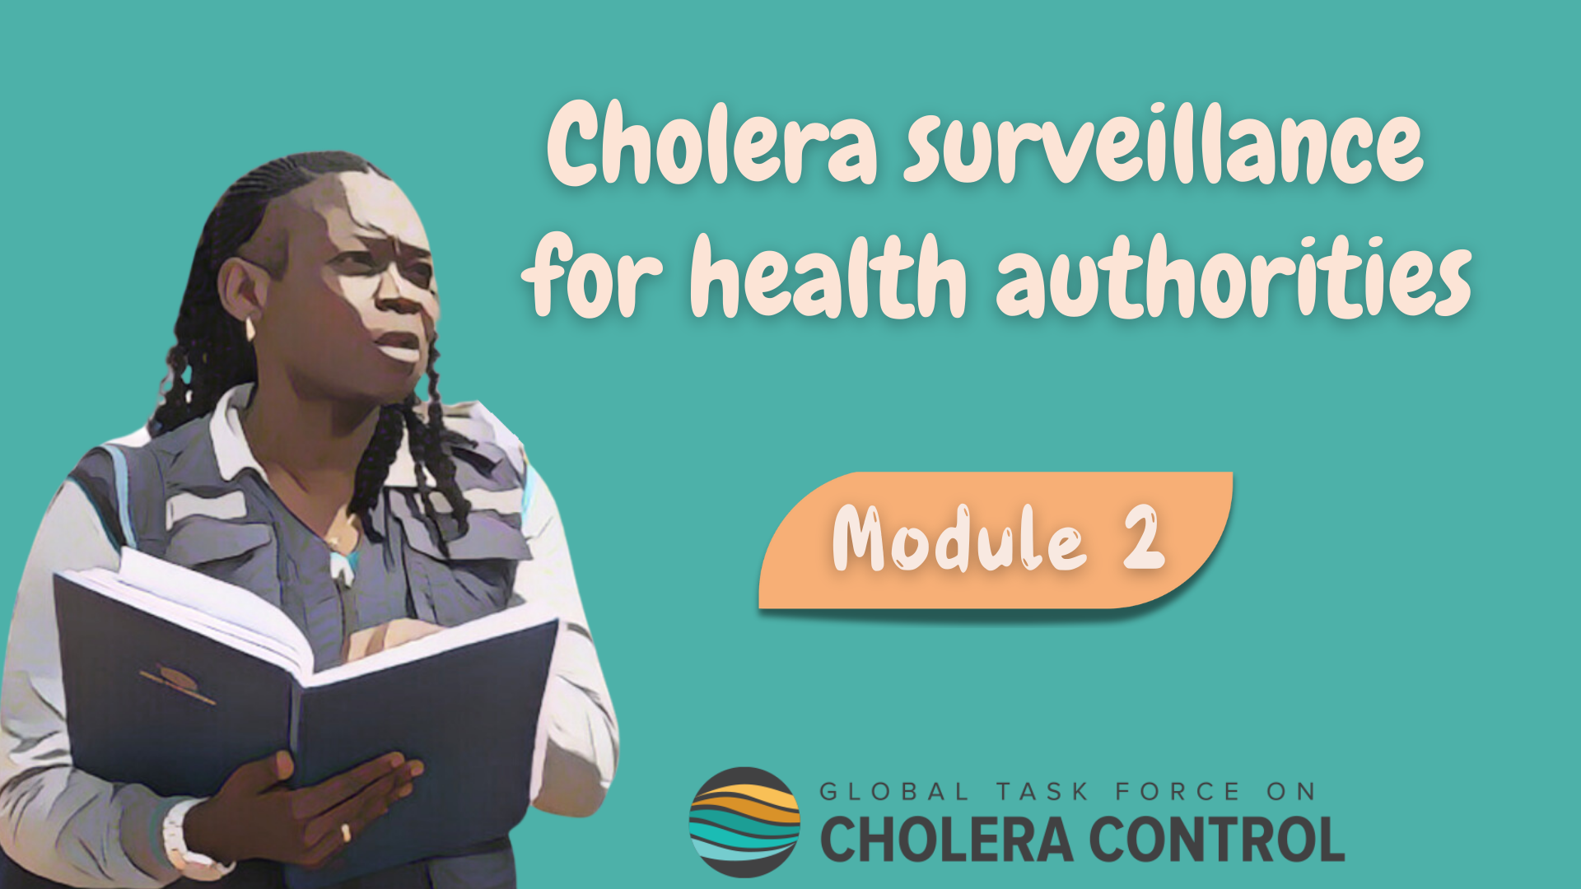
Notes:
Welcome to Module 2 of the GTFCC online course on cholera surveillance for health authorities.

Slide 2
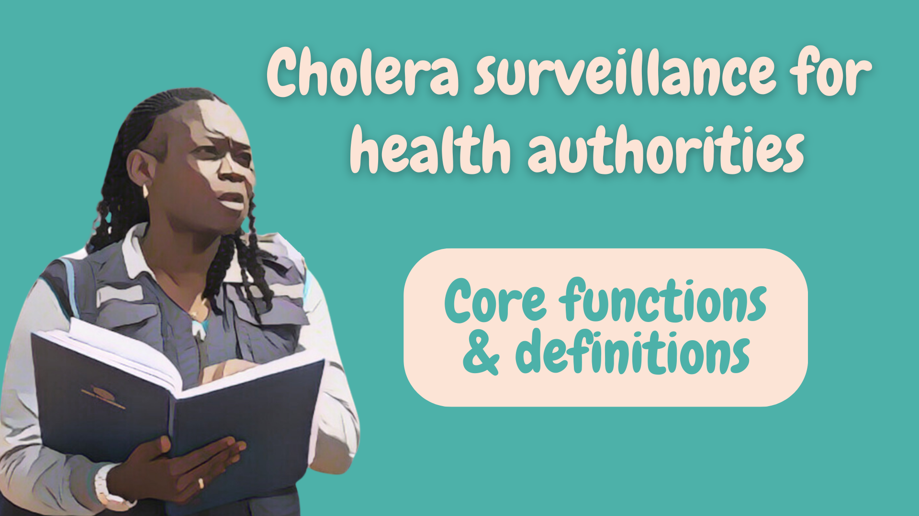
Notes:
This module focuses on the core functions of health authorities in cholera surveillance.

Slide 3
What will you learn?
Core functions of health authorities in cholera surveillance
Cholera case definitions
Cholera outbreak definitions
Notes:
After completing this module, you will be aware of the core functions of health authorities in cholera surveillance and you will be familiar with cholera case definitions and outbreak definitions.

Slide 4

Health authorities’ core functions
Photo adapted from: WHO
Notes:
Let’s look into the core functions of health authorities in cholera surveillance.

Slide 5

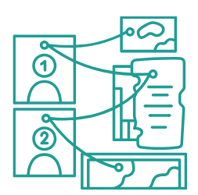



Core functions
Core surveillance functions are performed by health authorities
at all times in all surveillance units independent of the cholera situation
Oversee
reporting
and testing
Transmit, analyze, interpret data
Investigate
(case investigation
& field investigation)
Disseminate outcomes
Guide prevention and response
Notes:
Core surveillance functions are those performed by health authorities at all times, in all surveillance units, independent of the ongoing cholera situation.
Here is an overview of these functions.
First of all, health authorities are responsible for overseeing that the reporting of suspected cholera cases and the testing of suspected cholera cases are implemented by all surveillance stakeholders in accordance with applicable surveillance strategies.
Then, health authorities transmit the surveillance data reported to them to the next upper level and analyze and interpret the data.
As needed, health authorities also perform case investigation and field investigation to better understand the cholera situation.
Health authorities make sure to disseminate the surveillance outcomes in a timely manner to a broad range of stakeholders.
Lastly, health authorities ensure that surveillance outcomes are directly used to guide prevention and response strategies against cholera.

Slide 6

Reporting
and testing
Photo adapted from: WHO / Mulugeta Ayene
Notes:
Let’s look into how suspected cholera cases are reported and tested.

Slide 7

Detection & reporting
Health facility-based, community-based, event-based surveillance
Health facility-based surveillance reporting sites
Any institution with outpatient and/or inpatient facilities
Health centres, hospitals, clinics, private practices
Cholera treatment centres (CTCs), cholera treatment units (CTUs)
Oral rehydration points (ORPs)
Etc
Notes:
Suspected cholera cases are routinely detected and reported by health facility-based surveillance and community-based surveillance. These two routine surveillance streams are complemented by event-based surveillance.
Any institution with outpatient or inpatient facilities contribute to health facility-based surveillance. This includes health centres, hospitals, clinics, private practices, cholera treatment centres, cholera treatment units, oral rehydration points and so on.

Slide 8


Reporting by health facilities
Standard case-based data is reported by health facility-based surveillance
Case-based data
  Individual information on each suspected cholera case
  Recorded in a case report form or a line list
Standard data
  Same information is collected on each suspected cholera case
  Patient information: age, sex, place of residence
  Clinical information: symptom onset, inpatient/outpatient, dehydration, outcome
  Tests: tests performed, results
Learn where to access data collection tools in Module 6
Notes:
At health facility-level, standard case-based data is collected and reported on any suspected cholera case seen at a health facility.
Case-based data means that individual information is collected on each suspected cholera case. This information is recorded in a case report form or in a line list.
Standard data means that the same information is always collected on suspected cholera cases.
This information includes:
- information on the patient such as age, sex, and place of residence;
- as well as clinical information such as the date of symptom onset, whether the patient was hospitalized for treatment, the patient dehydration level at arrival, and the outcome of the disease;
- lastly, information on the tests performed and their results are also collected.
In module 6, we will show you where to access template tools to record standard case-based data for health facility-based reporting.

Slide 9
Reporting at community level
Standard aggregate data is recorded and reported by community-based surveillance
Aggregate data
  Number of suspected cholera cases and cholera deaths in a day
  Recorded in a summary table
Standard data
  The same information is recorded every day
  Number of suspected cholera cases and cholera deaths
    By sex and age group
Learn where to access data collection tools in Module 6
Notes:
Regarding community-based surveillance, standard aggregate data is recorded and reported.
Aggregate data means that the number of suspected cholera cases and cholera deaths are compiled by day. Typically, this is recorded in a summary table.
Standard data means that the same information is recorded on every day, namely the number of suspected cholera cases and cholera deaths by sex and age group.
In module 6, we will show you where to access template tools to record standard aggregate data for community-based reporting.

Slide 10
Testing
Why to test
Who to test
For surveillance
  AWD can be caused by different diseases
  Testing is to characterize the cholera situation
Suspected cholera cases
Among those, which one to test
depends on the cholera situation
Learn about testing strategies in Modules 3, 4, 5
But not for treatment
  Test results do not influence treatment
  Treatment depends on dehydration level
Notes:
Moving on to the testing of suspected cholera cases.
Acute Watery Diarrhoea (AWD) is a key sign of cholera. However, AWD can be caused by different diseases. Therefore, testing for cholera is important for surveillance in order to characterize the actual cholera situation.
However, cholera test results do not influence the treatment of suspected cholera cases. Indeed, treatment depends on dehydration level, not on cholera test results.
Cholera tests are performed on patients who meet the definition of a suspected cholera case.
Among those, which one should be tested depends on the cholera situation.
You will learn about testing strategies applicable in different situations in the next modules of this course.

Slide 11
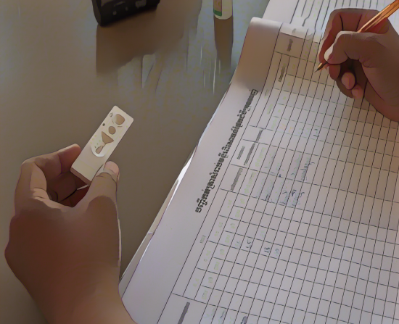
Screening by RDT
Rapid Diagnostic Tests (RDTs) are useful screening tools but
CANNOT be used to confirm cholera
RDTs
Can be used at health facility level
To triage samples to send for laboratory confirmation
RDT results
Sufficient to rule out cholera if negative
Recorded as part of standard information
  Positive and negative results
Photo adapted from: WHO/ Blink Media - Cindy Liu
Learn where to access resources on testing in Module 6
Notes:
Rapid Diagnostic Tests for cholera, RDT, may be available in your country. If so, they are useful screening tools. However, they cannot be used to confirm cholera.
RDT can be performed at health facility level; they are rapid and easy to use.
They are used to triage samples to be sent for laboratory confirmation, namely those tested positive by RDT.
If the RDT is negative, cholera can be ruled out and there is no need to send the sample for laboratory confirmation.
All RDT results, positive or negative, are recorded as part of standard information, and should be reported.
You will learn where to access information on how to perform RDT in Module 6.

Slide 12

Laboratory confirmation
Laboratory confirmation of cholera is by culture or PCR
Samples collected
  Within the first 4 days of illness
  Before antibiotic therapy
No need to wait for the results to initiate treatment
Photo adapted from: WHO / Fid Thompson
Notes:
For cholera to be confirmed, samples collected on suspected cholera cases are sent to a laboratory for confirmatory testing by culture or PCR.
Samples for laboratory confirmation should be collected within the first four days of illness and before initiating antibiotic therapy.
There is no need to wait for the laboratory confirmation results to treat suspected cholera cases. Treatment depends on dehydration level, not on test results.

Slide 13
Reporting
Health facility-based & community-based surveillance data
and tests results are reported to health authorities
Reporting of suspected cholera cases
  Case-based reporting reporting by health facilities
  Aggregate reporting by community health workers / volunteers
Zero reporting
  Reporting of absence of suspected cholera cases
  Health facility-based and community-based surveillance
Reporting of test results
  Positive and negative
Notes:
The standard data collected by health facility-based surveillance and community-based surveillance as well as test results are reported to the health authority.
When suspected cholera cases have been detected, case-based data collected at health facility level and aggregate data recorded at community level are reported.
When no suspected cholera cases have been detected, the absence of suspected cases is also reported to the health authority. This is zero reporting and applies to health facility-based surveillance and community-based surveillance.
Laboratories report to the health authority, all cholera test results positive and negative.

Slide 14

Oversight
by health authorities
Photo adapted from: WHO / Genna Print
Notes:
Let’s look into how health authorities oversee that suspected cholera cases are reported and tested in accordance with applicable surveillance strategies.

Slide 15

Awareness
Health authorities ensure that all reporting sites and laboratories are aware
of what to report when and how, and who to test when and how
Health authorities regularly inform
  Health facility workers
  Community health workers / volunteers
  Laboratories
Ongoing cholera situation in their surveillance unit
Applicable strategies for reporting and testing
Notes:
Health authorities are responsible for ensuring that all reporting sites and laboratories are fully aware of what to report, when and how; and who to test, when and how.
Health authorities regularly inform health facility workers; community health workers or volunteers implementing community-based surveillance as well as laboratories: on the cholera situation in their surveillance unit and on the applicable strategies for reporting and testing suspected cholera cases.

Slide 16

Capacity building
Health authorities ensure that all reporting sites and laboratories are in capacity
to implement reporting and testing according to applicable strategies
Health facility workers & community health workers / volunteers
  Are trained on case definitions and on how to report
  Have reporting tools and are trained to use them
Health facility workers
  Are trained and have supplies to perform RDTs (if applicable)
  Are trained and have supplies to collect and send samples for laboratory testing
Laboratories
  Are trained and have supplies and reagents to perform testing for cholera
  Are trained on how to report results
Notes:
Health authorities also ensure that all reporting sites and laboratories are in capacity to report and test suspected cholera cases according to applicable strategies.
For example, they make sure that health facility workers and community health workers or volunteers are trained on case definitions and on how to report suspected cholera cases. Health authorities also make sure that these stakeholders have standard reporting tools on hand and that they know how to use them.
In addition, health authorities also make sure that health facility workers are trained on how to perform RDTs and have the necessary supplies on hand. They also make sure that health facility workers know how to collect samples for laboratory testing and have the necessary supplies on hand and know where to send the samples for testing.
Lastly, health authorities make sure that laboratories expected to perform cholera tests are adequately trained and have the necessary supplies and reagents on hand to perform cholera tests, and that they know how to report test results.

Slide 17

Monitoring
Health authorities monitor on a weekly basis that reporting and testing are
implemented according to applicable strategies, and take supportive measures as needed
Monitoring of performance indicators
    Completeness and timeliness of reporting
    Adherence to testing strategies
Feedback and recommendations
    Reporting sites and laboratories receive feedback
    Recommendations/support for improvement as needed
Notes:
Health authorities monitor at least on a weekly basis that all reporting sites and laboratories report and test suspected cholera cases in accordance with applicable strategies, and they take supportive measures to improve reporting and testing as needed.
To monitor that reporting and testing are performed in accordance with applicable strategies, health authorities monitor surveillance performance indicators, in particular the completeness and the timeliness of reporting and the adherence to applicable testing strategies.
Health authorities regularly provide feedback to all reporting sites and laboratories on their performance.
If reporting or testing is not implemented according to applicable strategies, health authorities provide recommendations and support as needed to improve the performance of surveillance.

Slide 18

Transmission, analysis and
interpretation
Photo adapted from: WHO / NOOR / Alixandra Fazzina
Notes:
Now let’s look into the next core function of health authorities which is to transmit, analyze and interpret cholera surveillance data.

Slide 19
Data transmission
Local health authorities
Reporting sites and laboratories
Compile and clean the data reported by
  Health facility-based surveillance
  Community-based surveillance
  Laboratories
Health authorities at the surveillance unit level
Health authorities at the intermediate level
Report it to the next level
  Up to the national level
Health authority at the national level
National level health authority
Report aggregate data to the regional and global levels
Regional and global levels
Notes:
Local health authorities compile and clean the data reported by all reporting sites at health facility level and community level as well as tests results reported by laboratories.
Then, they transmit the data to the next upper level up to the national level.
The health authority at the national level, report aggregate data to the regional and global levels.

Slide 20

Analysis & interpretation
Health authorities analyse and interpret the data to describe and assess the situation
Interpretation
Data from health facility-based and community-based surveillance
  Analysed separately
  But interpreted jointly
Surveillance performance indicators are duly considered
Notes:
Health authorities routinely analyze and interpret cholera surveillance data to describe and assess the cholera situation at the surveillance unit level.
The following is considered to interpret the cholera situation.
The data reported by health facility-based surveillance and community-based surveillance are analyzed separately; they are not merged. However, they are interpreted jointly to assess the cholera situation.
Surveillance performance indicators are also taken into account to interpret the cholera situation in a sound manner.

Slide 21

Investigation
Photo adapted from: WHO / NOOR / Alixandra Fazzina
Notes:
To better understand and interpret the cholera situation, health authorities may also investigate as needed. Let's look into this.

Slide 22

Investigations
Collection of additional information to supplement standard surveillance data to better interpret the cholera situation
  Verification of reported information
  Case investigation
  Field investigation
Notes:
Investigations are performed by health authorities as needed to collect additional information to supplement standard surveillance data routinely reported in order to better interpret the cholera situation.
Investigations may be in the form of a verification of the reported information, a case investigation, or a field investigation.

Slide 23

Verification
Performed by contacting reporting source(s) to check
that the information is accurate and reliable
  For example
    Check whether a case meets the case definition
    Clarify laboratory test(s) performed or result(s)
Notes:
To perform a verification, health authorities usually contact the reporting source to check that the reported information is accurate and reliable. For example, a verification may be performed to check that the definition of a suspected cholera case is met or to request clarifications on tests performed and their results.

Slide 24

Case investigation
Performed by interviewing suspected cholera case(s)
  Classify case(s) by geographic origin of infection
    Locally acquired or imported
  Generate hypotheses on exposure and context of transmission
    Orientation for field investigation
  Identify epidemiological links between cases
    Clustered or community transmission
Learn where to access a cholera case investigation form in Module 6
Notes:
To perform a case investigation, health authorities interview suspected cholera cases.
The case investigation aims to classify the case by origin of infection.
This is achieved by assessing whether the case is locally acquired which means that he was infected in the surveillance unit where he was reported or if the case is an imported case if he was infected outside of the surveillance unit where he was reported.
In addition, case investigations are also very insightful to generate hypotheses about exposure to potential source of contamination and contexts of transmission; this can then be used to orient a field investigation.
Lastly, case investigations help determine epidemiological links between cases which is essential to assess whether transmission is occurring in clusters or in the community.
Using a standard form is recommended to perform a comprehensive case investigation. In module 6, you will learn where to access as standard cholera case investigation form.

Slide 25

Field investigation
Onsite assessment performed in an outbreak area
Assess
  Source(s) of contamination
  Context of transmission
  Risk factors for spread
  Oriented by the findings of case investigations
  Combined with risk and needs assessments & immediate measures
  Used to guide effective response measures
Notes:
To perform a field investigation, health authorities perform an onsite assessment in an outbreak area.
A field investigation aims to assess potential sources of contamination, assess the contexts of transmission, and assess risk factors for spread.
The field investigation is usually oriented by the findings of case investigation. It is usually combined with a risk assessement and needs assessment and combined with immediate response measures. The findings of the field investigation are used to guide effective response measures.

Slide 26
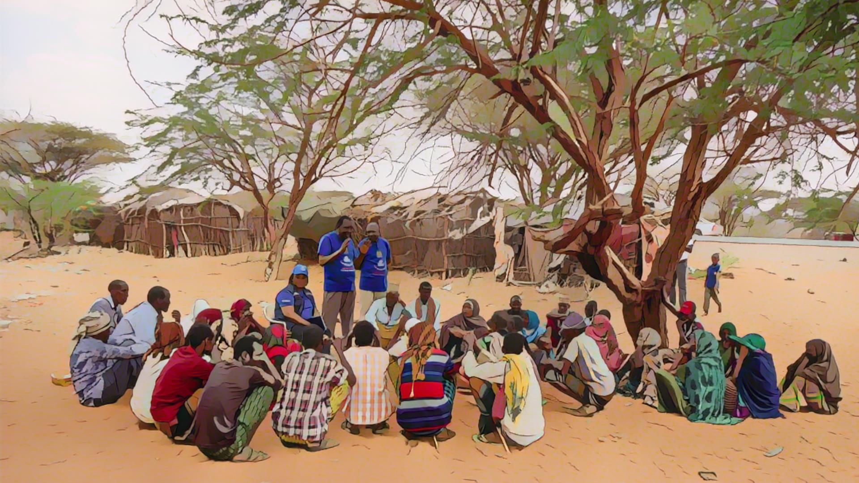
Dissemination
of outcomes
and response
Photo adapted from: WHO / NOOR / Billy Miaron
Notes:
Health authorities disseminate the outcomes of surveillance and investigation to guide the response against cholera.

Slide 27

Dissemination
Information on the cholera situation is disseminated in a timely manner
to all stakeholders involved in cholera prevention and control
Epidemiological reports
  Disseminated to
      Health professionals
      Community health workers / volunteers
      Stakeholders representing all cholera pillars
      Operational partners and international organizations
      Etc
  Discussed in a multisectoral manner
      Guide prevention and response strategies
Notes:
Information on the cholera situation is disseminated in a timely manner to all stakeholders involved in cholera prevention and control.
This information is usually presented in epidemiological reports prepared by health authorities and is disseminated to health professionals, community health workers and volunteers, stakeholders representing all cholera prevention and control pillars, operational partners, international organizations, and so on.
The cholera situation is then assessed and discussed in a multisectoral manner to guide effective prevention and response strategies at the surveillance unit level.

Slide 28

Definitions
Photo adapted from: WHO
Notes:
To play their role effectively, health authorities must adhere to standard cholera case definitions and outbreak definitions. We will now walk you through key definitions.

Slide 29

Acute Watery Diarrhoea
A sign of cholera is Acute Watery Diarrhoea (AWD)
AWD is not any type of diarrhoea
Acute if it lasts for less than 7 days
Watery if stools are non-bloody and liquid (and may contain mucous)
Diarrhoea if there are ≥3 loose stools within a 24-hour period
Notes:
A key sign of cholera is Acute Watery Diarrhoea, also referred to as AWD.
AWD is not any type of diarrhoea.
It is acute if it lasts for less than 7 days.
It is watery if stools are non-bloody and liquid and may contain mucous.
It is diarrhoea if there are 3 loose stools or more within a 24-hour period.

Slide 30
AWD & dehydration
AWD may cause dehydration
SEVERE dehydration
Treament guided by dehydration level
One or more danger sign(s)
  Lethargic or unconscious
  Absent or weak pulse
  Respiratory distress
Severe dehydration
  Intravenous rehydration
Or
At least two of the following
  Sunken eyes
  Not able to drink or drinks poorly
  Skin pinch goes back very slowly
Other dehydration levels
  Oral rehydration solution
Notes:
Acute Watery Diarrhoea can cause dehydration.
A patient has severe dehydration if one danger sign or more is present, namely being lethargic or unconscious, or having an absent or weak pulse, or having a respiratory distress.
If no danger sign is present, a patient has severe dehydration if at least two of the following signs are present: having sunken eyes, or not being able to drink or drinking poorly, or having a skin pinch which goes back very slowly.
Assessing the level of dehydration is essential to determine the appropriate rehydration plan.
Severe dehydration requires intravenous rehydration. In other situations, oral rehydration is sufficient.

Slide 31
Cholera case definitions
Depending on the cholera situation, different cholera case definitions apply
Where there is NO probable or confirmed cholera outbreak
Where there is an ONGOING probable or confirmed cholera outbreak
Person aged ≥ 2 with AWD and severe dehydration
or
Person aged ≥ 2 who died from AWD
Person with AWD (or who died from AWD)
Criteria on age and severe dehydration
NO criteria on age and severe dehydration
Limit false suspected cholera outbreaks
Avoid overwhelming early detection systems
For sensitive monitoring
Notes:
Depending on the ongoing cholera situation, different definitions of suspected cholera cases apply.
In surveillance units where there is no ongoing probable or confirmed cholera outbreak, suspected cholera cases are any person aged 2 years or older with AWD and severe dehydration, or aged 2 years or older who died from AWD.
In surveillance units where there is an ongoing probable or confirmed cholera outbreak, suspected cholera cases are any person with AWD or who died from AWD.
The key difference between these case definitions is that in surveillance units where there is no ongoing probable or confirmed cholera outbreak, age and severe dehydration are taken into account to identify suspected cholera cases. These criteria limit the number of false alerts. This avoids overwhelming the surveillance system with false alarms which would decrease the effectiveness of early detection.
On the other hand, in surveillance units where there is a probable or confirmed cholera outbreak, age and severe dehydration are not considered to identify suspected cholera cases. This is to ensure the sensitive monitoring of an outbreak.

Slide 32

Confirmed cholera case
Any person infected with Vibrio cholerae O1 or O139
as confirmed by culture (including seroagglutination) or PCR
Strain should be demonstrated as toxigenic if
  No confirmed cholera outbreak in another surveillance unit
    and
  No established epidemiological link to a confirmed cholera case or source of exposure in another country
Notes:
A confirmed cholera case is any person infected with Vibrio cholerae O1 or O139, as confirmed by culture (including seroagglutination) or PCR.
In addition, in particular circumstances, the strain in a confirmed cholera case should also be demonstrated as toxigenic. That is if there is no confirmed cholera outbreak in another surveillance unit of the country and if there is no established epidemiological link to a confirmed cholera case or source of exposure in another country.

Slide 33



Suspected cholera outbreak
  ≥ 2 suspected cholera cases
  or
  1 suspected cholera case RDT+
  Reported in a surveillance unit within 7 days
Public health measures for acute diarrheal diseases
(not specific to cholera) implemented immediately
Notes:
Moving on to cholera outbreak definitions.
There is a suspected cholera outbreak in a surveillance unit if two suspected cholera cases or more or one suspected cholera case tested positive by RDT have been reported in a surveillance unit within 7 days.
If a suspected cholera outbreak is detected, public health measures for acute diarrheal diseases, not specific to cholera, should be implemented immediately.

Slide 34


Probable cholera outbreak
Number of suspected cholera cases tested positive by RDT ≥ threshold within 14 days
Threshold
Number of
cases tested
Number of
RDT+
3 to 7
8 to 10
11 to 14
15 to 17
18 to 21
≥ 3 RDT+
≥ 4 RDT+
≥ 5 RDT+
≥ 6 RDT+
≥ 7 RDT+
High confidence that a cholera outbreak is occurring
Cholera outbreak response measures
rapidly implemented without waiting for laboratory confirmation
Notes:
There is a probable cholera outbreak in a surveillance unit if the number of suspected cholera cases tested positive by RDT reaches a threshold within 14 days.
This threshold depends on the number of suspected cholera cases tested by RDT, as represented on this chart.
For example, if in a surveillance unit, between 3 to 7 suspected cholera cases were tested by RDT and at least 3 of them tested positive, there is a probable outbreak in this surveillance unit.
Similarly, if in a surveillance unit, between 8 to 10 suspected cholera cases were tested by RDT and at least 4 of them tested positive, there is a probable outbreak.
These thresholds were statistically determined to provide high confidence, around 95 percent, that when the threshold is met a cholera outbreak is occurring.
As a result, if a probable cholera outbreak is detected, cholera outbreak response measures should be rapidly implemented without waiting for laboratory confirmation.

Slide 35

Confirmed cholera outbreak
≥ 1 locally acquired confirmed cholera case
Locally acquired
  Infected in the surveillance unit
  Not an imported case
Cholera outbreak response measures rapidly implemented
Notes:
There is a confirmed cholera outbreak in a surveillance unit, if at least one locally acquired confirmed cholera case has been detected.
A locally acquired cholera case is a case who was infected in the surveillance unit considered. In other words, the case is not an imported case.
If a confirmed cholera outbreak is detected, cholera outbreak response measures should be rapidly implemented.

Slide 36
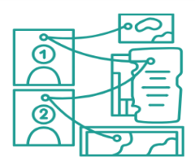
Wrap up
Oversee
reporting
and testing
Transmit, analyze, interpret data
Investigate
(case investigation & field investigation)
Disseminate outcomes
Guide prevention and response
Continuously monitor and ensure that stakeholders detect, report, and test suspected cases in accordance with applicable strategies
Collect additional information as needed with case and field investigations to better assess the cholera situation
Contribute to coordinated multisectoral prevention and control strategies against cholera
Regularly analyze and interpret epidemiological data and test results to characterize the cholera situation
Inform all relevant stakeholders of the cholera situation in a timely manner
Notes:
As we wrap up this module, here are the important points to remember.
The core functions of health authorities in cholera surveillance are to continuously monitor and ensure that all reporting sites and laboratories detect, report, and test suspected cases in accordance with applicable strategies.
Health authorities regularly analyze and interpret epidemiological data and test results to characterize and understand the cholera situation at the surveillance unit level.
As needed, health authorities collect additional information through case investigations and field investigations to supplement surveillance data and better assess the cholera situation in a surveillance unit.
Health authorities inform all relevant stakeholders of the cholera situation in a timely manner, including by preparing and disseminating epidemiological reports.
Lastly, health authorities ensure that the outcomes of surveillance are directly used to guide coordinated prevention and control strategies against cholera.

Slide 37

Notes:
Before moving on to the next module, we encourage you to take a short quiz. There are four questions in this quiz.

Slide 38

Question 1
Cholera health-facility based surveillance relies on the reporting of:
    Individual ("case based") data on suspected cholera cases
    Data aggregated by day on suspected cholera cases
    Data aggregated by week on suspected cholera cases
Notes:
Question 1. Cholera health-facility based surveillance relies on the reporting of:
Individual ("case based") data on suspected cholera cases
Data aggregated by day on suspected cholera cases
Data aggregated by week on suspected cholera cases

Slide 39

Question 1 – Answer
Cholera health-facility based surveillance relies on the reporting of:
    Individual ("case based") data on suspected cholera cases
    Data aggregated by day on suspected cholera cases
    Data aggregated by week on suspected cholera cases
Notes:
The correct answer is a. Individual ("case based") data on suspected cholera cases are reported via health facility-based surveillance.

Slide 40
Question 2
Cholera community-based surveillance relies on the reporting of:
    a) Individual ("case based") data on suspected cholera cases
    b) Data aggregated by day on suspected cholera cases
    c) Data aggregated by week on suspected cholera cases
Notes:
Question 2. Cholera community-based surveillance relies on the reporting of:
a) Individual ("case based") data on suspected cholera cases
b) Data aggregated by day on suspected cholera cases
c) Data aggregated by week on suspected cholera cases

Slide 41
Question 2 – Answer
Cholera community-based surveillance relies on the reporting of:
    a) Individual ("case based") data on suspected cholera cases
    b) Data aggregated by day on suspected cholera cases
    c) Data aggregated by week on suspected cholera cases
Notes:
The correct answer is b. Data aggregated by day on suspected cholera cases are reported via community-based surveillance.

Slide 42
Question 3
Rapid Diagnostic Test (RDTs) can be used to:
Select all that apply
    a) Confirm cholera
    b) Rule out cholera
    c) Screen samples for laboratory confirmation
Notes:
Question 3. Select all that apply. Rapid Diagnostic Test (RDTs) can be used to:
a) Confirm cholera
b) Rule out cholera
c) Screen samples for laboratory confirmation

Slide 43
Question 3 – Answers
Rapid Diagnostic Test (RDTs) can be used to:
    a) Confirm cholera
    b) Rule out cholera
    c) Screen samples for laboratory confirmation
Notes:
The correct answers are b and c. RDTs are used to rule out cholera when negative, and to screen samples for laboratory confirmation when positive.

Slide 44
Question 4
The surveillance unit level corresponds to:
Select all that apply
    a) The spatial level at which the cholera situation is monitored to determine applicable surveillance objectives and strategies
    b) The supervisory level at which the implementation of cholera surveillance is coordinated and monitored
    c) The operational level at which cholera prevention and control measures are implemented
Notes:
Question 4. This is the last question. Select all that apply. The surveillance unit level corresponds to:
a) The spatial level at which the cholera situation is monitored to determine applicable surveillance objectives and strategies.
b) The supervisory level at which the implementation of cholera surveillance is coordinated and monitored.
c) The operational level at which cholera prevention and control measures are implemented.

Slide 45

Question 4 – Answers
The surveillance unit level corresponds to:
    a) The spatial level at which the cholera situation is monitored to determine applicable surveillance objectives and strategies
    b) The supervisory level at which the implementation of cholera surveillance is coordinated and monitored
    c) The operational level at which cholera prevention and control measures are implemented
Notes:
All are correct. The cholera situation is monitored at the surveillance unit level and the applicable surveillance objective and strategies are determined at this level. The implementation of cholera surveillance is coordinated and monitored at the surveillance unit level. Strategies against cholera are also designed and implemented at the surveillance unit level.

Slide 46

Notes:
We have now completed this module.

