Slide 1
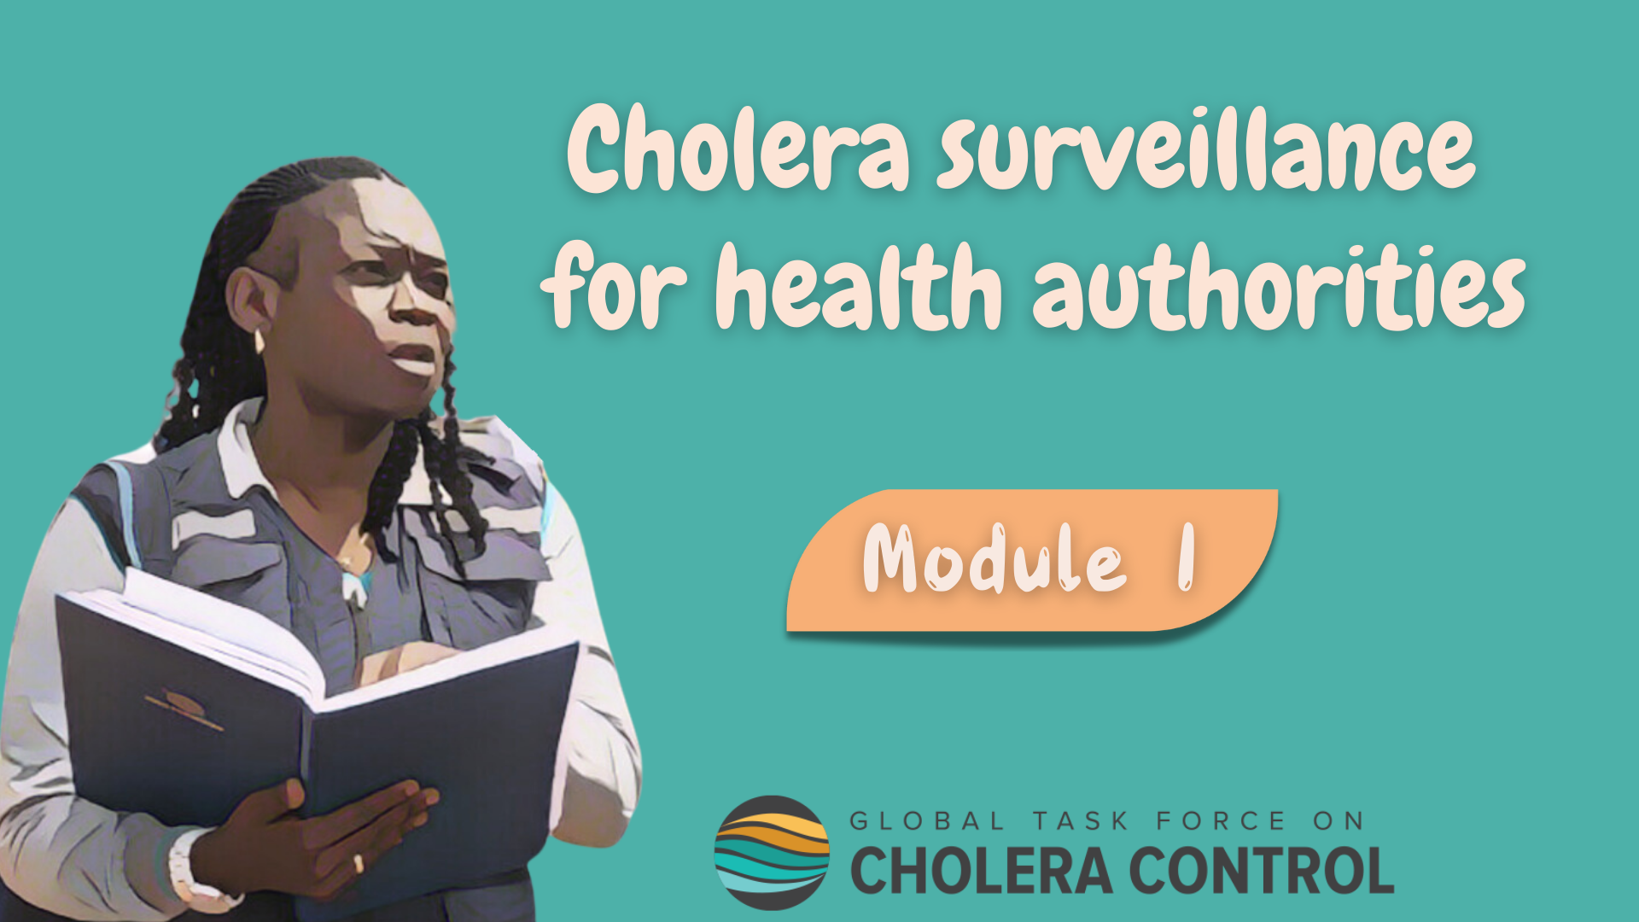
Notes:
Welcome to Module 1 of the GTFCC online course on cholera surveillance for health authorities.

Slide 2
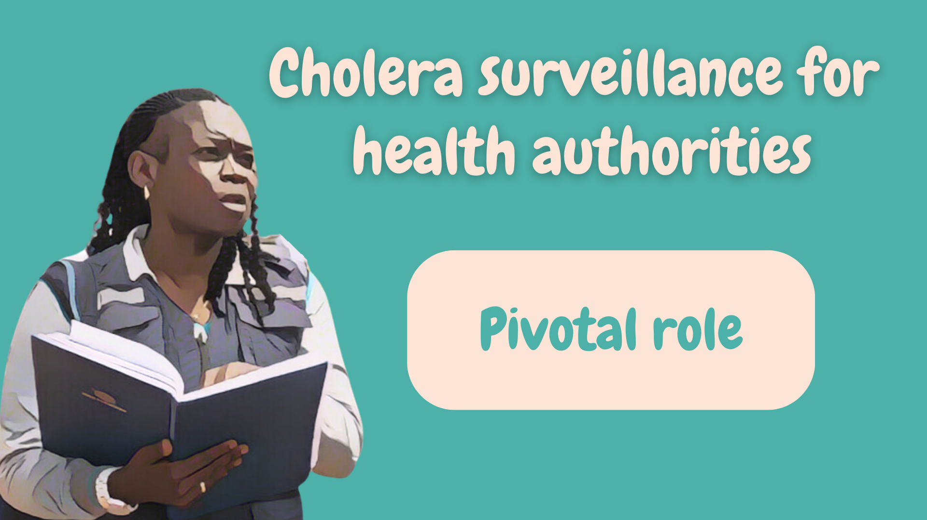
Notes:
In this module, we will walk you through the objectives of cholera surveillance and the reasons why health authorities play such a pivotal role in cholera surveillance.

Slide 3
What will you learn?
Ojectives of cholera surveillance in different situations
Pivotal role of health authorities to ensure that cholera surveillance meets its objectives
Notes:
After completing this module, you will be familiar with the objectives of cholera surveillance in different situations and you will be aware of the pivotal role that health authorities play to ensure that cholera surveillance continuously meets these objectives.

Slide 4
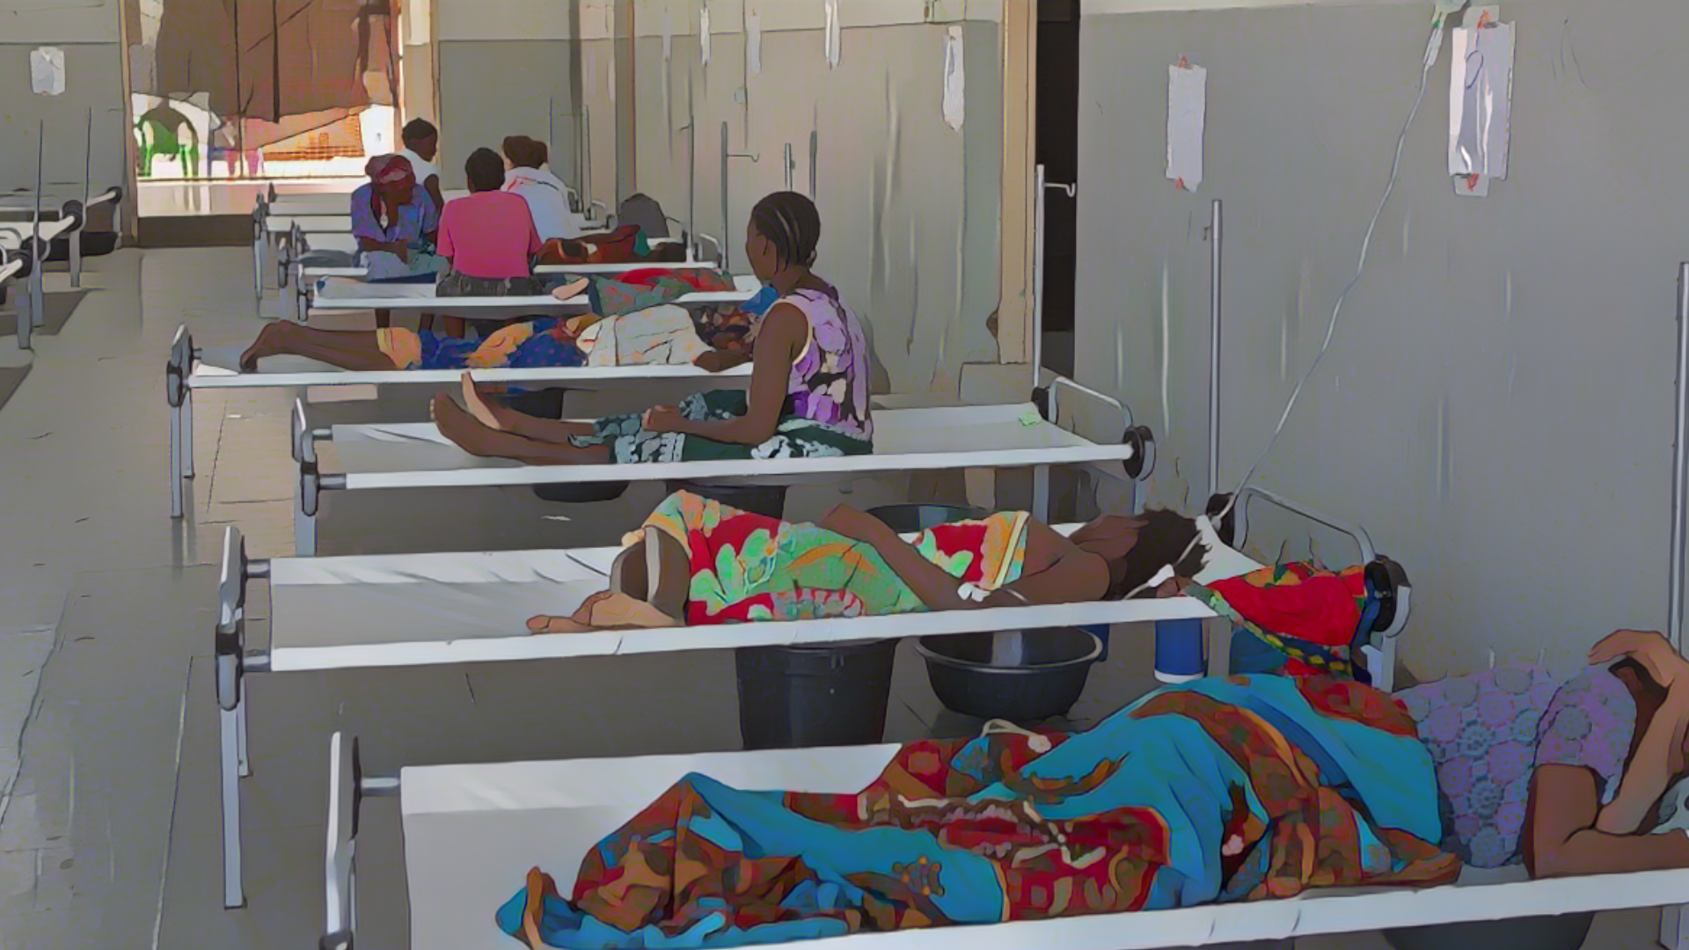
Background
Photo adapted from: WHO /Mark Nieuwenhof
Notes:
Before we dive in, let us quickly remind you what cholera is and what surveillance is.

Slide 5
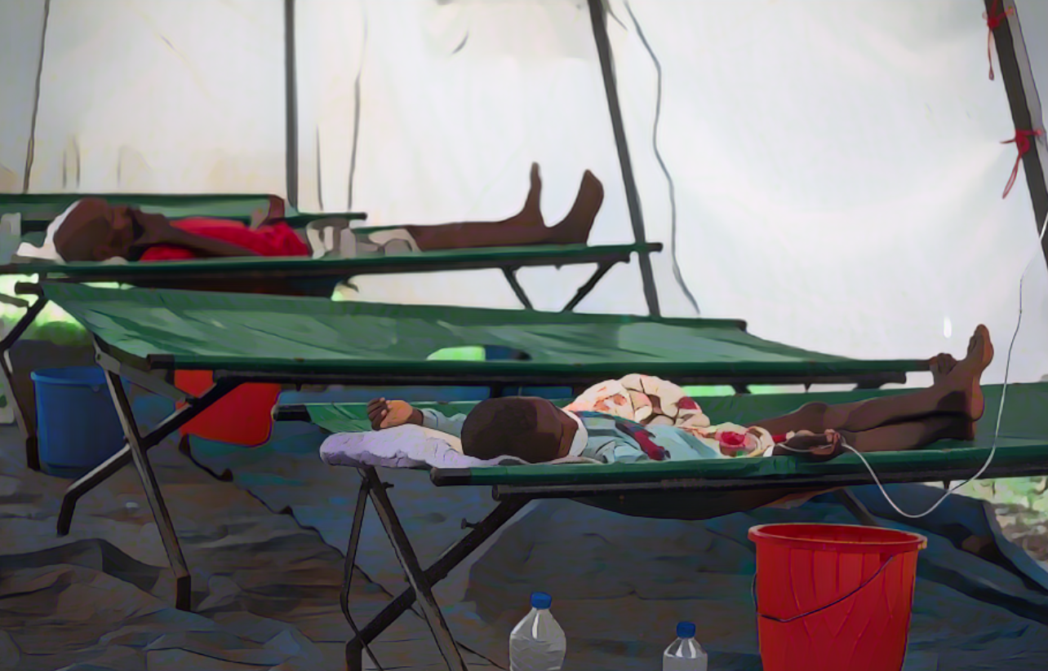
Cholera
Acute diarrhoeal infection
Spread through contaminated food and water
Caused by the bacterium Vibrio cholerae
(toxigenic, serogroup O1 or O139)
Can spread rapidly and cause large outbreaks
Severe forms of the disease can lead to severe dehydration and death within hours if not treated
It is preventable and easily treatable (rehydration)
Photo adapted from WHO/Mulugeta Ayene
Notes:
Cholera is an acute diarrheal infection which spreads through contaminated food and water.
It is caused by the bacterium toxigenic Vibrio cholerae, serogroup O1 and O139.
Cholera can spread rapidly and cause large outbreaks.
Severe forms of the disease can lead to severe dehydration and death within hours if not treated. However, it is preventable and easily treatable.

Slide 6


Disease surveillance
Continuous and systematic collection, analysis, and interpretation of health-related
data with prompt dissemination of results to guide public health response
Essential to
  Understand outbreak dynamics
    Who is affected, where, when
  Design effective interventions
Notes:
Disease surveillance is the continuous and systematic collection, analysis and interpretation of health-related data with prompt dissemination of results to guide public health response.
Surveillance is essential to understand the dynamics of disease outbreaks by describing who is affected, where and when. This understanding is critical to design effective interventions to control and prevent disease outbreaks.

Slide 7
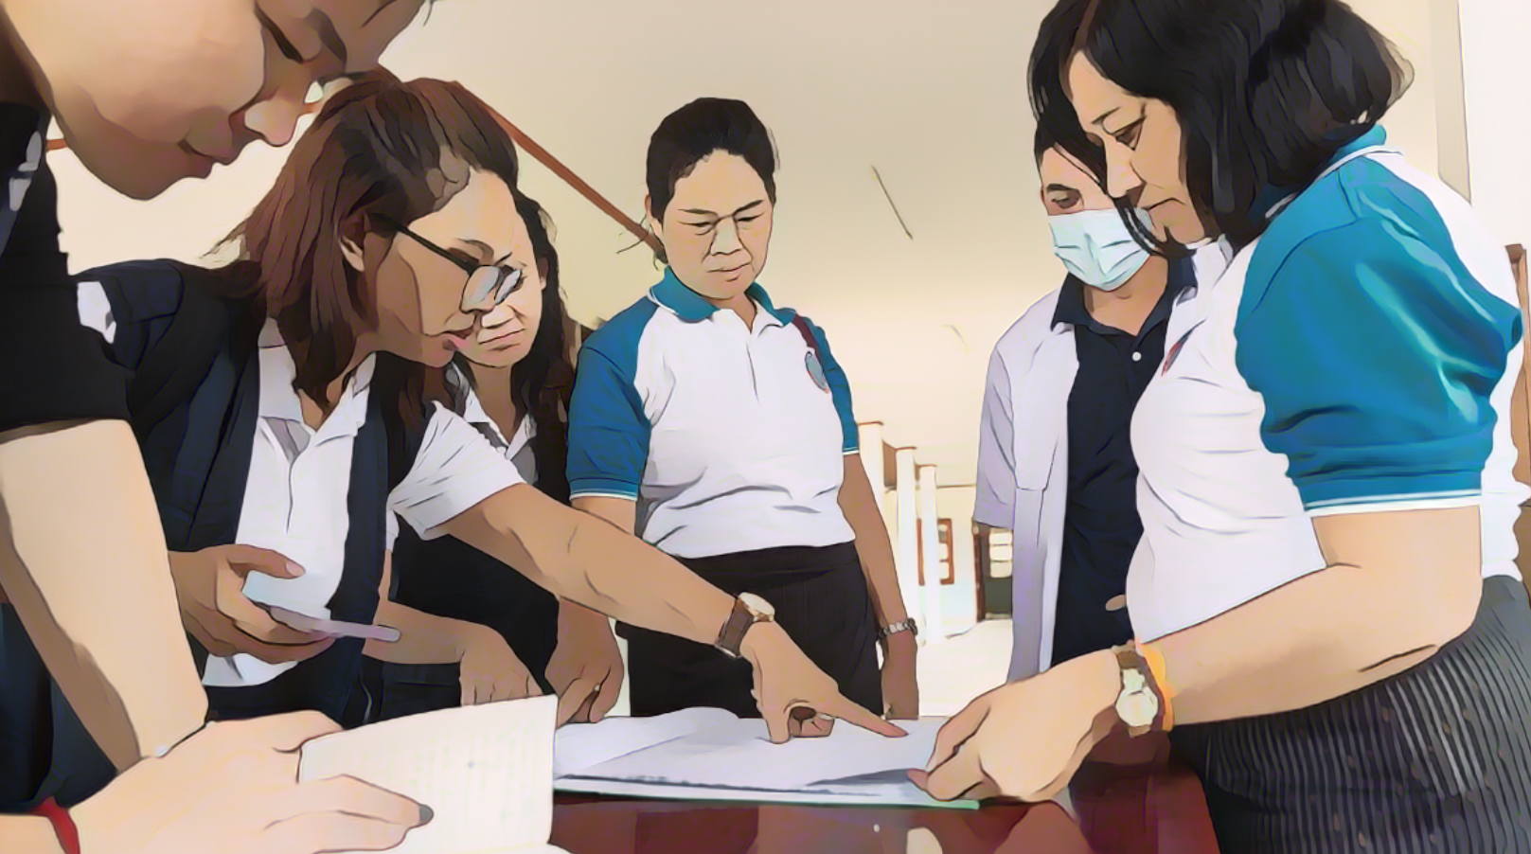
Objectives
of cholera surveillance
Photo adapted from: WHO /Enric Catala
Notes:
Let’s look into the objectives of cholera surveillance more specifically.

Slide 8


Overview
Cholera surveillance generates information to guide an effective response to
reduce the number of cholera cases and deaths, and limit the spread of the disease
Depending on the cholera situation in an area,
the surveillance objectives evolve
  In geographic areas without an outbreak
    Surveillance is for the early detection of any new outbreak for rapid response
  In geographic areas with an outbreak that is not yet widespread (“cases in cluster”)
    Surveillance is to track clusters to stop transmission with targeted interventions
  In geographic areas with an outbreak (“community transmission”)
    Surveillance is to monitor the outbreak to guide the response
Notes:
The general objective of cholera surveillance is always to generate information to guide an effective public health response in order to reduce the number of cholera cases and cholera deaths and limit the spread of cholera.
Then, depending on the cholera situation in a local geographic area, the specific objectives of cholera surveillance evolve.
In geographic areas where there is no ongoing cholera outbreak, surveillance aims to detect any cholera outbreak early so that it can be responded to rapidly.
In geographic areas where a cholera outbreak is starting but has not yet spread in the community and cholera cases are occurring in clusters, surveillance aims to track the clusters in order to interrupt transmission with highly targeted interventions around the cases.
Lastly, in geographic areas where there is an ongoing cholera outbreak, surveillance aims to monitor the outbreak in order to guide the public health response.

Slide 9


Early detection
Outbreaks detected early can be controlled rapidly
Spread & impact mitigated
Notes:
Early detection is an essential surveillance objective because when outbreaks are detected early, they can be controlled rapidly which is critical to mitigate their spread and their impact.

Slide 10
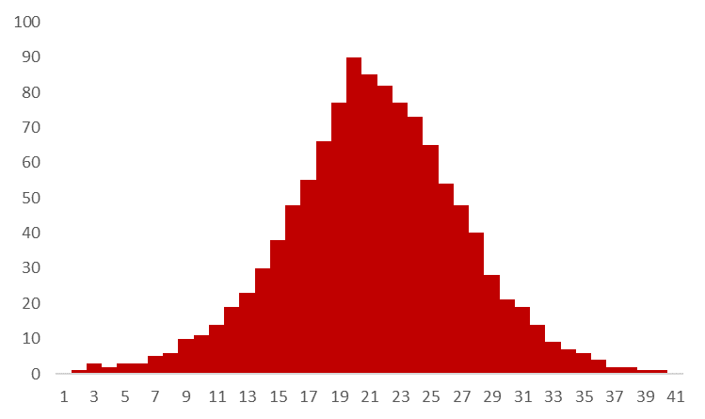
Early detection
Illustration
Late
response
Late
detection
Number of cases
Days
Notes:
Let’s illustrate the importance of early detection with a fictive example.
This epidemic curve represents the potential number of cholera cases by day if a cholera outbreak was detected with delay which would result in a delayed public health response.

Slide 11
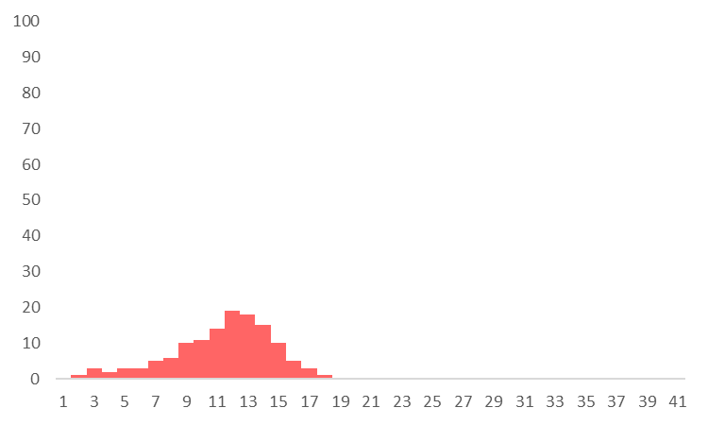
Early detection
Illustration
Early
detection
Number of cases
Rapid
response
Days
Notes:
On the other hand, this epidemic curve represents the potential number of cholera cases by day if an outbreak was detected early which would enable a rapid public health response.

Slide 12

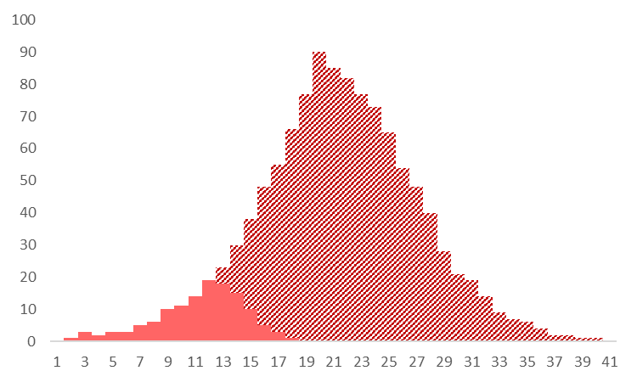
Early detection
Illustration
Early
Delayed
Potential cases prevented with early detection and rapid response
Number of cases
Days
Notes:
If we compare the number of cases by day in these two situations, we can see that with early detection and rapid response, the number of cholera cases remained much lower compared to if the outbreak would have been detected and responded to with delay. This illustrates that early detection and rapid response help prevent further cholera cases.

Slide 13
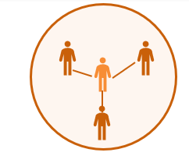

Tracking clusters
Cluster
  A group of cases
    infected one another
    or
    got infected by the same source
Cluster
  Usually at the very early stage of an outbreak
    Following cholera introduction in a new geographic area
With robust surveillance and highly targeted interventions, it is possible to interrupt transmission at cluster stage before it spreads in the community
Widespread outbreak in the community
Notes:
Moving on to cholera clusters and the surveillance objective in that situation.
There is a cholera cluster when a group of cases infected one another or got infected by the same source. Clusters are more likely to occur at the very early stages of an outbreak following the introduction of cholera in a new geographic area.
If clustered transmission is not interrupted rapidly, cholera might spread in the community and cause a large outbreak that would be more challenging to control.
With robust surveillance that can guide highly targeted interventions around cases, it is possible to interrupt transmission at cluster stage before it spreads in the community.

Slide 14
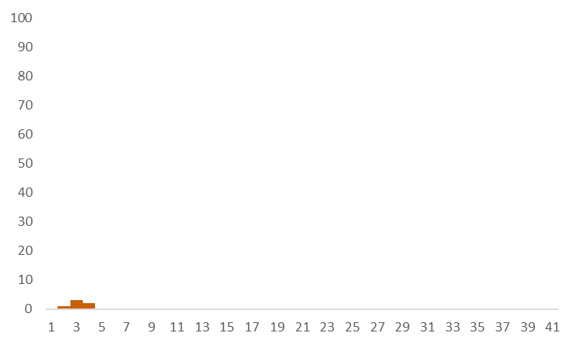
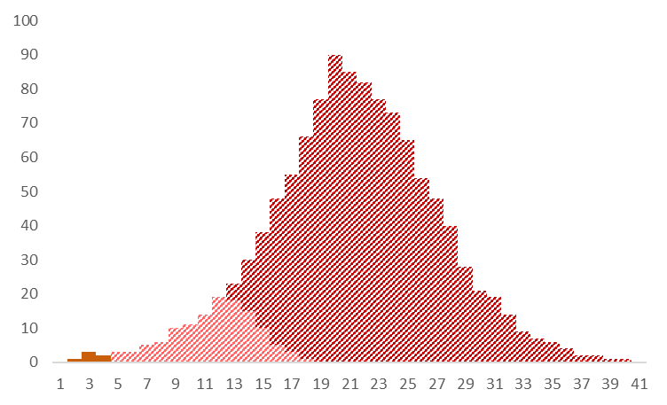
Tracking clusters
Illustration
Potential cases prevented by interrupting transmission at cluster stage
Number of cases
Transmission interrupted at cluster stage
Days
Notes:
Going back to our previous example, if surveillance is sufficiently performant to track clusters in order to guide highly targeted interventions around cases, then the number of cholera cases that can be prevented is even higher.

Slide 15
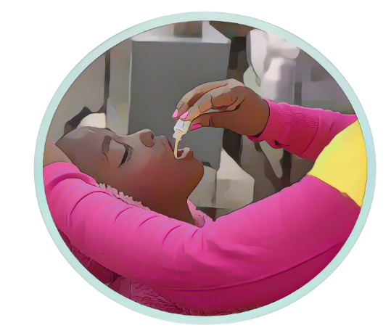
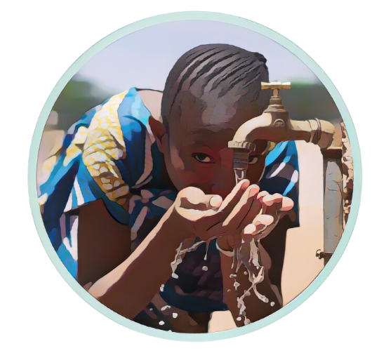
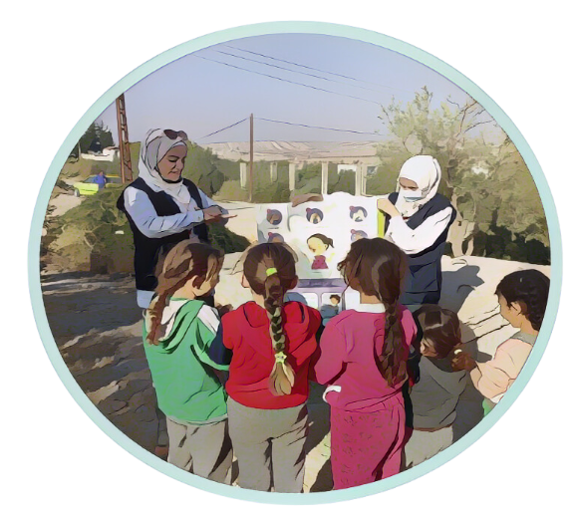
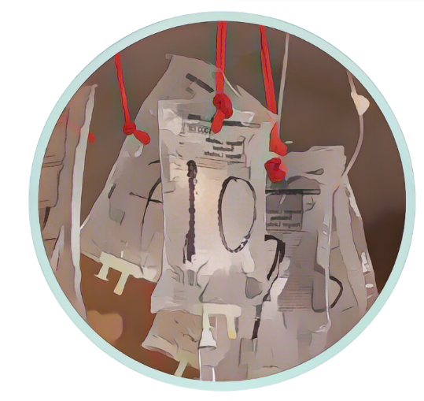

Monitoring outbreaks
During an outbreak, the information generated by surveillance is used to
target multisectoral strategies to control the outbreak
Surveillance guides interventions across all pillars
  Vaccination campaigns, water, sanitation and hygiene (WaSH), community engagement, case management
Notes:
As the last surveillance objective, during an outbreak, if cholera has spread in the community, surveillance continuously generates information that is directly used to target effective multisectoral strategies to control and end the outbreak.
Surveillance is pivotal to guide interventions across all cholera control and prevention pillars from vaccination campaigns, to water, sanitation and hygiene efforts, community engagement, and case management.

Slide 16
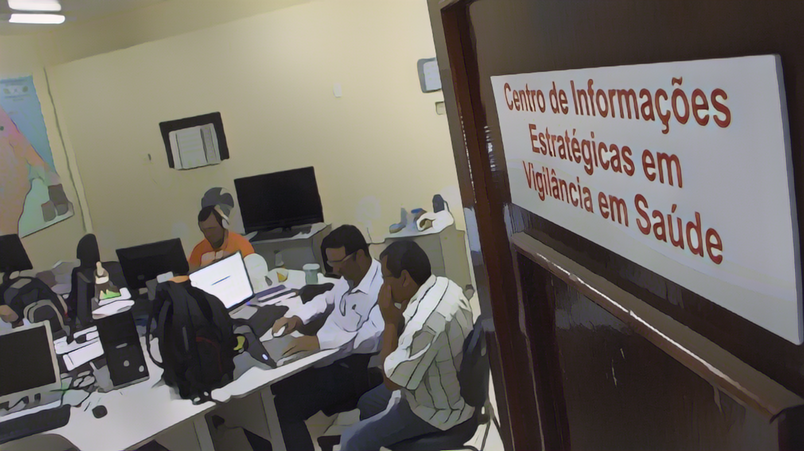
Health authorities’ role
in cholera surveillance
Photo adapted from: WHO / Julio Takayama
Notes:
Health authorities play a pivotal role in cholera surveillance. Let’s see why.

Slide 17

Adaptive surveillance
Different cholera situations
Different surveillance objectives
Different surveillance strategies to reach the surveillance objective
Adaptive cholera surveillance
Surveillance strategies adapted locally depending on the cholera situation in “surveillance units”
Surveillance units
Lowest administrative level at which decisions are made on cholera prevention and control
Corresponding administrative level is country-specific
  Typically, administrative levels 2 or 3
Notes:
Cholera surveillance is adaptive.
We have just seen that depending on the cholera situation, the objectives of surveillance evolve. As a result, the surveillance strategies to achieve the corresponding objectives also evolve depending on the cholera situation.
Adaptive surveillance means that surveillance strategies are adapted locally depending on the ongoing cholera situation. The local level considered is the surveillance unit level.
The surveillance unit level corresponds to the lowest administrative level at which decisions are made regarding cholera prevention and control in a given country. The corresponding level is determined by each country in its specific context.
Typically, countries often select administrative level 2 or administrative level 3 as their surveillance unit level. However, different levels may also be considered depending on what’s most appropriate in a specific country.

Slide 18
Adaptive surveillance
Illustration
Units where there is an ongoing cholera outbreak
(community transmission)
Surveillance aims to monitor the outbreak
Unit where there is a cluster of cholera cases
Surveillance aims to track the cluster
Units where there is no ongoing cholera outbreak
Surveillance aims to detect any outbreak early
Notes:
Let’s illustrate the principle of adaptive surveillance with a fictive example.
This map represents the surveillance units of a fictional country. The southern part of this country is regularly affected by cholera outbreaks whilst the northern part has not been affected by large cholera outbreaks in decades.
Currently, in the southern part of the country, there is an ongoing cholera outbreak in several surveillance units. Those are represented in red on the map. In these surveillance units, the current surveillance objective is to monitor the outbreak to generate information to orient control measures to mitigate the impact and the spread of cholera.
In the northern part of the country, there is an ongoing cholera cluster in one surveillance unit. This surveillance unit is represented in orange on the map. In this unit, the current surveillance objective is to track this cluster in order to interrupt transmission before it becomes widespread in the community and more challenging to control.
In other surveillance units of the country, currently there is no cholera outbreak. Those are represented in yellow on the map. In these surveillance units, the current surveillance objective is to detect any cholera outbreak early in order to trigger rapid response measures.
Because the cholera situation is heterogenous in this country, different surveillance strategies currently apply in different surveillance units. This is adaptive cholera surveillance.

Slide 19

Local level health authorities
Because cholera surveillance is adapted at the LOCAL level,
LOCAL health authorities play a pivotal role in its implementation
Local health authorities ensure that, at all times, cholera surveillance is:
Adapted to the ongoing cholera situation
Effectively implemented
Used to guide prevention & control
Notes:
Because cholera surveillance is continuously adapted to the ongoing cholera situation at the local level of surveillance units, local health authorities play a pivotal role to coordinate the implementation of adaptive surveillance.
Local health authorities ensure that at all times, in all surveillance units they are responsible for, surveillance is:
Adapted to the ongoing cholera situation;
Effectively implemented in accordance with applicable surveillance strategies;
Continuously used to guide public health measures to prevent and control cholera.

Slide 20

Operationalisation
Adaptive surveillance is implemented in a stable surveillance system
Stability
Adaptability
Some strategies are adapted depending on the local
cholera situation
Some core functions are implemented at all times
Notes:
Importantly, although adaptive, cholera surveillance is implemented within a stable surveillance system.
Some surveillance core functions are implemented at all times independent of the cholera situation. This is the backbone of a robust and stable surveillance environment.
Some surveillance strategies are then adapted in a dynamic manner depending on the local cholera situation. This ensures that surveillance continuously achieves its objectives in an effective and efficient manner.

Slide 21

Learn more
Stability
Core functions applicable at all times
Module 2. Core functions of health authorities in cholera surveillance
Surveillance strategies adapted to the local cholera situation
Adaptability
Module 3. Surveillance for early detection
Module 4. Surveillance to monitor outbreaks
Module 5. Surveillance to track clusters
Case studies
Notes:
In the next modules, you will learn more about the role of health authorities in cholera surveillance.
In module 2, we will walk you through the core surveillance functions that health authorities implement at all times.
Then, in the following modules, we will walk you through specificities to implement cholera surveillance depending on the ongoing cholera situation and the corresponding surveillance objective.
In Module 3, we will focus on surveillance for the early detection of cholera outbreaks.
In module 4, we will address surveillance to monitor cholera outbreaks.
Lastly, in module 5, we will cover surveillance to track cholera clusters.
Case studies will be offered in modules 3 to 5 to dive into the surveillance specificities depending on the ongoing cholera situation.

Slide 22
Wrap up
Depending on the cholera situation, surveillance has different objectives
  Detect cholera outbreaks early so that they can be controlled rapidly
  Monitor cholera outbreaks to generate information to guide effective control strategies
  Track cholera clusters to interrupt transmission before spread in the community
Surveillance strategies are adapted according to the cholera situation at the local level of “surveillance units”
Health authorities ensure that cholera surveillance is effectively implemented in each surveillance unit according to the ongoing cholera situation
Notes:
As we wrap up this module, here are the important points to remember.
Depending on the cholera situation, surveillance has different objectives:
detecting cholera outbreaks early so that they can be controlled rapidly;
monitoring cholera outbreaks to generate information to guide effective strategies to control outbreaks;
tracking cholera clusters to interrupt transmission before cholera spreads in the community.
Surveillance strategies are adapted in a dynamic manner according to the cholera situation at the local level of “surveillance units”.
Health authorities are responsible for ensuring that surveillance is effectively implemented in each surveillance unit according to applicable strategies depending on the ongoing local cholera situation.

Slide 23

Notes:
Before moving on to the next module, we encourage you to take a short quiz. There are three questions in this quiz.

Slide 24

Question 1
In surveillance units where there is no cholera outbreak, surveillance is for the:
    a) Early detection of outbreaks
    b) Monitoring of outbreaks
    c) Tracking of clusters
This is critical to:
    d) Generate information to guide effective interventions across all cholera control pillars
    e) Interrupt transmission before cholera spreads in the community
    f) Respond rapidly to any new outbreak to mitigate its spread and impact
Notes:
Question 1. In surveillance units where there is no cholera outbreak, surveillance is for the:
a) Early detection of outbreaks
b) Monitoring of outbreaks
c) Tracking of clusters
This is critical to:
d) Generate information to guide effective interventions across all cholera control pillars
e) Interrupt transmission before cholera spreads in the community
f) Respond rapidly to any new outbreak to mitigate its spread and impact

Slide 25

Question 1 – Answers
In surveillance units where there is no cholera outbreak, surveillance is for the:
    a) Early detection of outbreaks
    b) Monitoring of outbreaks
    c) Tracking of clusters
This is critical to:
    d) Generate information to guide effective interventions across all cholera control pillars
    e) Interrupt transmission before cholera spreads in the community
    f) Respond rapidly to any new outbreak to mitigate its spread and impact
Notes:
The correct answers are a and f. In surveillance units where there is no cholera outbreak, surveillance is for the early detection of outbreaks, this is critical to respond rapidly to any new outbreak to mitigate its spread and impact.

Slide 26
Question 2
In surveillance units where there is a cholera outbreak, surveillance is for the:
    a) Early detection of outbreaks
    b) Monitoring of outbreaks
    c) Tracking of clusters
This is critical to:
    d) Generate information to guide effective interventions across all cholera control pillars
    e) Interrupt transmission before cholera spreads in the community
    f) Respond rapidly to any new outbreak to mitigate its spread and impact
Notes:
Question 2. In surveillance units where there is a cholera outbreak, surveillance is for the:
a) Early detection of outbreaks
b) Monitoring of outbreaks
c) Tracking of clusters
This is critical to:
d) Generate information to guide effective interventions across all cholera control pillars
e) Interrupt transmission before cholera spreads in the community
f) Respond rapidly to any new outbreak to mitigate its spread and impact

Slide 27
Question 2 – Answers
In surveillance units where there is a cholera outbreak, surveillance is for the:
    a) Early detection of outbreaks
    b) Monitoring of outbreaks
    c) Tracking of clusters
This is critical to:
    d) Generate information to guide effective interventions across all cholera control pillars
    e) Interrupt transmission before cholera spreads in the community
    f) Respond rapidly to any new outbreak to mitigate its spread and impact
Notes:
The correct answers are b and d. In surveillance units where there is a cholera outbreak, surveillance is for the monitoring of the outbreak. This is critical to generate information to guide effective interventions across all cholera control pillars.

Slide 28
Question 3
In surveillance units where cholera has just been introduced and hasn’t yet spread in the community, surveillance is for the:
    a) Early detection of outbreaks
    b) Monitoring of outbreaks
    c) Tracking of clusters
This is critical to:
    d) Generate information to guide effective interventions across all cholera control pillars
    e) Interrupt transmission before cholera spreads in the community
    f) Respond rapidly to any new outbreak to mitigate its spread and impact
Notes:
Question 3. This is the last question. In surveillance units where cholera has just been introduced and hasn’t yet spread in the community, surveillance is for the:
a) Early detection of outbreaks
b) Monitoring of outbreaks
c) Tracking of clusters
This is critical to:
d) Generate information to guide effective interventions across all cholera control pillars
e) Interrupt transmission before cholera spreads in the community
f) Respond rapidly to any new outbreak to mitigate its spread and impact

Slide 29
Question 3 – Answers
In surveillance units where cholera has just been introduced and hasn’t yet spread in the community, surveillance is for the:
    a) Early detection of outbreaks
    b) Monitoring of outbreaks
    c) Tracking of clusters
This is critical to:
    d) Generate information to guide effective interventions across all cholera control pillars
    e) Interrupt transmission before cholera spreads in the community
    f) Respond rapidly to any new outbreak to mitigate its spread and impact
Notes:
The correct answers are c and e. In surveillance units where cholera has just been introduced and hasn’t yet spread in the community, surveillance is to track clusters. This is critical to interrupt transmission before cholera spreads in the community.

Slide 30

Notes:
We have now completed this module.

