Slide 1
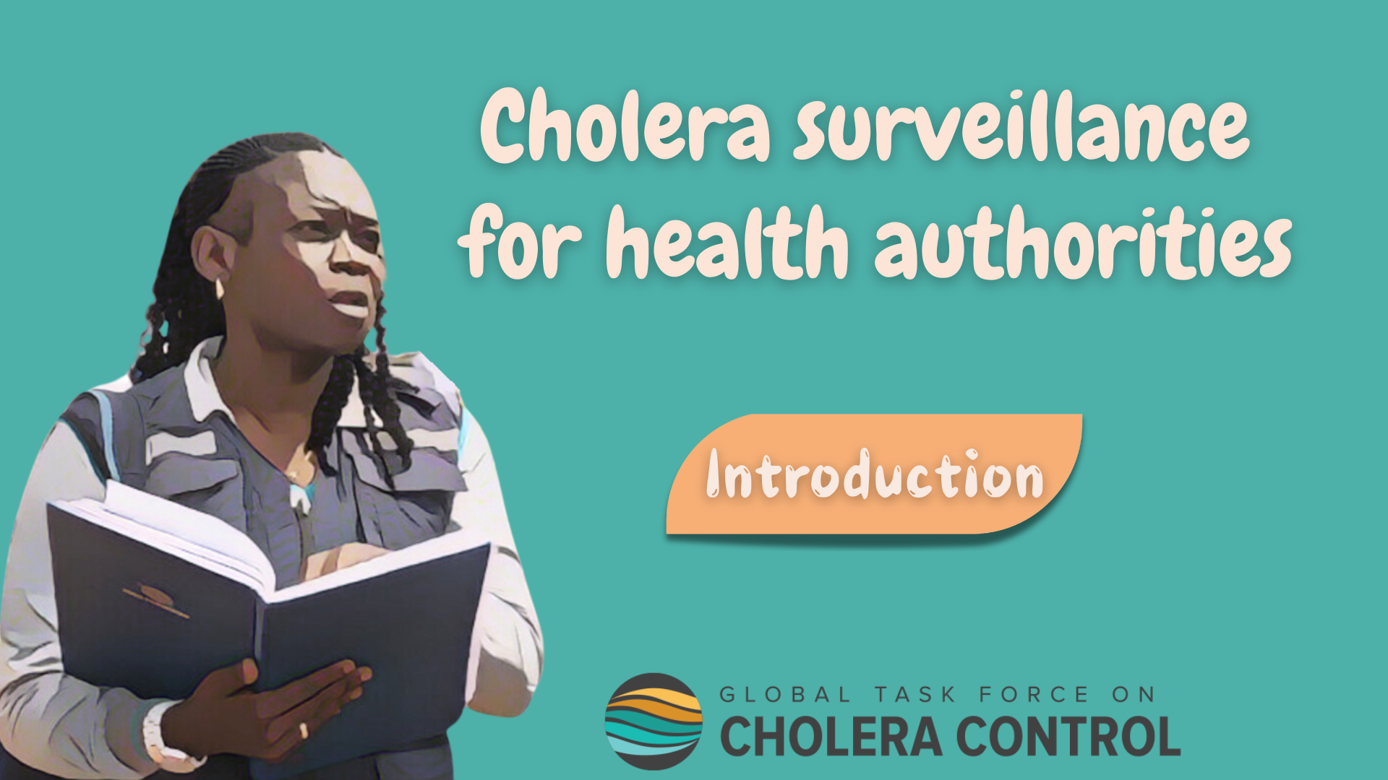
Notes:
Welcome to the GTFCC online course on cholera surveillance for health authorities.

Slide 2
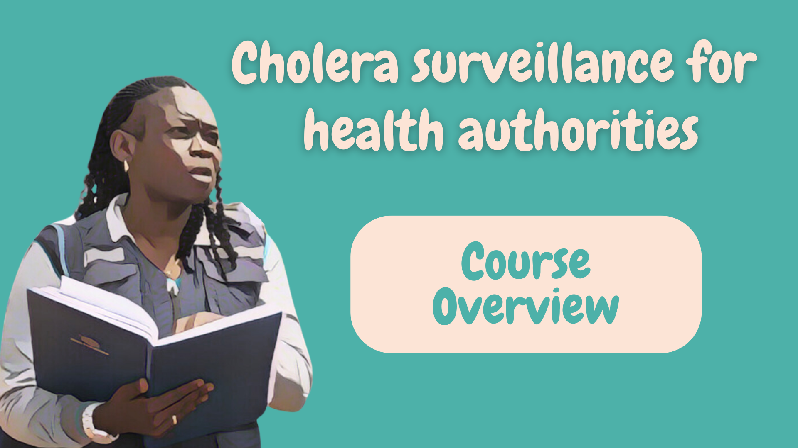
Notes:
This module provides an overview of the course, and will help you get ready to take this course.

Slide 3

Who is this course for?
Health authorities' officers
Who implement or oversee the implementation of public health surveillance for cholera at the local, subnational, or national level
Partners or stakeholders
Who support or advise health authorities in implementing public health surveillance for cholera at the local, national, international level
(e.g., epidemiologists, public health officers, data analysts, etc)
Notes:
This course is for health authorities’ officers who implement or oversee the implementation of public health surveillance for cholera at the local, subnational, or national level.
Partners or stakeholders who support or advise health authorities in implementing public health surveillance for cholera at the local, national, or international level will also greatly benefit from this course. For example, epidemiologists, public health officers, data analysts, and so on.

Slide 4
What will you learn?
Objectives of cholera surveillance
Key role of health authorities in cholera surveillance
How health authorities:
  Monitor that surveillance strategies are effectively implemented
  Analyze and interpret surveillance data
  Perform case investigation and field investigation
  Disseminate findings to guide control and prevention measures
Access supplementary resources on cholera surveillance
Notes:
In this course, you will learn about:
The objectives of cholera surveillance;
The key role that health authorities play in cholera surveillance;
Including how health authorities monitor that surveillance strategies are effectively implemented;
How health authorities analyze and interpret surveillance data;
When and how health authorities perform case investigation and field investigation;
How health authorities guide effective control and prevention measures by disseminating the findings of surveillance;
And, where to access supplementary resources about cholera surveillance.

Slide 5

What are the modules?
2h30
15’
25’
35’
Module 1
Role of health authorities in cholera surveillance
Module 2
Core functions of health authorities in cholera surveillance
Module 3
Surveillance for the early detection of cholera outbreaks
40’
30’
5’
Module 4
Surveillance to monitor cholera outbreaks
Module 5
Surveillance
to track cholera clusters
Module 6
Resources
Notes:
There are six modules in this course.
Module 1 outlines the important role that health authorities play in cholera surveillance.
Module 2 goes through the core functions of health authorities in cholera surveillance These are functions that are always implemented regardless of the cholera situation.
Module 3 focuses on cholera surveillance to ensure the early detection of an outbreak.
Module 4 focuses on cholera surveillance to monitor an outbreak.
Module 5 focuses on cholera surveillance to track clusters.
Lastly, Module 6 introduces supplementary resources.
This course takes about 2 hour and a half to complete.

Slide 6


How to nagivate this course?
Modules 1 & 2
Modules 3 to 5
Generic
Context-specific
Do not depend on the cholera situation
Depend on the cholera situation
Include case studies to illustrate surveillance specificities
Take Modules 1 & 2
before Modules 3 to 5
Notes:
Module 1 and Module 2 address generic principles for cholera surveillance. These are principles which always apply independent of the ongoing cholera situation.
Module 3 to Module 5 focus on context-specific surveillance recommendations. These are recommendations which depend on the ongoing cholera situation at a local level. Case studies are offered in these modules to illustrate surveillance specificities in each situation.
We recommend you take Module 1 and Module 2 before moving on to Modules 3 to 5.

Slide 7


How to use this course?
Course based on the recommendations on cholera surveillance of the Global Task Force on Cholera Control (GTFCC)
Does not substitute for national or local protocols
Notes:
This course is based on the recommendations on cholera surveillance of the Global Task Force on Cholera Control (GTFCC).
Bear in mind that the recommendations of the GTFCC do not substitute for the national or local surveillance protocols and mechanisms applicable in your country.

Slide 8



Get additional support
For any question on cholera surveillance or for technical assistance,
contact the GTFCC Secretariat
GTFCCsecretariat@who.int
Notes:
For any questions or to request technical assistance on cholera surveillance, we invite you to contact the GTFCC Secretariat at GTFCCsecretariat@who.int; we are here to support you.

Slide 9

Notes:
We have now completed this brief introduction.

