Slide 1

Notes:
Welcome to Module 4 of the GTFCC online course on the identification of PAMIs for cholera elimination.

Slide 2

Notes:
In this module, we will provide you some insights on how to organize a successful PAMI stakeholder validation.

Slide 3

What will you learn?
Objectives of the stakeholder validation
How to prepare a PAMI validation workshop
How to run a PAMI validation workshop
How to foster consensus on the list of PAMIs
Notes:
After completing this module, you will be able to:
Explain the objectives of the stakeholder validation;
Describe how to prepare a PAMI validation workshop;
Describe how to run a PAMI validation workshop;
And, understand approaches to foster consensus on the list of PAMIs.

Slide 4

Stakeholder validation
              Objectives
                Endorse the vulnerability factors & measurable indicators
                Complement missing data
                Select a vulnerability index threshold
              Expected outcome
                Final list of PAMIs
                Buy-in from all parties
              Preferred format
    On-site workshop (e.g., 3 days)
    Fosters participative discussions
    Encourages collaboration across sectors / stakeholders
Notes:
The PAMI stakeholder validation is an important moment for the identification of PAMIs for cholera elimination. This is when the vulnerability factors and measurable vulnerability indicators are endorsed, any remaining missing data are complemented and finally a vulnerability index threshold is selected.
The outcome of a successful stakeholder validation is the final list of PAMIs with strong buy-in from all parties.
To achieve the validation of PAMIs in a participative manner, it is recommended that the stakeholder validation be organized in the form of an on-site workshop.
Experience shows that a 3-day workshop is ideal to achieve stakeholder validation.
A key benefit of hosting the stakeholder validation as an onsite workshop is not only to foster participative discussions. Experience shows that onsite PAMI workshops also encourage collaboration across stakeholders which is essential for the successful continuation of the NCP process.

Slide 5
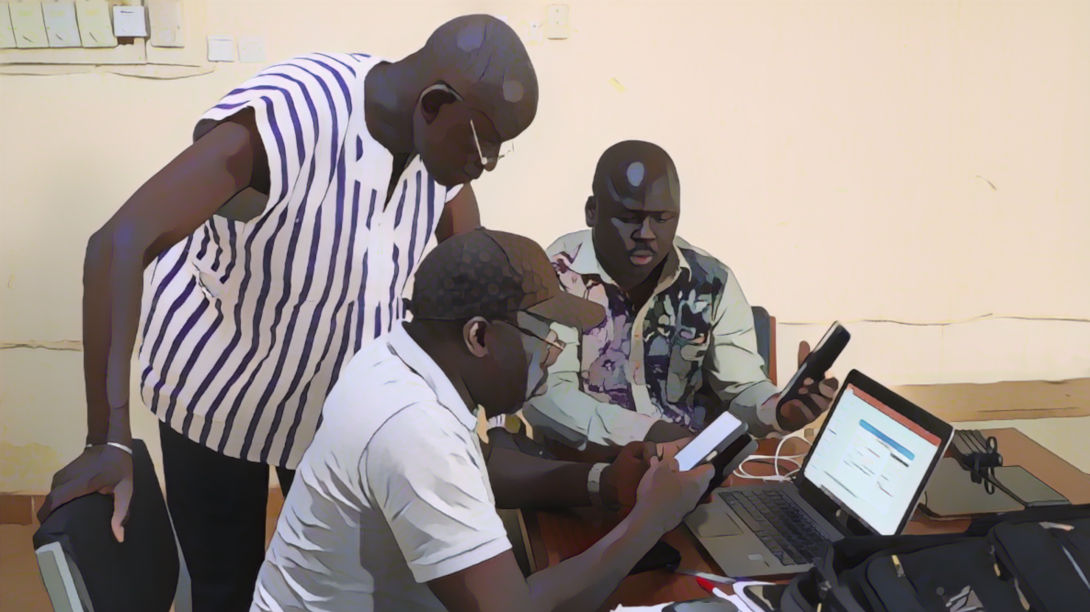
Preparation of
stakeholder validation
Photo adapted from: WHO/Francine Tchouta
Notes:
Critical to a successful PAMI validation workshop is a thorough preparation of this important event.

Slide 6

Preparation steps
Preparation and anticipation are key success factors
Identify relevant stakeholders to be invited
Prepare the agenda
Send out the invitations
Arrange the logistics
Prepare the supporting material/visuals
Confirm and brief speakers and facilitators
Appoint and brief a chair
Identify and brief note-takers
Notes:
Careful preparation and anticipation are key success factors.
Plan ahead to identify relevant stakeholders to be invited, prepare the agenda. Make sure to send out invitations well in advance to maximize attendance. Make the necessary arrangements for the logistics of the workshop. Prepare the supporting material and the visuals that will be displayed at the workshop. Confirm and brief speakers and facilitators. Do not forget to appoint and to brief a chair, and make sure to identify and to brief note-takers.

Slide 7

Participants
The stakeholder validation is multisectoral
  Multiple sectors
    Public health
    Water, Hygiene, and Sanitation (WaSH)
    Finance
    Etc
  Various levels
    National
    Sub-national
  Organizations and partners playing a key role in cholera elimination
Notes:
When establishing the list of participants, make sure that the PAMI validation will be as multisectoral as possible. Consider inviting multiple sectors beyond the public health sector, such as WASH, finance, and so on. It is also advisable to invite representatives from different levels, ensuring that both the national level and subnational levels are represented.
Overall, make sure that all organizations and partners that play an active role in cholera elimination in your country are given a chance to be involved in the PAMI validation.

Slide 8

Example of agenda
Indicative only
Day 1. Set the scene
Welcome and introduction / icebreaker
Opening remarks
Update on cholera in the country
  Epidemiological situation
  Strategies to control/eliminate cholera - Progress & challenges
  Pillar-specific updates
GTFCC method to identify PAMIs for cholera elimination
Outcomes of the data driven PAMI identification phase
  Vulnerability factors selected and associated measurable indicators and data sources
  Key findings and limitations
Notes:
Here is an example of a possible agenda for a PAMI workshop. Of course, this is indicative and is only provided as a basis for customization.
The focus of the first day can be to set the scene, as all participants may not yet be familiar with PAMIs.
As background, updates on the cholera situation in your country can be presented covering the epidemiological situation, the strategies against cholera that have been implemented, along with the progress achieved and the challenges that have been faced. Cholera pillar-specific updates may also be very insightful.
Then, you can bring participants up to speed on PAMI identification by walking them through the PAMI identification method.
Lastly, present the outcomes of the first phase of PAMI identification, including the vulnerability factors selected and associated measurable indicators and data sources.
Bring up for discussion, not only the key findings of the first phase of PAMI identification, but also and as importantly their potential limitations.

Slide 9
Example of agenda
Indicative only
Day 2. Discuss the list of PAMIs in a participative manner
Calculations of vulnerability index
  Complement missing data as needed based on a qualitative assessment
  Determine whether weights should be given to vulnerability factors
Vulnerability index threshold
  Plenary session to introduce scenarios for the vulnerability index threshold
  Group sessions to assess the scenarios
  Plenary reporting from each group
Notes:
The focus of the second day can be on discussing the list of PAMIs in a participative manner.
This includes finalizing calculations of the vulnerability index by complementing any remaining missing data based on a qualitative assessment building on participants’ knowledge, and determining whether any weights should be applied to some vulnerability factors in the calculations.
To discuss how to set the vulnerability index threshold, different scenarios can be outlined in a plenary session. Then, these scenarios can be discussed in group sessions. Each group can then report in a plenary session on its thoughts and findings.

Slide 10
Example of agenda
Indicative only
Day 3. Reach consensus on the list of PAMIs & organize next steps
Wrap up of Day 2
  Address any pending questions
  Decide on the vulnerability index threshold
Plan immediate next steps
  Role, responsibilities, timelines for the PAMI identification report
  Timelines and responsible stakeholder for requesting a GTFCC PAMI review
Set the way forward
  Way forward and timelines for NCP development
Closing remarks
Notes:
The third and last day of the workshop is the moment to reach an agreement among all participants on the final list of PAMIs and to get organized for next steps.
Building on outcomes from day 2, a consensus should be reached on the vulnerability index threshold.
The next steps to be organized are the preparation of the report on PAMI identification and of the request for a GTFCC PAMI review. For those, roles and responsibilities should be assigned, and timelines should be set.
Lastly, the way forward for NCP development should also be discussed.

Slide 11
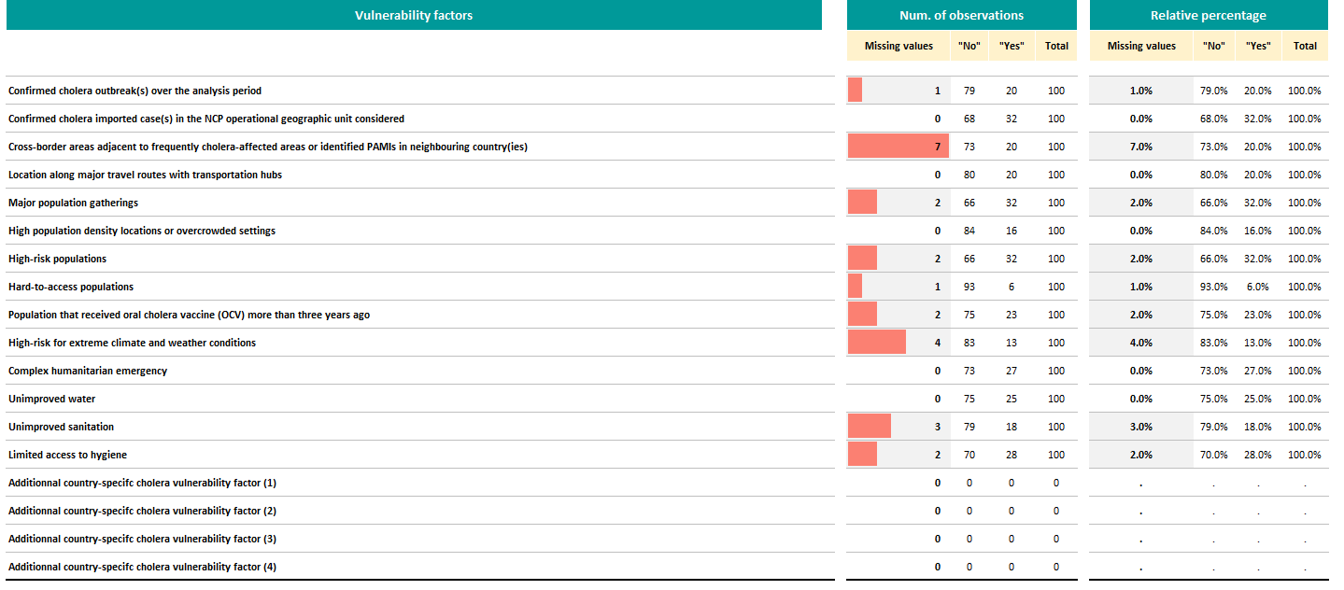
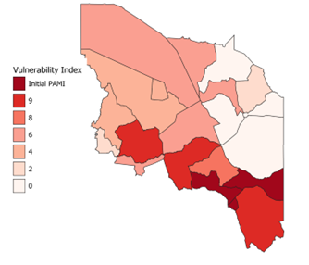
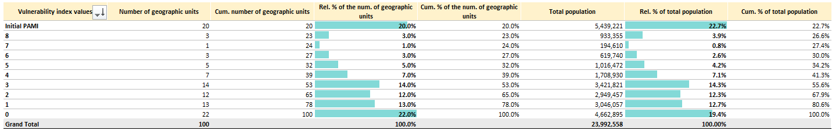
Supporting material
Prepare visuals to streamline discussions and decisions on PAMIs
    Sheet R.3 of the PAMI Excel tool
    Missing data overview
    To ensure all missing data get filled
Shapefile
Include vulnerability index in a shapefile
To map PAMIs
    Sheet R.2 of the PAMI Excel tool
    Vulnerability Index Summary
    To guide discussions on the index threshold
Geo units by vulnerability index value
Fictive country
Notes:
As part of the preparation of the workshop, visuals and supporting material that will be displayed at the workshop should be prepared in advance.
At a minimum, this should include supporting material to discuss missing values, for example sheet R3 of the PAMI Excel tool as well as figures for setting the vulnerability index threshold, for example similar to sheet R2 of the PAMI Excel tool.
In addition, shapefiles should also be prepared in order to map PAMIs.

Slide 12

Tips to run a
stakeholder validation
Photo adapted from: WHO/Francine Tchouta
Notes:
We will now go through a few tips to run a successful stakeholder validation.

Slide 13
Ojective decision making
The chair & facilitators play a key role in fostering decision-making
based on data and oriented towards operational implications
Display the supporting material/visuals prepared prior to the workshop
Encourage participants to back up personal opinions with facts
Discuss the practical and operational implications
Notes:
The chair and the facilitators play a key role to keep a sound decision-making process on track. This means ensuring that decisions on PAMIs are grounded on data and take into account operational implications.
To keep a sound decision-making process on track, displaying the supporting material and the visuals prepared ahead of the workshop helps focus the attention and the discussions on data.
In addition, the chair and the facilitators should encourage participants not to bring up personal opinions or impressions but as much as possible documented facts.
Lastly, it is essential that the practical and operational dimensions of PAMI identification be carefully considered in the decision-making process, in particular the feasibility of the NCP.

Slide 14
Group sessions
Benefits
  Increases opportunities for all participants to actively engage in the discussions
  Channel convergent expertise and knowledge for time-effective discussions
Groups’ composition
    By region
      Useful to complement missing data based on local knowledge for specific geo units
      Facilitates discussions on local context and specific challenges
    By cholera prevention & control pillar
      Facilitates technical discussions on feasibility and practical considerations
Tips for effective group sessions
  Explain objectives and provide guiding questions to each group
  Assign roles (facilitator, note-taker, rapporteur)
Notes:
Group sessions in break-out are useful tools for a participative and engaging process.
Group sessions give all participants greater opportunities to actively engage in the discussions compared to plenary sessions. In addition, group sessions can make the discussions more time effective by bringing together in a group, the participants who have convergent expertise and knowledge.
Groups can be formed by regions; this is helpful for example to complement missing data based on local knowledge for specific geographic units with remaining missing data; this may also facilitate discussions on local context and specific challenges.
Alternatively, groups can also be formed by cholera prevention and control pillar. This is helpful for example to discuss technical and practical considerations.
For group sessions to be effective and fully beneficial, it is essential that each group be briefed on the objective of the session and be provided with an outline to structure the discussions such as guiding questions.
In addition, a facilitator, a note-taker, and a rapporteur should be designated in each group.

Slide 15
Documentation
        Discussions and decisions along with supporting justifications are documented
        throughout the workshop for traceability of the decision-making process
Key role of note takers
  Record the discussions
  Flag decisions made without sufficient justification
  Keep track of any unresolved discussions to ensure they get addressed
Tips for note takers
  Use a copy of sheet R4 of the PAMI Excel tool to record discussions on specific geo units
  Columns may be added as needed
Notes:
Throughout the workshop, discussions, decisions, and justifications for the decisions should be documented for traceability of the decision-making process.
Note takers play a key role in ensuring comprehensive record keeping.
In addition, during the workshop, note takers also support the chair and facilitators by flagging any decisions made without sufficient justifications. They also keep track of any unresolved discussions and make sure that they get addressed and solved.
Note takers are encouraged to use the sheet R4 of the PAMI Excel tool to record discussions on specific geographic units. To that end, they may add columns in sheet R4 as needed.

Slide 16

Consensus building
at the stakeholder validation
Photo adapted from: WHO/ Tini Media
Notes:
Decisions on PAMIs are always made by consensus. We will walk you through the approaches that can facilitate consensus building.

Slide 17
Consensus
        Consensus means that all participants are overall onboard with the decision
Participants should reach a consensus on:
      Vulnerability factors, measurable indicators, data sources
      Whether weights should be given to vulnerability factors
      Presence/absence of vulnerability factors in geo units with missing data
      Vulnerability index threshold
Reaching consensus is facilitated by objective decision-making
    Ground discussions on data and operational implications to limit divergent opinions that may rely on personal impressions or unrealistic aspirations
Notes:
Reaching a consensus means that all participants are overall onboard with the decisions.
At the workshop, a consensus should be reached on four main dimensions:
The relevance of vulnerability factors selected and associated measurable indicators and data sources;
Whether weights should be given to vulnerability factors in the calculation of the index;
The presence or absence of vulnerability factors in geographic units with remaining missing data;
The vulnerability index threshold.
As a general principle, consensus building is facilitated by objective decision-making grounded on data and operational considerations. This helps keep the decision-making process on track, setting aside personal opinions or impressions as well as unrealistic aspirations.

Slide 18
Consensus on vulnerability factors & indicators
        The vulnerability factors and measurable vulnerability indicators
        and associated data sources are endorsed by consensus
List of vulnerability factors
Justifications for any generic factor from the GTFCC indicative list not included
Relevance in the country-specific context of any additional vulnerability factor
Definitions of measurable vulnerability indicators & data sources
Reviewed and adapted if needed
Notes:
The list of vulnerability factors considered relevant in the country-specific context, together with their measurable vulnerability indicator and associated data source should be endorsed by consensus.
A consensus should be reached on the rationale for not considering any vulnerability factor from the GTFCC indicative list of generic vulnerability factors.
A consensus should also be reached on the rationale for considering in the analysis any additional vulnerability factor not included in the indicative list.
The definitions of measurable vulnerability indicators and associated data sources should also be reviewed and adapted as needed for endorsement.

Slide 19
Consensus on weights of vulnerability factors
        The justifications for giving more weight to any vulnerability factor(s) in the
        vulnerability index (if applicable) are validated by consensus
By default, all vulnerability factors have an equal weight
If it is proposed to give more weight to any vulnerability factor(s), this should be justified by tangible arguments
The corresponding justifications should be endorsed by consensus
Notes:
If applicable, the justifications for giving more weight to any vulnerability factor in the calculation of the vulnerability index should be validated by consensus.
By default, all vulnerability factors have an equal weight.
If it is proposed to give more weight to any vulnerability factor, this should be justified by tangible arguments. The corresponding justifications should be discussed and endorsed by consensus.

Slide 20

Consensus on how to fill missing data
        If there are a few remaining missing data, they are filled by consensus
        building on local knowledge and multisectoral expertise
Filling missing data at the stakeholder validation is only considered if missing data is for a few geo units
  If there are significant missing data, this should be addressed prior to the stakeholder validation
For a refresher on how to address significant missing data go to Module 2
Consensus on the presence/absence of vulnerability factors should be reached for all geo units with missing data
  There should be no remaining missing data in the dataset
Notes:
If there are a few remaining missing data, they are filled by consensus at the workshop, building on local knowledge and multisectoral expertise.
Filling missing data at the workshop is only considered if missing data is for a few geographic units. If there are significant missing data, this should be addressed prior to the stakeholder validation. For a reminder about how to address significant missing data do not hesitate to go back to Module 2 of this course.
Consensus on the presence or absence of vulnerability factors should be reached for all geographic units with remaining missing data. As a result, there should be no more remaining missing data in the dataset.

Slide 21

Consensus on vulnerability index threshold
        Different scenarios for setting the threshold are discussed
Depending on the threshold considered what are:
        # & % of geo units that are PAMIs?
        # & % of the population in PAMIs?
What is the lowest threshold still allowing feasibility of multisectoral interventions in PAMIs?
Notes:
To build consensus on the vulnerability index threshold, different scenarios for setting the vulnerability index threshold can be discussed at the workshop.
The expected feasibility of the NCP is assessed depending on the selected threshold taking into account the number and the percentage of geographic units that would be PAMIs as well as the population in PAMIs.
Deciding on the threshold value focuses on finding the lowest vulnerability index threshold still allowing feasibility of multisectoral interventions in PAMIs.

Slide 22
Wrap up
Consensus on the list of PAMIs is driven by the data and by operational considerations
Justifications for all decisions are documented for traceability of the decision-making process
The stakeholder validation is a key opportunity to maximize buy-in and multisectoral engagement in the NCP
Notes:
As we wrap up this module, here are the important points to remember.
Consensus building on the list of PAMIs is driven by the data and by operational considerations.
Justifications for all decisions should be documented for traceability of the decision-making process.
The collaborative and participative discussions at the stakeholder validation represent a key opportunity to maximize buy-in and multisectoral engagement in the NCP.

Slide 23

Test your knowledge
Notes:
Before moving on to the next module, we encourage you to take a short quiz. There are three questions in this quiz.

Slide 24

Question 1
What is an expected benefit of having consensus from all parties on the final list of PAMIs?
  It ensures that all personal opinions are duly considered
  It maximizes stakeholder engagement in the future NCP
  It reduces the need for follow up training sessions
Notes:
Question 1. What is an expected benefit of having consensus from all parties on the final list of PAMIs?
a) It ensures that all personal opinions are duly considered.
b) It maximizes stakeholder engagement in the future NCP.
c) It reduces the need for follow up training sessions.

Slide 25

Question 1 – Answer
What is an expected benefit of having consensus from all parties on the final list of PAMIs?
  It ensures that all personal opinions are duly considered
  It maximizes stakeholder engagement in the future NCP
  It reduces the need for follow up training sessions
Notes:
The correct answer is b. Consensus from all parties on the final list of PAMIs maximizes stakeholder engagement in the future NCP.

Slide 26
Question 2
Why group sessions might be useful at a stakeholder validation workshop?
  To extend the duration of the workshop
  To channel convergent expertise/knowledge for more effective discussions
  To limit the number of participants
  To create closer bounds between participants
Notes:
Question 2. Why group sessions might be useful at a stakeholder validation workshop?
To extend the duration of the workshop.
To channel convergent expertise and knowledge for more effective discussions.
To limit the number of participants.
To create closer bounds between participants.

Slide 27
Question 2 – Answer
Why group sessions might be useful at a stakeholder validation workshop?
  To extend the duration of the workshop
  To channel convergent expertise/knowledge for more effective discussions
  To limit the number of participants
  To create closer bounds between participants
Notes:
The correct answer is b. Group sessions are a useful tool at the stakeholder validation to help bring together convergent expertise and knowledge in order to have more effective discussions.

Slide 28
Question 3
When setting the vulnerability index threshold, which key factor should guide the decision-making?
  Statistical modelling of the risk of (re)mergence of cholera outbreaks
  Practical and operational implications regarding the feasibility of implementing multisectoral interventions in PAMIs
  The historical significance of the geographic units considering cholera history in the country over past decades
Notes:
Question 3. This is the last question. When setting the vulnerability index threshold, which key factor should guide the decision making?
a) Statistical modelling of the risk of reemergence of cholera outbreaks.
b) Practical and operational implications regarding the feasibility of implementing multisectoral interventions in PAMIs.
c) The historical significance of the geographic units considering cholera history in the country over past decades.

Slide 29
Question 3 – Answer
When setting the vulnerability index threshold, which key factor should guide the decision-making?
  Statistical modelling of the risk of (re)mergence of cholera outbreaks
  Practical and operational implications regarding the feasibility of implementing multisectoral interventions in PAMIs
  The historical significance of the geographic units considering cholera history in the country over past decades
Notes:
The correct answer is b. The key factor that should guide the decision making on the vulnerability index threshold are practical and operational implications regarding the feasibility of implementing multisectoral interventions in PAMIs.

Slide 30

Notes:
We have now completed this module.

