Slide 1
Notes:
Welcome to Module 6 of the GTFCC online course on cholera surveillance for health care workers.

Slide 2
Notes:
In this module, we will show you how to access supplementary material.

Slide 3
What will you learn?
Where to find supporting material on cholera surveillance
Notes:
After completing this module, you will know where to find supporting material on cholera surveillance.

Slide 4
GTFCC App
Photo adapted from: WHO / Genna Print
Notes:
Let’s start with the GTFCC App.

Slide 5
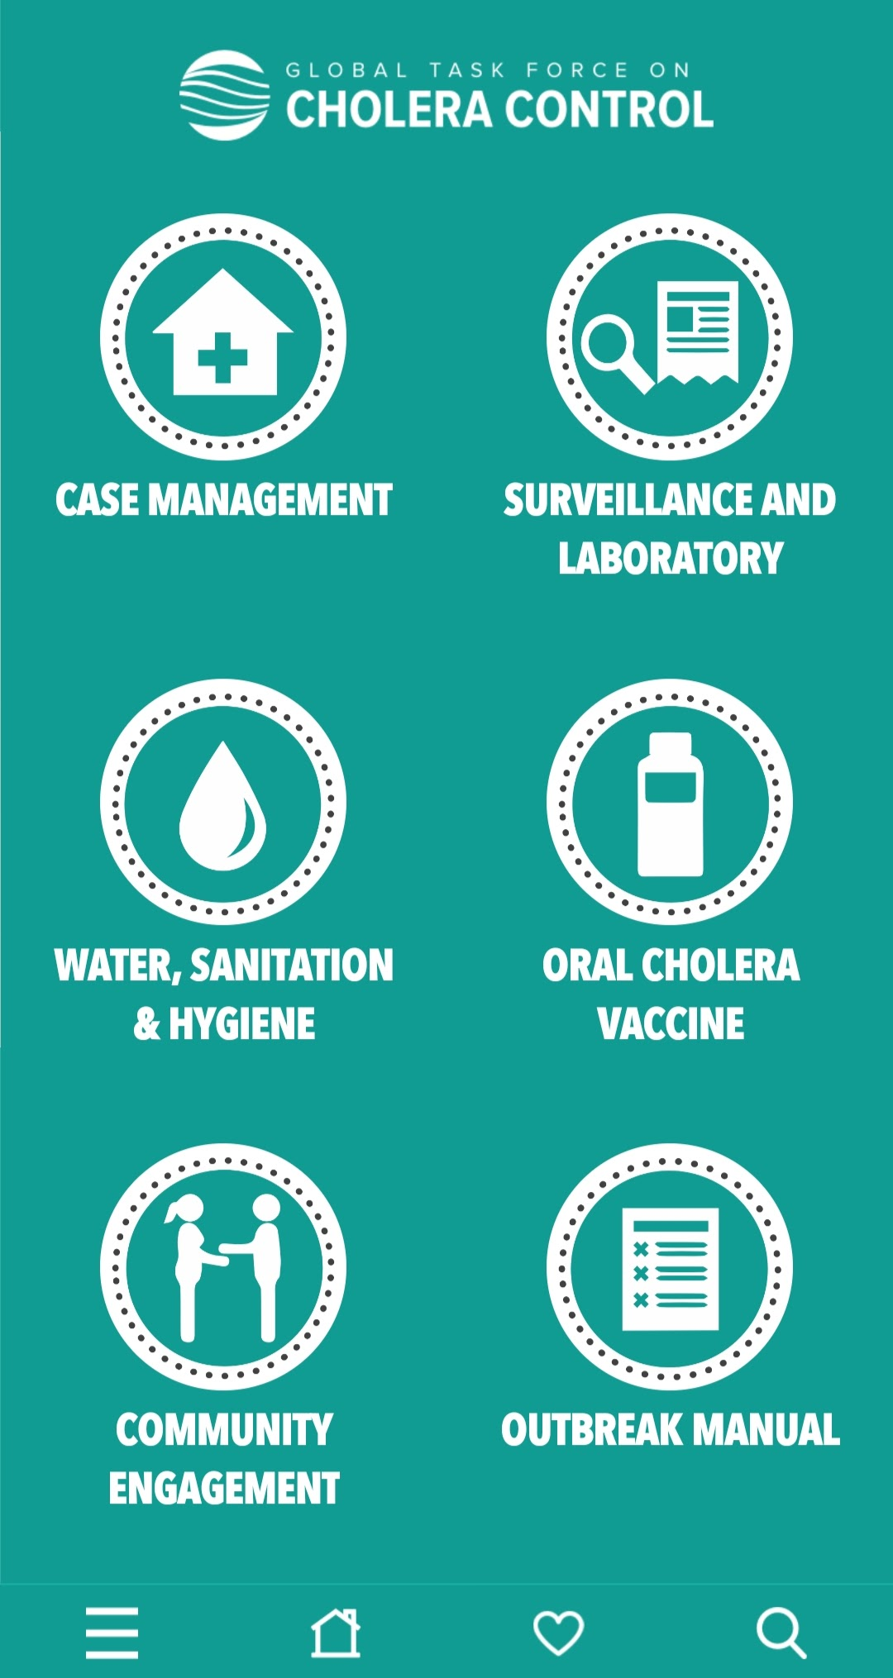
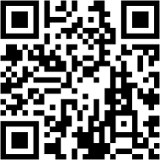
GTFCC cholera app
Phone-based application for health professionals
Free of charge
Compatible with Android and iOS
Can be used offline
Includes summary guidance and practical tools including on:
Case management
Surveillance
Testing
https://www.gtfcc.org/cholera-app/
Notes:
The GTFCC App is a phone-based application designed for health professionals.
It is free of charge and compatible with android and IOS.
Once downloaded, this app can be used offline.
It includes summary guidance and practical tools on all cholera control and preventions pillars including case management, surveillance and testing.
This app can be found by searching GTFCC cholera in your usual app store, or via the link below, or by scanning this QR code.

Slide 6
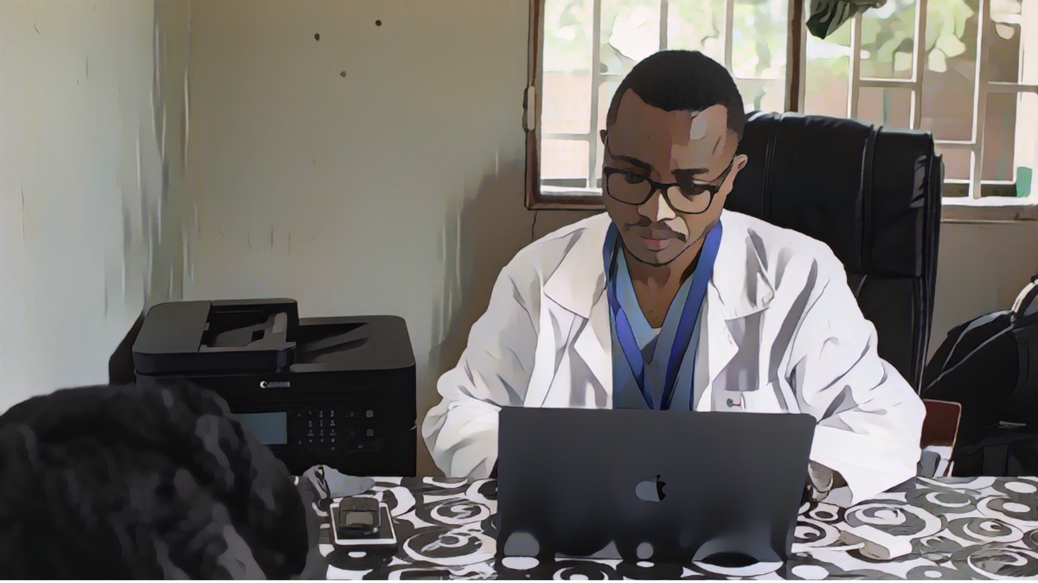
GTFCC website
Photo adapted from: Raissa Karama Rwizibuka/Wellcome Trust
Notes:
Supplementary resources can also be found on the GTFCC website.

Slide 7
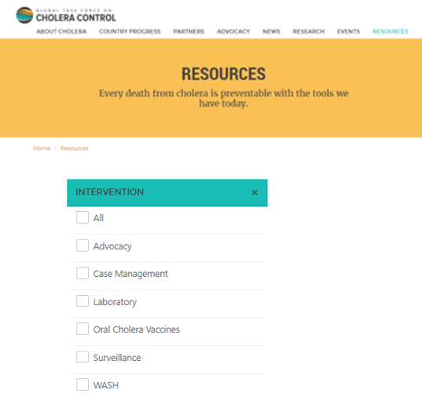
GTFCC website – Resources tab
https://www.gtfcc.org/resources
Detailed technical guidance including on:
Case management
Surveillance
Testing
Notes:
We invite you to consult the resources section of the GTFCC website.
You can access it at https://www.gtfcc.org/resources/
In this section, you will find detailed and up-to-date GTFCC technical guidance, including on case management, surveillance and testing.

Slide 8
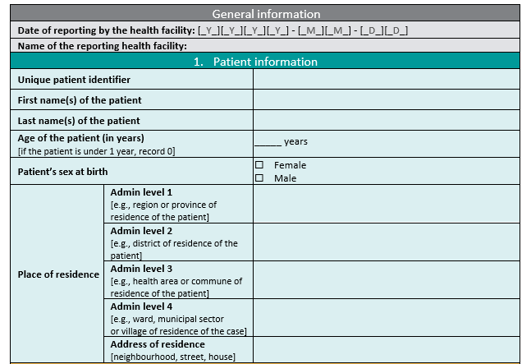
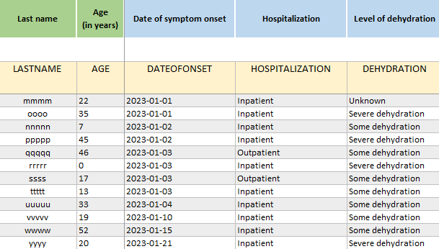
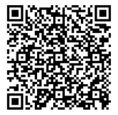
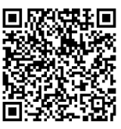
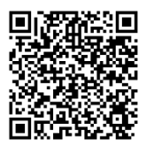
GTFCC Website – Surveillance
https://tinyurl.com/CholeraSurveillance
Detailed guidance
Template case report form
Example of a line list
Notes:
Key resources on cholera surveillance available on the GTFCC website include:
A detailed guidance document on cholera surveillance
A template form to collect standard information on patients with suspected cholera in the form of a word document
A template line list to collect standard information on patients with suspected cholera in the form of an Excel file.
You can access each document by scanning the QR codes at the bottom of your screen or at https://tinyurl.com/CholeraSurveillance.

Slide 9
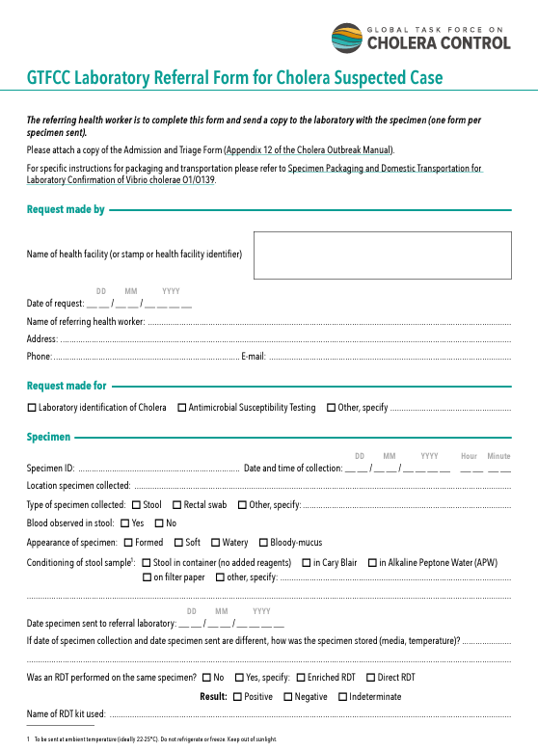
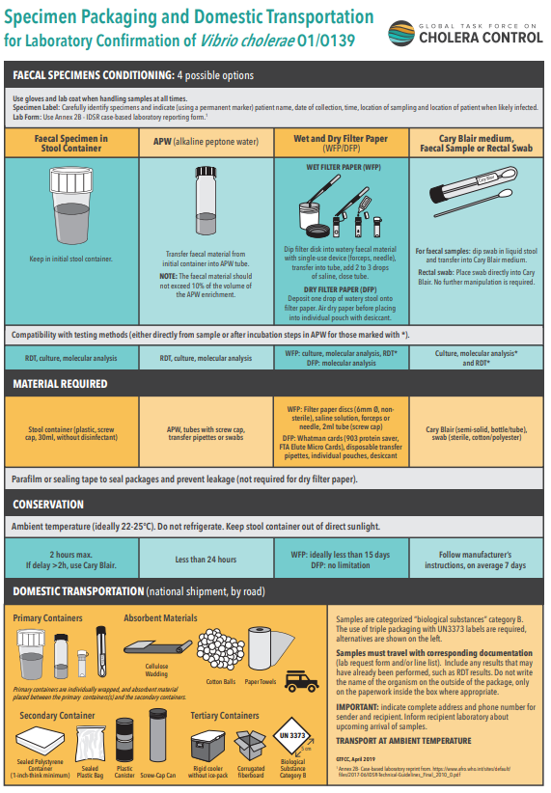
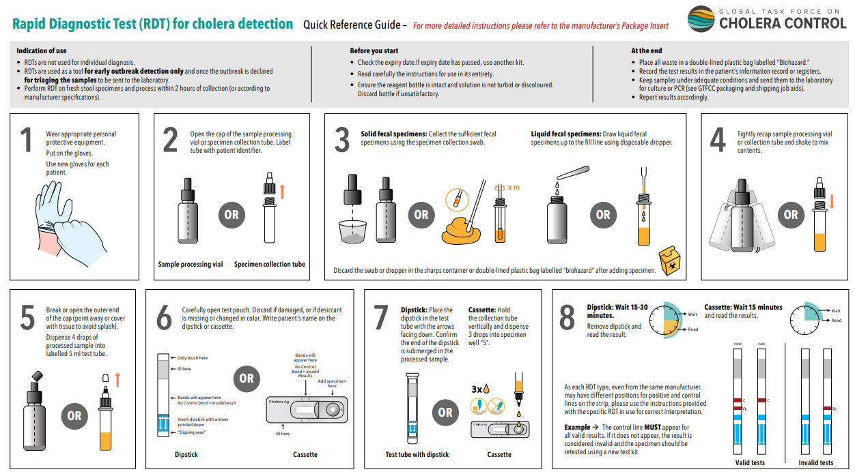
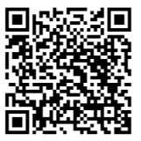
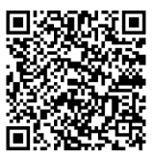
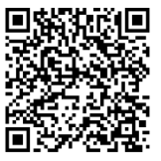
GTFCC Website – Testing
RDT - Job aid
Referral form for testing
Handling samples
Notes:
Key resources on testing for cholera available on the GTFCC website include:
Step-by-step instructions for performing RDTs
A referral form for testing to accompany stool samples to a laboratory for testing.
Guidance on how to collect specimen and prepare and package them for transportation.
You can access these resources by scanning the QR codes at the bottom of your screen.

Slide 10
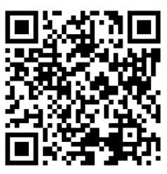
GTFCC Website – Testing
Trainings on sample collection and testing with RDT for cholera for health care workers
Notes:
On the GTFCC website, you will also find some training material on sample collection and testing for cholera.
You can access these trainings by scanning this QR Code.

Slide 11
Local guidance
Photo adapted from: WHO / Mukhsindzhon Abidzhanov
Notes:
To supplement the technical recommendations and generic material developed by the GTFCC, it is essential that you also consider any local guidance on cholera surveillance or testing that may be applicable in your context.

Slide 12
Local guidance
Stay in contact with your health authority
To know the ongoing cholera situation in your geographic area
To receive pratical guidance to implement cholera surveillance
Forms/tool/channels to report
Contact details of laboratories
Etc
Notes:
We encourage you to stay in close contact with your health authority.
This is important for you to stay up-to-date on the ongoing cholera situation in your geographic area.
In addition, your health authority will provide you practical guidance to implement cholera surveillance. For example, which form, tool and channels you should use to report cholera; contact details of laboratory you should send sample to for cholera testing, and so on.

Slide 13
GTFCC network
Photo adapted from: MOH Cameroon Ngomba
Notes:
Lastly, the GTFCC network is always here to support you.

Slide 14
GTFCC network
The GTFCC and its network of partners is here to support you
For any question or technical assistance,
contact the GTFCC Secretariat
GTFCCsecretariat@who.int
Notes:
For additional information on cholera surveillance or to request technical assistance, please contact the GTFCC Secretariat at GTFCCsecretariat@who.int.

Slide 15
Notes:
We have now completed the last module. Thank you for taking this course. We hope that you found it useful.

